Slide 1



Advising
To-dos
Student Teaching Orientation

Slide 2

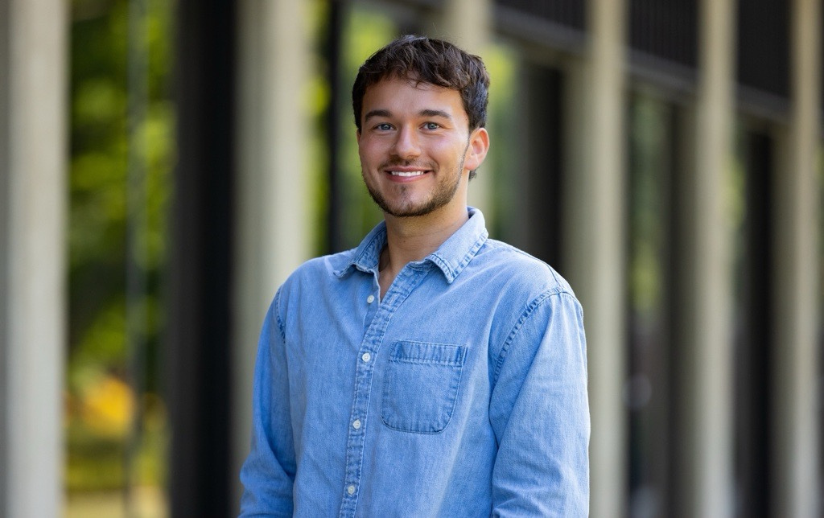
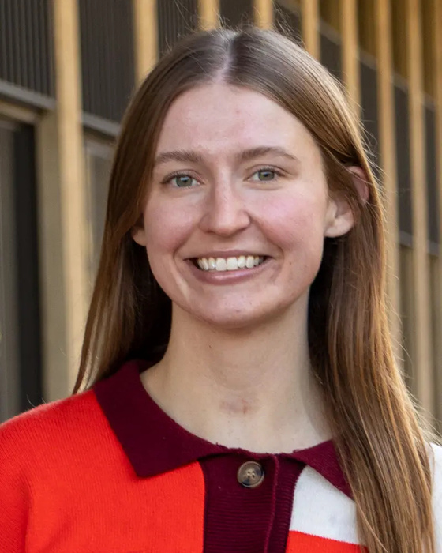
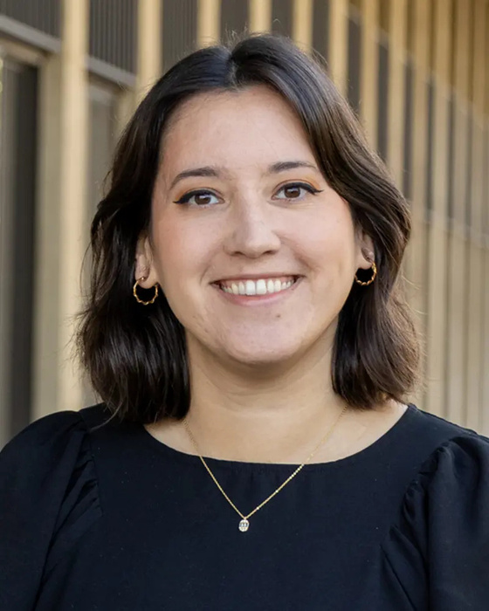

EDUCATION ADVISING TEAM
Alex Kellerman
Kami Lafoon
Rebekah Zhao
alexk@illinois.edu
lafoon2@illinois.edu
rebekah2@illinois.edu
Find your advisor:
education.illinois.edu/student-resources/undergraduate/undergraduate-advising-support
will link in chat!

Slide 3


CHECKLIST
Run a Degree Audit
Register for spring classes
Apply to graduate

Slide 4

RUN A DEGREE AUDIT
(‘UIUC DARS’ --> Generate an Audit)
LOOK FOR ANY RED X’S
DOUBLE CHECK:
Missing required coursework
Deferred study abroad transcripts
Declared minor requirements
Hours to graduate

Slide 5



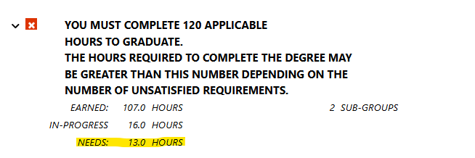
NOTES ON AUDITS
There will be a Red X
for the Professional Education section
You need 120 hours to graduate & your spring semester will total 15 credit hours

Slide 6
NOTES ON AUDITS
All gen eds and ISBE Social Science requirements must be complete to graduate
A degree cannot be conferred with incomplete study abroad transcripts
Subsequent endorsements are not trackable on DARS
Won’t finish your minor?
You must cancel it!

Slide 7
CANCELLING YOUR MINOR
If you are unable to complete your minor requirements - you must cancel it in order for your transcripts to be processed next semester.
education.illinois.edu/student-resources/undergraduate/forms-petitions-resources
Campus Minor Forms -> Minor Cancelation Form

Slide 8
REGISTER FOR SPRING CLASSES
Early Childhood
EDPR 432 (12 hours)
CI 445 (3 hours)
Elementary
EDPR 432 (12 hours)
CI 407 (3 hours)
*no other classes should be taken this semester unless approved by Sue and your advisor!*

Slide 9
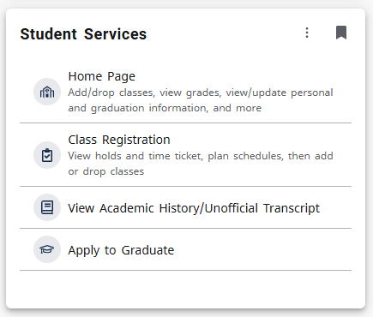
APPLY TO GRADUATE
Applying to graduate alerts the Registrar to process your transcripts and confer your degree
Apply to graduate once you’ve registered for spring classes - DO ASAP so you don’t forget!

Slide 10
WORK WITH YOUR ADVISOR
Your Academic Advisor can:
Clarify questions on your degree audit
Look over ESL/Bilingual endorsement progress
Provide suggestions on completing degree requirements if needed
Confirm if you have applied to graduate

Slide 11


COMMENCEMENT & CONVOCATION
Keep an eye out for information on participating in Campus-wide Commencement and College of Education Convocation
https://education.illinois.edu/student-resources/convocation
Applying to graduate participating in convocation

Slide 12
Thanks!

