Slide 1
Introduction to Equity-Centered Trauma-Informed Education

Slide 2
Today’s Goals
Review or introduce the basics of equity-centered, trauma-informed education (ECTIE)
Share the common language we used with preservice teacher candidates
Let you know what are candidates are bringing to their student teaching classrooms
Share some stories of preservice teacher candidates’ experiences in the field

Slide 3
The Journey
Instructors were trained on ECTIE.
Modifications were made to 2 Elementary Education courses (SPED 405, CI 406) and EDPR 250 (field placement and seminar).
Candidates had an introduction to the content you’ll see today. El Ed was in person; middle and secondary candidates saw a recording.
The Elementary Education candidates saw ECTIE integration during supervision (pre- post- conferences and evaluations), CI 406, SPED 405.

Slide 4
Definition of Trauma
Trauma results from an event, series of events, or set of circumstances that is experienced by an individual as physically or emotionally harmful or threatening and that has lasting adverse effects on the individual's functioning and physical, social, emotional, or spiritual well-being (SAMHSA).
Meghana Ratna Pydi

Slide 5
Examples of Potentially Traumatic Events
Witnessing or experiencing physical, sexual, emotional abuse
Neglect
Family members who have mental health or substance abuse disorders
Divorce
Violence in the community
Poverty and/or systemic discrimination (racism, ableism, sexism)
Institutional trauma
Developmental trauma
Isolated events such as a natural disaster or auto accident
Chronic bullying
COVID was a traumatic event for many

Slide 6
Awareness, Action, and Advocacy: An Equity-Based, Trauma-Informed Framework
AWARENESS | ACTION | ADVOCACY
Realize: -The incidence of trauma -Brain-based impacts of trauma -Systemic inequities as a cause of trauma -Your role in trauma and inequity -The importance of self-care to mitigate STS Recognize: -The symptoms of trauma, mental health challenges in adults and students -Bias and inequity in your classroom/institution -Root causes of inequity and trauma -Deficit mindsets -Instances of power and privilege | Respond: -Implement equity-centered, trauma-informed practices universally -Get to know your students and their lived experiences -Intervene in inequities -Set (and equitably apply) reasonable boundaries and expectations -Solicit and value feedback from students Resist Retraumatization -Avoid trauma triggers and repair damage -Universality of practice -Use curriculum, assessment, and practices that reflect student identities and experiences -Use discipline strategies that teach not punish | Redress: -Advocate against inequities -Promote student advocacy efforts -Have conversations about inequities Actively Cultivate: -Apply a trauma-informed equity lens -Prioritize marginalized populations Sustain -Commit to equity in the face of concern

Slide 7
Equity-Centered, Trauma-Informed Practice for Teacher Educators

Slide 8
AWARENESS:
Realize
AWARENESS
Realize: -The incidence of trauma -Brain-based impacts of trauma -Systemic inequities as a cause of trauma -Your role in trauma and inequity -The importance of self-care to mitigate STS Recognize: -The symptoms of trauma, mental health challenges in adults and students -Bias and inequity in your classroom/institution -Root causes of inequity and trauma -Deficit mindsets -Instances of power and privilege

Slide 9
Realize: The High Incidence of Trauma
The numbers vary, but studies indicate more than half the students in your classroom have experienced at least one potentially traumatic event:
Data from the CDC indicates 61% of adults surveyed across 25 states said they had experienced at least one adverse childhood experience by the time they were 18 years old (2019).
National Survey of Children’s Health (2016) found that almost half of all children in the country experienced at least one adverse childhood experience. 10% had experienced three or more.
In a 2009 study, 85% of college students reported having experienced a traumatic event (Frazier et al., 2009).
Notes:
https://www.cdc.gov/vitalsigns/aces/pdf/vs-1105-aces-H.pdf
National Survey and Frazier study cited in Brown et al., 2022 (Preparing Teacher Candidates for Trauma-Informed Practices)

Slide 10
Realize: Incidence Higher in Marginalized Populations
The incidence of trauma is significantly higher among marginalized populations (e.g., individuals with disabilities, individuals who live in poverty, children of color, LGBTQ population, military youth, homeless youth)
Social injustices, past and present (racism, sexism, poverty, ableism, identity discrimination, and other biases) are potentially traumatic.
Systems/institutions (including education) can be traumatic for individuals
Teachers’ actions, ideas, identities, biases impact their practices which may cause trauma in students

Slide 11
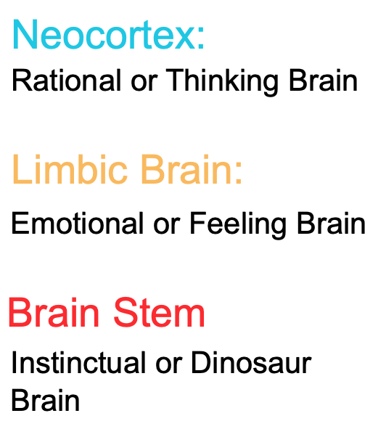
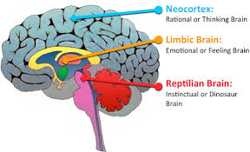
Realize the Impacts of Trauma
Trauma can impact behavior, emotions and relationships, and academic performance.
Brain stem is responsible for safety which “trumps” all other brain processes.
When an individual is experiencing fear (fight/flight/freeze response), they are “stuck” in their brain stem, attachments cannot be formed and learning cannot occur.
Responses are often not choices-they are brain-based in a response to threat or fear (fight-flight-freeze)

Slide 12
The HUMAN Brain
The anatomy and function of the normal brain is the same for every human being, so al this information applies to US and our preservice teachers.
The brain responses (neural pathways) among individuals who are chronically stressed and individuals who have experienced trauma are the same or similar-this removes the need for a “trauma label”- it’s ALL HUMANS.
Trauma-informed practices help all people, but are critical for those who have experienced trauma.
Notes:
Remove label
Explanation of HUMAN BRAIN vs “trauma kids”

Slide 13
AWARENESS:
Recognize
AWARENESS
Realize: -The incidence of trauma -Brain-based impacts of trauma -Systemic inequities as a cause of trauma -Your role in trauma and inequity -The importance of self-care to mitigate STS Recognize: -The symptoms of trauma, mental health challenges in adults and students -Bias and inequity in your classroom/institution -Root causes of inequity and trauma -Deficit mindsets -Instances of power and privilege

Slide 14
Recognize: The Signs and Symptoms of Trauma
The signs and symptoms (manifestations) of trauma typcially exhibited in children’s and adolescents fall into three categories:
Behavior
Emotional/Relational
Academic performance

Slide 15
Manifestations of Trauma in Children: Behavior
Externalizers
Acting out behavior
Ignoring/defying directions
Difficulty self-regulating
Hyperactivity
Internalizers
Shutting down (“hoodie hider”)
Anxiety and depression
Oversensitivity

Slide 16
Manifestations of Trauma in Children: Emotional/Relational
Relationships/Social Emotional
Expectations of danger in new and/or existing relationships
Fear of being hurt
Difficulty with trust
Difficulty with adult and peer relationships
Shame or guilt
Anxiety or depression
A desire to isolate or withdraw

Slide 17
Manifestations of Trauma in Children: Academics/Learning
Decreased executive functioning
Decreased cognitive skills
Learning disabilities
Poor memory
Inability to unconsciously shift attention between multiple tasks
Deficits in verbal ability (specifically comprehension and vocabulary)
Challenges with mathematical calculation

Slide 18
Recognize Potential Causes of Trauma: The Trauma-Informed Lens
Root Causes
Individual traumas
Biases
Inequities
Oppressive ideologies
Classroom materials that are not representative of the varied cultures of our classroom and the world.
Practices or policies that could trigger students who have experienced trauma.
Punitive/exclusionary discipline policies, homework policies, dress codes
Ability tracking
Deficit mindsets

Slide 19
Trauma-Informed Practices: Paradigm Shifts
What’s wrong with this child?
This child is seeking attention.
The child won’t do this.
The child needs a time out after misbehaving.
I need to control and fix this child’s behavior.
What happened to this child?
The student needs attention to connect.
The child can’t do this because they are stressed.
The student needs connection and logical consequences after misbehaving.
I need to understand this child’s behavior.

Slide 20
Examples from the Field
AWARENESS

Slide 21
ACTION:
Respond
ACTION
Respond: -Implement equity-centered, trauma-informed practices universally -Get to know your students and their lived experiences -Intervene in inequities -Set (and equitably apply) reasonable boundaries and expectations -Solicit and value feedback from students Resist Retraumatization -Avoid trauma triggers and repair damage -Universality of practice -Use curriculum, assessment, and practices that reflect student identities and experiences -Use discipline strategies that teach not punish

Slide 22
Respond: Trauma-Informed Practices
The Big Three
Creating Safety in the Learning Environment
Building Relationships
Teaching and Practicing Self-Regulation Skills
Others:
Discipline that teaches rather than punishes
Strengths-based approach/mindset

Slide 23
Respond: Creating a Safe Learning Environment
Identity Safety
All students are not only accepted, but are celebrated for their uniqueness
Build a culture that celebrates diversity.
Physical and Emotional Safety
Maintain an organized classroom.
Involve students in developing clear, positive expectations.
TEACH and use consistent and predictable routines and procedures.
Post the daily schedule.
Warn students about unexpected changes to the routine.
Talk through transitions.
Be aware of triggers.

Slide 24
Respond: Creating a Safe Learning Environment
Lessons that are at the appropriate level and are relevant to the lives of the students in their classrooms.
Universal Design for Learning:
Multiple options for how to gain the knowledge
Multiple options for demonstrating their knowledge
Multiple ways to engage students
Intervene in any instance of inequity or bias.
Boundaries should be reasonable and consistently/equitably applied.

Slide 25
Respond: Building Relationships with Children
Strategies to build relationships:
2x10 strategy
Greet students by name at the door
Insist on a bully-free environment
Establish and maintain a supportive classroom culture
Morning meeting circles
Listen to student perspectives and let them know their voices are heard.
ALWAYS respond with (MODEL) empathy.
Small interactions go a LONG WAY.

Slide 26
Respond: Teach Children Self-Regulation
Help students navigate and verbally express their emotions.
Self-regulation strategies to incorporate/teach before:
Take regular brain-breaks (clapping, call-and-response games, silent ball, etc.)
Incorporate movement, mindfulness and meditation Go Noodle, Move to Learn, muscle relaxation, deep breathing, listening to classroom sounds, visualization).
Provide time for movement (rhythmic)
Peace corners, calming corners, designated adult
Stress balls, fidget spinners, Flexible seating (wiggle seats, standing desks, individual spaces)
Teach them about their bodies and their brains.

Slide 27
Model Self-Regulation
Adults model thinking :
“I am really angry right now and I need a minute to breathe.. Please take out a book or sit quietly” “I’m going to just take a few deep breaths…”
“Let’s all get up and do a few quick stretches”
“Circle up! Please share a strategy you know how to use when you’re angry or frustrated.”
Strategies: Movement (especially rhythmic), breathing
Honor/validate your feelings “I am frustrated and that’s ok. We all get frustrated. I need a minute to…”
DO NOT respond to misbehavior in the moment. Let the feeling pass, breathe, think, then respond with self-regulation

Slide 28
The Adults’ Role in Self-Regulation
Teach and model self-regulation
Adult must stay regulated.
A dysregulated adult cannot help a dysregulated child.
When adults model self-regulation strategies, it helps students understand how others monitor and regulate emotions.
Stay out of power struggles
Do not take behavior personally-it is brain-based.
Do not try to reason with an escalated child. There is nothing rational going on in the moment.

Slide 29
Responding to Dysregulation Effectively
Preserve your relationship and build safety
Connect-leverage your relationship
Slow down-slow movement, and slow, deliberate speech using simple language
Use non-threatening body language
Reduce the power differential
Show empathy and understanding
Validating and accepting
Use the regulating activities you taught them.
Breathing, movement, rhythm, sensory stimulation, etc.

Slide 30
Responding to Dysregulation INEFFECTIVELY
Public reprimands
Excessive questioning
Lecturing
Giving or appealing to logic
Asking to make a better choice
Comparing children to other children
Promising a reward
Ignoring
Threatening
Using point charts
Getting angry
Exclusion

Slide 31
Responding AFTER the Child is Re-regulated
Be prepared to respond on the student’s time frame
Help the student process through the event
Help the student see what happened from others’ perspectives
Reassure safety
Reaffirm your relationship
Welcome the student back into the group

Slide 32
ACTION:
Resist Re-traumatization
ACTION
Respond: -Implement equity-centered, trauma-informed practices universally -Get to know your students and their lived experiences -Intervene in inequities -Set (and equitably apply) reasonable boundaries and expectations -Solicit and value feedback from students Resist Retraumatization -Avoid trauma triggers and repair damage -Universality of practice -Use curriculum, assessment, and practices that reflect student identities and experiences -Use discipline strategies that teach not punish

Slide 33
Trauma Triggers
Watch for things that trigger their students (e.g., bright lights, loud sounds, being alone).
When triggers cause students to become dysregulated, repair the damage and avoid triggers in the future.
Create lessons and use materials that respect the students’ identities and experiences.
Strategies used for discipline should teach rather than punish. They should preserve student dignity.

Slide 34
Examples from the Field
ACTION

Slide 35
ADVOCACY:
Redress
ADVOCACY
Redress: -Advocate against inequities -Promote student advocacy efforts -Have conversations about inequities Actively Cultivate: -Apply a trauma-informed equity lens -Prioritize marginalized populations Sustain -Commit to equity in the face of concern

Slide 36
Fighting Inequities and Bias
Be advocates against school policies and practices that reflect bias and can be traumatic for their students.
We have a role in supporting student advocacy efforts to eliminate inequities and biases that can be traumatic for students.
When we see instances of bias or inequity, we should have conversations with colleagues about how to address them to minimize their impact on students.

Slide 37
ADVOCATE:
Actively Cultivate
and Sustain Equity
ADVOCACY
Redress: -Advocate against inequities -Promote student advocacy efforts -Have conversations about inequities Actively Cultivate: -Apply a trauma-informed equity lens -Prioritize marginalized populations Sustain -Commit to equity in the face of concern

Slide 38
Cultivating and Sustaining Equity
Apply an “Equity-centered, trauma-informed” lens to all polices, practices, and program decisions.
The interests and needs of all students should be prioritized by preservice teacher candidates, with attention to students who have been historically marginalized.
When equity-centered, trauma-informed practices are questioned, we should maintain and communicate a commitment to these policies and practices.

Slide 39
Advocacy
Redress, Cultivate and Sustain are challenging as GUESTS in the classroom.
Based on coop’s knowledge and willingness

Slide 40
QUESTIONS
or
FINAL THOUGHTS FROM THE FIELD

Slide 41
Awareness, Action, and Advocacy: An Equity-Based, Trauma-Informed Framework
AWARENESS | ACTION | ADVOCACY
Realize: -The incidence of trauma -Brain-based impacts of trauma -Systemic inequities as a cause of trauma -Your role in trauma and inequity -The importance of self-care to mitigate STS Recognize: -The symptoms of trauma, mental health challenges in adults and students -Bias and inequity in your classroom/institution -Root causes of inequity and trauma -Deficit mindsets -Instances of power and privilege | Respond: -Implement equity-centered, trauma-informed practices universally -Get to know your students and their lived experiences -Intervene in inequities -Set (and equitably apply) reasonable boundaries and expectations -Solicit and value feedback from students Resist Retraumatization -Avoid trauma triggers and repair damage -Universality of practice -Use curriculum, assessment, and practices that reflect student identities and experiences -Use discipline strategies that teach not punish | Redress: -Advocate against inequities -Promote student advocacy efforts -Have conversations about inequities Actively Cultivate: -Apply a trauma-informed equity lens -Prioritize marginalized populations Sustain -Commit to equity in the face of concern

Slide 42
What’s Available?
Online Trauma Module
Certificate of Specialization
Fully Funded Master’s Program
Trauma MOOC
Online Master’s Concentration in Trauma-Informed Education (coming Fall 2024)
Innovative Training opportunities for Educators (and others!) interested in Trauma
Notes:
Online Trauma Module
Certificate of Specialization
Fully Funded Master’s Program
Trauma MOOC
Online Master’s Concentration in Trauma-Informed Education (coming Fall 2024)

Slide 43
Online Trauma Module
This FREE, self-paced, interactive module includes four units which cover the prevalence and impact of trauma, manifestation of trauma in young children, providing trauma-informed supports, and preventing future trauma.
It is designed to be a high-level overview of the topic and a starting point for professionals working with children and their families.
All participants who complete the module and pass the post-test will be eligible to receive EI continuing education credits.
Notes:
https://web.cvent.com/event/06626b54-9025-4c4c-a148-0c4eb0bf4eb6/summary
This FREE, self-paced, interactive module includes four units which cover the prevalence and impact of trauma, manifestation of trauma in young children, providing trauma-informed supports, and preventing future trauma.
It is designed to be a high-level overview of the topic and a starting point for professionals working with children and their families.
All participants who complete the module and pass the post-test will be eligible to receive EI continuing education credits.

Slide 44
2. Certificate of Specialization in Trauma Informed Education
The online certificate program in Trauma-Informed Education (TIE) will prepare you to identify and implement trauma-informed practices in education settings. The coursework consists of content related to:
trauma-informed education,
child development, and
researching solutions to issues of everyday practice in education such as behavior, academics, classroom management, strengths-based approaches to support, and individualization.

Slide 45
3. Project Ti3: Trauma Informed EI/ECSE/SW
Project TI3 will prepare 24 full-time master's students in early intervention (EI), early childhood special education (ECSE), or school social work (SSW) who have expertise in:
supporting social emotional development
using trauma-informed supports
providing responsive, evidence-based services to young children (birth through five) with delays or disabilities and their families.
Project TI3 students will acquire competencies via coursework, a trauma-informed practice seminar, and multi-disciplinary practicum and traineeship experiences. Full-time students funded through Project TI3 will receive:
Competitive monthly stipends
Tuition waiver
A waiver of most university fees

Slide 46
4. Trauma MOOC (Massive Open Online Course)
This FREE, self-paced modules
Four modules which cover the prevalence, impact and manifestation of trauma, and trauma-informed supports
Offered through Coursera Illinois

Slide 47
5. Master’s in Curriculum & Instruction with a Concentration in Trauma-Informed Education (coming soon)
Fully online master’s degree in Curriculum and Instruction
Addresses critical issues of teaching and learning in diverse settings
Cross disciplinary degree (C&I, Special Education, Educational Psychology, Social Work).
32 credit hours
Required and elective courses (24 hours) in Trauma-Informed Education
Foundations courses in Education, Policy, Organization and Leadership; and Educational Psychology (4 hours each)
Target start date for cohort 1: Fall 2024

Slide 48
ISBE Opportunity: REACH Modules
REACH is a partnership with the Illinois State Board of Education (ISBE) and the Center for Chidhood Reslience.
It helps Illinois’ schools and school districts create healthy learning environments that protect, support and heal. Our new REACH Learning and Resource Hub (RLRH) provides free, on-demand learning on trauma-focused topics.
Click HERE to sign up for access the REACH modules.

Slide 49
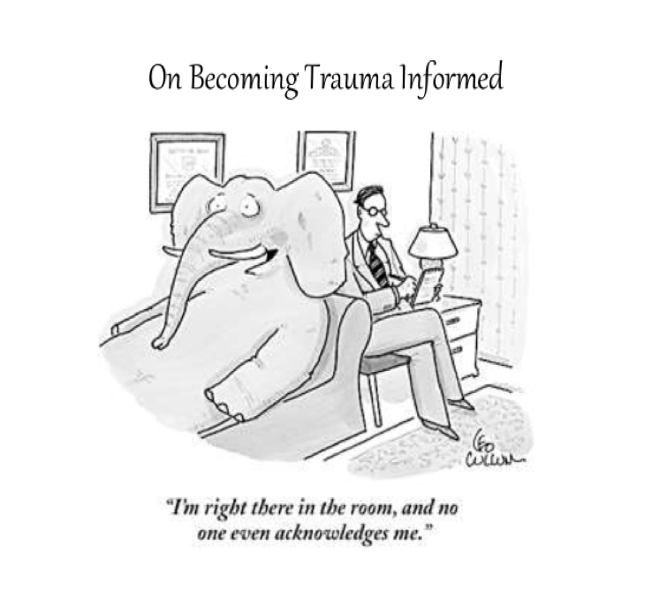
LYNN BURDICK
Director of Trauma-Informed Education
lburdick@illinois.edu
217-412-2815

