Slide 1
Cooperating teacher orientation
Spring 2025
EDPR 250
Year 1 Elementary Candidates

Slide 2
agenda
Welcome
Course sequence
Expectations – Professionalism
Expectations – Academic
Supports
Evaluations
Questions?
Tuition waivers

Slide 3
Welcome!
Introductions
  Sue Talbott, Clinical Experiences Specialist
  Dr. Scott Filkins, Program Coordinator
  Instructors
Share a winter break highlight in the chat!

Slide 4
Course sequence –year 1
Courses
Placements
Intro to Teaching
Children's Literature
Methods
    Math
    Language Arts – Part 1
    Science
    Social studies
    Music/Art/Dance
Fall
  3 hours per week
Spring
  1 full day per week

Slide 5

Course sequence – Year 2
Courses
Placements
Special Education
Action and Inquiry
Methods
  Language Arts – Part 2
Theory and Practice (fall and spring)
Seminar
Fall
  Monday, Tuesday, Thursday - mornings
  Wednesday – all day
Spring
  STUDENT TEACHING

Slide 6
Trauma-informed education
Intentional focus on best practices that support ALL children, but are CRITICAL for children who have experienced trauma.
Pillars include:
  Genuine, caring relationships
  Safe and predictable environment and routines
  Teaching self-regulation strategies

Slide 7
Professional expectations
Promptness
Mature and appropriate attire and hygiene
Communication
Engagement
All absences must be made up
Arrive and depart according to school's contractual hours
Begin the week of January 20, end the week of May 5 (Tuesday placement only)
PROFESSIONAL BEHAVIOR CHECKLIST

Slide 8
Academic expectations
Teach two lessons and ask cooperating teacher for written feedback
Final evaluation
Course assignments
  Candidates are instructed to inform you of their requirements as soon as possible
  We will share assignments after the semester gets started

Slide 9
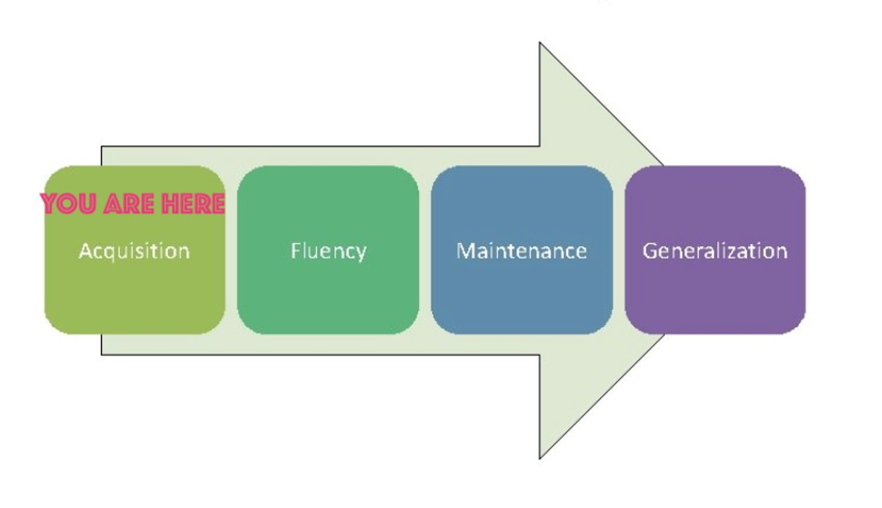
What do candidates need from you?
A safe and nurturing relationship
Feedback (positive AND corrective)
Opportunities to practice
Tips and tricks
Time to ask questions
YOU = candidate

Slide 10
evaluations
Observation feedback
Final
  Portal: https://cote.illinois.edu/cote-portal-access
Support plans

Slide 11
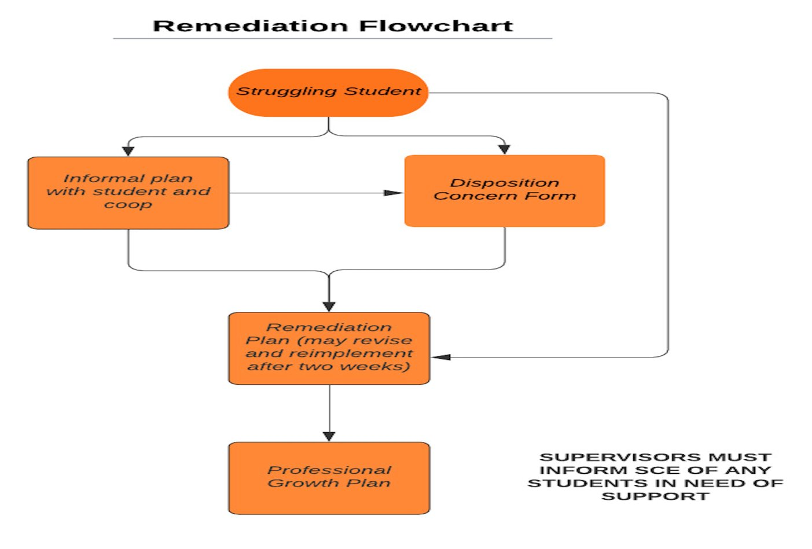

Slide 12
Immediate actions to welcome your candidates
Exchange contact information (set boundaries!)
Show them where to put their belongings
Share policies about food, beverages, cellphones, and arrival/departure times
Tour the school
Introduce them to staff
Teach them to access your online curriculum and classroom, if applicable
Ask them to plan to introduce themselves to the students in a creative way
Post their name on the board
Be clear and specific about what you would like them to do. They should be active, helpful, and engaged!

Slide 13
Tuition waivers
Non-degree vs. Master’s/Endorsement/Doctoral
Contact Council on Teacher Education with questions!
  cote-waivers@illinois.edu
  https://cote.illinois.edu/cooperating-personnel-supervisors/cp-tuition-fee-waivers
Waiver Information
  If you are intending to use a Cooperating Teacher Waiver to complete an online degree through the College of Education, you must contact both Jena Pfoff (jrooseve@illinois.edu) and Linda Stimson (ls9@illinois.edu) after submitting your application to the Graduate College in order to utilize the Cooperating Teacher Waiver. Your subject line should read, “Cooperating Teacher Waiver – Online Program."

Slide 14
resources
SCE: https://sce.education.illinois.edu/
  Professional Behavior Checklist
  Syllabus
Portal: https://cote.illinois.edu/cote-portal-access
Email Sue directly:
  stalbott@illinois.edu

Slide 15

It's never too soon.....
AY 2025-2026 application will be available in February!

Slide 16

Questions?

