Slide 1
Cooperating teacher orientation
Spring 2025
CI 420
Year 1 Early Childhood Candidates

Slide 2
agenda
Welcome
Placement Sequence
Expectations – Professional
Expectations – Academic
Giving Feedback
Supports
Tuition Waivers
Questions

Slide 3
Welcome!
Sue Talbott, Clinical Experiences Specialist
Dr. Scott Filkins, Program Coordinator
Mentors

Slide 4
Placement sequence
Year 1 – Fall – Infants and Toddlers at Child Development Lab on campus
Year 1 – Spring – Primary placement (K-2)
Year 2 – Fall – Preschool
Year 2 – Spring – STUDENT TEACHING!
  Most candidates student teach in kindergarten

Slide 5
attendance
Weeks 1-6:
  Thursday mornings (first day is Thursday, January 23)
  Start of school day (contracted hours) until noon-ish
  FOUR HOURS per day
Week 7 (March 3) - Week 14 (April 28)
  Monday-Thursday (last day is Thursday, May 1)
  Start of school day (contracted hours) until noon-ish
  FOUR HOURS per day

Slide 6
absences
Candidates are required to make up all absences
They will arrange this with you during the last two weeks of the semester

Slide 7
Professional expectations
Promptness
Mature and appropriate attire and hygiene
Communication
Engagement
PROFESSIONAL BEHAVIOR CHECKLIST

Slide 8
Academic expectations
Three observations (including pre- and post- conference) from university mentor
  1: Phonemic Awareness
  2: Literacy (whole group)
  3: Math (small group)
Candidates will collaborate with you and share lesson plan with you in advance
Final evaluation with cooperating teacher, student, and mentor
Coursework
Placement Guide

Slide 9
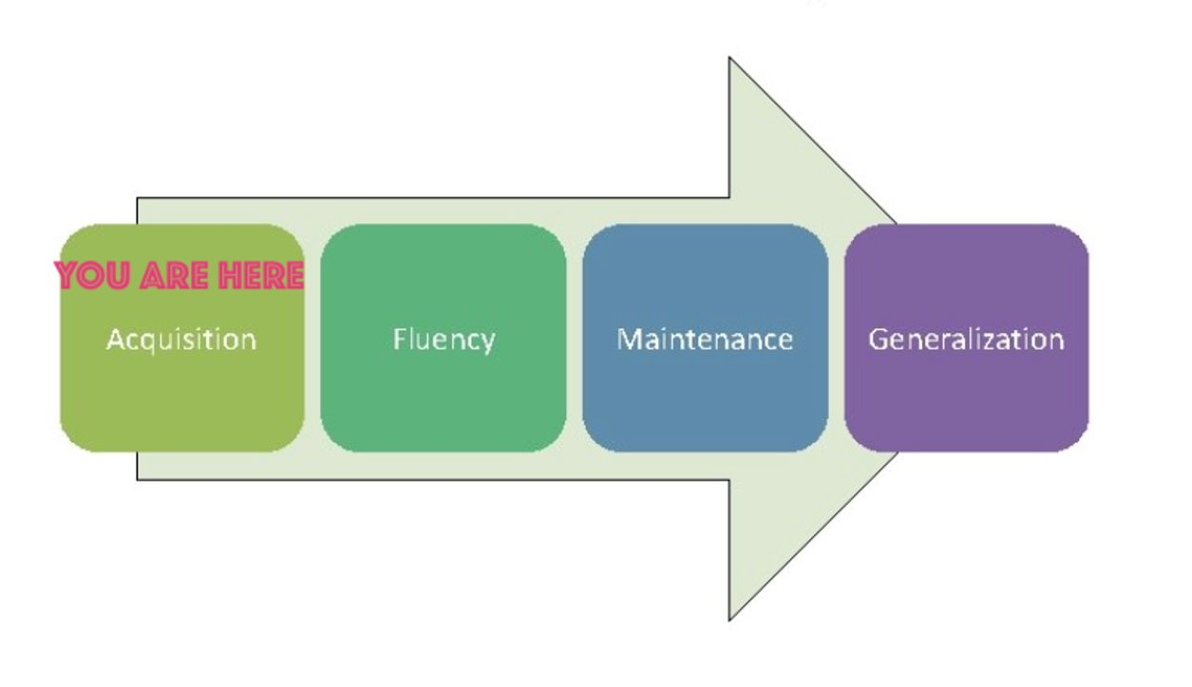
What do candidates need from you?
Opportunities to practice
Safe and nurturing relationships
Feedback (positive AND corrective)
Time to ask questions
Tips and tricks from a pro
YOU = candidate

Slide 10
Giving feedback
Cooperating teachers submit weekly written feedback – usually emailed to candidate and supervisor. Any format is acceptable.
Positive AND corrective (when needed)
  Most common corrective feedback is related to professional behaviors
  Good communication with the mentor is CRITICAL

Slide 11
evaluations
Observation feedback – shared by mentor
Weekly feedback
Final
  Portal: https://cote.illinois.edu/cote-portal-access
Support plans

Slide 12
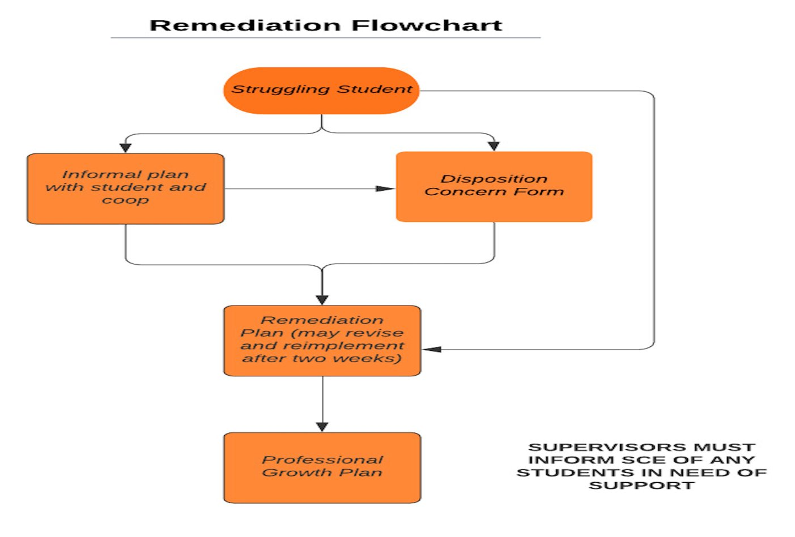

Slide 13
Immediate actions to welcome your candidate
Exchange contact information (set boundaries!)
Show them where to put their belongings
Share expectations about cell phone use, appropriate attire, food/beverages
Tour the school
Introduce them to staff
Teach them how to access your online curriculum and classroom
Ask them to plan to introduce themselves to the students in a creative way
Post their name on the board/Give them a nametag
Be clear and specific about what you would like them to do

Slide 14
Tuition waivers
Non-degree vs. Master’s/Endorsement/Doctoral
Contact Council on Teacher Education with questions!
  cote-waivers@illinois.edu
  https://cote.illinois.edu/cooperating-personnel-supervisors/cp-tuition-fee-waivers
  •Waiver Information
    •If you are intending to use a Cooperating Teacher Waiver to complete an online degree through the College of Education, you must contact both Jena Pfoff (jrooseve@illinois.edu) and Linda Stimson (ls9@illinois.edu) after submitting your application to the Graduate College in order to utilize the Cooperating Teacher Waiver. Your subject line should read, “Cooperating Teacher Waiver – Online Program."

Slide 15
resources
SCE: https://sce.education.illinois.edu/
Portal: https://cote.illinois.edu/cote-portal-access
Email Sue directly:
  stalbott@illinois.edu

Slide 16

AY 2025-2026 application will be sent on February 14!

Slide 17

Questions?

