Slide 1

Spring 2024
Supervisor Orientation

Slide 2

Title
Introductions
Dr. Cara Gutzmer, Director of School and Community Experiences
Sue Talbott, Clinical Experiences Specialist
Danielle Galardy, Office Manager
THE TEAM!
  Name, program, best part of your winter break

Slide 3
AGENDA
Your role
Our candidates
Procedures and processes
Responsibilities and timeline
Break
Trauma-informed education

Slide 4
Title
Your Role
“….as the university supervisor, you must strive to keep all the parties working toward a common goal: to keep the placements for our students positive and effective.”

Slide 5
Title
Consider the following….
The work that we do is centered around supporting candidates in the competencies outlined in the Danielson Framework for Teaching.
Let's talk about supervisor actions and behaviors that may SUPPORT your candidates’ growth.
And, supervisor actions and behaviors that may INHIBIT your candidates’ growth.
How might your actions and behaviors support/undermine cooperating teachers?

Slide 7
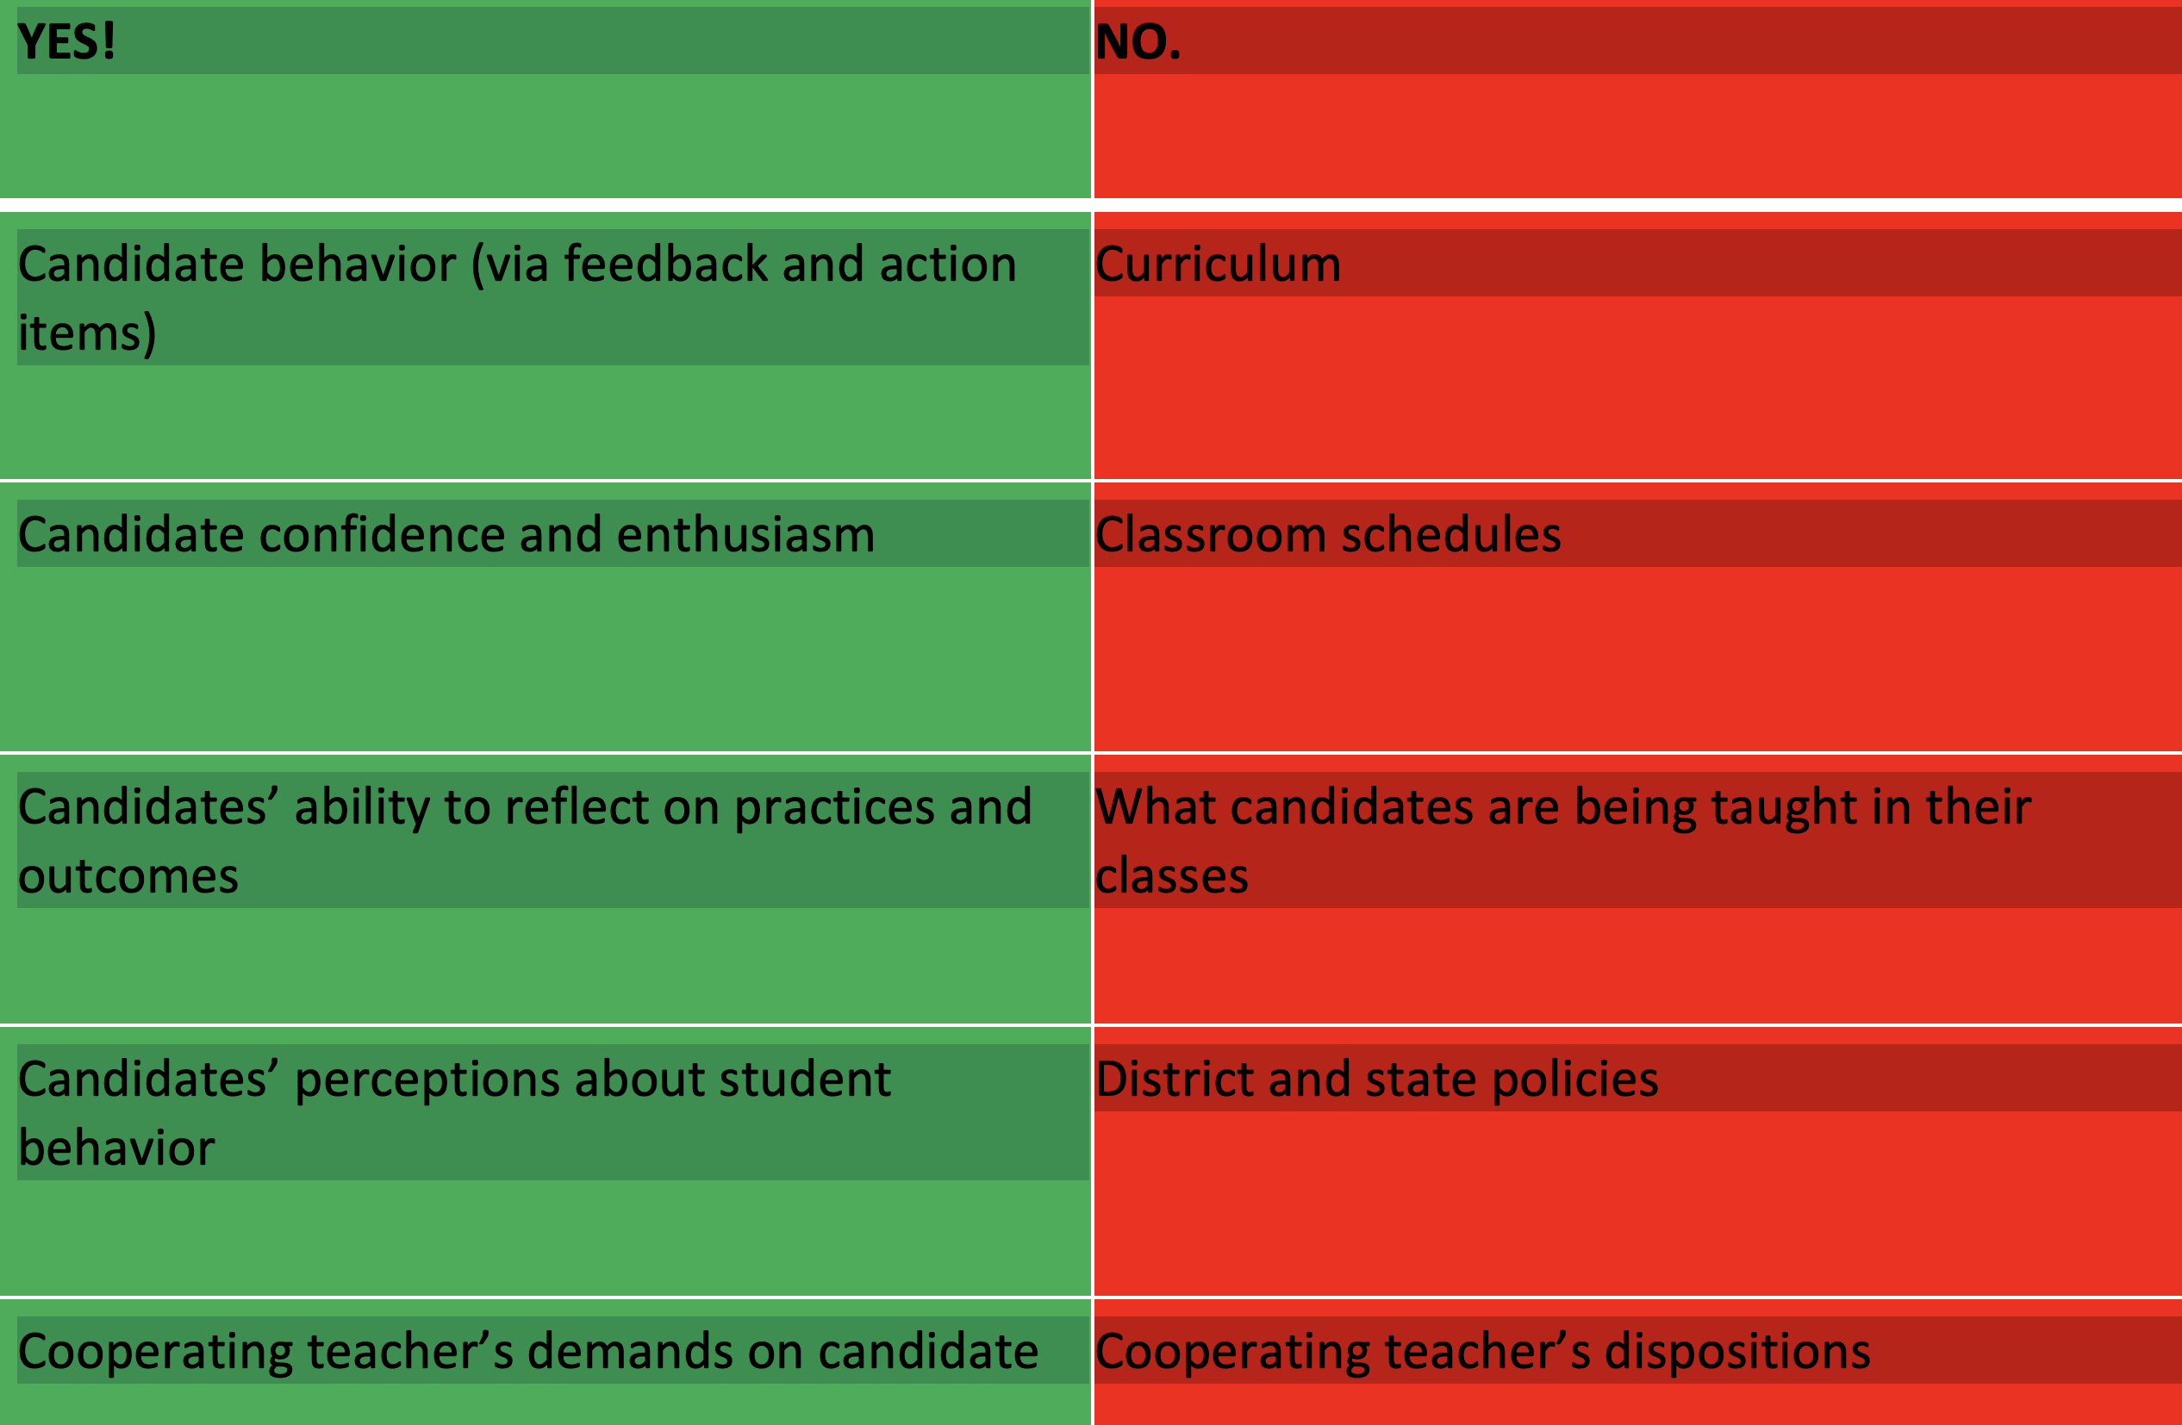
Title
In our control/NOT in our control

Slide 8

Share with
Students!

Slide 9
Title
Student Characteristics
Take a minute to think about your previous candidates. Talk with your tablemates about strengths and needs. We will add your thoughts to the slide.
Strengths- Content knowledge, forming relationships, enthusiasm, passionate about wanting to make a difference, quick learners about trauma informed awareness, open to feedback, want to improve, collaborating with cooperating teachers, formal lesson planning, responding to what's going on in the room- flexibility!
Areas for Growth- classroom management, time management, pacing- lesson and week, executive functioning, timely communication, developing a teacher voice, forgetfulness, READING EMAIL, personal responsibility, teacher presence/look, asking HOT questions, understanding and planning for various needs; equitable participation, setting reasonable expectations for themselves- day to day solid instruction

Slide 10
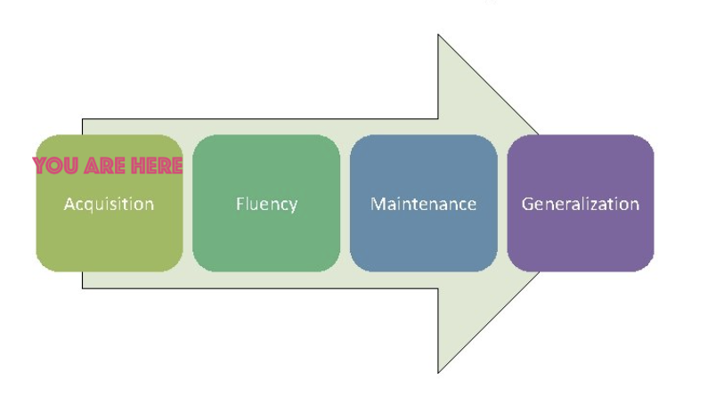
Title
Learning Stage
You = candidate

Slide 11
Title
What do candidates need
in this stage?
LOTS of
  Affirmation
  Positive AND corrective feedback
  Practice
  Support
  Patience
  Opportunities to try new things
  Tips and tricks from a seasoned professional

Slide 12
Title
General Procedures
Box
https://uofi.app.box.com/folder/35576766936?s=3d5s06qry2h5fhz7ja155egxkw003adf
-Mileage
-Uploading and naming observations
432EC Yoo, Lauren Bellina #1
432EL Gaddis, Ava Leonard #1
442MG Conti, Sam Jones #1
442SEC Swanson, Cameron Good #1
ELED and ECE – Canvas for student work
MG and SEC – Box
Laptops
Contet test

Slide 13
Title
Seminar
https://sce.education.illinois.edu/supervisors/middle-grades
You arrange time and set up the Zoom sessions or in-person. ​
You must meet with students for a total of 12 clock hours, so you don’t need to meet every week.​
Remind students that seminar is NOT optional. ​
Ann Pennicook will do a presentation on classroom management from 4-5:30 on January 9th via Zoom. MG and SEC only. Please make sure you have sent student the link.

Slide 14
Title
Suggested Timeline
Student teaching calendar is organized by week (January 8 is Week 1, April 22 is Week 16)​
Opening meetings (ECE/ELED) should be held in Week 1 or Week 2 ​
Three observations prior to midterms
Midterms completed by March 15
Three more observations prior to final evaluation
Final evaluations completed by Friday, May 3
EARLIEST END DATE FOR STUDENTS IS Friday, April 26

Slide 15
Title
Observations
Scheduling (minimum of five per student)
Three before midterm, two before final
Please schedule additional observations for candidates who would benefit
Pre-conference
Observation and feedback form
Post-conference
Share observation feedback with coop and candidate
Upload to Box

Slide 16
Title
Observations
Preconference
  For at least the first three observations, students will provide a written copy of this form prior to your meeting
  Lesson plans will be submitted 24 hours in advance
  If students do not submit plans or sign up for a preconference, you have the right to cancel their observation
  Post-conference
  Use form to guide reflective conversation. Take notes and share with student.
  You do not need to upload these forms. Encourage students to use them as evidence for Domains 1 and 4 for midterm/final evals.

Slide 17
Title
Observations
Email completed form to student and cooperating teacher within 48 hours
Be direct and specific with any items needing improvement (“I need to see x,y,z in your next observation.”
Include several positive statements of performance
Upload a copy to Box (see labeling format on slide 12)

Slide 18
Title
Evaluations
CoTE portal: https://www.cote.illinois.edu/
Midterm/Takeover meeting prior to spring break
Discuss takeover plan at midterm meeting
Final in last two weeks of student teaching
Get these meetings on your calendar at the beginning of the semester
Danielson framework/training
Professional Behavior Checklist
https://sce.education.illinois.edu/supervisors/elementary

Slide 19
Title
Evaluations
Most candidates will move on with a score of “Continue without Reservation”
Sometimes, candidates need a support plan to be successful.
Which brings us to…..

Slide 20
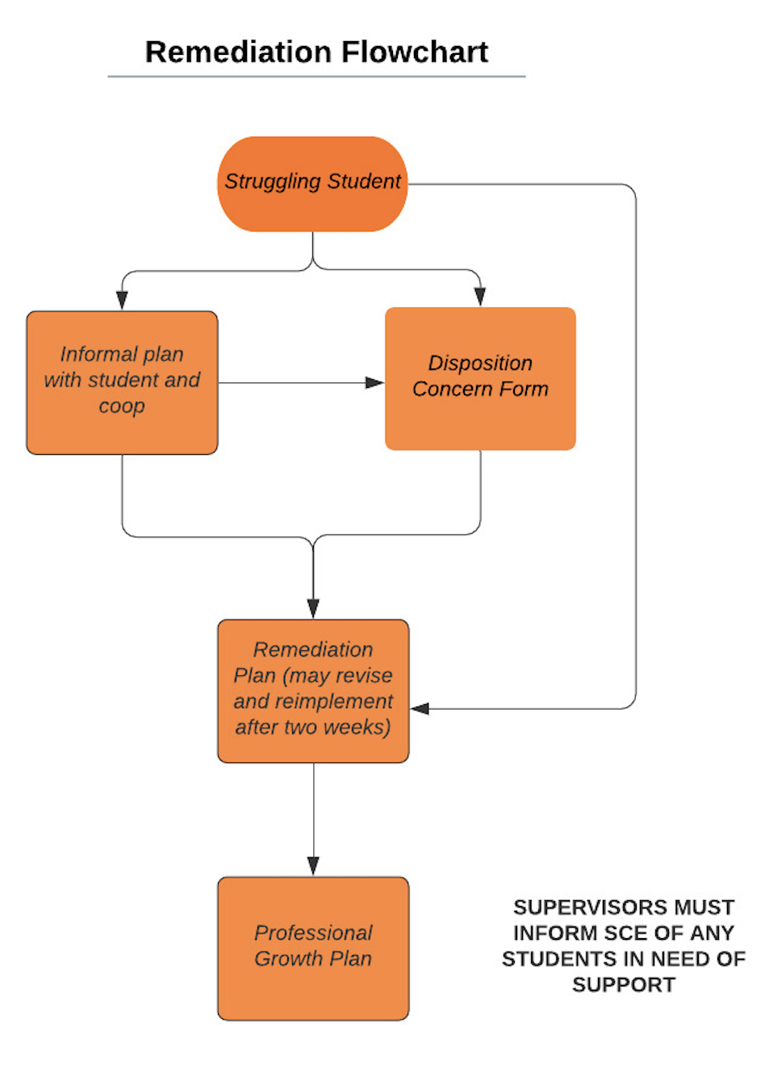
Title
Protocol for Struggling Students
https://sce.education.illinois.edu/

Slide 21
Title
Student teaching subbing guidelines (sub license required)
Prior to full takeover, candidates may be employed as a substitute for their cooperating teacher a maximum of five times (half or full days).
During or after full takeover, candidates may be employed as a substitute for their cooperating teacher a maximum of five times (half or full days).
Candidates have the right to refuse requests to substitute teach.
Candidates may not serve as a substitute outside of their classroom during their assigned practicum schedule.
Candidates are free to work at-will for any district they wish during breaks in their student teaching calendar and after their placement ends on April 26 or after all absences have been made up.
Candidates MUST inform their supervisor about subbing and record their subbing time for CoTE in an Excel sheet. We will share this soon.
Candidates do NOT record their time subbing on their CoTE time card.
Candidates do not make up the hours they spent subbing. They will still have plenty to graduate with their license!

Slide 22
Title
Action Items
Schedule opening meetings
Familiarize yourself with the SCE website/resources
Canvas
Think about seminar topics - share with team and consider joining forces!
Email/call us with any questions!

Slide 23

Title
IN CLOSING…

Slide 24


