Slide 1
COOPERATING TEACHER ORIENTATION
Spring 2025
Student Teaching
Middle Grades and Secondary Education

Slide 3
AGENDA
Welcome
Course sequence
Expectations – Professional
Expectations – Placement
Giving feedback
Evaluations
Tuition waivers
Questions?

Slide 4
WELCOME!
Introductions
Dr. Cara Gutzmer, Director, School and Community Experiences
Sue Talbott, Clinical Experiences Specialist
Danielle Galardy, Office Manager
Did you host someone this fall? Share a success!

Slide 6
ATTENDANCE
January 6-April 25
Four sick days and one professional day (any others must be made up)
Teach Abroad – done on March 8 and are allowed THREE absences

Slide 7
PROFESSIONAL EXPECTATIONS
Promptness
Mature and appropriate attire and hygiene
Communication
Engagement
Follow assigned district’s calendar – NOT UIUC’s
PROFESSIONAL BEHAVIOR CHECKLIST

Slide 8
PLACEMENT EXPECTATIONS
Five observations and an opening meeting
Takeover – minimum of 20 days- does not include
Midterm/Final evaluation
Content test
No edTPA
Timeline: https://sce.education.illinois.edu/cooperating-teachers/secondary/edpr442sec-coop
Teach Abroad: three observations plus final evaluation

Slide 9
SUPPORTING YOUR CANDIDATE
Model
Reinforce
Weekly feedback
Communicate with supervisor

Slide 10
STAGES OF LEARNING
This is a slide we share with candidates.

Slide 11
WHAT DO CANDIDATES NEED IN THIS STAGE?
LOTS of
Affirmation
Practice
Support
Patience
Opportunities to try new things
Tips and tricks from a seasoned professional

Slide 14
GRADUAL RELEASE
https://sce.education.illinois.edu/docs/librariesprovider33/default-document-library/sp25-student-teaching-timeline.docx?sfvrsn=4db5ccad_1
Don't expect your student to take on too much too soon. They still need to see excellent instruction modeled for them.

Slide 15
EVALUATIONS
Observation feedback
Weekly written feedback (any format is acceptable)
Midterm/Final
Portal: https://cote.illinois.edu/cote-portal-access
Support plans

Slide 16
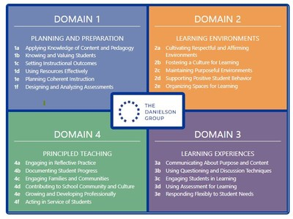
Danielson framework for teaching
Four domains
22 components
MANY indicators
On-stage vs. Off-stage
Big themes:
Student-centered
Engagement-driven
Differentiated
Reflective/responsive
Why does this matter?
EFE/ST Evaluations
Teacher evaluations

Slide 17
SUPPORTS
Disposition Concern Form
Remediation Plan
Professional Growth Plan

Slide 18
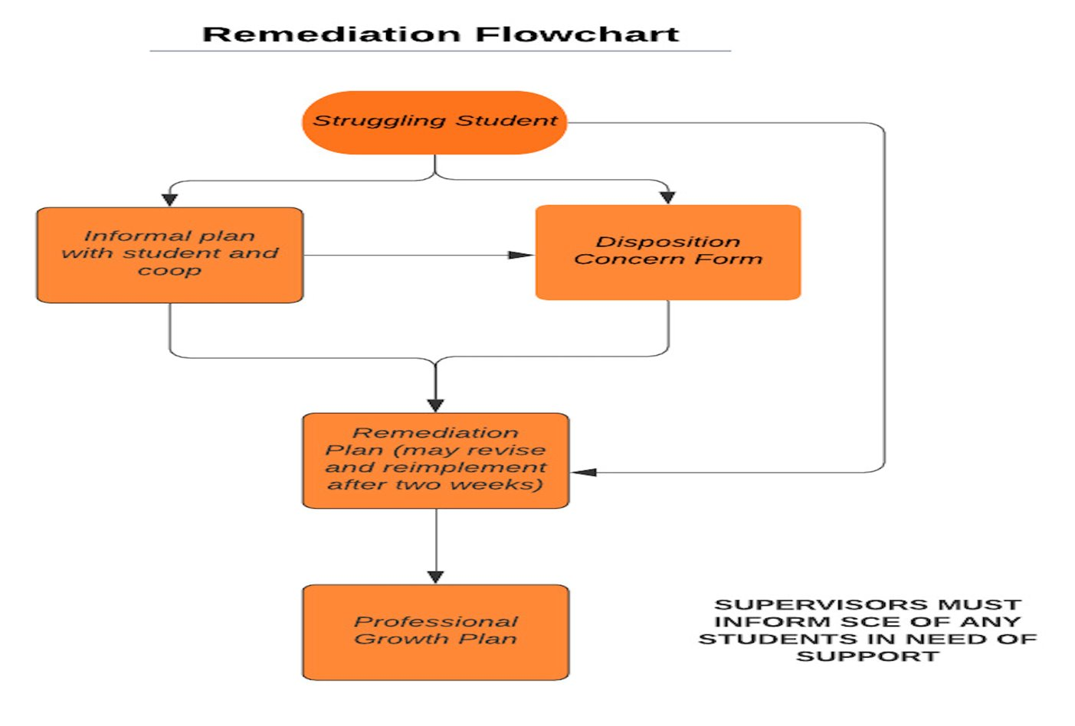

Slide 19
THE SUPERVISOR
Role, responsibility
Please contact your student's supervisor with any concerns or praise!
Communication

Slide 20
IMMEDIATE ACTIONS TO WELCOME YOUR CANDIDATE
Exchange contact information (set boundaries!)
Show them where to put their belongings
Tour the school
Introduce them to staff
Show them how to access your online curriculum and classroom (work with district IT to get them an email account)
Have them introduce themselves to the students in a creative way
Post their name on the board
Be clear and specific about what you would like them to do the first few days and weeks

Slide 21
TUITION WAIVERS
Non-degree vs. Master’s/Endorsement/Doctoral
Contact Council on Teacher Education with questions!
cote-waivers@illinois.edu
https://cote.illinois.edu/cooperating-personnel-supervisors/cp-tuition-fee-waivers

Slide 22
SUB OPPORTUNITIES
Candidates have been encouraged to apply for their sub license
May be able to sub for cooperating teacher for a limited number of days
More information will be available in January

Slide 23
RESOURCES
SCE: https://sce.education.illinois.edu/
Professional Behavior Checklist
Student Teaching Guidelines
Weekly Feedback Form
Portal: https://cote.illinois.edu/cote-portal-access
Midterm/Final
Approve hours
FAQs re: waivers
PDH entry
Email Cara or Sue directly:
caraknox@illinois.edu (middle grades and secondary)
stalbott@illinois.edu (early childhood and elementary)
sce@education.Illinois.edu (general questions)

Slide 24
IT'S NEVER TOO SOON.....

Slide 25
QUESTIONS?

Slide 26
GIVING FEEDBACK
Why is feedback important?
How do you reinforce the students in your class?
How do you correct and shape students in your class?
Do you approach feedback differently with your teacher candidates?
Ratio of positive to negative
Timeliness
Frequency
How does your use of feedback reflect on you as a leader?

Slide 27
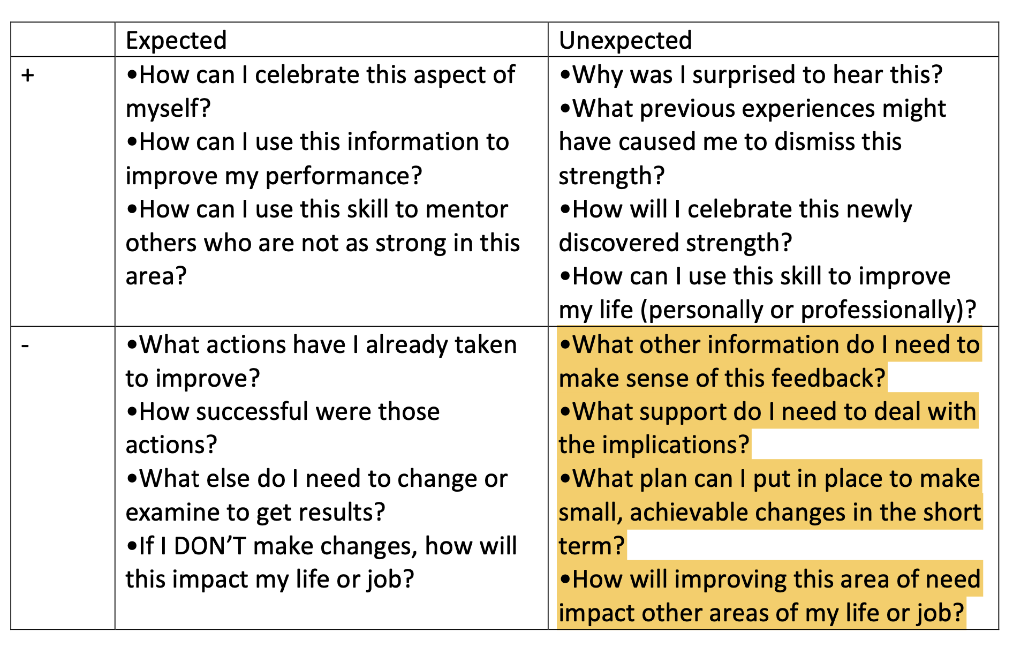

Slide 28
UNEXPECTED NEGATIVE FEEDBACK (IT'S AWKWARD FOR EVERYONE)
"I have some feedback for you, and it may be uncomfortable. I feel a bit uncomfortable myself, but I care about you and your development more than I care about how uncomfortable I feel. So, if you're feeling a little unsure about what to expect here, we are in this together. Can we talk a bit about _____________ ?"

Slide 29
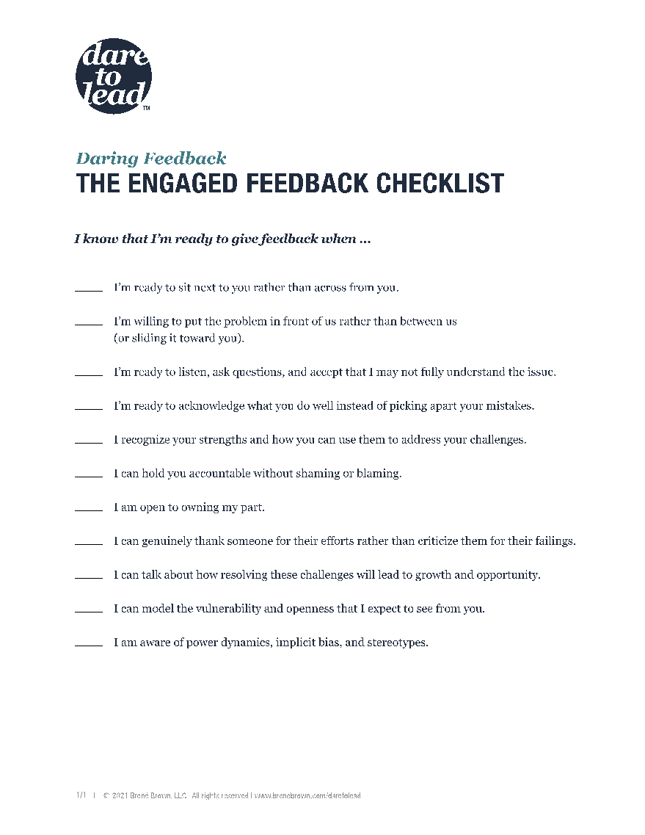

Slide 30
IN PRAISE OF POSITIVE FEEDBACK
https://www.forbes.com/sites/alisacohn/2017/07/21/in-praise-of-positive-feedback/?sh=394b7696db65 (the article has a billion pop-ups, so here are some highlights for your reference)
1. Embrace the need to give positive feedback. As with everything, the first step is to get your mind set right. You may have your own blocks against giving positive feedback – you might think that you don’t need it so your employees shouldn’t. You might not want to “over-praise” for fear of giving someone a big ego, or you might simply be uncomfortable. Please get over it. Study after study show that positive feedback increases employee performance. Accept this truth.

Slide 31
2. Look for opportunities to give positive feedback. Once you buy in to the idea that increasing positive feedback is necessary, you might justifiably not be sure what to praise. Spend some time really tuning in to what’s positive about what your employees are doing. No, you don’t have to praise someone for simply coming in on time, but you could certainly praise someone who has done a good job day in and day out over a period of time. If someone exceeds your expectations even in a small way tell them. Be specific.
Here’s an example of a script you could use when someone is just doing a good job at her job: Perhaps your sales executive is supposed to set targets with the team and then meet them. That’s her job. Even so….when she sets targets and meets them quarter after quarter, what’s wrong with pointing it out? That can simply look like “Gosh, Mary, you set challenging targets for your team and then meet them, quarter after quarter. If only Swiss watches were as reliable as you! You do a great job for us and I want you to know I appreciate it.”

Slide 32
3. Make sure you say it (or write it.) Sometimes we humans think that people read our minds. You might notice a person doing something worthy of positive feedback or praise. You may register this “good job” and it may make you happy – so happy that you forget to go tell the person. Or you may simply feel awkward to be that proactive or direct with someone. Find ways to trigger yourself to tell this person. If a manager feels positively about the employee or about the work she just did, often they won’t say anything.

Slide 33
4. Don’t make it a sandwich. I just wrote about the evils of the feedback sandwich. Don’t think that you have to “balance out” positive feedback with constructive feedback. In fact, the opposite is true. When you give enough straight positive feedback to your employees you’ve demonstrated that you are an ally. You can then give constructive or directive or critical feedback to your employees when they need it without sugar coating it.

Slide 34
5. Encourage employees to give each other positive feedback. Creating a climate of positivity and feedback around you is a marker of a master manager. You can do this informally by simply suggesting that one of your employees go tell another that they did a good job on something or that they helped. You can also give praise publicly in team meetings and other forums to reinforce this kind of behavior. You can also encourage this formally by incorporating into your team values or asking everyone to share positive feedback about another team member in a monthly team meeting. To make this meaningful you have to role model the behavior yourself – see number 1!

