Slide 1
CI 401 orientation
Spring Semester - 2024
Presentation date: November 30, 2023

Slide 2
agenda
Celebrations
Overview of spring 2024
Questions/Comments
Introductions

Slide 3
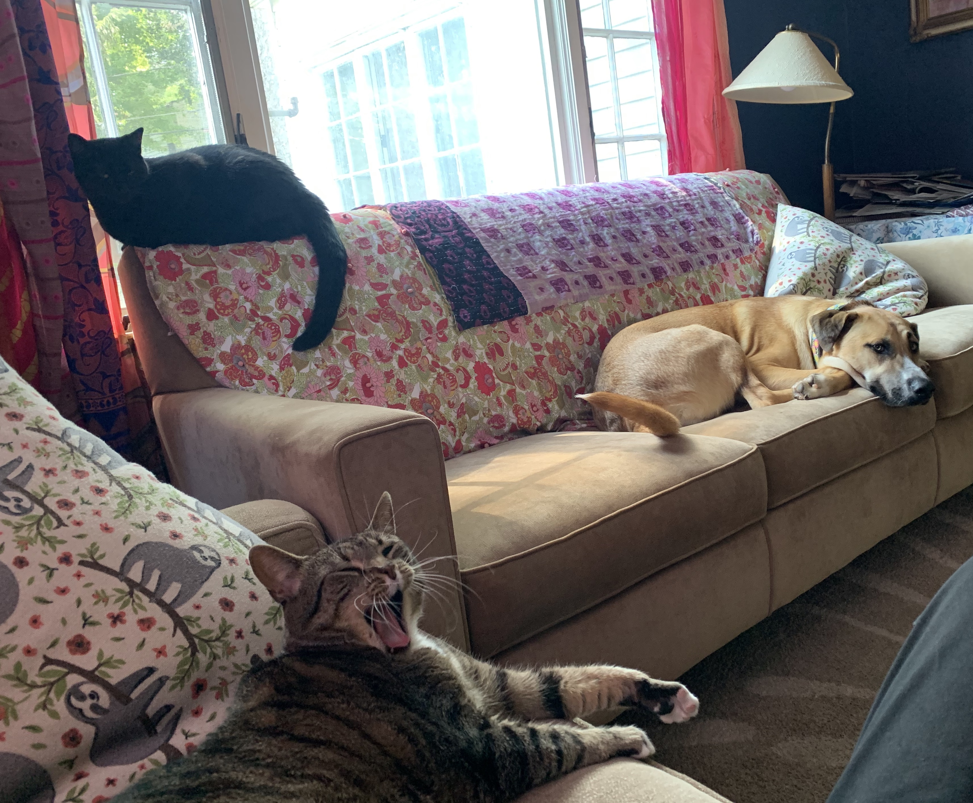
Celebrations?
What’s making you happy these days?
Type a celebration in the chat, or unmute your audio and say it out loud!

Slide 4
Welcome and updates
Dr. Cara Gutzmer, Director of School and Community Experiences
Helpful resources:
Websites:
http://sce.education.illinois.edu/ (School and Community Experiences
http://www.cote.illinois.edu (Council on Teacher Education)
sce@education.Illinois.edu (email to contact our office)
Staff:
Sue Talbott, Clinical Experiences Specialist, SCE
Danielle Galardy, Office Manager, SCE
Robin Craig and Suzanne Lee, Licensure officers, CoTE
Academic advisors (Amira Al-Mutairi A-F; Stacy Clemmons G-N; Keri Marion O-Z)

Slide 5
Overview of Spring 2024
Methods class: CI 401 Tuesday 8-11
Placement 3 hours/week (42 total)
January 22 – May 3
Placed in pairs (in most cases); you do not have to attend together
SCE website: (https://sce.education.illinois.edu/secondary-program/student-information)

Slide 6
Teaching performance activity
Consider the following:
“What knowledge, skills, and dispositions make for high-quality teaching performance? When you talk to a teacher or when you see a teacher, in action, what evidence could you gather that demonstrates ‘good teacher performance?’”

Slide 7
Danielson framework for teaching
Four domains
22 components
MANY indicators
On-stage vs. Off-stage
Big themes:
Student-centered
Engagement-driven
Differentiated
Reflective/responsive
Why does this matter?
EFE/ST Evaluations
Teacher evaluations

Slide 8
Student teaching—spring 2025
Make sure you have completed your placement application
Email sce@education.Illinois.edu with any changes
Complete, review/revise, and submit cover letter/resume by DECEMBER 8.
Student teaching 2025 begins before the start of the UIUC calendar: JANUARY 6th! You follow your assigned school’s schedule – NOT U of I’s!
Be ready to interview in winter/spring 2024 through fall 2024 (if necessary)
Pass the Content test by December 15, 2024 (take over the summer)
RELAX!

Slide 9
What to do when you get your Spring 2024 placement
GET EXCITED!
Use the roster to arrange a carpool. It's fun to ride together! Lots of time to laugh and debrief about your day.
Send an individual introductory email to your cooperating teacher
It should be polite and professional, not informal
Plan to complete your background check prior to January
Ask your teacher if there is anything they would like you to do prior to your first day

Slide 10
YES!

Slide 11
NO!

Slide 12
The first day
Dress professionally and practice good hygiene (no sweats, jeans, cover up).
Arrive 5-10 minutes early (ALWAYS!). Practice your route.
Put your phones away. Communicate if you are taking notes on your computer.
Sign in at the office. Introduce yourself to the office staff. Be friendly! These people should like you and be happy to see you every time you come in!
Find classroom. Smile and greet people in the hall.
Observe, participate, engage! Be polite and friendly. Defer to your teacher’s directives.
Be proactive. Offer to help. If you don’t know, ask.

Slide 13
What to expect
You will have some class assignments that tie into your placement. You will need to communicate your needs to your cooperating teacher well in advance.
Your cooperating teacher will observe you and give written feedback a minimum of two times during the semester.
If are ill and cannot attend practicum, you must inform your cooperating teacher right away. Exchanging phone numbers is a good idea.
Absences must be made up.
You will have a minimum of 42 early field hours by the end of the semester.

Slide 14
If trouble should arise….
Your cooperating teacher will contact me and I will intervene to document issues and design a support plan
If issues continue, a remediation plan will be put in place
If issues persist, your continuation in the program may be in jeopardy

Slide 15
Follow the chain of command
First, talk to instructors or cooperating teachers
Next, talk me (placements)
If we can’t help, we will advise you who to contact next:
Advisors
Student Academic Affairs Office (SAAO)
Department head (Dr. Sarah McCarthey)
Campus resources (Title IX, OSCR, Counseling Center, financial aid, etc.)
The dean is responsible for overseeing the overall functioning of the College of Education and does not typically get involved in student issues unless they are extremely, EXTREMELY serious.

Slide 16
Don’t let trouble arise
COMMUNICATE! If you feel anxious and overwhelmed, reach out to someone. There are so many people who are here to support you! Your success is OUR success! We care about you!
Be proactive and plan ahead.
Remember that you are representing the College of Education as well as yourselves, so be polite, professional, and conscientious in all that you do.
Refer to the SCE website if you have questions. If you can’t find an answer, find ME! I’m here to help!

Slide 17
Questions? Comments? Concerns?

