Slide 1
Cooperating teacher orientation
Spring 2024
CI 401
Year 1 Candidates

Slide 2
agenda
Welcome
Course sequence
Expectations – Professionalism
Expectations – Academic
Giving feedback
Evaluations
Questions?
Tuition waivers

Slide 3
Welcome!
Share some winter break fun in the chat!
Share a story about a rock star candidate you hosted in the past!

Slide 4
Course sequence –year 1
Courses
Placements
Ci 401: Introduction to Teaching in a Diverse Society
CI 473 Disciplinary Literacy
Fall (MG Only)
3 hours per week
Spring
3 hours per week

Slide 5
Course sequence – Year 2
Courses
Placements
Special Education
Assessment
CI 403
Fall
6 hours/week placement
Spring
STUDENT TEACHING

Slide 6
Professional expectations
Promptness
Mature and appropriate attire and hygiene
Communication
Engagement
PROFESSIONAL BEHAVIOR CHECKLIST

Slide 7
Academic expectations
Teach two lessons and ask cooperating teacher for written feedback
Final evaluation
Course assignments

Slide 8
Candidate: Cooperating Teacher: Supervisor: Date: | Always | Most of the time | Some of the time | Rarely | n/a
Candidate is punctual. •Arrival and departure times align with assigned hours •Attends and participates in required meetings •Replies promptly to emails, phone calls, texts, etc.
Candidate communicates regarding absences. •Plans ahead and informs appropriate personnel of absences •Communicates with appropriate personnel regarding unexpected events that impact placement time •Submits sub plans when required
Candidate is professional in appearance and demeanor. •Clothing and personal hygiene reflect maturity and professionalism •On-site behavior indicates alertness, enthusiasm, and care •Actively supports and interacts with students across the day •Keeps busy without prompting •Cell phones are not in use outside of plan and lunch times
Candidate shares plans and requirements with cooperating teacher in a timely manner. •Assignments that require student contact are shared ahead of the due date •Lesson plans are approved at least 24 hours in advance of implementation
Candidate interactions with staff are professional. •Conversations are cordial and polite and do not interfere with instruction •Gossip is avoided •Confidentiality is maintained
Candidate’s participation in remote meetings/instruction is professional. •Camera is on •Background is free of distractions •Candidate is seated at a desk/table
Candidates are expected to score “ALWAYS” for all components. If concerns arise, please talk to the candidate directly and follow up with the University supervisor. School and Community Experiences may follow up with a support plan, if appropriate. Cooperating teachers, please complete this form at least once per semester. This form may be used more frequently to monitor students who are not meeting expectations.
COMMENTS:
\

Slide 9
Giving feedback
How do you reinforce?
How do you correct and shape?
Do you have a way to track your positive to corrective ratio?

Slide 10
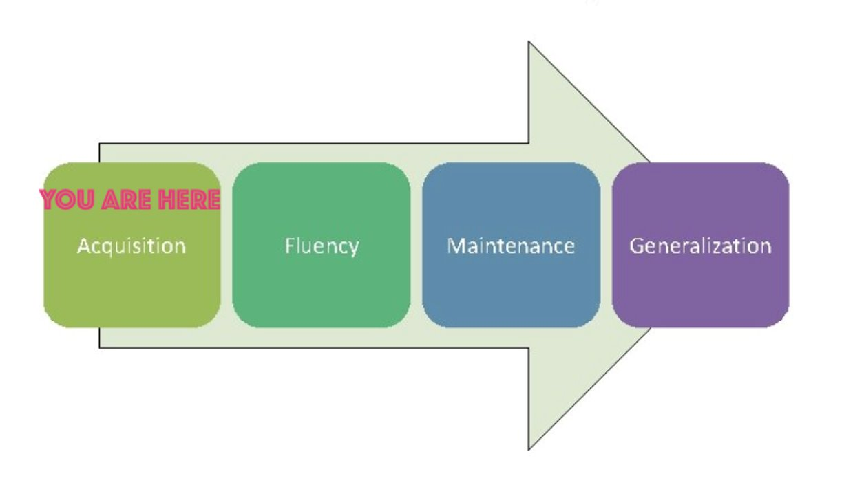
What do candidates need from you?
A safe and nurturing relationship
Feedback (positive AND corrective)
Opportunities to practice
Tips and tricks
Time to ask questions
YOU = candidate

Slide 11
Characteristics of feedback (Positive AND corrective)
Descriptive rather than evaluative
Similar to “evidence” on the Danielson, based on observations
Specific
Actionable

Slide 12
Unexpected negative feedback (It's awkward for everyone)
"I have some feedback for you, and it may be uncomfortable. I feel a bit uncomfortable myself, but I care about you and your development more than I care about how uncomfortable I feel. So, if you're feeling a little unsure about what to expect here, we are in this together. Can we talk a bit about _____________ ?"

Slide 13
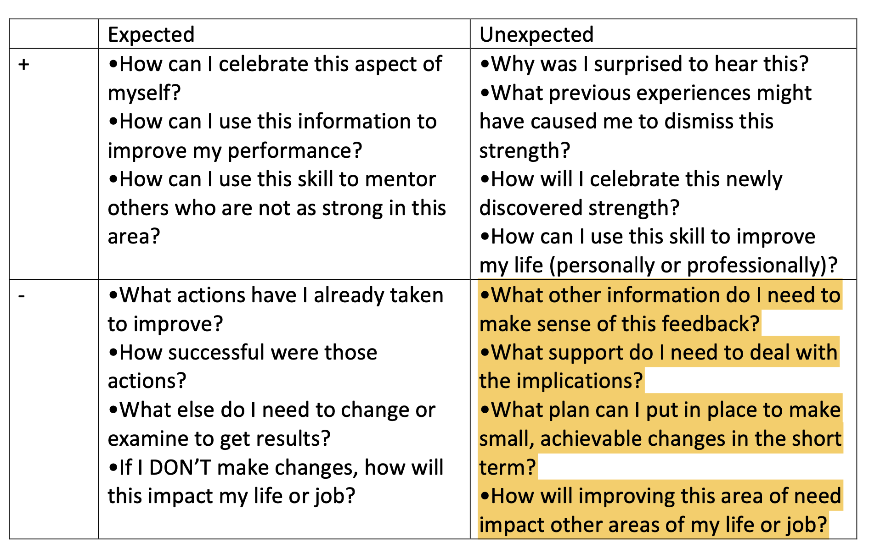

Slide 14
evaluations
Observation feedback
Final
Portal: https://cote.illinois.edu/cote-portal-access
Approve time card
Support plans

Slide 15
supports
Disposition Concern Form
Remediation Plan
Professional Growth Plan

Slide 16
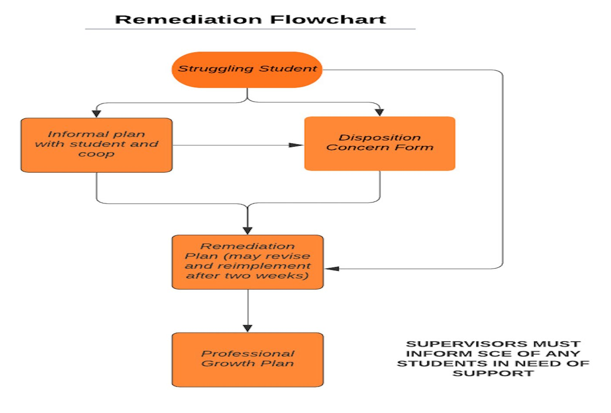

Slide 17
Immediate actions to welcome your candidate
Exchange contact information (set boundaries!)
Show them where to put their belongings
Tour the school (ask a student to show them around)
Introduce them to staff
Show them how to access your online curriculum and classroom
Ask them to plan to introduce themselves to the students in a creative way
Post their name on the board
Be clear and specific about what you would like them to do. They should be active, helpful, and engaged!

Slide 18
Tuition waivers
Non-degree vs. Master’s/Endorsement/Doctoral
Contact Council on Teacher Education with questions!
cote-waivers@illinois.edu
https://cote.illinois.edu/cooperating-personnel-supervisors/cp-tuition-fee-waivers

Slide 19
resources
SCE: https://sce.education.illinois.edu/
Portal: https://cote.illinois.edu/cote-portal-access
Email Cara or SCE directly:
caraknox@illinois.edu
Sce@education.illinois.edu

Slide 21
Questions?

