Slide 1
EDPR250 EL orientation
April 12, 2023

Slide 2
Welcome!

Slide 3
agenda
Welcome!
People and places to know
Content test
Fall placements
Danielson
The supervisor’s role
edTPA
Student teaching update
Wrapping up this semester
Action items
Questions

Slide 4
Celebrations!
In the chat, describe briefly how your cooperating teacher effectively gets the class’s attention.
ATTENTION SIGNALS are one of the many basic competencies we will look for in the fall. Steal all the ideas you can! ☺

Slide 5
websites
Helpful resources:
Websites:
http://sce.education.illinois.edu (School and Community Experiences)
https://cote.illinois.edu (Council on Teacher Education)
sce@education.illinois.edu (email to contact our office)
There will also be a Canvas site for the class

Slide 6
People to know
Dr. Cara Gutzmer, Director, School and Community Experiences
Sue Talbott, Clinical Experiences Specialist, SCE
Danielle Galardy, Office Manager, SCE
Robin Craig, Licensure officer, CoTE
Lynn Burdick, Program Coordinator, edTPA support
Amira, Keri, and Stacy – advisors
Wei Liu, Study Abroad

Slide 7
Content test
https://www.il.nesinc.com/TestView.aspx?f=HTML_FRAG/IL305_TestPage.html
Elementary (305)
Accommodations – GET YOUR DOCUMENTATION IN ORDER!
You must take and pass it by December 15 in order to begin student teaching in January
Consider taking it this summer
STUDY!!!
Materials are available on your CoTE portal. Under the ”Content Test Requirement” you will see “Click here for available content test study resources.” Contact Room 25 if you need assistance with the VPN.

Slide 8
About fall placements….
Grade level considerations
Everyone will be in a classroom – no intervention or ESL support placements.
Think about how you will build a great relationship with your supervisor and cooperating teacher.
CARPOOL!!!!!

Slide 9
Fall placements
Three mornings plus one full day
Complete a VERY supported “mini-takeover” in November
Friday morning (8am!) seminar
PES class Friday 9am-noon
Start Monday, August 21, ends Wednesday, December 6
Two excused absences for illness and emergency – you must let your coop and supervisor know!
All students can expect to travel at some point their senior year
Great opportunity to see a variety of schools!
We want to give you a diverse range of experiences
CARPOOL to save money and make friends!
Must complete BBP training and background check prior to your August start date

Slide 10
Professional behaviors
Checklist: Available on SCE website for your reference.
Punctuality
Professional dress – no sweats, no logos
Communication
Relationship with cooperating teacher and supervisor
Here are some actual quotes from cooperating teachers and supervisors:
"My student teacher is a BLESSING. I don't know what I would do without her!"
"EM is an incredible asset to our school. She is making my job easier! I feel like she's more like my co-teacher than a student!"
"We are having so much FUN together!"
"JP has stepped up in every way possible. He shares data during referral meetings, is fearless in his interactions with some of our hard-to-reach students, and is active and 'present' every day."
“They are teaching me SO MUCH! I feel so rejuvenated and excited to teach! I will be at a loss when they leave. Can I keep them???”

Slide 11
Planning ahead
You will be TIRED! It takes time for your body and mind to adjust to the new hours and expectations. Your stamina will build over time.
You may not have very much time between placement and class. Pack a lunch and something to drink. Pack any meds or personal items you may need.
Good communication matters! Our support options are best if you tell us your needs!

Slide 12
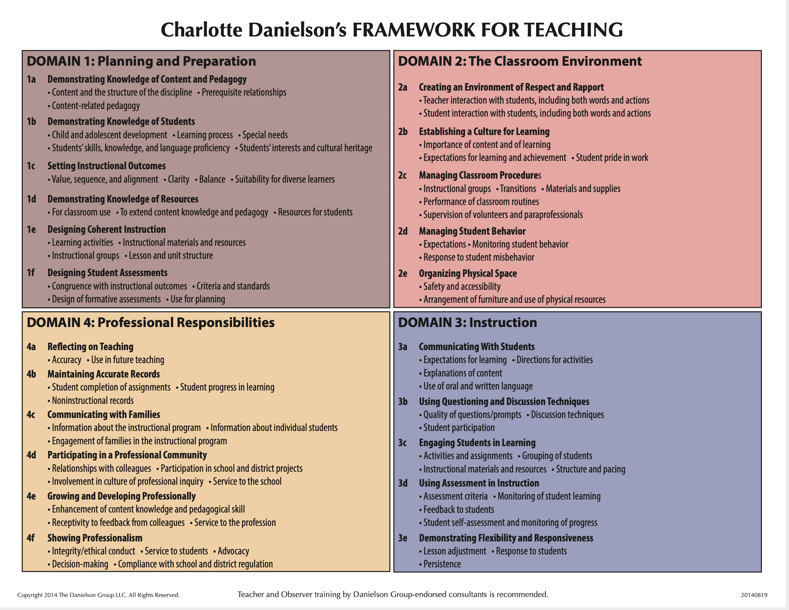
Danielson framework for teaching
Four domains
22 components
MANY indicators
On-stage vs. Off-stage
Big themes:
Student-centered
Engagement-driven
Differentiated
Reflective/responsive
Why does this matter?
EFE/ST Evaluations
Teacher evaluations

Slide 13
Your supervisor
You are assigned a university supervisor who will teach your Friday seminar
Four observations (pre/post conference)
Midterm/Final evaluation
They will be your best support/coach/mentor!
Often initiate support plans

Slide 14
What is the EDTPA?
Education Teacher Performance Assessment (edTPA)
State licensure performance examination for prospective teachers
Completed during student teaching (final semester)
You will submit before spring break
Portfolio-based w/ video
LOTS of formative experiences and staff/faculty support along the way

Slide 15
Teach abroad!!! Dr. Wei Liu, associate director of international programs

Slide 16
Questions?
Contact Wei at weiliu1@Illinois.edu

Slide 17
Student teaching updates
Northern placements
Might have to interview
Take this process VERY SERIOUSLY
Placement confirmation comes from SCE, not from the district
All placements will be announced in late November
REMEMBER that you follow the calendar of the district to which you are assigned!
Placements begin January 8

Slide 18
Wrapping up the semester (checklist will be sent)
Upload your two observation feedback forms to Canvas by Friday, May 5 at 5pm (Many of you have already done this. Good job!)
Enter your hours on the timesheet on COTE (minimum 80)
Remind your cooperating teacher to complete your final evaluation (COTE)
Complete the cooperating teacher evaluation on COTE
If you are pursuing an endorsement, ask your cooperating teacher to write a letter to verify your hours.
You will submit that letter to Robin Craig (rcraig@Illinois.edu) at COTE.
THE LETTER MUST BE ON SCHOOL LETTERHEAD OR COME FROM THE TEACHER’S SCHOOL EMAIL
Please send an email or write a note to your cooperating teacher to say thank you for hosting you ☺
Send an introductory email to your fall cooperating teacher
Background checks, BBP
Have a safe and wonderful summer break!

Slide 19
MORE Action items
Check everything off the end of the semester list (posted on Canvas next week!)
Respond quickly and professionally to any outreach from northern districts
Wait patiently for fall placement information and take care of everything immediately for a smooth start in August.
Register for the content test
Do not freak out ☺

Slide 20
Questions

