Slide 1
Cooperating teacher orientation
Spring 2023
EDPR 250
Year 1 Elementary Candidates

Slide 2
agenda
Welcome
Course sequence
Expectations – Professionalism
Expectations – Academic
Supports
Evaluations
Questions?
Tuition waivers

Slide 3
Welcome!
Introductions
Sue Talbott, Clinical Experiences Specialist
Lynn Burdick, Elementary Program Coordinator
Share a winter break highlight in the chat!

Slide 4
Course sequence –year 1
Courses
Placements
Intro to Teaching
Children's Literature
Methods
Math
Language Arts – Part 1
Science
Social studies
Music/Art/Dance
Fall
3 hours per week
Spring
1 full day per week

Slide 5
Course sequence – Year 2
Courses
Placements
Special Education
Action and Inquiry
Methods
Language Arts – Part 2
Theory and Practice (fall and spring)
Seminar
Fall
Monday, Tuesday, Thursday - mornings
Wednesday – all day
Spring
STUDENT TEACHING

Slide 6
Professional expectations
Promptness
Mature and appropriate attire and hygiene
Communication
Engagement
All absences must be made up
Arrive and depart according to school's contractual hours
Begin the week of January 17, end the week of May 1 (Tuesday placement only)
PROFESSIONAL BEHAVIOR CHECKLIST

Slide 7
Academic expectations
Teach two lessons and ask cooperating teacher for written feedback
Final evaluation
Course assignments
Candidates are instructed to inform you of their requirements as soon as possible

Slide 8
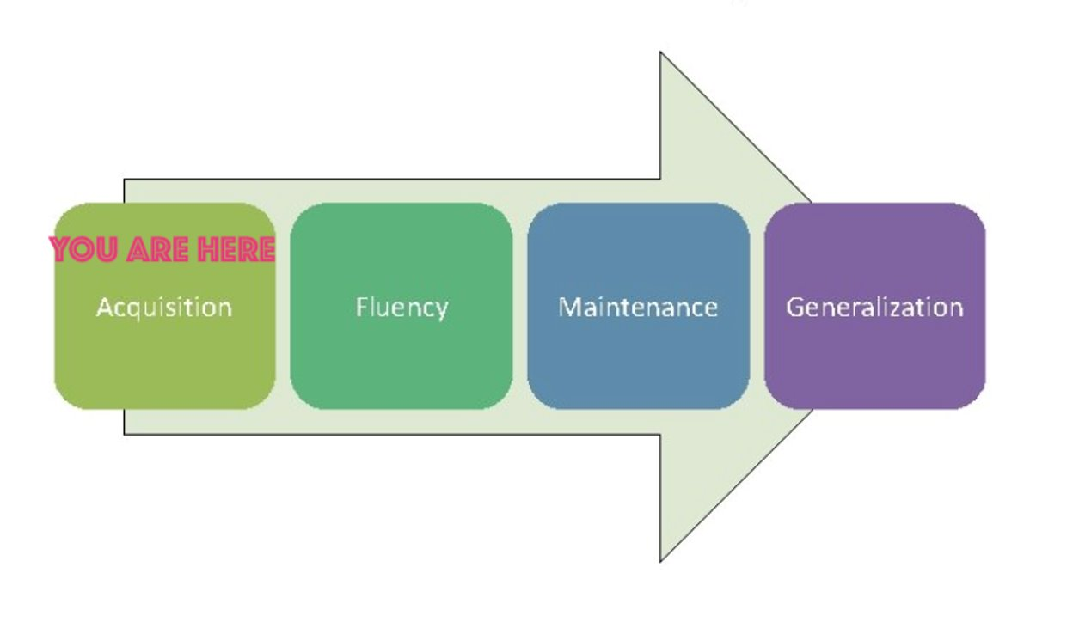
What do candidates need from you?
A safe and nurturing relationship
Feedback (positive AND corrective)
Opportunities to practice
Tips and tricks
Time to ask questions
YOU = candidate

Slide 9
Unexpected negative feedback (It's awkward for everyone)
"I have some feedback for you, and it may be uncomfortable. I feel a bit uncomfortable myself, but I care about you and your development more than I care about how uncomfortable I feel. So, if you're feeling a little unsure about what to expect here, we are in this together. Can we talk a bit about _____________ ?"

Slide 10
evaluations
Observation feedback
Final
Portal: https://cote.illinois.edu/cote-portal-access
Support plans

Slide 11
supports
Disposition Concern Form
Remediation Plan
Professional Growth Plan

Slide 12
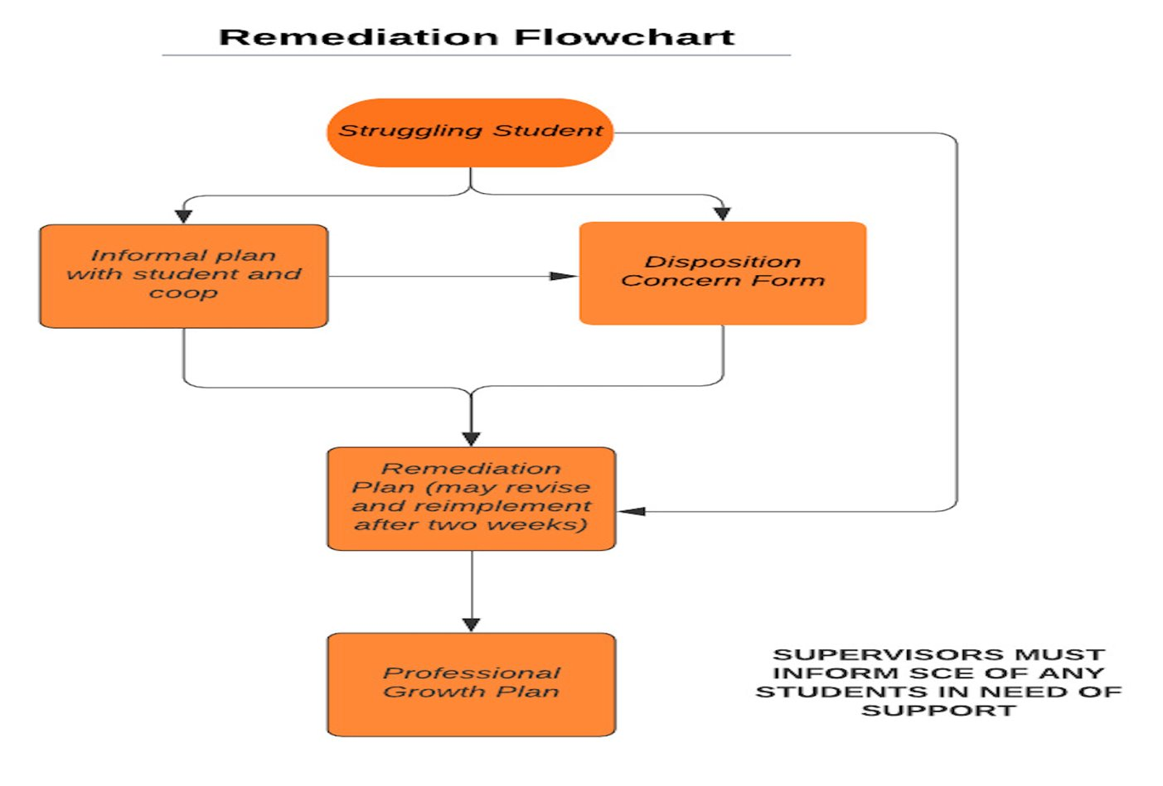

Slide 13
Immediate actions to welcome your candidates
Exchange contact information (set boundaries!)
Show them where to put their belongings
Tour the school
Introduce them to staff
Teach them to access your online curriculum and classroom
Ask them to plan to introduce themselves to the students in a creative way
Post their name on the board
Be clear and specific about what you would like them to do. They should be active, helpful, and engaged!

Slide 14
Tuition waivers
Non-degree vs. Master’s/Endorsement/Doctoral
Contact Council on Teacher Education with questions!
cote-waivers@illinois.edu
https://cote.illinois.edu/cooperating-personnel-supervisors/cp-tuition-fee-waivers

Slide 15
resources
SCE: https://sce.education.illinois.edu/
Professional Behavior Checklist
Syllabus
Portal: https://cote.illinois.edu/cote-portal-access
Email Cara or Sue directly:
caraknox@illinois.edu
stalbott@illinois.edu

Slide 16
It's never too soon..... AY 2023-2024 application will be available February 14!

Slide 17
Questions?

