Slide 1
Professional Education Sequence (PES) Induction
Middle Grades Education
March 5th, 2026

Slide 2
Bingo!

Slide 3
Agenda
Academic Advisors
Degree Requirements & Helpful Reminders
Council on Teacher Education (CoTE)
Student Portal & Licensure Requirements
School and Community Experiences (SCE)
Student Teaching & Placements
Questions/Wrap Up/Next Steps

Slide 4
Degree Requirements
Students must maintain minimum 2.5 cumulative GPA and earn grades of C- or higher in all content and professional coursework
  Education Foundations Coursework
  PES Coursework
  Concentration Coursework
PES classes are sequential for the next four semesters – they must be taken in order + passed with a qualifying grade to move onto the next semester of classes.
Not passing a PES class can delay graduation by a full year

Slide 5
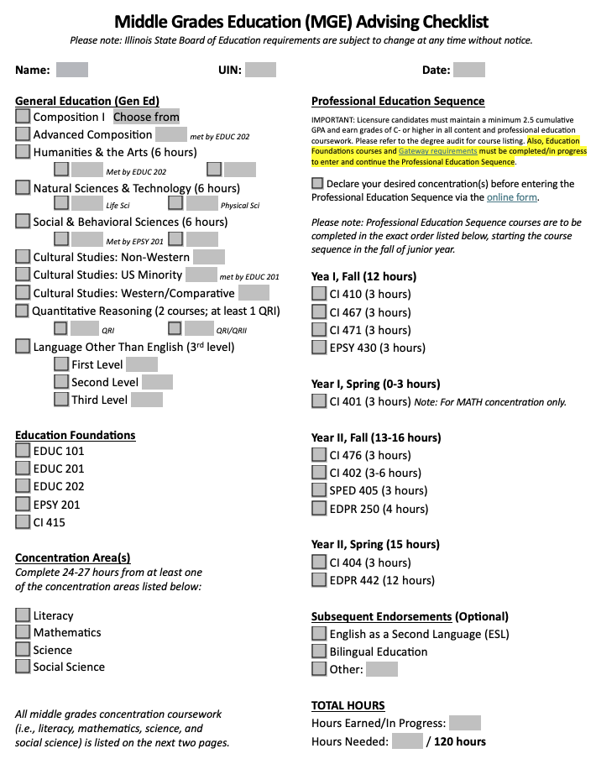
Degree Requirements
Degree Planning checklist (blank copy in your folders!)
  Should have all/most of the left-hand column complete by end of SP sophomore year
  Run your degree audit to ensure Gen Eds, Education Foundations, and ISBE requirements are complete
Notes:
CHECKLIST IN FOLDER
1st page left side: Gen Eds + Education Foundations (EDUC 101, 201, 202, EPSY 201, CI 415)
1st page right side: PES
Year 1 = Junior year
Year 2 = Senior year
Concentrations = second/third page of checklist in folder

Slide 6
Degree Requirements
Middle Grades Education Gateways
  Maintain a C- or better in ALL content and education foundations courses
  Maintain a 2.50 or higher overall, UIUC, content and professional education GPA
  Declare 1-2 concentrations
  Language Other Than English to the 3rd Level
Education Foundations coursework should be completed before moving on to PES, with the exception of CI 415
Students who have not met Gateways have been notified to sign the petition and schedule a meeting with their academic advisor
Notes:
Qualifying grade is at least a C-
Passing grade is at least a C-
Gateway requirements must be met to move onto jr year and begin PES
If you do not meet any of these reqs, you should have received an email on Mon 2/23 to fill out the gateway petition and meet with your advisor

Slide 7
Specific Concentration Tips
Math
If you have not already taken Math 119 (Ideas in Geometry), this must be done this upcoming fall
  Only offered in fall; conflicts with senior PES courses
Social Science
Social science electives must be chosen from the specific list under the concentration or SOC courses
  Random HIST, GGIS, PS, ANTH, ECON electives will not count
Science
Life Science Applications (IB 105) not usually offered; students should choose two Life Science Foundations courses for this section
Please contact an advisor if you notice issues in DARS, sometimes the concentration does not populate correctly
Literacy
Make sure you are checking total hours since some cover both concentration and PES requirements
Notes:
Literacy: very important to check total hours

Slide 8
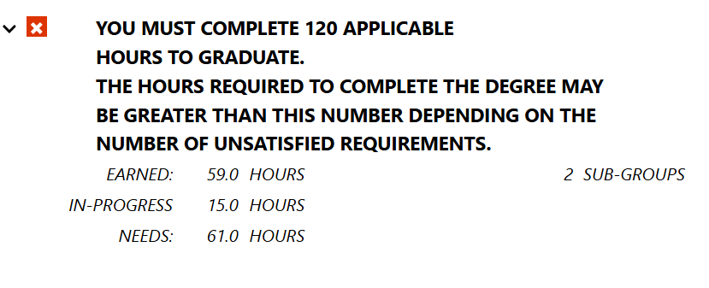
Reminders and Recommendations
You must complete 120 credit hours to receive your degree
  PES courses comprise 40 (43 for Math) hours
  Map out your remaining courses/hours (concentration, endorsements, minors, electives) to ensure you will reach 120
On your DARS: look at ‘EARNED’ & ‘NEEDS’
Ideally, you will have completed at least 60 hours (halfway to completion)

Slide 9
Reminders and Recommendations
If you have outstanding Gen Eds, plan to complete them soon!
  Meet with your advisor to discuss how to fit requirements in prior to Fall 2026 registration
  Don’t assume classes are offered every semester
      Check which semesters concentration-specific courses are usually offered (Fall only, Spring only, both Fall/Spring)
  Further into PES, there will be less freedom in your schedule to complete requirements
      No additional classes can be taken during Spring Senior Year (student
teaching) with the exception of CI 517 for an endorsement

Slide 10
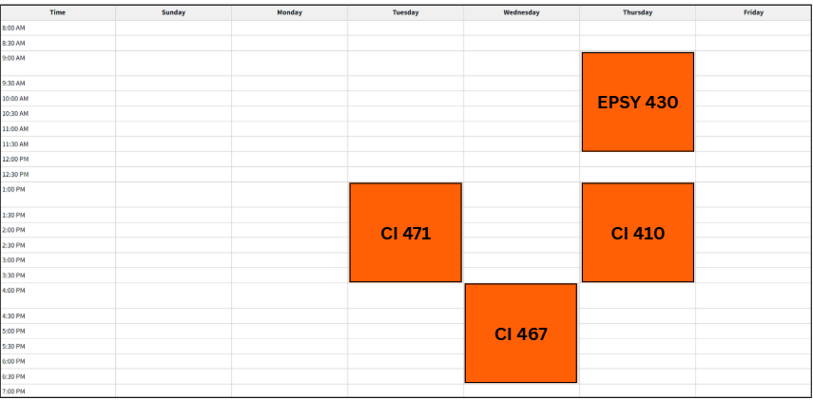
Junior Year Visual: Fall
Notes:
You will also be in placement 3 hours/week (more on this later)

Slide 11
Junior Year Spring
Math candidates are the only concentration with a PES class + placement (CI 401) - Tuesdays 8:00 - 10:50 AM
Ways to spend the semester:
Finish your concentration coursework
Take coursework for a second concentration/minor/endorsement
Study abroad!

Slide 12
CoTE Website – The Portal
https://cote.Illinois.edu/cote-portal-access
The CoTE website deals with licensure, field-related requirements, and documentation. Please bookmark it and refer to it frequently when you have questions.
  Licensure information
  Time sheets
  Evaluations
  Required Trainings

Slide 13
Licensure Requirements
MGE Licensure: Grades 5-8
You must continue to monitor your email and review the CoTE website for up-to-date requirements
C- or higher necessary for all qualifying coursework
Students must take and pass their content exam(s) prior to student teaching
  CoTE has access to study resources/vouchers

Slide 14
Endorsements
ESL
BILINGUAL
18 credit hours from specific coursework
5 course areas
100 clinical clock hours in an ESL classroom
18 credit hours from specific coursework
5 course areas
100 clinical clock hours in a Bilingual classroom
Passing applicable Proficiency Test OR holding the Seal of Biliteracy
Talk to your advisor about how to fit endorsement classes into your schedule!

Slide 15
School and Community Experiences (SCE)
SCE Staff:
Dr. Cara Gutzmer, Director
Sue Talbott, Clinical Experiences Specialist
Danielle Galardy, Office Manager

Slide 16
SCE Website
https://sce.education.Illinois.edu
The SCE website is for field placement information and clinical assignments. Please bookmark it and refer to it frequently when you have questions
  Forms used in clinical experiences
  Handbooks, timelines, guidelines
  Remediation forms
  Information for cooperating teachers, supervisors, and students pertaining to clinical experiences
  Links to presentations and other resources

Slide 17
Placements
Year One – Fall Early Field | Year One – Spring Early Field | Year Two – Fall Early Field | Year Two – Spring STUDENT TEACHING
This placement is tied to your CI 410 class 2 students per co-op Students must earn 45 hours over the course of the semester; 3 hours/week for 15 weeks Days/times are determined by student and co-op | CI 401 (MATH ONLY) Students must earn 45 hours over the course of the semester; 3 hours/week for 15 weeks Days/times are determined by student and co-op | EDPR 250 MG Students attend T, W, Th from 8:00 a.m. (or the start of the school day) until 12:00 p.m. Weekly seminar with supervisor on Monday mornings | EDPR 442 MG Full day, M-F beginning first day that schools return from Winter Break; University students follow the schedule of their placement school Seminar arranged by supervisor Northern placements

Slide 18
Student Teaching
Option to teach locally or in northern suburbs/Chicago Public Schools
Option to participate in Teach Abroad program
You follow the calendar of your assigned district
  Your spring break may be different from UIUC’s
  You will begin your placement before UIUC classes begin
  You will have a few days off sprinkled in your experience (school holidays!)
Most candidates have only two course requirements during student teaching
  Seminar for EDPR 442 (arranged by supervisor)
  CI 407 (online in evening)
  Any additional classes must be approved by your advisor and SCE staff prior to Spring 2028 registration

Slide 19
Placement application
Application link
Due March 27 at 5:00 pm
Look at location carefully and think about what you want for student teaching
Use the comment box!
Application FAQs are posted on SCE website for your reference

Slide 20
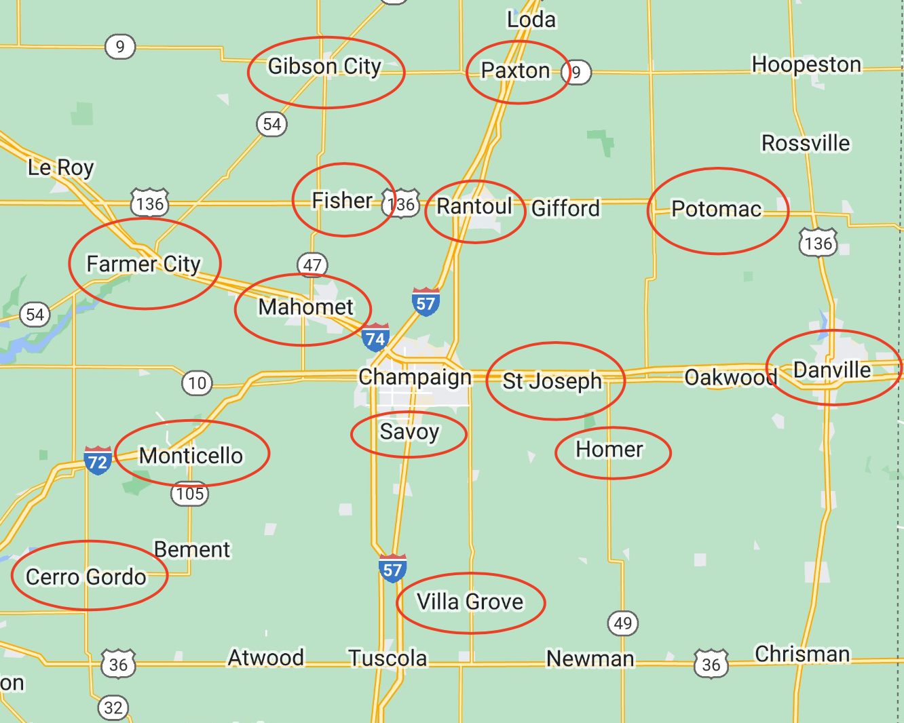
Local Map :55-mile radius from campus

Slide 21
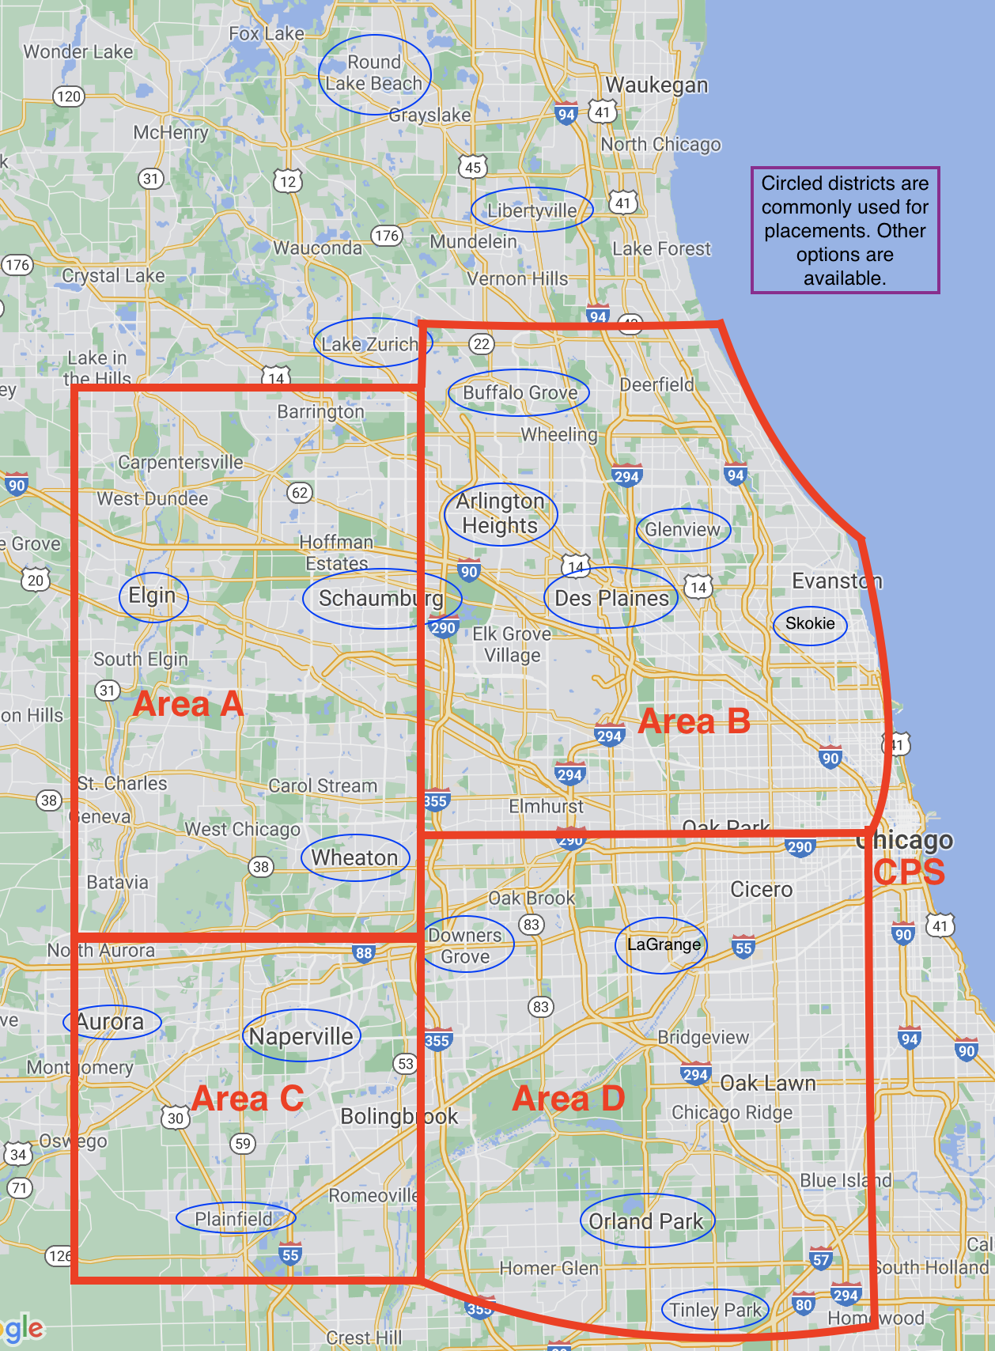
Northern Placement Map (Student Teaching Only)

Slide 22
If you have concerns
COMMUNICATE! We are all here to support you in your journey!
Start with instructors/cooperating teachers/supervisors
If you need further assistance, talk to your support team in Cara, your Academic Advisor, the program Coordinator, Scott Filkins, or Assistant Dean, Kelli Halfman. Your team can only help when they’re made aware of a situation!
Please note that Dr. Mouza, Dean of the College of Education oversees the general functioning of the college and is not directly involved in individual student issues. Please refrain from contacting her with concerns.

Slide 23
Helpful Hints
Plan to make an excellent first impression in your placements. Professional behaviors, such as maturity, good hygiene, clothing appropriate to the setting, and positive communication are critical.
Lock down your social media!!
If you work during the semester – you need to plan your hours around your courses and your placement requirements. Holding a job during your last semester if very difficult.
Carpooling is often necessary!
If you want to student teach in the Northern suburbs, plan your fall campus housing early.
Make us proud as representatives of the College of Education!

Slide 24
Next Steps
SCE & CoTE
Academic Advising
Complete placement application by March 27 at 5:00 pm
Review SCE and CoTE websites
Complete mandatory orientations and trainings in CoTE portal
caraknox@illinois.edu (Cara)
info@cote.illinois.edu (CoTE)
Run a Degree Audit to check for outstanding requirements
Complete gateway petition (if applicable)
Keep advisor aware of any changes prior to making them (dropping class, summer classes, etc.)
Register according to time ticket
Complete Teacher Candidate Contract by March 27

Slide 25

Questions?
You will receive these slides in an email with relevant links and action items to complete.
Notes:
Check your Illinois email!!

Slide 26
Middle Grades Education
Class of 2028
Notes:
Group picture background

