Slide 1
Professional Education Sequence (PES) Induction
Elementary Education
March 5th, 2026

Slide 2
Agenda
Academic Advisors
Degree Requirements & Helpful Reminders
Council on Teacher Education (CoTE)
Licensure Requirements & Student Portal
School and Community Experiences (SCE)
Student Teaching & Placements
Wrap Up/Next Steps

Slide 3
Pair and Share
Pair - Find someone you haven’t met before and introduce yourselves
Share – What are you most excited about for these next 2 years? What are you most nervous about?

Slide 4
Degree Requirements
Students must maintain a minimum 2.5 cumulative GPA and earn grades of C- or higher in all content and professional education coursework
  Education Foundation Coursework
  PES classes
  ISBE Requirements (Social Science Rubrics, Algebra Standard)
PES classes are sequential for the next four semesters – they must be taken in order and passed with a qualifying grade to move onto the next semester of classes. Not passing a PES class can delay graduation

Slide 5
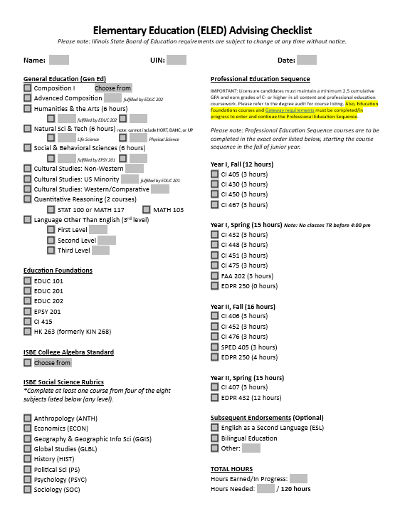
Degree Requirements
Degree Planning checklist (blank copy in your folders!)
  Should have all or most of the left-hand column complete by end of SP sophomore year
  Run your degree audit to ensure gen eds, EDU foundations, and ISBE requirements are complete

Slide 6
Degree Requirements
Elementary Education Gateways
  ISBE College Algebra Standard
  Language Other Than English to the 3rd Level
  Maintain a 2.50 or higher overall, UIUC, content and professional education GPA
  Students who have not met the gateways have been notified by their Advisor to submit a petition and determine game plan for gateway completion

Slide 7
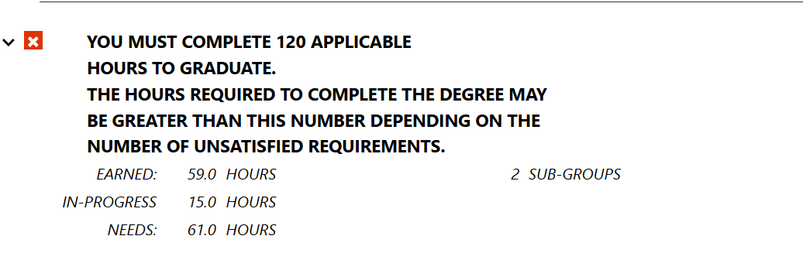
Reminders and Recommendations
You must complete 120 credit hours to receive your degree
  Your PES courses comprise 58 hours
  By the end of this semester –
    Completed 62+ hours: don’t need to take additional coursework
    Completed 56-61 hours: will need to take 1-2 additional classes
    Completed under 56 hours: will need to meet with your advisor to discuss gameplan
On your DARS: look at ‘EARNED’ & ‘NEEDS’
(this student would need one 3-credit hour class to finish with at least 120 hours assuming they do not drop a class this semester)

Slide 8
Reminders and Recommendations
If you have outstanding coursework – plan to complete it sooner rather than later!
  Meet with your advisor to discuss how to fit these requirements in prior to Fall 2026 registration
  Don’t assume all classes are offered every semester
  As you get further into the PES, there will be less freedom in your schedule to complete outstanding requirements
    No additional classes can be taken during Spring Senior Year (student teaching semester)

Slide 9
PES Schedule
You will be assigned a ‘group number’ 1 - 4 which coincides with the section of classes you register for.
Pay attention to restrictions on Course Explorer to know which section is yours.
Follow the sequence on your degree checklist (right-hand column) to know which classes to take each semester.

Slide 10
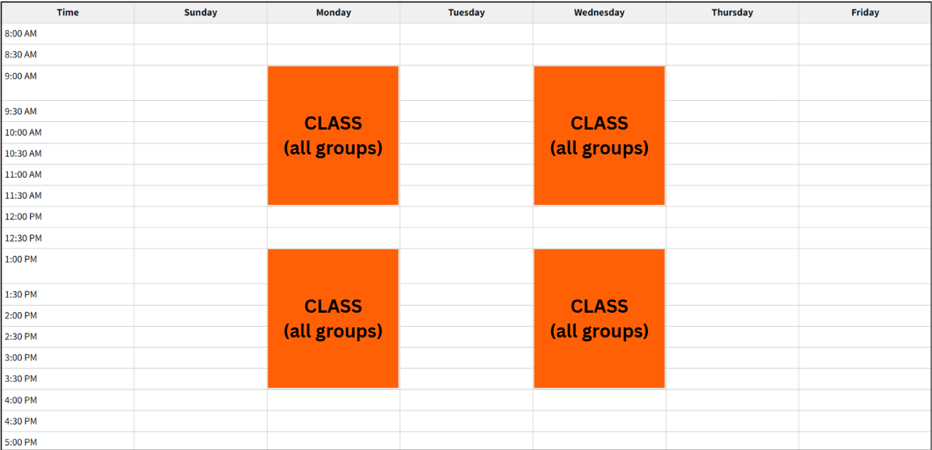
Junior Year Visual - Fall

Slide 11
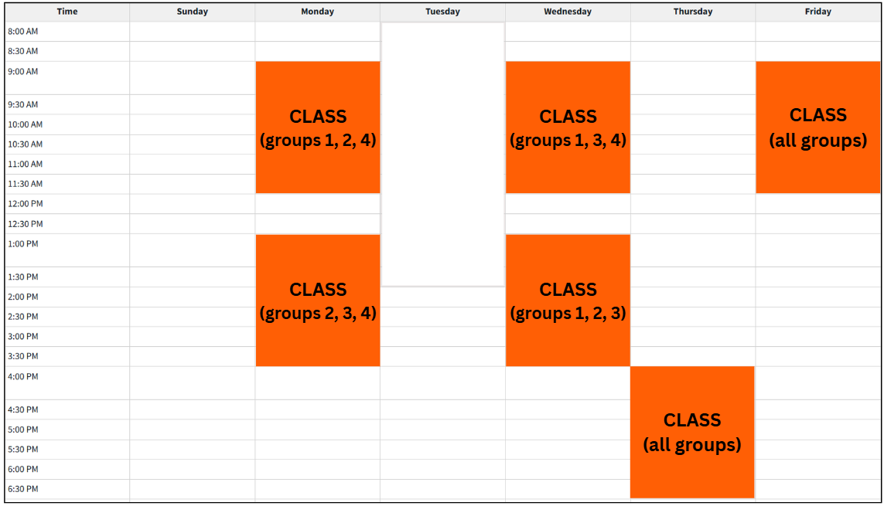
Junior Year Visual - Spring

Slide 12
CoTE Website – The Portal
https://cote.Illinois.edu/cote-portal-access
The CoTE website deals with licensure, field-related requirements, and documentation. Please bookmark it and refer to it frequently when you have questions.
  Licensure information
  Time sheets
  Evaluations
  Required Trainings
*You must complete the required trainings in your CoTE portal to be able to register for FA26 PES classes.

Slide 13
Licensure Requirements
ELED Licensure: Grades 1-6
You must continue to monitor your email and review the CoTE website for up-to-date requirements
C- or higher necessary for all qualifying coursework
Students must take and pass their content exam(s) prior to student teaching
  CoTE has access to study resources/vouchers

Slide 14
Endorsements
ESL
BILINGUAL
18 credit hours from specific coursework
5 course areas
100 clinical clock hours in an ESL classroom
18 credit hours from specific coursework
5 course areas
100 clinical clock hours in a Bilingual classroom
Passing applicable Proficiency Test OR holding the Seal of Biliteracy
Talk to your advisor about how to fit endorsement classes into your schedule!

Slide 15
School and Community Experiences (SCE)
SCE Staff:
Dr. Cara Gutzmer, Director
Sue Talbott, Clinical Experiences Specialist
Danielle Galardy, Office Manager

Slide 16
SCE Website
https://sce.education.Illinois.edu
The SCE website is for field placement information and clinical assignments. Please bookmark it and refer to it frequently when you have questions
  Forms used in clinical experiences
  Handbooks, timelines, guidelines
  Professional Behavior Checklist
  Information for cooperating teachers, supervisors, and students pertaining to clinical experiences
  Links to presentations and other resources

Slide 17
Placements
Year One – Fall Early Field | Year One – Spring Early Field | Year Two – Fall Early Field | Year Two – Spring STUDENT TEACHING
This placement is tied to your CI 405 class Three hours per week, arranged by you and your cooperating teacher Teach lessons, receive written feedback Other course assignments | EDPR 250 One full day – Tuesday OR Thursday Teach two lessons, receive written feedback Other course assignments | EDPR 250 Two consecutive full days (M/T or W/Th) Supervisor observes a minimum of four lessons Seminar at 8am on Fridays | EDPR 432 All day, every day! Begins January 3, 2028 Supervisor observes a minimum of five lessons Seminar arranged by supervisor CI 407 Northern placements

Slide 18
Student Teaching
Option to teach locally or in northern suburbs/Chicago Public Schools
Option to participate in Teach Abroad program
You follow the calendar of your assigned district
  Your spring break may be different from UIUC’s
  You will begin your placement before UIUC classes begin
  You will have a few days off sprinkled in your experience (school holidays!)
Most candidates have only two course requirements during student teaching
  Seminar for EDPR 432 (arranged by supervisor)
  CI 407 (online in evening)
  Any additional classes must be approved by your advisor and SCE staff prior to Spring 2028 registration

Slide 19
Placement Application
Application link
Due March 27 at 5:00 pm
Look at grade level preferences carefully and think about what you want for student teaching
Transportation
Use the comment box!
Application FAQs are posted on SCE website for your reference

Slide 20
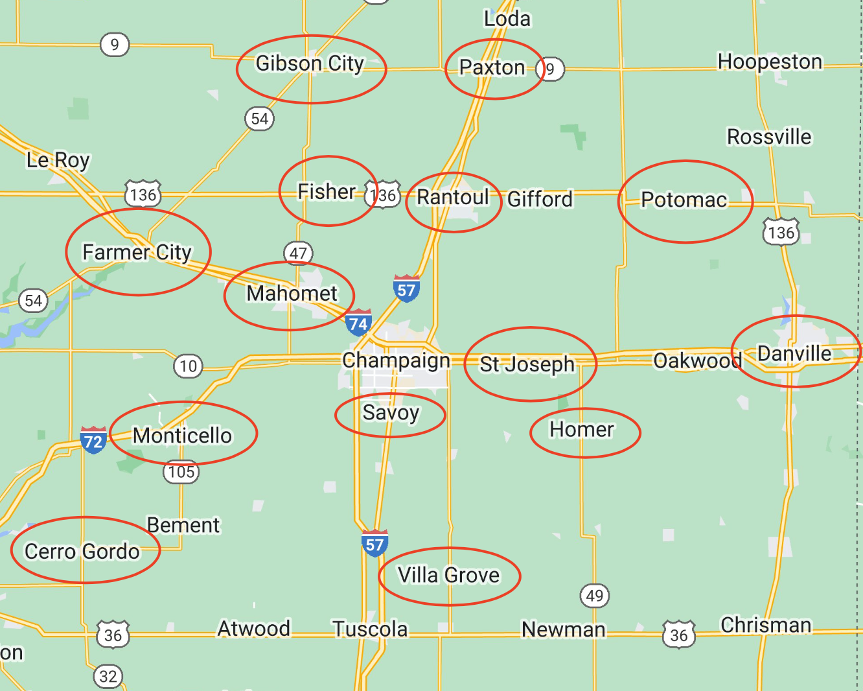
Local Map :55-mile radius from campus

Slide 21
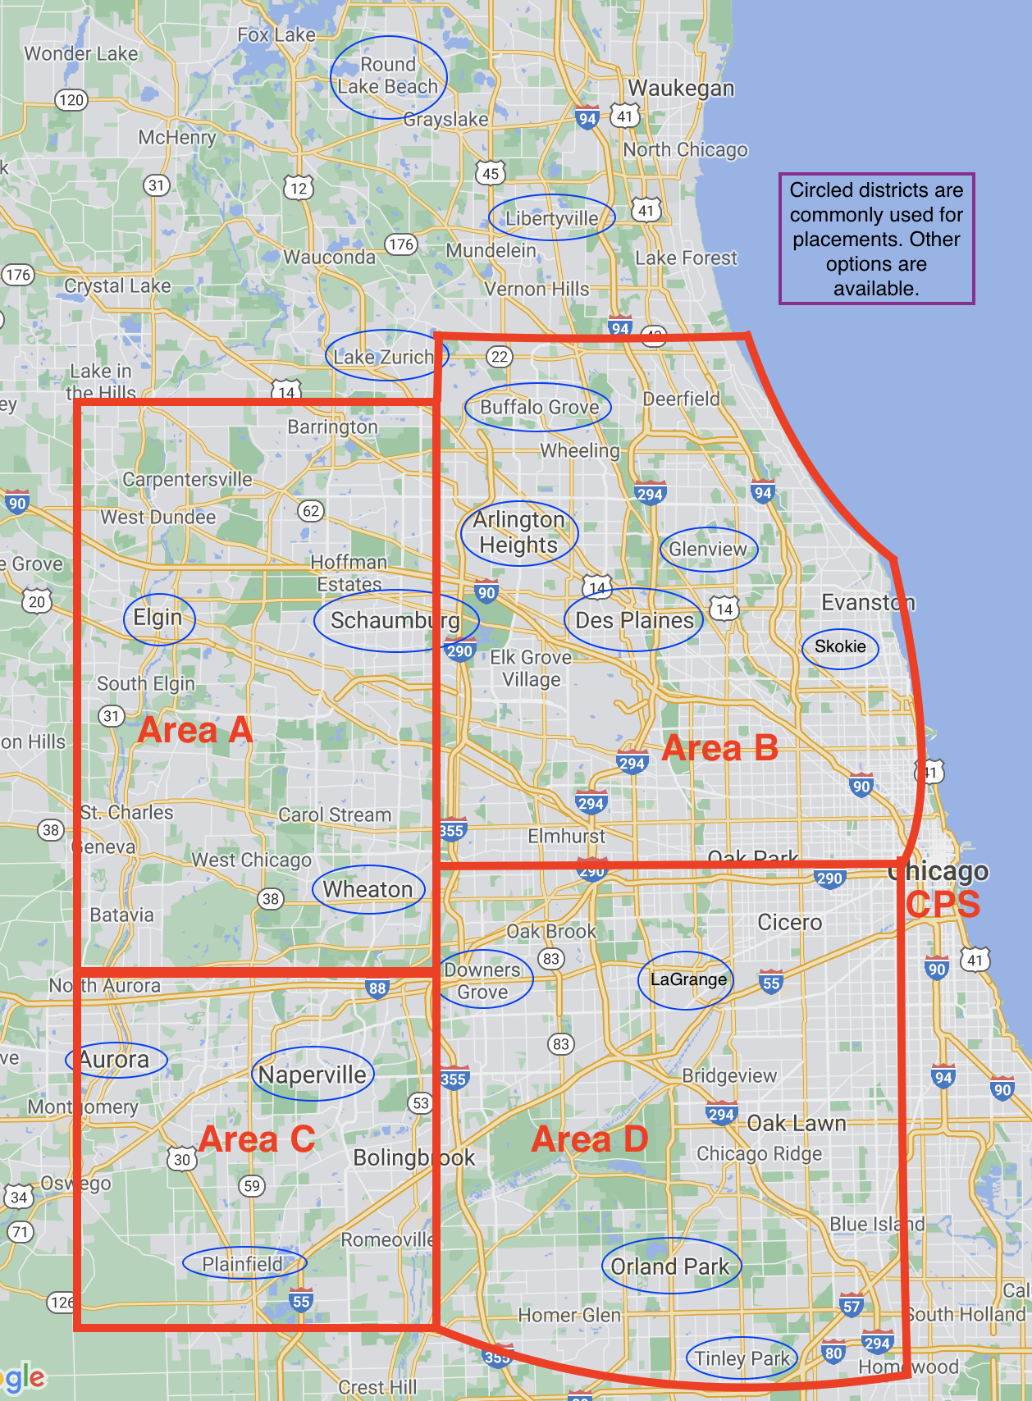
Northern Placement Map (Student Teaching Only)

Slide 22
If you have concerns
COMMUNICATE! We are all here to support you in your journey!
Start with instructors/cooperating teachers/supervisors
If you need further assistance, talk to Sue, your Academic Advisor, the program coordinator, Scott Filkins, or assistant dean, Kelli Halfman. We are here to help!
Please note that Dr. Mouza, Dean of the College of Education, oversees the general functioning of the college and is not directly involved in individual student issues. Please refrain from contacting her with concerns.

Slide 23
Helpful Hints
Plan to make an excellent first impression in your placements. Professional behaviors, such as punctuality, maturity, good hygiene, clothing appropriate to the setting, and positive communication are critical.
Lock down your social media!!
If you work during the semester – you need to plan your hours around your courses and your placement requirements. Holding a job during your last semester is very difficult.
Carpooling is a great idea!
If you want to student teach in the suburbs or Chicago, plan your campus housing early.
Make us proud!

Slide 24
Next Steps
SCE & CoTE
Academic Advising
Complete placement application by March 27 at 5:00 pm
Review SCE and CoTE websites
Complete mandatory orientations and trainings in CoTE portal
stalbott@illinois.edu (Sue)
info@cote.illinois.edu (CoTE)
Run a Degree Audit to check for outstanding requirements
Complete gateway petition (if applicable)
Keep advisor aware of any changes prior to making them (dropping class, summer classes, etc.)
Register according to time ticket
Read through and acknowledge Teacher Candidate Contract

Slide 25

Questions?
You will receive these slides in an email with relevant links and action items to complete.

Slide 26
Group Photo!

