Slide 1
Professional Education Sequence (PES) Induction
Early Childhood Education
March 5th, 2026

Slide 2
Agenda
Academic Advisors
Degree Requirements & Helpful Reminders
Council on Teacher Education (CoTE)
Licensure Requirements & Student Portal
School and Community Experiences (SCE)
Student Teaching & Placements
Wrap Up/Next Steps

Slide 3
The moment I knew I wanted to teach…
Find a partner and share the moment you knew you wanted to be a teacher, especially in early childhood

Slide 4
Degree Requirements
Students must maintain a minimum 2.5 cumulative GPA and earn grades of C- or higher in all content and professional education coursework
  Education Foundation Coursework
  Professional Education Sequence (PES) classes
  ISBE Requirements (Social Science Rubrics, Earth and Space Science)
PES classes are sequential for the next four semesters – they must be taken in order and passed with a qualifying grade to move onto the next semester of classes.
Not taking the courses in order and/or passing a PES course can delay graduation.

Slide 5
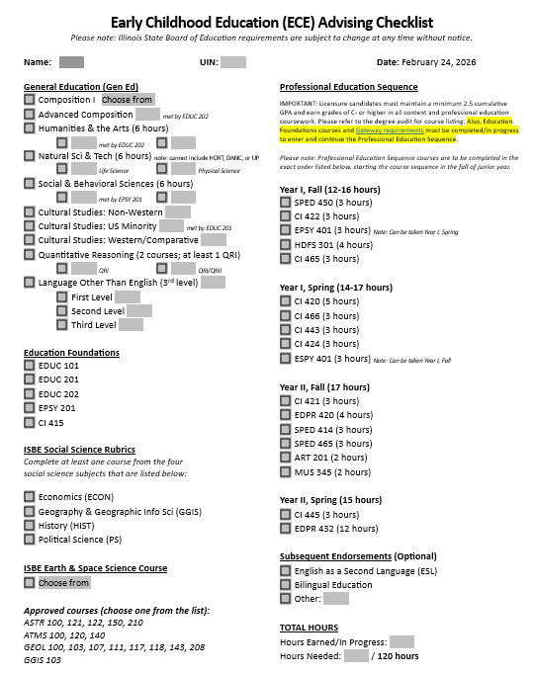
Degree Requirements
Degree Planning checklist (blank copy in your folders!)
  You should have all or most of the left-hand column complete by end of SP sophomore year
  Run your degree audit to ensure gen eds, EDU foundations, and ISBE requirements are complete.

Slide 6
Degree Requirements
Early Childhood Education Gateways
  Language Other Than English to the 3rd Level
  Maintain a 2.5 or higher UIUC, overall, content and professional ed GPA
Students who have not met the gateways have been notified to review and sign a petition and to meet with their advisor to develop a game plan for gateway completion.

Slide 7
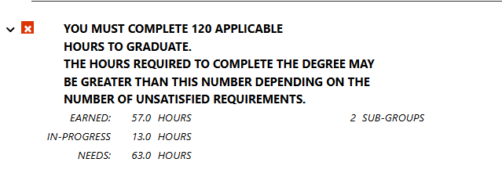
Reminders and Recommendations
You must complete 120 credit hours to receive your degree
  Your PES courses comprise 62 hours
  By the end of this semester –
    Completed 58+ hours: don’t need to take additional coursework
    Completed 52-55 hours: will need to take 1-2 additional classes
    Completed under 52 hours: will need to meet with your advisor to discuss gameplan
On your DARS: look at ‘EARNED’ & ‘NEEDS’
(this student would be short 1 credit hour if they didn’t take any additional courses and would be advised to add one 2-3 credit hour class)

Slide 8
Reminders and Recommendations
If you have outstanding coursework – plan to complete it sooner rather than later!
  Meet with your advisor to discuss how to fit these requirements in prior to Fall 2026 registration
  Don’t assume all classes are offered every semester
  As you get further into the PES, there will be less freedom in your schedule to complete outstanding requirements
    No additional classes can be taken during Spring Senior Year (student teaching semester)

Slide 9
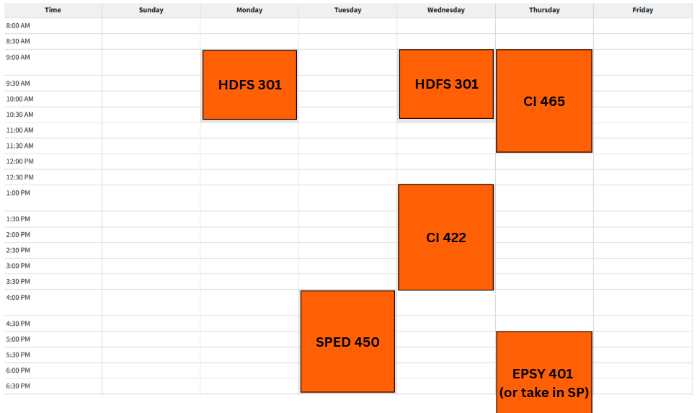
Junior Year Visual - Fall

Slide 10
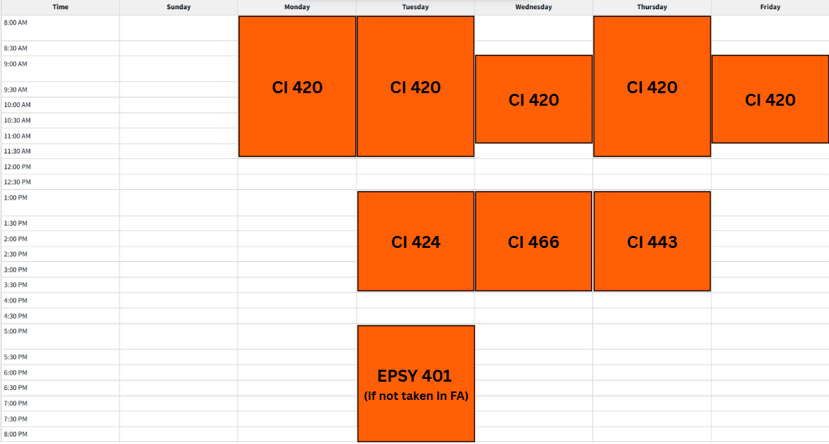
Junior Year Visual - Spring

Slide 11
CoTE Website – The Portal
https://cote.Illinois.edu/cote-portal-access
The CoTE website deals with licensure, field-related requirements, and documentation. Please bookmark it and refer to it frequently when you have questions.
  Licensure information
  Time sheets
  Evaluations
  Required Trainings
*You must complete the required trainings in the CoTE portal to be able to register for FA26 PES classes

Slide 12
Licensure Requirements
ECE Licensure: Birth-Grade 2, Pre-K SPED approval
You must continue to monitor your email and review the CoTE website for up-to-date requirements
C- or higher necessary for all qualifying coursework
Students must take and pass their content exam(s) prior to student teaching
  CoTE has access to study resources/vouchers

Slide 13
Endorsements
ESL
BILINGUAL
18 credit hours from specific coursework
5 course areas
100 clinical clock hours in an ESL classroom
18 credit hours from specific coursework
5 course areas
100 clinical clock hours in a Bilingual classroom
Passing applicable Proficiency Test OR holding the Seal of Biliteracy
Talk to your advisor about how to fit endorsement classes into your schedule!

Slide 14
School and Community Experiences (SCE)
SCE Staff:
Dr. Cara Gutzmer, Director
Sue Talbott, Clinical Experiences Specialist
Danielle Galardy, Office Manager

Slide 15
SCE Website
https://sce.education.Illinois.edu
The SCE website is for field placement information and clinical assignments. Please bookmark it and refer to it frequently when you have questions
  Forms used in clinical experiences
  Handbooks, timelines, guidelines
  Professional behavior checklist
  Information for cooperating teachers, supervisors, and students pertaining to clinical experiences
  Links to presentations and other resources

Slide 16
Placements
Year One – Fall Early Field | Year One – Spring Early Field | Year Two – Fall Early Field | Year Two – Spring STUDENT TEACHING
HDFS 301 Infant and Toddler placement at the Child Development Lab | CI 420 Primary Placement (K-2) Supervised by a University mentor – three observations One morning per week, then builds to four mornings per week | EDPR 420 Preschool placement Supervised by a University mentor – four observations Four mornings per week, then builds to five mornings per week | EDPR 432 All day, every day! Begins January 3, 2028 Supervisor observes a minimum of five lessons Seminar arranged by supervisor CI 445 Northern placements

Slide 17
Student Teaching
Option to teach locally or in northern suburbs/Chicago Public Schools
Option to participate in Teach Abroad program
You follow the calendar of your assigned district
  Your spring break may be different from UIUC’s
  You will begin your placement before UIUC classes begin
  You will have a few days off sprinkled in your experience (school holidays!)
Most candidates have only two course requirements during student teaching
  Seminar for EDPR 432 (arranged by supervisor)
  CI 445 (online in evening)
  Any additional classes must be approved by your advisor and SCE staff prior to Spring 2028 registration

Slide 18
Placement application
Application link
Due March 27 at 5:00 pm
Look at grade level preferences carefully and think about what you want for student teaching
Use the comment box!
Application FAQs are posted on SCE website for your reference

Slide 19
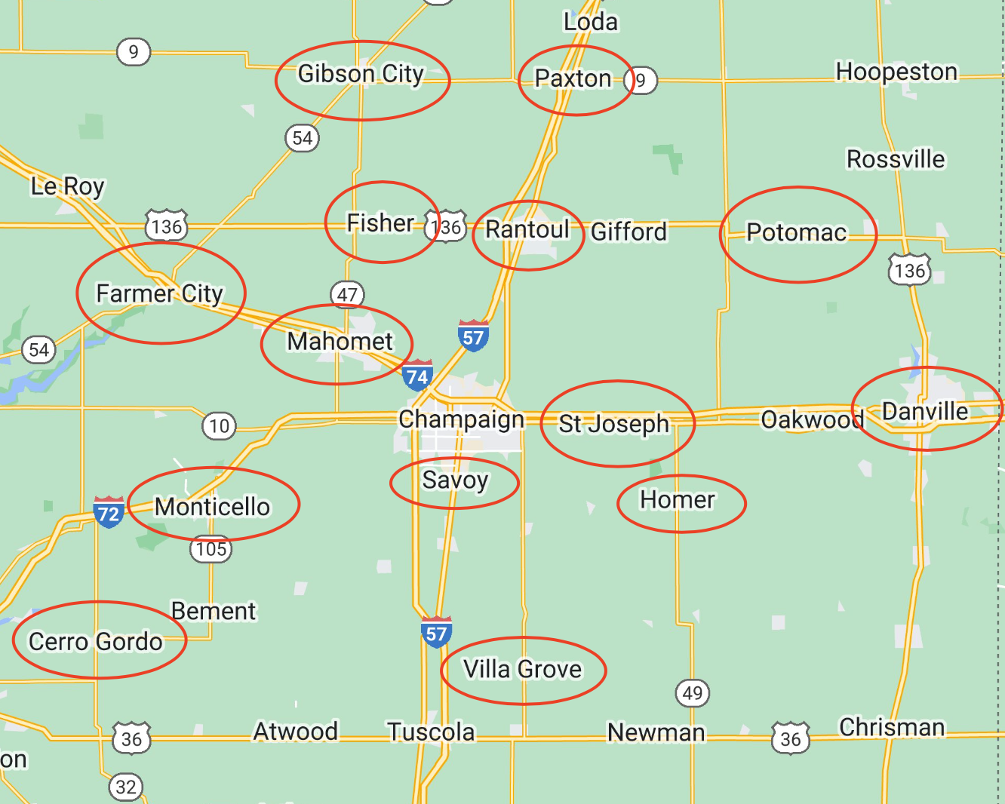
Local Map :55-mile radius from campus

Slide 20
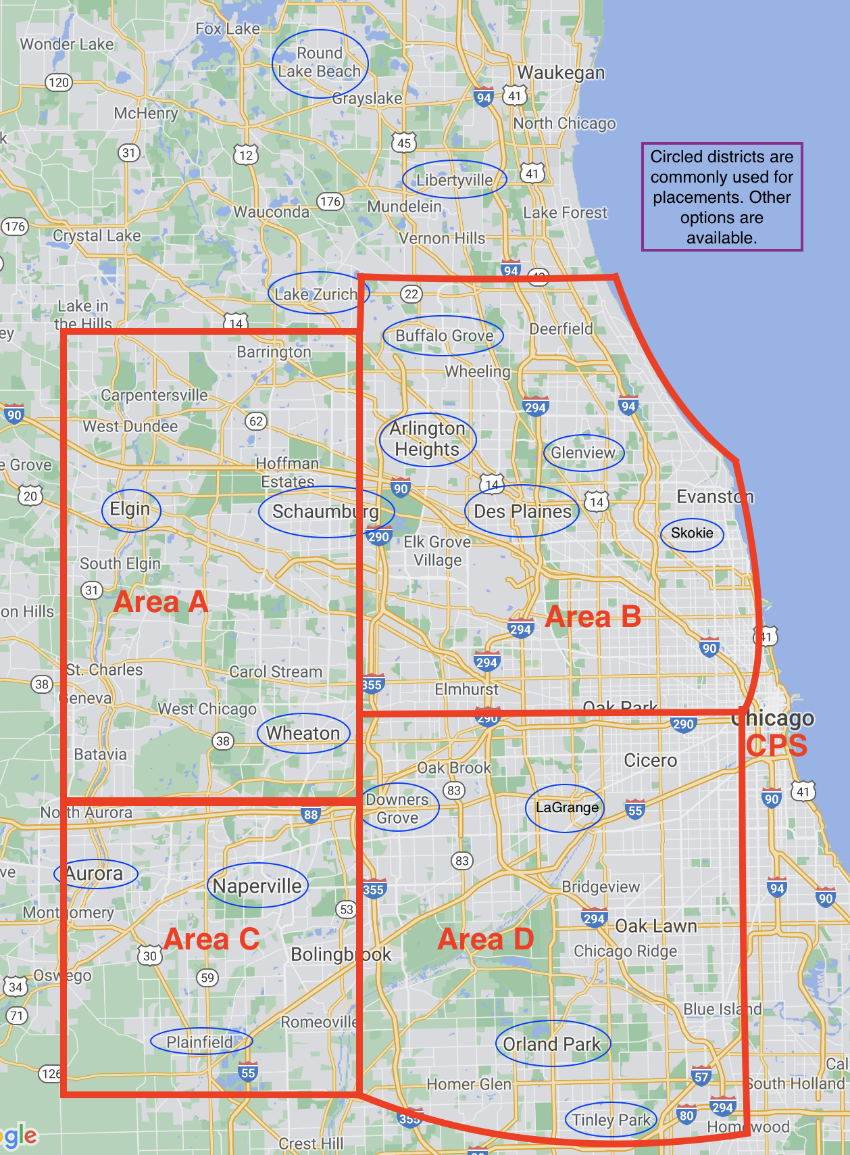
Northern Placement Map (Student Teaching Only)

Slide 21
If you have concerns
COMMUNICATE! We are all here to support you in your journey!
Start with instructors/cooperating teachers/supervisors
If you need further assistance, talk to your support team or Sue, your Academic Advisor, the program Coordinator, Scott Filkins, or Assistant Dean, Kelli Halfman. Your team can only help when they’re made aware of a situation!
Please note that Dr. Mouza, Dean of the College of Education oversees the general functioning of the college and is not directly involved in individual student issues. Please refrain from contacting her with concerns.

Slide 22
Helpful Hints
Plan to make an excellent first impression in your placements. Professional behaviors, such as maturity, good hygiene, clothing appropriate to the setting, and positive communication are critical.
Lock down your social media!!
If you work during the semester – you need to plan your hours around your courses and your placement requirements. Holding a job during your last semester is very difficult.
Carpooling is often necessary!
If you want to student teach in the Northern suburbs, plan your fall campus housing early.
Make us proud as representatives of the College of Education!

Slide 23
Next Steps
SCE & CoTE
Academic Advising
Complete placement application by March 27 at 5:00 pm
Review SCE and CoTE websites
Complete mandatory orientations and trainings in CoTE portal
stalbott@illinois.edu (Sue)
info@cote.illinois.edu (CoTE)
Run a Degree Audit to check for outstanding requirements
Complete gateway petition (if applicable)
Keep advisor aware of any changes prior to making them (dropping class, summer classes, etc.)
Register according to time ticket
Read Through and Acknowledge Teacher Candidate Contract

Slide 24

Questions?
You will receive these slides in an email with relevant links and action items to complete.

