Slide 1
Cooperating teacher orientation
Fall 2025
EDPR420
Year 2 Early Childhood Candidates

Slide 2
Welcome!
Introductions
  Dr. Cara Gutzmer, Director of School and Community Experiences
  Sue Talbott, Clinical Experiences Specialist
  Danielle Galardy, Office Manager
  Supervisors!
  Use the chat to tell us your school and how many years you've been teaching! If you are a returning cooperating teacher, how many past candidates have you mentored?

Slide 3
agenda
Welcome
Placement Sequence
Expectations – Professional
Expectations – Academic
Giving Feedback
Evaluations
Tuition Waivers
Questions

Slide 4
Placement sequence
Year 1 – Fall – Infants and Toddlers at Child Development Lab on campus
Year 1 – Spring – Primary placement (K-2)
Year 2 – Fall – Preschool
Year 2 – Spring – STUDENT TEACHING!
  Most candidates student teach in kindergarten

Slide 5
Attendance
August 25-December 5
Weeks 1-6:
  M-Th
  Start of school day (contracted hours) until noon-ish
  Candidates with a commute might need to leave a little early to make it back to campus for class
  FOUR HOURS each day
Weeks 7-14
  M-F
  Start of school day (contracted hours) until noon-ish
  FOUR HOURS each day

Slide 6
absences
Candidates are allowed two excused absences that do not need to be made up.
These are reserved for illness, emergencies, and other urgent situations.
Career Day is Thursday, November 6 – excused absence
Other absences must be made up during finals week
If your district has a fall break, this time does not need to be made up

Slide 7
Paired placements
THANK YOU!!!
Same mentor, schedule observations as efficiently as possible
Collaborate on THE PROJECT
Help them decide which children would be a good fit for other assignments

Slide 8
Professional expectations
Promptness
Mature and appropriate attire and hygiene
Communication
Engagement
PLEASE REVIEW THE SCHOOL'S EXPECTATIONS REGARDING DRESS, CELL PHONES, ETC. Be specific and clear. Candidates want to know the rules!
PROFESSIONAL BEHAVIOR CHECKLIST

Slide 9
Academic expectations
Four observations
Midterm/Final evaluation
Course assignments
Content test
Project
Placement Guide

Slide 10
Trauma-informed practices
Intentional push to incorporate the following best practices into their coursework and field placements:
  Build relationships
  Create a safe and predictable environment
  Teach self-regulation strategies
  Candidates may need lots of support and feedback about managing the classroom and deciding on logical, consistent, and fair consequences.

Slide 11
Giving feedback
Cooperating teachers submit weekly written feedback – usually emailed to/shared with candidate and supervisor. Any format is acceptable.
Paired placements – please be discreet and confidential in your feedback to each candidate.

Slide 12
evaluations
Observation feedback
Weekly feedback
Midterm/Final
  Portal: https://cote.illinois.edu/cote-portal-access
Support plans
PLEASE INFORM CANDIDATE OF ANY CONCERNS

Slide 13
supports
Disposition Concern Form
Remediation Plan
Professional Growth Plan

Slide 14
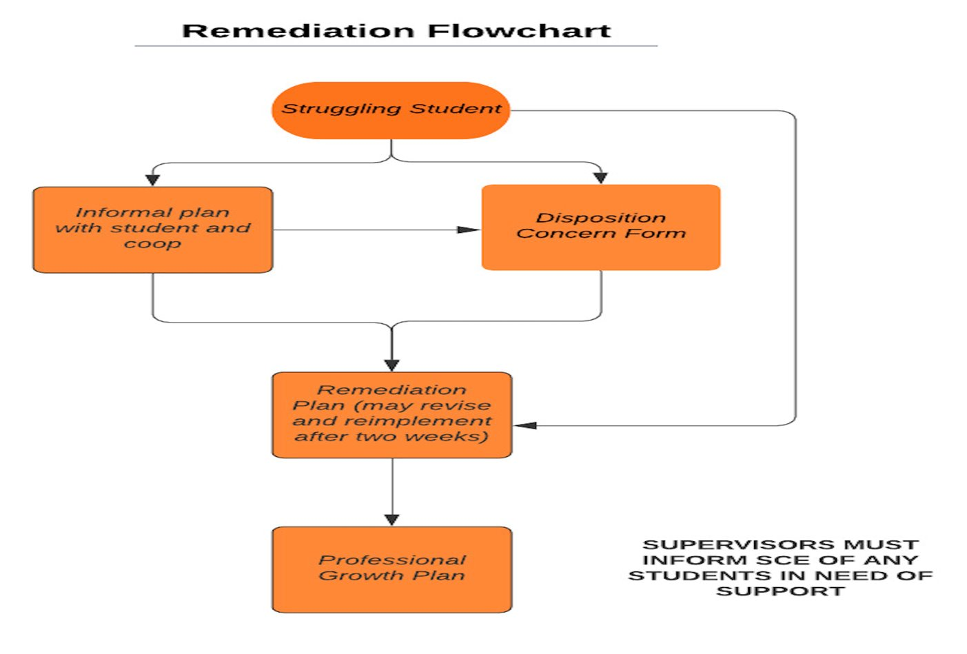

Slide 15
The supervisor
Role, responsibility
Communication
Observations (4)
Midterm/Final

Slide 16
Immediate actions to welcome your candidate
Exchange contact information (set boundaries!)
Show them where to put their belongings
Tour the school
Introduce them to staff
Teach them how to access your online curriculum and classroom
Ask them to plan to introduce themselves to the students in a creative way
Post their name on the board/Give them a nametag
Be clear and specific about what you would like them to do the first few days and weeks
Review expectations regarding arrival/departure, dress, cellphone use, etc.

Slide 17
Tuition waivers
Non-degree vs. Master’s/Endorsement/Doctoral
Contact Council on Teacher Education with questions!
  cote-waivers@illinois.edu
  https://cote.illinois.edu/cooperating-personnel-supervisors/cp-tuition-fee-waivers
Waiver Information (from SCE website)
  If you are intending to use a Cooperating Teacher Waiver to complete an online degree through the College of Education, you must contact both Jena Pfoff (jrooseve@illinois.edu) and Linda Stimson (ls9@illinois.edu) after submitting your application to the Graduate College in order to utilize the Cooperating Teacher Waiver. Your subject line should read, “Cooperating Teacher Waiver – Online Program."
  https://cote.illinois.edu/cooperating-personnel-supervisors/cp-tuition-fee-waivers

Slide 18
resources
SCE: https://sce.education.illinois.edu/
Portal: https://cote.illinois.edu/cote-portal-access
Email Sue directly:
  stalbott@illinois.edu

Slide 19

Can you help?

Slide 20

Questions?

