Slide 1
EDPR250 orientation
School and Community Experiences
College of Education
Year 2 Fall Placements - ELED

Slide 2

Welcome!

Slide 3
agenda
Welcome!
People and places to know
Content test
Fall placements
Danielson
The supervisor’s role
Student teaching update
Wrapping up this semester
Action items
Questions

Slide 4
Celebrations!
  In the chat, describe briefly how your cooperating teacher effectively gets the class’s attention.
  ATTENTION SIGNALS are one of the many basic competencies we will look for in the fall. Steal all the ideas you can! ☺

Slide 5
websites
Helpful resources:
  Websites:
    http://sce.education.illinois.edu (School and Community Experiences)
    https://cote.illinois.edu (Council on Teacher Education)
    sce@education.illinois.edu (email to contact our office)
    There will also be a Canvas site for the class

Slide 6
People to know
      Dr. Cara Gutzmer, Director, School and Community Experiences
      Sue Talbott, Clinical Experiences Specialist, School and Community Experiences
      Danielle Galardy, Office Manager, School and Community Experiences
      Robin Craig, Licensure Officer, Council on Teacher Education
      Dr. Scott Filkins, Program Coordinator
      Kami, Alex, Rebekah – advisors
      Dr. Wei Liu and Dr. Jacob Minniear - Study Abroad

Slide 7
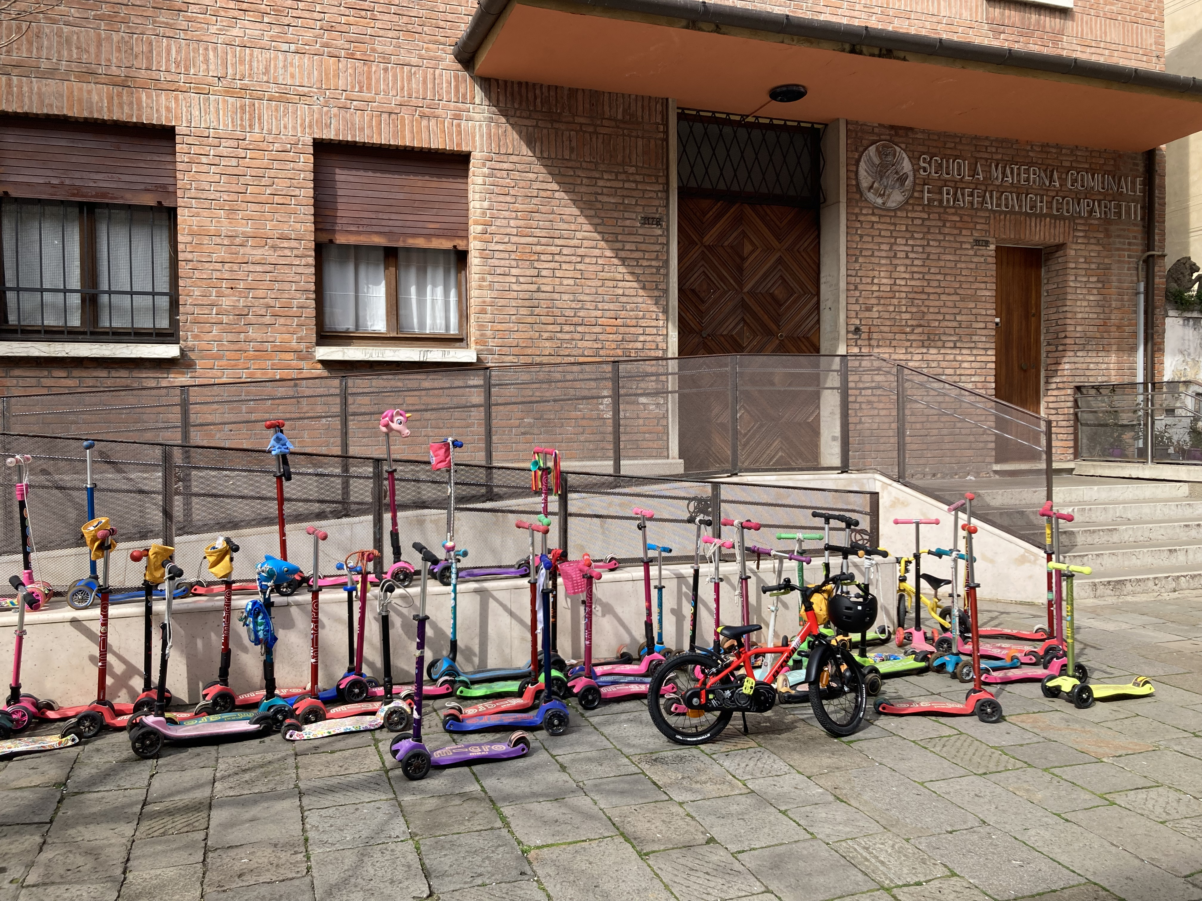
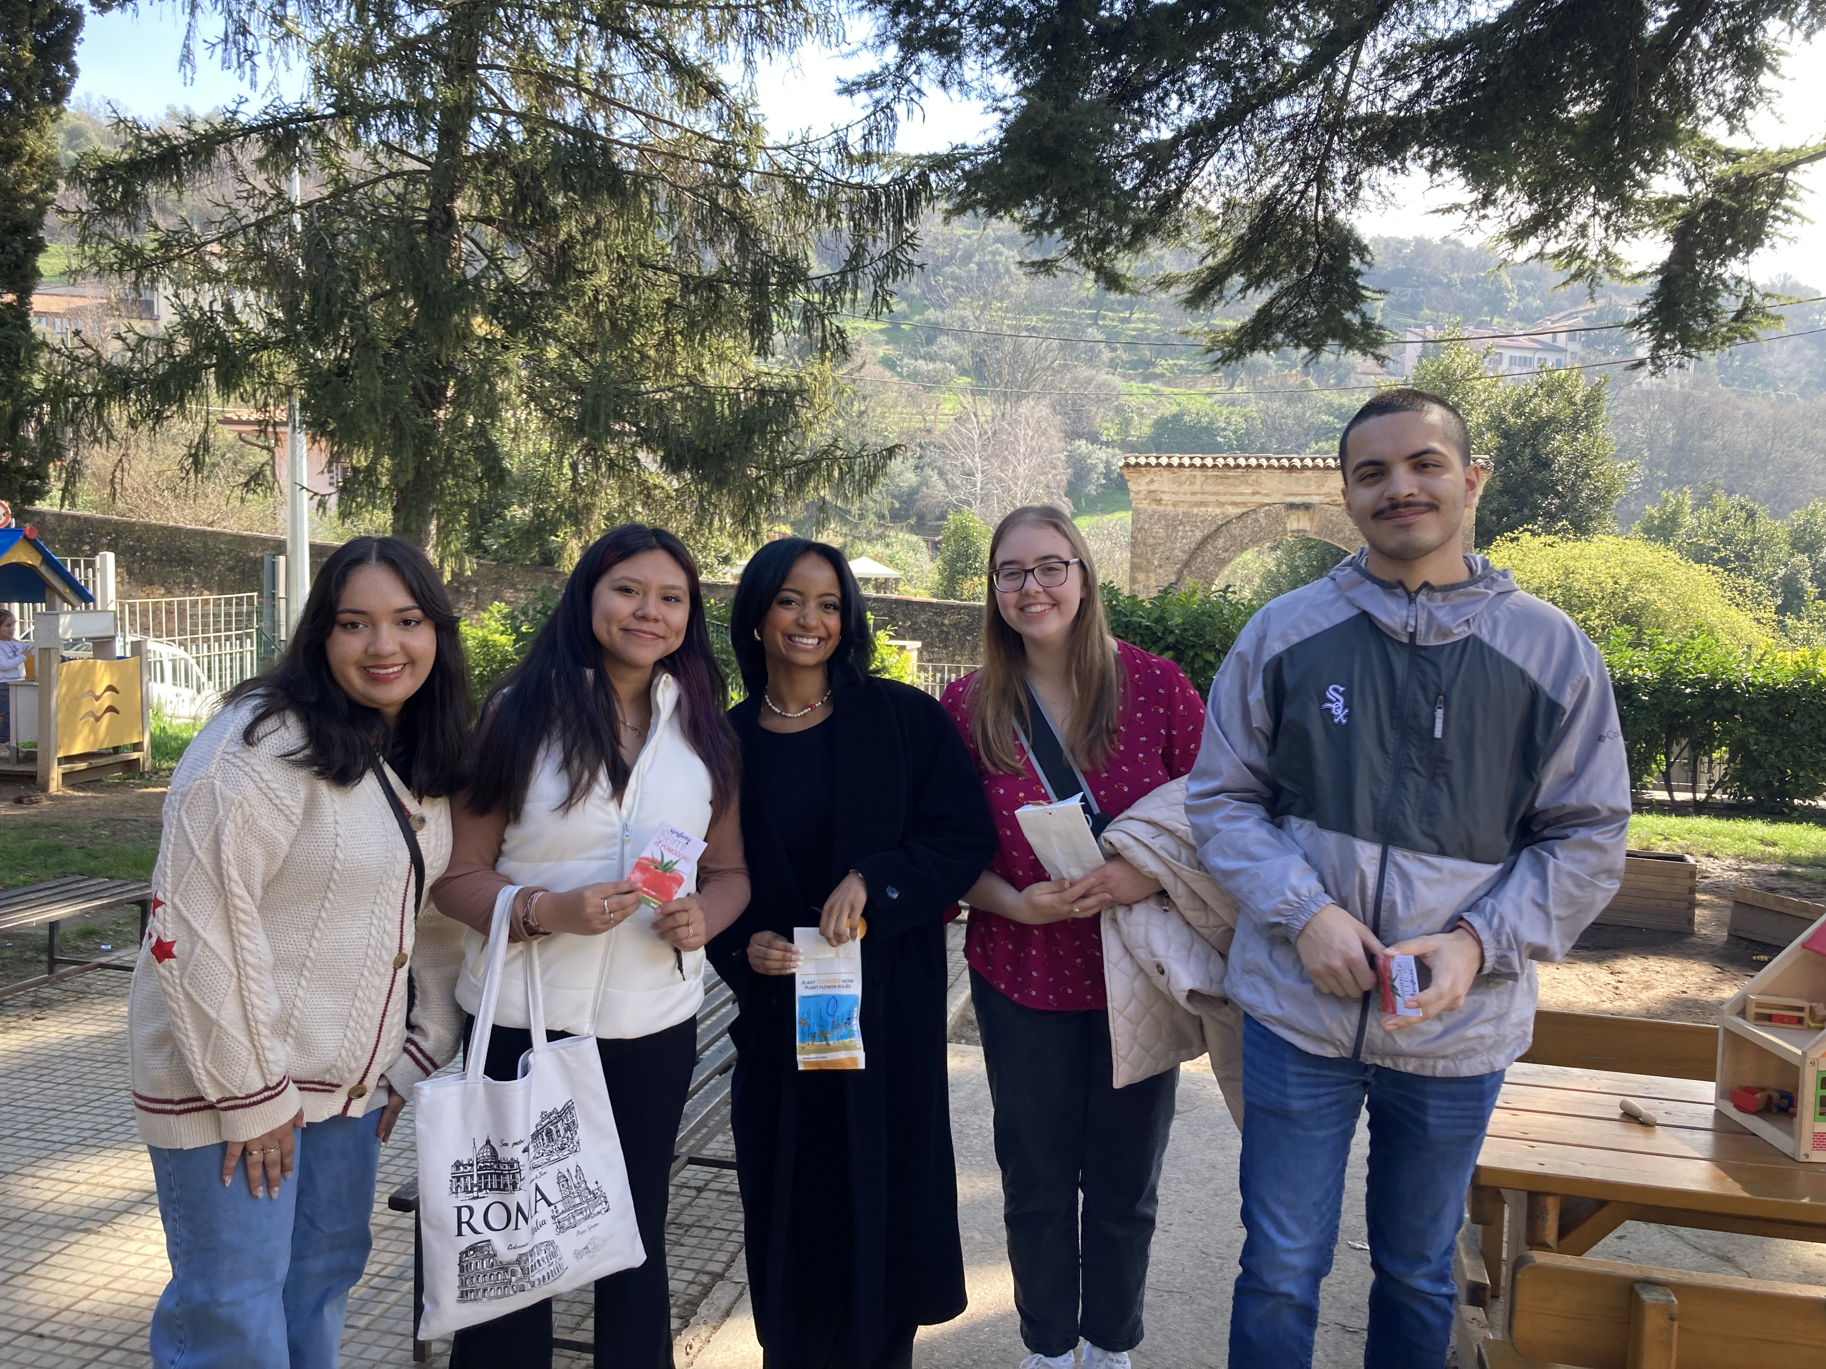
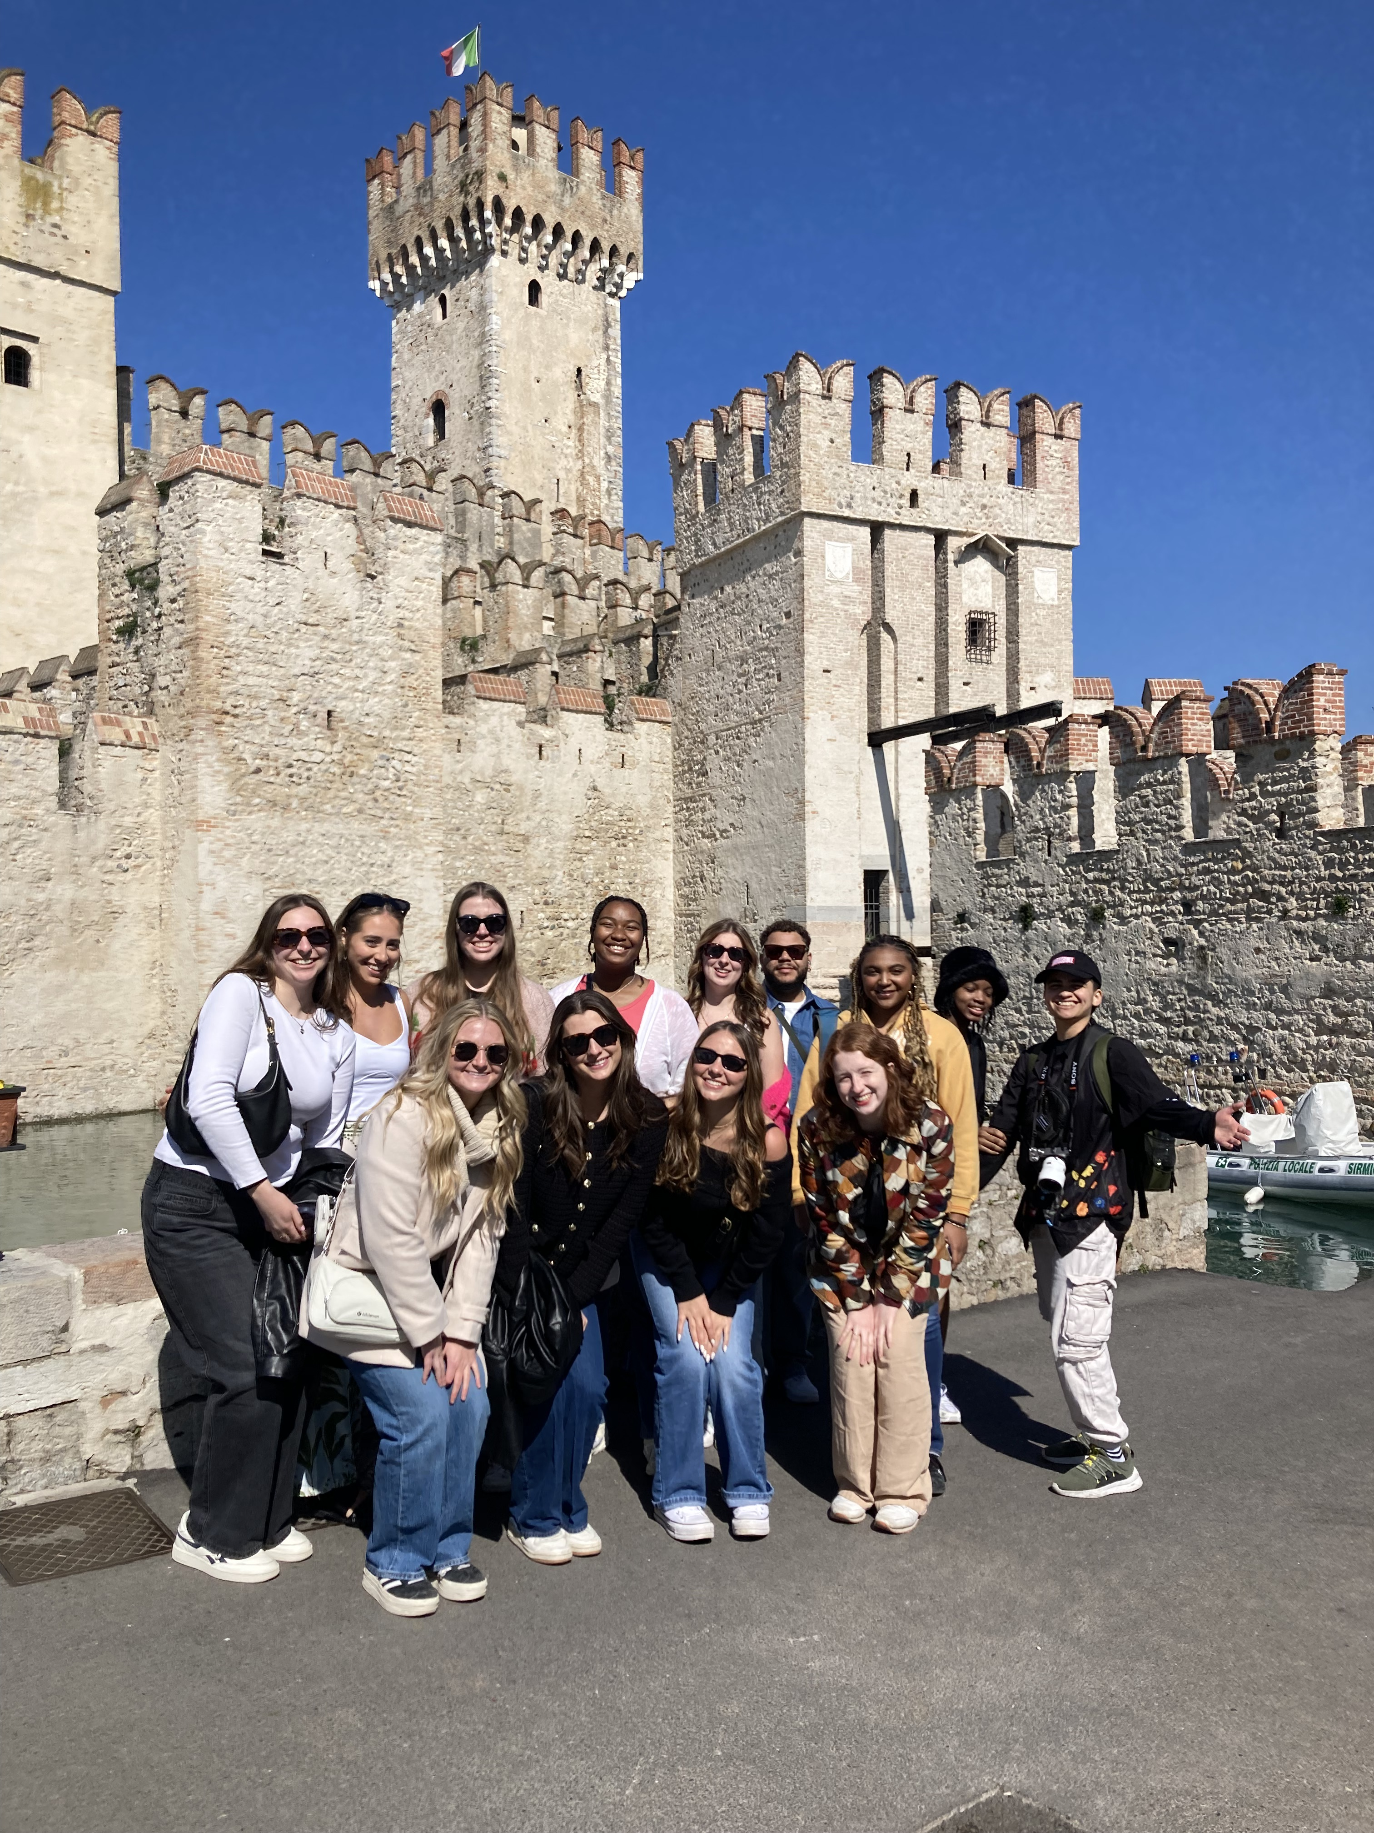
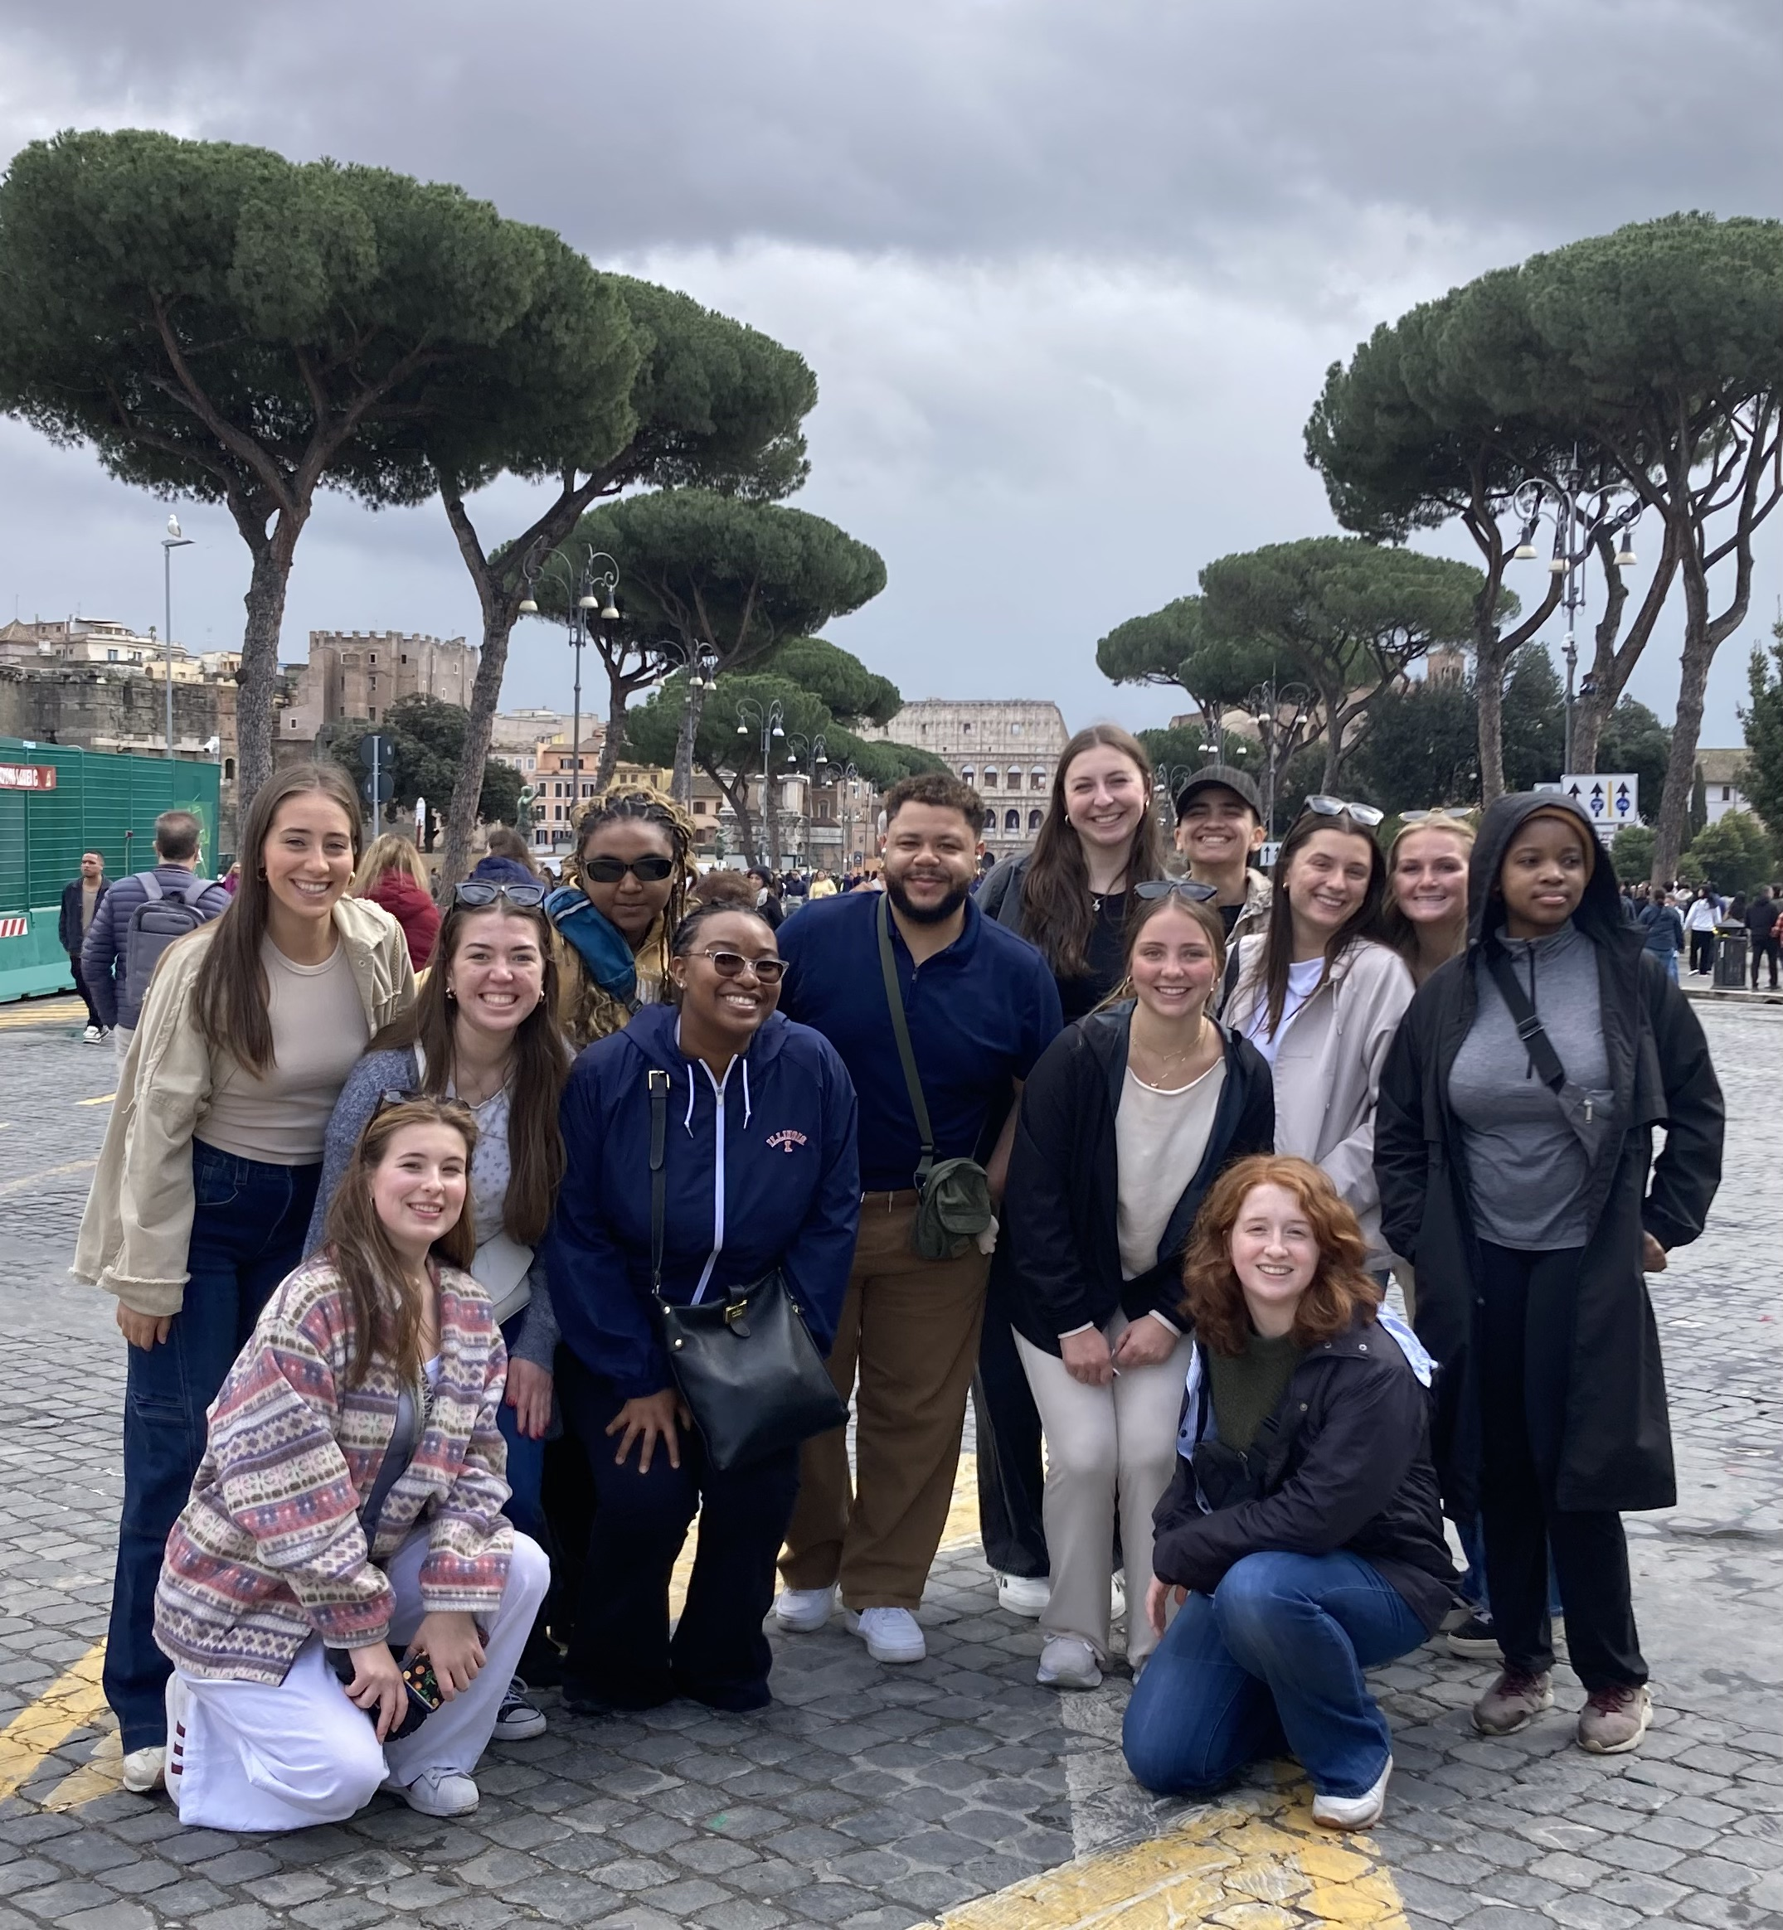
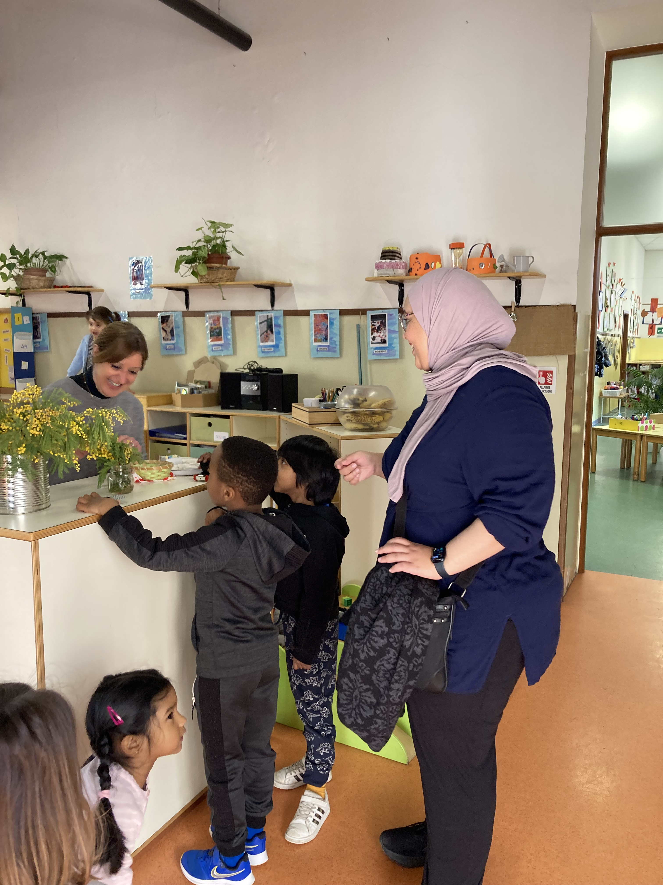
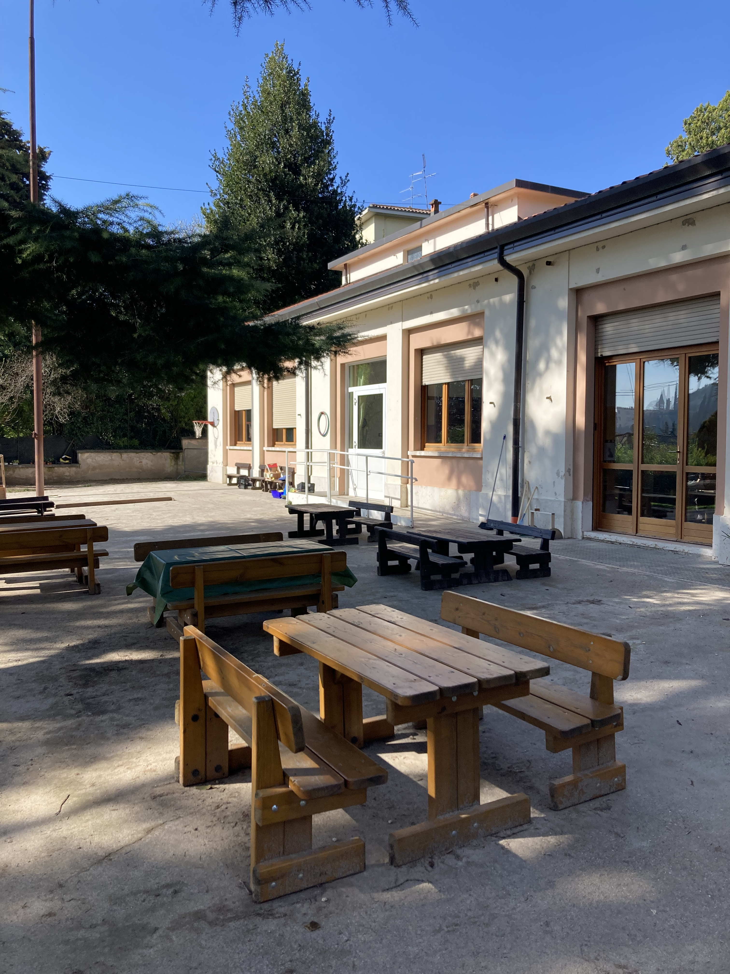
Teach abroad!!!
Dr. Jacob minniear

Slide 8
Content test: CHECK YOUR EMAIL!
Practice test vouchers expire april 15!!!!!
https://www.il.nesinc.com/TestView.aspx?f=HTML_FRAG/IL305_TestPage.html
Elementary (305)
Accommodations – GET YOUR DOCUMENTATION IN ORDER!
Register to take the test by September 1st.
You should pass the test by December 15 in order to begin student teaching in January

Slide 9
About fall placements….
Sent Friday, April 18 at 3pm
Grade level considerations
Everyone will be in a classroom – no intervention or ESL support placements.
Think about how you will build a great relationship with your supervisor and cooperating teacher.
CARPOOL!!!!!

Slide 10
Fall placements
Three mornings plus one full day
Complete a VERY supported “mini-takeover” in November
Friday morning (8am!) seminar
PES class Friday 9am-noon
Start Monday, August 25, ends Wednesday, December 10
Two excused absences for illness and emergency – you must let your coop and supervisor know!
All students can expect to travel at some point their senior year
Great opportunity to see a variety of schools!
We want to give you a diverse range of experiences
CARPOOL to save money and make friends!
Must complete BBP training and background check prior to your August start date

Slide 11
Professional behaviors
Checklist: Available on SCE website for your reference.
Punctuality
Professional dress – no sweats, no logos, dress modestly
Communication
Relationship with cooperating teacher and supervisor
Here are some actual quotes from cooperating teachers and supervisors:
  "My student teacher is a BLESSING. I don't know what I would do without her!"
  "EM is an incredible asset to our school. She is making my job easier! I feel like she's more like my co-teacher than a student!"
  "We are having so much FUN together!"
  "JP has stepped up in every way possible. He shares data during referral meetings, is fearless in his interactions with some of our hard-to-reach students, and is active and 'present' every day."
  “They are teaching me SO MUCH! I feel so rejuvenated and excited to teach! I will be at a loss when they leave. Can I keep them???”

Slide 12
Planning ahead
You will be TIRED! It takes time for your body and mind to adjust to the new hours and expectations. Your stamina will build over time.
You may not have very much time between placement and class. Pack a lunch and something to drink. Pack any meds or personal items you may need.
Good communication matters! Our support options are best if you tell us your needs!

Slide 13
Your supervisor
You are assigned a university supervisor who will teach your Friday seminar
Four observations (pre/post conference)
Midterm/Final evaluation
They will be your best support/coach/mentor!
Often initiate support plans

Slide 14
What if you have concerns?
Please respect the protocols for addressing issues. Dean Mouza is responsible for the overall functioning of the College of Education and does not generally get involved in student issues unless they are very, very serious.
Course issues? -> Instructors
Registration issues? -> Advisors
Placement issues? -> School and Community Experiences
Licensure issues? -> Council on Teacher Education
We can also direct you to campus resources as needed. We are here to help!

Slide 15
Student teaching updates
Northern placements
  Might have to interview
  Take this process VERY SERIOUSLY
  Placement confirmation comes from SCE, not from the district
  All placements will be announced in late November
  You follow the calendar of the district to which you are assigned!
  Placements begin January 5

Slide 16
Wrapping up the semester
(checklist will be sent)
Upload your two observation feedback forms to Canvas by Friday May 9 at 5pm (Many of you have already done this. Good job!)
Enter your hours on the timesheet on COTE
Remind your cooperating teacher to complete your final evaluation (COTE)
Complete the cooperating teacher evaluation on COTE
If you are pursuing an endorsement, ask your cooperating teacher to write a letter to verify your hours.
  You will submit that letter to Robin Craig (rcraig@Illinois.edu) at COTE.
  THE LETTER MUST BE ON SCHOOL LETTERHEAD OR COME FROM THE TEACHER’S SCHOOL EMAIL
Please send an email or write a note to your cooperating teacher to say thank you for hosting you ☺
Send an introductory email to your fall cooperating teacher
Background checks, BBP
Have a safe and wonderful summer break!

Slide 17
A few more things...
Check everything off the end of the semester list (posted on Canvas next week!)
Respond quickly and professionally to any outreach from northern districts
Wait patiently for fall placement information and take care of everything immediately for a smooth start in August.
Register for the content test
Do not freak out ☺

Slide 18


Questions

