Slide 1

us

Slide 2


Title
WELCOME!

Slide 3
Title
Introduction
School and Community Experiences (SCE)
120 Education
Dr. Cara Gutzmer, Director
Sue Talbott, Clinical Experiences Specialist
Danielle Galardy, Office Manager

Slide 4
A bit about me….Sue Talbott
(Call me Sue, please)
Professional
Personal
UIUC Alum ☺
Bachelor of Arts in American Studies
Master of Education in Special Education
Licensed in elementary ed, special ed
Teacher
Clinical supervisor
Higher Ed administration
Special interest in trauma-informed practices, teacher wellness, literacy instruction
Hometown: Barrington, IL
Current home: Champaign
Family of 5, plus a dog, two cats, and a bearded dragon
I love: traveling, cooking, and being outside
I hate: surprises (seriously)

Slide 5
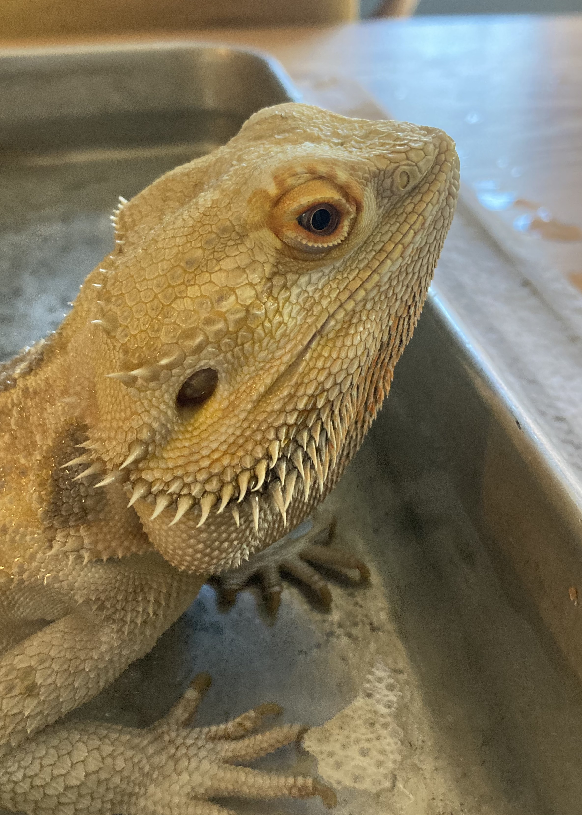
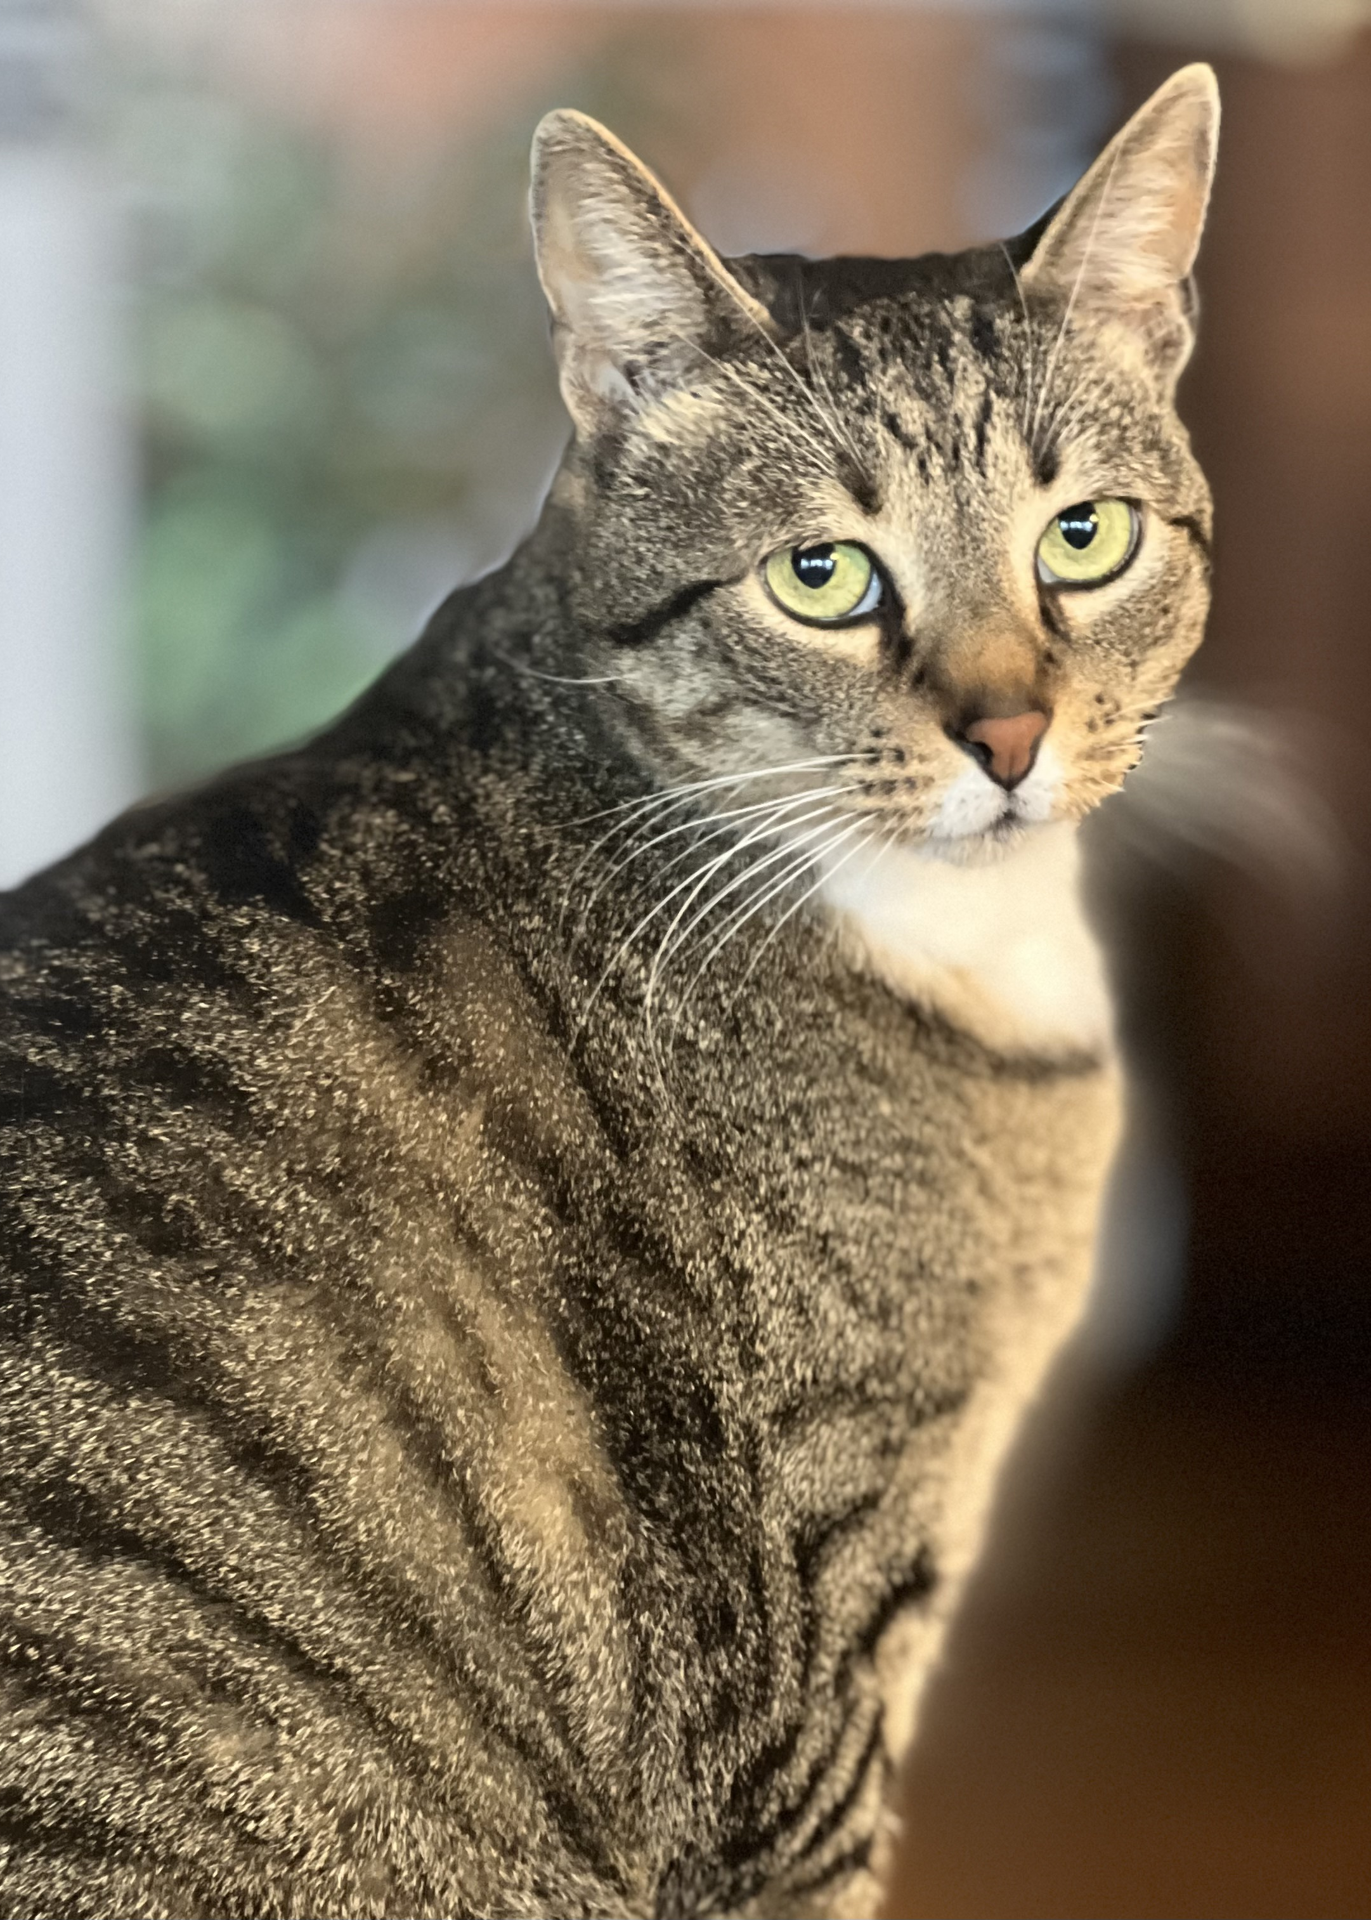
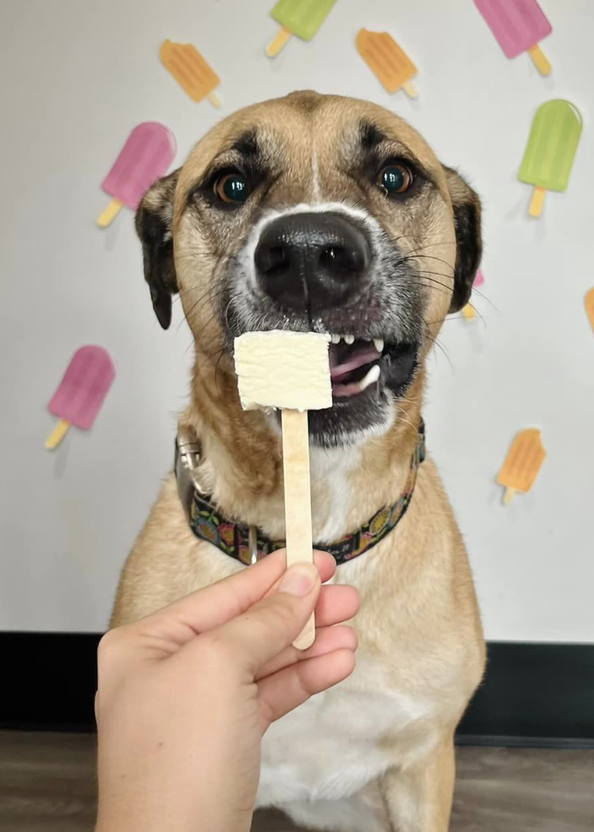
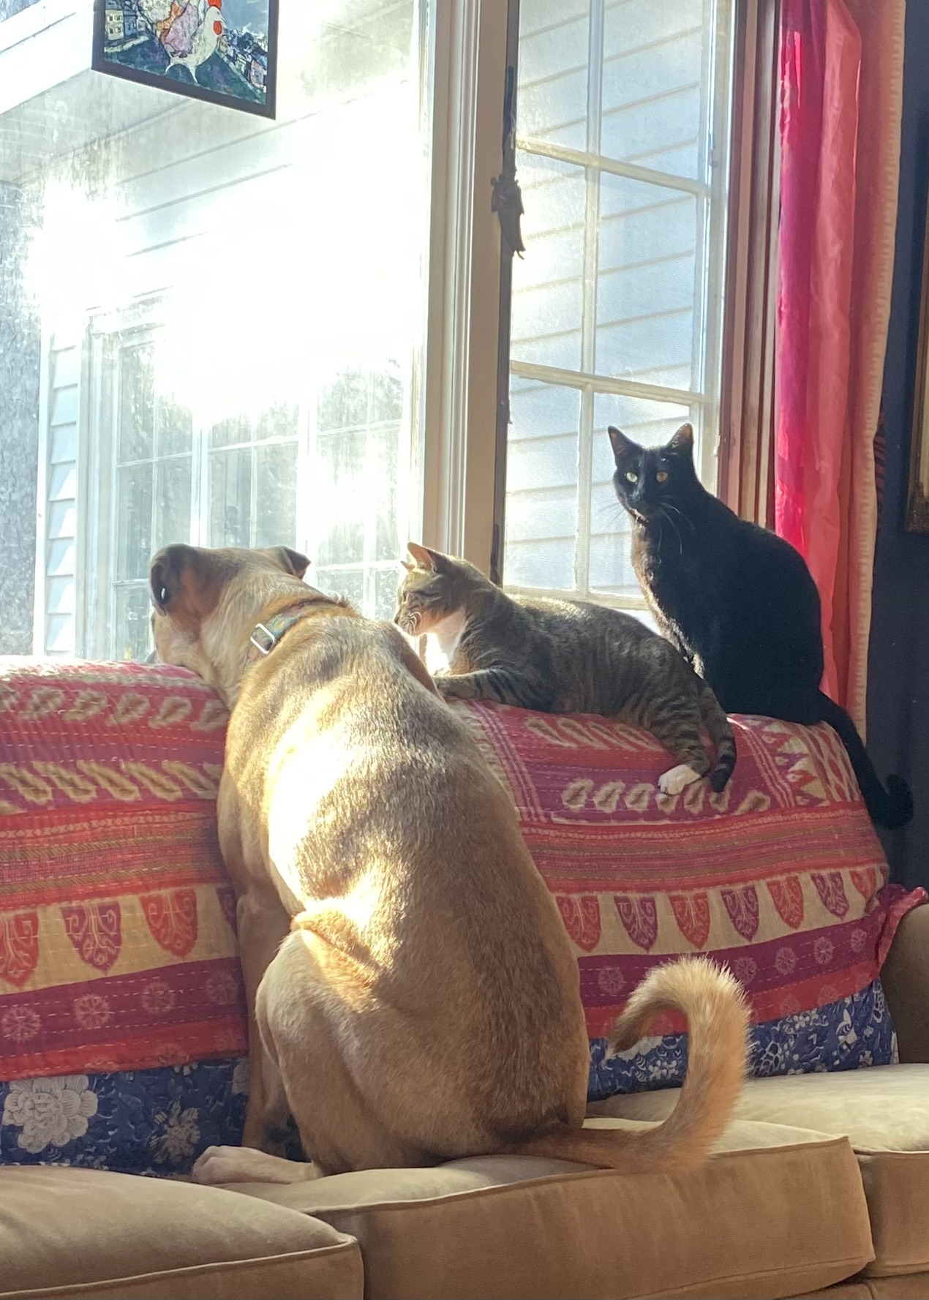
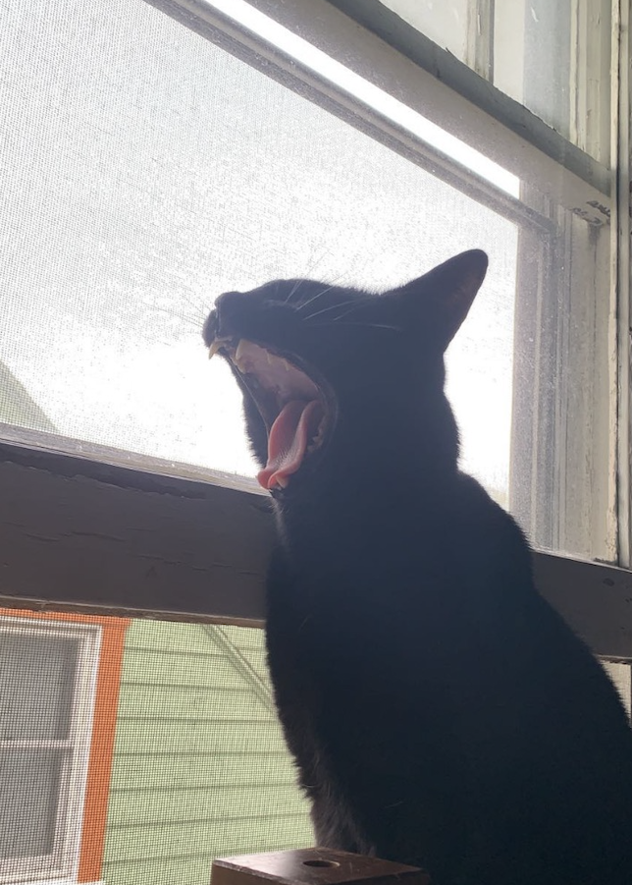
PETS are the BEST!
(let’s try a turn and talk)

Slide 6
Title
AGENDA
The Placement
Professional Behavior
The Portal
The Website
Expectations
Questions

Slide 7
Title
THE PLACEMENT
WELCOME TO THE PES!
Three hours per week – all semester long
Week 2 – Week 15
No placement during Fall Break or finals week
Wide range of locations and types of schools
Cooperating teachers (coops) host 2-3 candidates

Slide 8
Title
Looking Ahead…
Spring 2026: One full day – Tuesday OR Thursday
Fall 2026: Three half days, one full day
Spring 2027: STUDENT TEACHING! All day, every day! You will follow your district’s calendar and start in early January.
Are you teaching abroad? You’ll stay in your fall placement and hit the road when spring break starts and return in time for graduation!

Slide 9
Title
PROFESSIONAL BEHAVIOR
YOUR REPUTATION STARTS ON DAY 1!!!
Clean up your social media settings (PRIVATE)
Punctuality (10 minutes early is right on time!)
Communication (Be respectful of personal boundaries)
Dress and hygiene
Cell phones

Slide 10
Title
PROFESSIONAL BEHAVIOR
If you need to be absent, please let your cooperating teacher know right away.
Missed hours can be made up during finals week.
Show up when you are supposed to show up and make up all your absences and you will have enough hours.
I am in communication with cooperating teachers and often work to develop support plans for candidates who are struggling to meet expectations.

Slide 11
Title
THE PORTAL
https://cote.illinois.edu/cote-portal-access
Trainings
Hours
ESL/bilingual hours: ASK:
Does this school have an ESL program?
Do you have ESL students in your class?
Is there an ESL teacher in the building?
Would it be possible for me to meet this person?
  Your coop or the ESL teacher will write you a letter at the end of the semester to verify your hours working with ESL students and using ESL strategies. You will submit this to CoTE for approval.

Slide 12
Title
THE WEBSITE
https://sce.education.illinois.edu/
Forms
Presentations
Professional Behavior Checklist

Slide 13
Title
EXPECTATIONS
Present yourself in a positive and professional manner
Show up on time, plan to introduce yourself to your students, and be an active participant in the classroom. Don’t spend your time sitting in the back! That’s boring!
Communicate with your coop about assignments/observations in a timely manner, especially if you are in an intervention setting.
CI 405 requirements – placement is part of the deal
If you need to be absent, let your coop know and make a plan to make up the hours
Ask questions! Have fun! Learn a lot!

Slide 14
Title
QUESTIONS?
USE YOUR RESOURCES!
I am your placement person, so email me or stop by if you need anything!

Slide 15


Slide 16


