Slide 1
Cooperating teacher orientation
Fall 2025
CI 405
Year 1 Elementary Education Candidates

Slide 2
Welcome!
Introductions
  Dr. Cara Gutzmer, Director of School and Community Experiences (SCE)
  Sue Talbott, Clinical Experiences Specialist
  Danielle Galardy, Office Manager
  Pop in the chat and tell us your school and grade level. If you're a returning cooperating teacher, how many candidates have you mentored in the past?

Slide 3
agenda
Welcome
Course sequence
Expectations – Professionalism
Expectations – Academic
Giving feedback
Evaluations
Questions?
Tuition waivers

Slide 4
Course sequence –year 1
Courses
Placements
Intro to Teaching
Children's Literature
Methods
    Math
    Language Arts – Part 1
    Science
    Social studies
    Music/Art/Dance
Fall
  3 hours per week
Spring
  1 full day per week

Slide 5

Course sequence – Year 2
Courses
Placements
Special Education
Action and Inquiry
Methods
  Language Arts – Part 2
Theory and Practice (fall and spring)
Seminar
Fall
  Three mornings
  One full day
  No placement on Fridays
Spring
  STUDENT TEACHING
  All day, every day!

Slide 6
Professional expectations
Promptness
Mature and appropriate attire and hygiene
Communication
Engagement
PLEASE REVIEW SCHOOL EXPECTATIONS on the first day. Talk about dress code, cell phone use, arrival, departure, etc. Be specific. Candidates want to know the rules!
PROFESSIONAL BEHAVIOR CHECKLIST

Slide 7
Academic/Placement expectations
Teach two lessons and ask cooperating teacher for written feedback
Final evaluation
Course assignments
Build relationships
Be an active participant
Enhance instruction and the classroom environment

Slide 8
INterventionists
Thank you for hosting!!!
Candidates will have course work that target content areas outside of your position. PLEASE help them connect with classroom teachers and/or discuss options for completing their assignments.

Slide 9
Trauma-informed practices
Intentional push to incorporate the following best practices into their coursework and field placements:
  Build relationships
  Create a safe and predictable environment
  Teach self-regulation strategies
  Candidates may need lots of support with and feedback about managing the classroom and deciding on logical, consistent, and fair consequences.

Slide 10
Giving feedback
Candidates need LOTS of positive feedback and encouragement.
Observation form: https://docs.google.com/spreadsheets/d/1Pd4TErdIoqjaSQOjXJyvE7dXFC-bR-vhd02Lt-d3Pps/edit?gid=0#gid=0
I will send the Professional Behavior Checklist via email around Week 5 to remind you to complete and share with candidate

Slide 11
evaluations
Observation feedback
Final
  Portal: https://cote.illinois.edu/cote-portal-access
Support plans – CONTACT SUE!
PLEASE COMMUNICATE CONCERNS TO THE CANDIDATE.

Slide 12
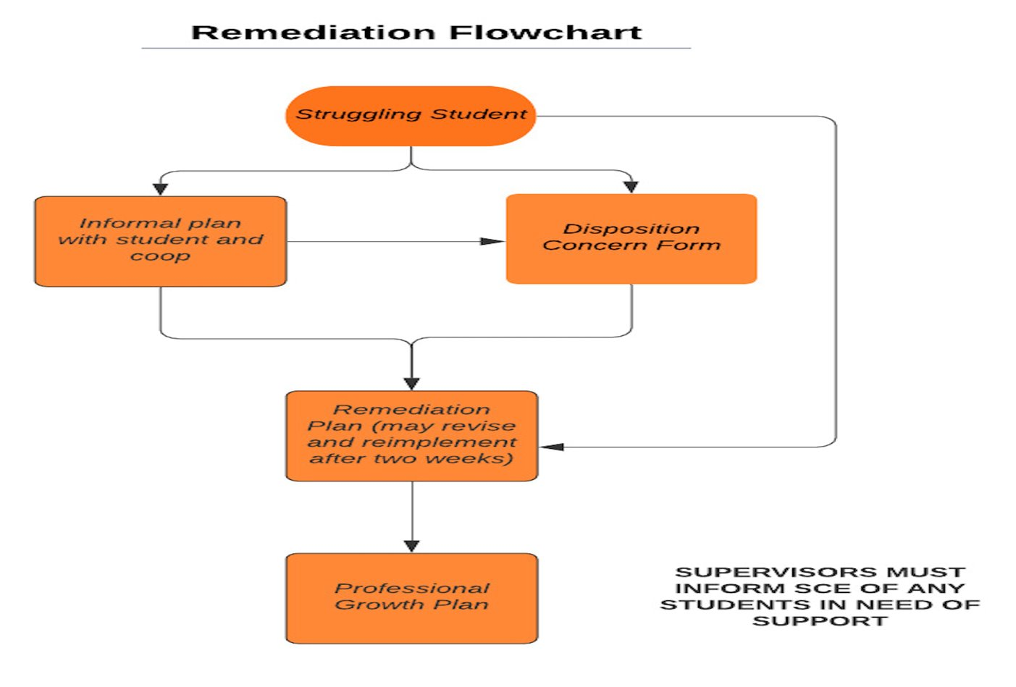

Slide 13
Immediate actions to welcome your candidate
Exchange contact information (set boundaries!)
Show them where to put their belongings
Tour the school (have a student show them around!)
Introduce them to staff
Teach them to access your online curriculum and classroom
Ask them to plan to introduce themselves to the students in a creative way
Post their name on the board
Be clear and specific about what you would like them to do. They should be active, helpful, and engaged!
Review expectations regarding dress, cell phone use, arrival, departure, etc.

Slide 14
Tuition waivers
Non-degree vs. Master’s/Endorsement/Doctoral
Contact Council on Teacher Education with questions!
  cote-waivers@illinois.edu
  https://cote.illinois.edu/cooperating-personnel-supervisors/cp-tuition-fee-waivers
Waiver Information (from SCE website)
  If you are intending to use a Cooperating Teacher Waiver to complete an online degree through the College of Education, you must contact both Jena Pfoff (jrooseve@illinois.edu) and Linda Stimson (ls9@illinois.edu) after submitting your application to the Graduate College in order to utilize the Cooperating Teacher Waiver. Your subject line should read, “Cooperating Teacher Waiver – Online Program."
  https://cote.illinois.edu/cooperating-personnel-supervisors/cp-tuition-fee-waivers

Slide 15
resources
SCE: https://sce.education.illinois.edu/
Portal: https://cote.illinois.edu/cote-portal-access
Course assignment grid and placement summary will be emailed to you
Email Sue directly:
  stalbott@illinois.edu

Slide 16

It's never too soon.....

Slide 17

Questions?

