Slide 1
COOPERATING TEACHER ORIENTATION
Fall 2024
EDPR 250
Year 2 Candidates

Slide 2
AGENDA
Welcome
Course sequence
Expectations – Professionalism
Expectations – Academic
Giving feedback
Evaluations
Tuition waivers
Questions?

Slide 3
WELCOME!
Introductions/People to Know
Dr. Cara Gutzmer, Director of School and Community Experiences
Sue Talbott, Clinical Experiences Specialist
Danielle Galardy, Office Manager
Supervisors ☺
You'll meet your person when the semester starts!
Share your name, school, grade, and how many candidates you've worked with over the years in the chat

Slide 4
COURSE SEQUENCE –YEAR 1
COURSES
PLACEMENTS
Intro to Teaching
Children's Literature
Methods
Math
Language Arts – Part 1
Science
Social studies
Music/Art/Dance
Fall
3 hours per week
Spring
1 full day per week

Slide 5
COURSE SEQUENCE – YEAR 2
COURSES
PLACEMENTS
Special Education
Action and Inquiry
Methods
Language Arts – Part 2
Theory and Practice (fall and spring)
Seminar
Fall
Three mornings, one full day
Four cohorts
No placement on Friday
Spring
STUDENT TEACHING
All day, every day!

Slide 6
PROFESSIONAL EXPECTATIONS
Promptness
Mature and appropriate attire and hygiene
Communication
Engagement
***Candidates are given two excused absences. Absences in excess must be made up.***
***Career Day is Thursday, November 7 – also an excused absence. ***
PROFESSIONAL BEHAVIOR CHECKLIST

Slide 7
BE PROACTIVE!
Have a meeting with your candidate to discuss dress code, cell phone use, arrival/departure times, etc.
If you have multiple candidates in your building, meet as a group so everyone hears the same message.

Slide 8
ACADEMIC EXPECTATIONS
Four observations
Midterm/Final evaluation
Course assignments
Content test

Slide 9
PLACEMENT EXPECTATIONS
Build relationships
Be an active participant
Ask questions
Try new things (WITH YOUR PERMISSION!)
Enhance your classroom environment and instruction

Slide 10
TRAUMA-INFORMED PRACTICES
Intentional push to incorporate the following best practices into their coursework and field placements:
Build relationships
Create a safe and predictable environment
Teach self-regulation strategies
Candidates may need lots of support with and feedback about managing the classroom and deciding on logical, consistent, and fair consequences.

Slide 11
THE SUPERVISOR
Role, responsibility
Communication

Slide 12
GIVING FEEDBACK
Candidates are VERY MUCH in need of reinforcement and positive feedback.
Observation feedback
From observations conducted by the supervisor
Shared with candidate and cooperating teacher
Weekly feedback
Supervisor will discuss this at the opening meeting

Slide 13
UNEXPECTED NEGATIVE FEEDBACK (IT'S AWKWARD FOR EVERYONE)
"I have some feedback for you, and it may be uncomfortable. I feel a bit uncomfortable myself, but I care about you and your development more than I care about how uncomfortable I feel. So, if you're feeling a little unsure about what to expect here, we are in this together. Can we talk a bit about _____________ ?"

Slide 14
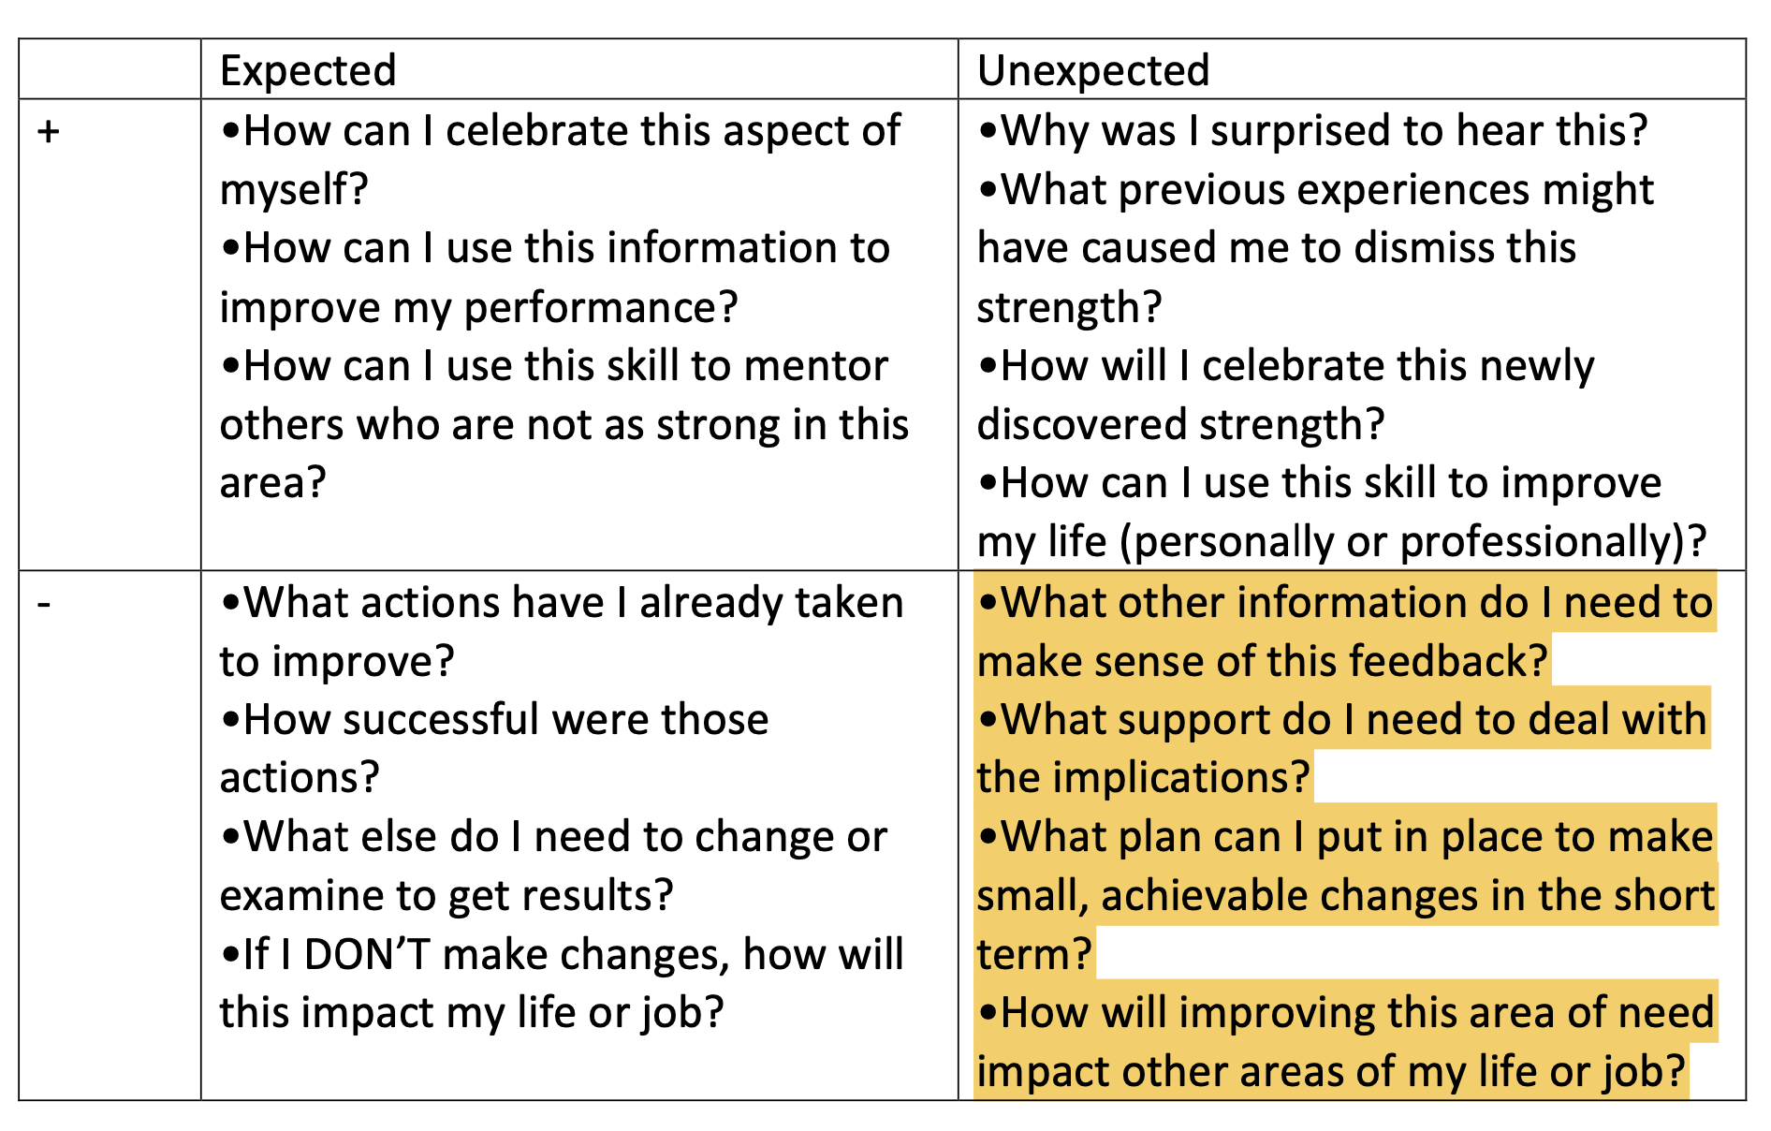

Slide 15
EVALUATIONS
Midterm/Final
Portal: https://cote.illinois.edu/cote-portal-access
Support plans
PLEASE TELL THE CANDIDATE ABOUT YOUR CONCERNS

Slide 16
SUPPORTS
Disposition Concern Form
Remediation Plan
Professional Growth Plan

Slide 17
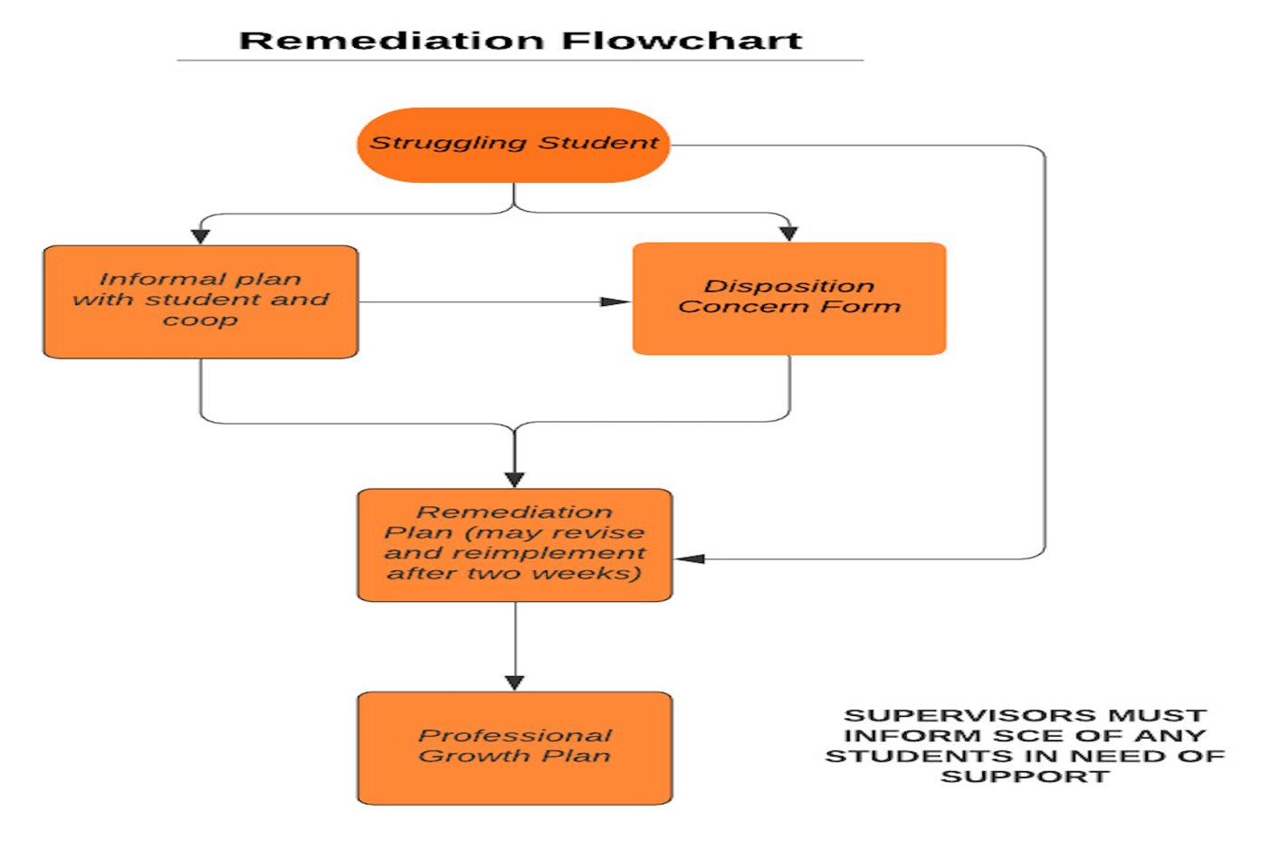

Slide 18
IMMEDIATE ACTIONS TO WELCOME YOUR CANDIDATE
Exchange contact information (set boundaries!)
Show them where to put their belongings
Tour the school (have one of your students show them around!)
Introduce them to staff
Teach them to access your online curriculum and classroom
Ask them to plan to introduce themselves to the students in a creative way
Post their name on the board
Be clear and specific about what you would like them to do the first few days and weeks
TELL THEM the expectations for dress, cell phones, etc.

Slide 19
TUITION WAIVERS
Non-degree vs. Master’s/Endorsement/Doctoral
Contact Council on Teacher Education with questions!
cote-waivers@illinois.edu
https://cote.illinois.edu/cooperating-personnel-supervisors/cp-tuition-fee-waivers
Waiver Information (from SCE website)
If you are intending to use a Cooperating Teacher Waiver to complete an online degree through the College of Education, you must contact both Jena Pfoff (jrooseve@illinois.edu) and Linda Stimson (ls9@illinois.edu) after submitting your application to the Graduate College in order to utilize the Cooperating Teacher Waiver. Your subject line should read, “Cooperating Teacher Waiver – Online Program."
https://cote.illinois.edu/cooperating-personnel-supervisors/cp-tuition-fee-waivers

Slide 20
RESOURCES
SCE: https://sce.education.illinois.edu/
Course assignment grid and placement summary will be emailed to you
Portal: https://cote.illinois.edu/cote-portal-access
Building reps
Email Sue directly:
stalbott@illinois.edu

Slide 21
WE NEED YOUR HELP! *APPLICATION ON SCE WEBSITE*

Slide 22
QUESTIONS?

