Slide 1
Student teaching Resume and cover letter workshop
School and Community Experiences
College of Education
University of Illinois at Urbana-Champaign

Slide 2
Introductions
Dr. Cara Gutzmer, Director of School and Community Experiences (MG, SEC)
Sue Talbott, Clinical Experiences Specialist (ECE, ELED)
Danielle Galardy, Office Manager
While we talk, please type into the chat the one word sums up your feelings
about student teaching. ☺

Slide 3
agenda
Introductions
Overview of the placement process
Student teaching vs. employment resumes/cover letters
Resumes
Cover letters
How to submit
Wrap-up/Questions

Slide 4
*Student teaching REMINDERS*
You must pass the content test prior to student teaching (ISBE rule) and you must attempt the test by September 1st, 2024.
Plan to take this test over the summer.
You will follow your assigned district's calendar
  Start January 6th, 2025
  Spring break may not be the same as UIUC
Travel is often required for student teaching and early field placements
  Carpooling
  Northern – close(ish) to home!

Slide 5
The Process
Timeline
Purpose of resumes and cover letters for student teaching
Northern placements
  IMPORTANT TO KNOW: Each district handles their placements differently. Some do interviews, some let students know they've been placed before SCE makes an official announcement, some ask you to do a background check way in advance of student teaching, etc. Don't compare your placement situation with others. Trust that we will take care of you!
Local placements
Considerations
Notes:
-Process begins a full year prior to student teaching
-Considerations of northern vs. Local placements: housing, "foot in the door" in desired home district, transportation, supervision

Slide 6
The difference between Student teaching and Employment documents
Student teaching documents:
•are general
•do not mention specific districts or schools
Employment documents:
•are highly specific
•are tailored to certain schools and administrators for whom you wish to work

Slide 7
General guidelines
Use clean design – lots of white space, one font, no clip art
Have SEVERAL people proofread your resume! You are representing not only yourself, but also the College of Education with this document
Use action verbs to start your bullet points (see list)
There are lots of templates and other online resources to inspire you
  Try the template gallery on google docs!
Notes:
Candidates have been turned down due to resume/cover letter quality

Slide 8
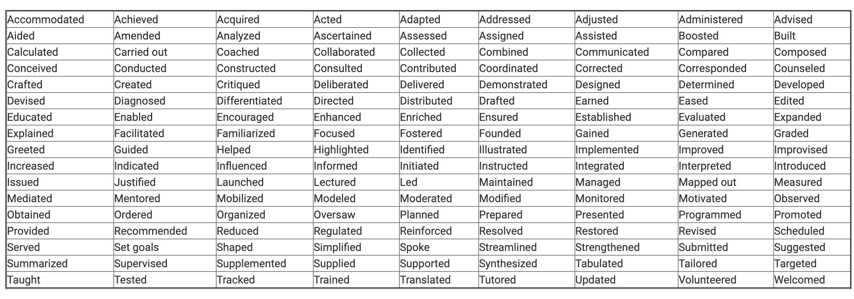
https://careers.uiowa.edu/power-verbs-education-resumes

Slide 9
resumes
A chronological (most recent comes first!) list of educational credentials and employment experiences that are applicable to the job you are seeking.
Education resumes can be two pages.
Objective is optional.
GPA is optional.

Slide 10
headings
1: Personal information
2: Education
3: Related Educational Experience
4: Work Experience
5: Campus Involvement (OPTIONAL)
6: Honors (OPTIONAL)
7: References

Slide 11
Heading 1: personal information
Name, address, contact information
  List campus and permanent address
  Make sure your email is appropriate (make sure it's one you check!)
  Voice message on your phone should be professional
  SIDE NOTE: Lock down your social media!

Slide 12

example

Slide 13
Heading 2: education
If you want to teach close to home, consider including your high school
Graduation can be called “expected graduation date”
Expected licensure is “Professional Educator License”
List expected endorsements as well
Secondary – list major and minor

Slide 14
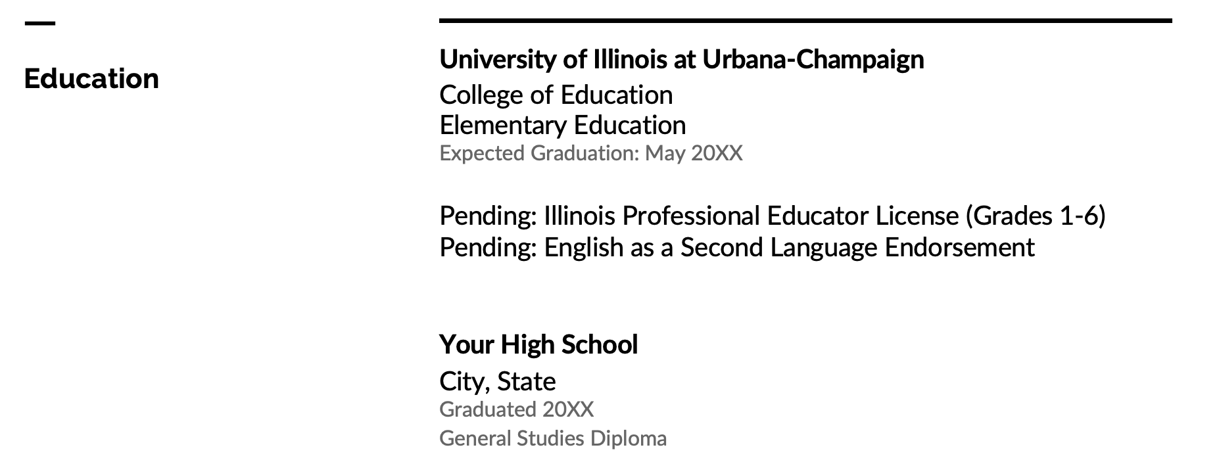
example

Slide 15
Heading 3: Related Educational experience
Starting with the most recent, you will highlight your teaching/school-related experiences
Have 2-3 bullet points under each experience to describe your responsibilities
Fall placement (if applicable) should be at the top. Call yourself a “practicum student” or “early field”

Slide 16
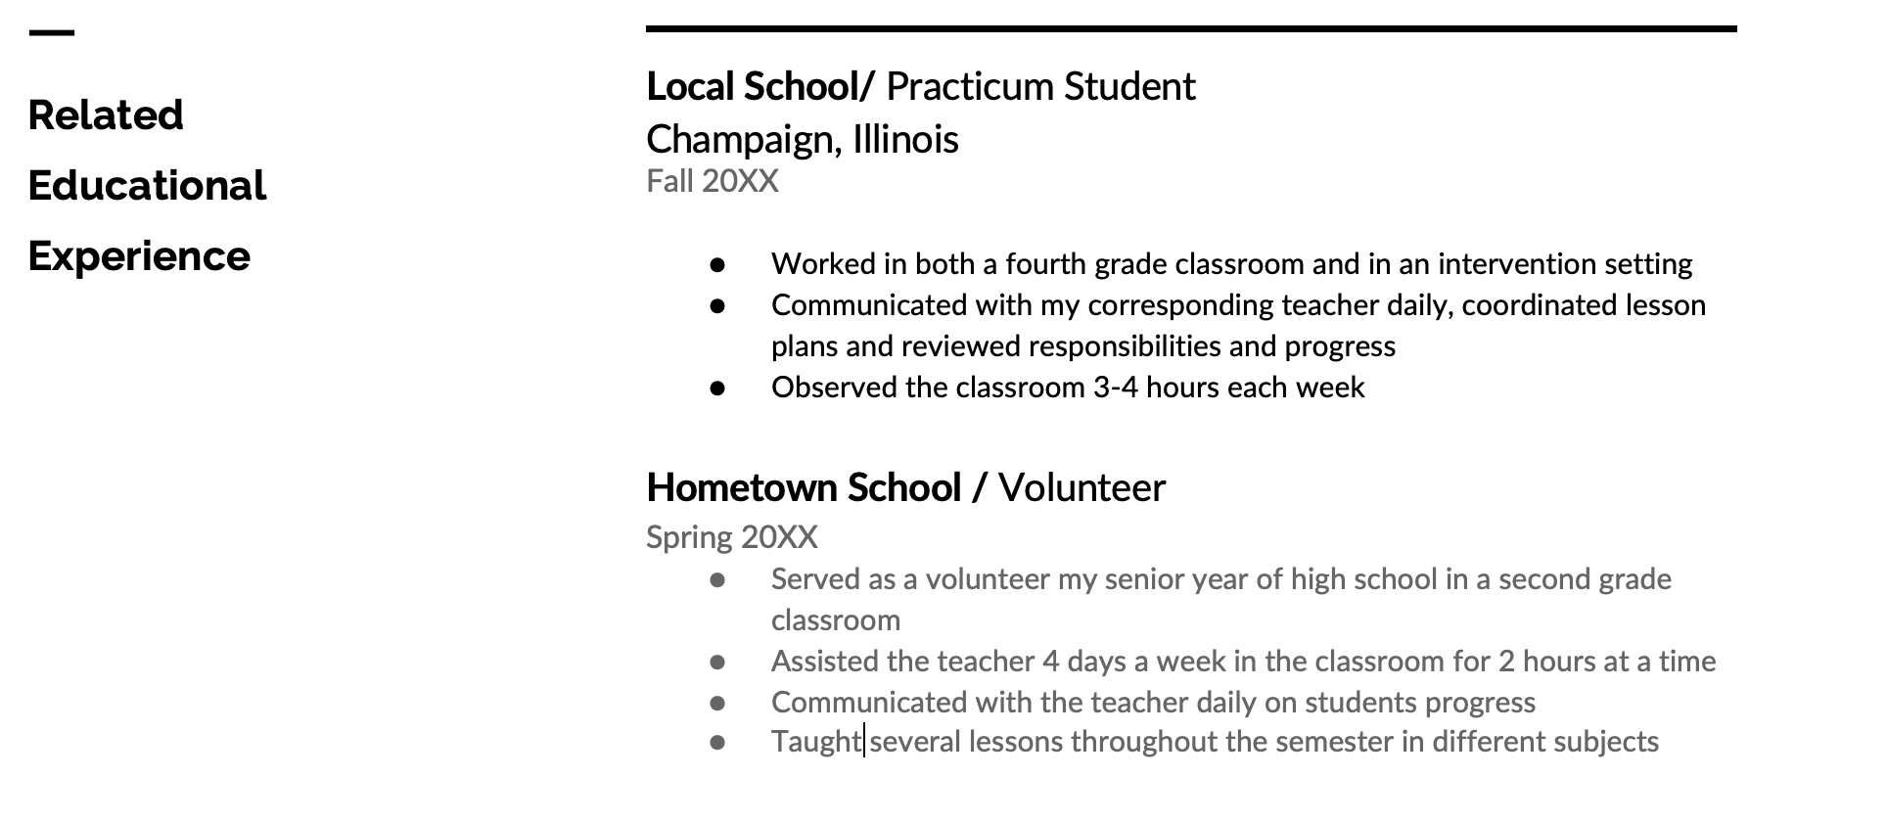
example

Slide 17
Heading 4: Work experience
Non-teaching related employment
Keep this section short, relevant, and professional
No need to go back to your very first job.
What jobs represent you the best?

Slide 18
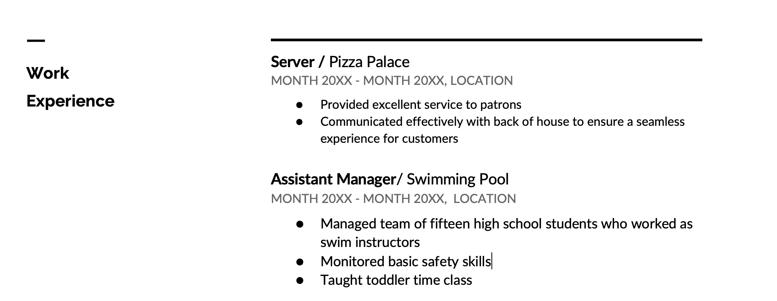
example

Slide 19
Heading 5: campus involvement
Optional
List clubs, organizations, teams, student government, etc.

Slide 20
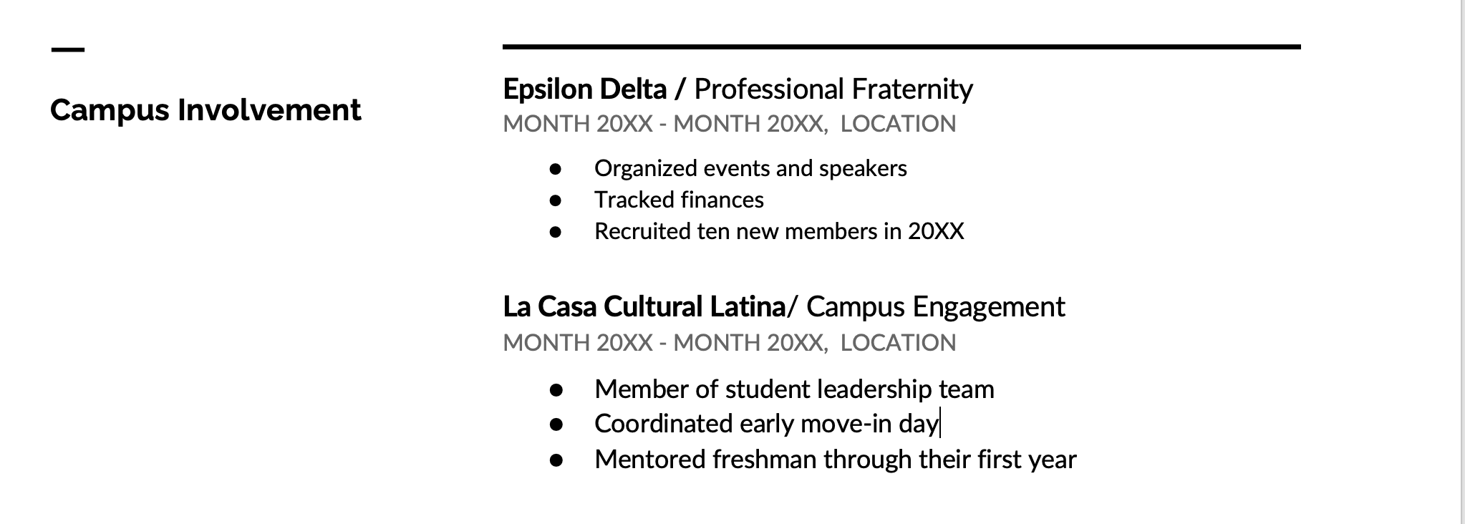
example

Slide 21
Heading 6: Honors
Optional
Dean’s list, awards, scholarships, etc.

Slide 22

Example

Slide 23
Heading 7: references
List 2-3 professional references (get permission first!)
Include name, title, school/company/organization, email, and phone
If you have connections in a particular district, list them as references.

Slide 24

example

Slide 25
Summary
Clean design
Two pages
Highlight most relevant experiences (focus on children, teaching, and other qualities important to the field – organization, efficiency, leadership)

Slide 26

Questions about resumes?

Slide 27
Cover letters
Sets you apart from other candidates
Serves as a writing sample
Highlights your strengths and passions

Slide 28
Heading/Greeting
Letter should have same design elements as resume
Include your identifying information at the top (name, address, etc.)
“Dear School Administrator, “ is an appropriate start

Slide 29
Paragraph 1
Say why you are writing this letter (“I am writing to apply for a student teaching placement in your district…”)
Hook the reader with a statement of purpose/passion
Tell why you feel you would be a good match for the district

Slide 30
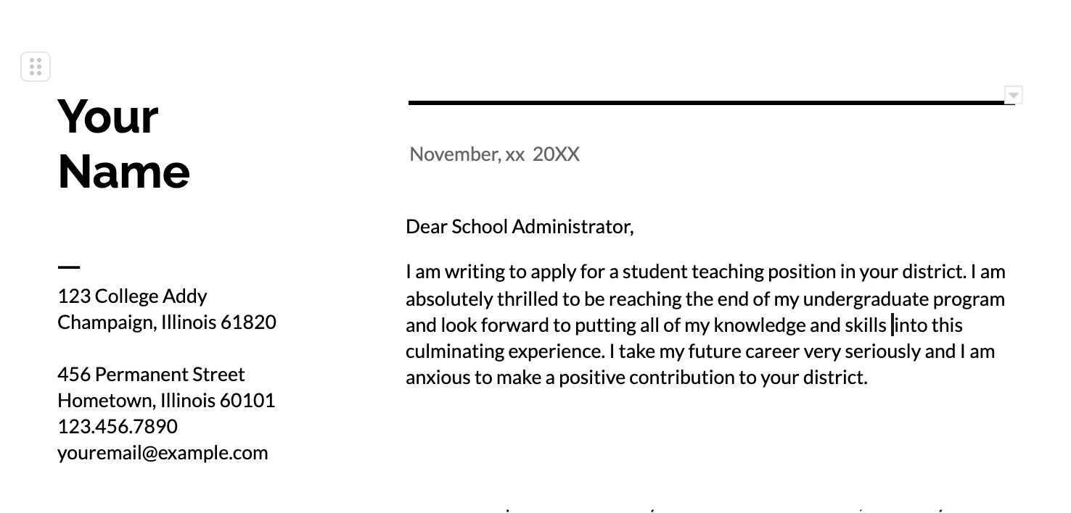
example

Slide 31
Paragraph 2
Highlight your strengths and tell what you would bring to the position
If you speak a language other than English, MENTION IT!
Share personal examples of success in teaching

Slide 32
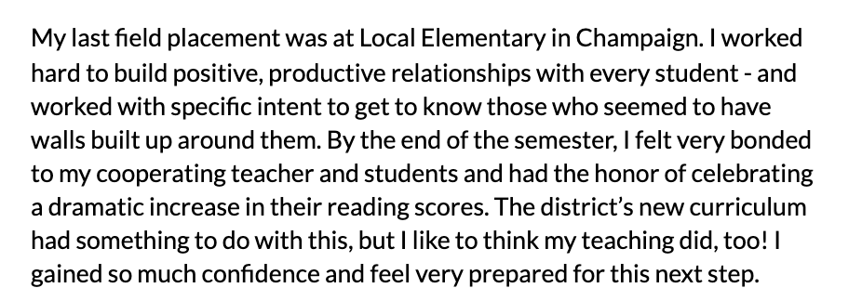
example

Slide 33
Paragraph 3
Close with a sincere thank you to the reader for their time and consideration
Include your contact information again (optional) and a statement of your availability
End with a professional closing and your name

Slide 34
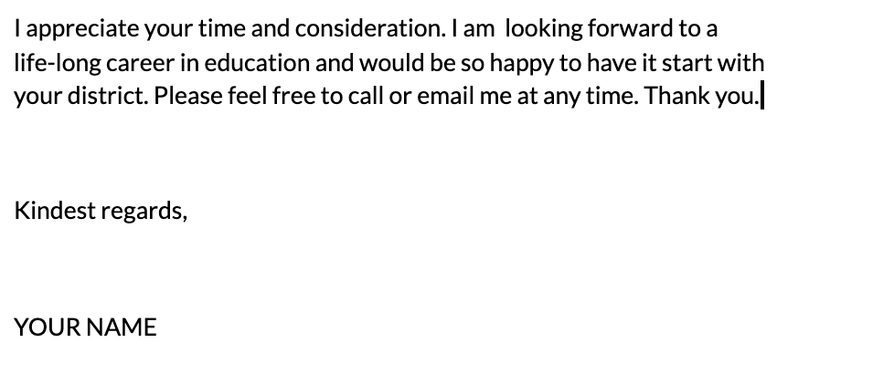
example

Slide 35
Cover Letter Activity
https://docs.google.com/document/d/1mi1Jvr41x6u1DdQm-T_TL2pK13DdYT1if6q23LVPUD0/edit?usp=sharing
In a group of 3, discuss problems with this cover letter.

Slide 36
Questions about cover letters?

Slide 37
How to submit
PROOFREAD! Have several friends/family proofread!
Combine resume and cover letter into one document or pdf
Follow the naming format for your program
  Early Childhood: Last name, first name EC Stu teaching term CLR (example: Malony, Brian EC SP25 CLR)
  Elementary: Last name, first name EL Stu teaching term CLR (example: Malony, Brian EL SP25 CLR)
  Middle Grades: Last name, first name MG Stu teaching term CLR (example: Malony, Brian MG SP25 CLR)
  Secondary: Last name, first name Content abbreviation (see below) Stu teaching term CLR Content Abbreviations: ENG – English, MAT – Math, BIO – Biology, CHE – Chemistry, PHY – Physics, EAR – Earth Science, SOC – Social Studies (example: Malony, Brian ENG SP25 CLR)
  MAIL TO SCE@education.Illinois.edu by FRIDAY, DECEMBER 8, 2023

Slide 38
Wrap up!
Questions
Comments
Resources
  University of Illinois Career Center: https://www.careercenter.illinois.edu/
  Resume templates and sample documents:
    https://resumegenius.com/resume-templates/google-docs-resume-templates
    https://docs.google.com/document/u/0/?ftv=1
    https://sce.education.illinois.edu/current-candidates/career-resources
    THANK YOU, EVERYONE! ☺

