Slide 1
Cooperating teacher orientation
Fall 2023
CI 405
Year 1 Candidates

Slide 2
Welcome!
Introductions
Dr. Cara Gutzmer, Director of School and Community Experiences (SCE)
Sue Talbott, Clinical Experiences Specialist
Danielle Galardy, Office Manager
Pop in the chat and tell us your school and grade level. If you're a returning cooperating teacher, how many candidates have you mentored in the past?

Slide 3
agenda
Welcome
Course sequence
Expectations – Professionalism
Expectations – Academic
Giving feedback
Evaluations
Questions?
Tuition waivers

Slide 4
Course sequence –year 1
Courses
Placements
Intro to Teaching
Children's Literature
Methods
Math
Language Arts – Part 1
Science
Social studies
Music/Art/Dance
Fall
3 hours per week
Spring
1 full day per week

Slide 5
Course sequence – Year 2
Courses
Placements
Special Education
Action and Inquiry
Methods
Language Arts – Part 2
Theory and Practice (fall and spring)
Seminar
Fall
Monday, Tuesday, Thursday - mornings
Wednesday – all day
Spring
STUDENT TEACHING

Slide 6
Professional expectations
Promptness
Mature and appropriate attire and hygiene
Communication
Engagement
PLEASE REVIEW SCHOOL EXPECTATIONS on the first day. Talk about dress code, cell phone use, arrival, departure, etc.
PROFESSIONAL BEHAVIOR CHECKLIST

Slide 7
Academic/Placement expectations
Teach two lessons and ask cooperating teacher for written feedback
Final evaluation
Course assignments
Build relationships
Be an active participant
Enhance instruction and the classroom environment

Slide 8
Giving feedback
Candidates need LOTS of positive feedback and encouragement.
Observation form
I will send the Professional Behavior Checklist via email around Week 5 to remind you to complete and share with candidate

Slide 9
evaluations
Observation feedback
Final
Portal: https://cote.illinois.edu/cote-portal-access
Support plans – CONTACT SUE!
PLEASE COMMUNICATE CONCERNS TO THE CANDIDATE.

Slide 10
supports
Disposition Concern Form
Remediation Plan
Professional Growth Plan

Slide 11
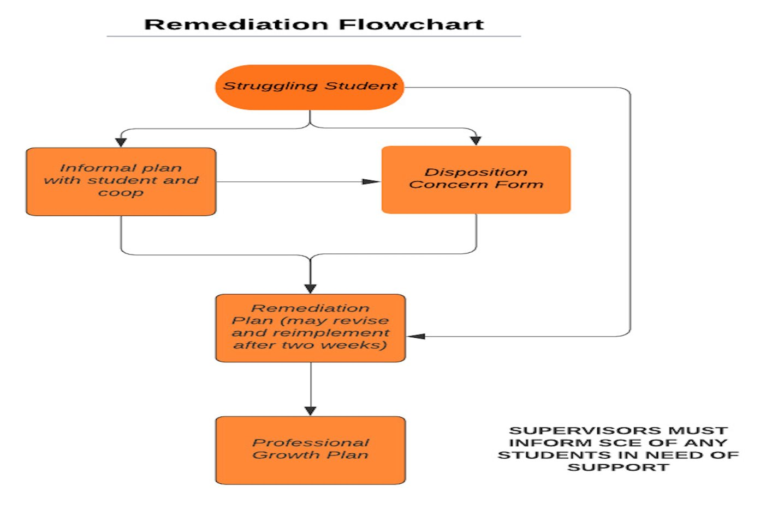

Slide 12
Immediate actions to welcome your candidate
Exchange contact information (set boundaries!)
Show them where to put their belongings
Tour the school (have a student show them around!)
Introduce them to staff
Teach them to access your online curriculum and classroom
Ask them to plan to introduce themselves to the students in a creative way
Post their name on the board
Be clear and specific about what you would like them to do. They should be active, helpful, and engaged!
Review expectations regarding dress, cell phone use, arrival, departure, etc.

Slide 13
Tuition waivers
Non-degree vs. Master’s/Endorsement/Doctoral
Contact Council on Teacher Education with questions!
cote-waivers@illinois.edu
https://cote.illinois.edu/cooperating-personnel-supervisors/cp-tuition-fee-waivers
Waiver Information (from SCE website)
If you are intending to use a Cooperating Teacher Waiver to complete an online degree through the College of Education, you must contact both Jena Pfoff (jrooseve@illinois.edu) and Linda Stimson (ls9@illinois.edu) after submitting your application to the Graduate College in order to utilize the Cooperating Teacher Waiver. Your subject line should read, “Cooperating Teacher Waiver – Online Program."
https://cote.illinois.edu/cooperating-personnel-supervisors/cp-tuition-fee-waivers

Slide 14
resources
SCE: https://sce.education.illinois.edu/
Portal: https://cote.illinois.edu/cote-portal-access
Course assignment grid and placement summary will be emailed to you
Email Sue directly:
stalbott@illinois.edu

Slide 15
It's never too soon.....

Slide 16
Questions?

