Slide 1
Student teaching Resume and cover letter workshop
Fall 2022
Office of School and Community Experiences

Slide 2
Introductions
Cara Gutzmer, Director of School and Community Experiences (MG, SEC)
Sue Talbott, Clinical Experiences Specialist (ECE, ELED)
Ashley Davis, Coordinator for Undergraduate Recruitment and Career Services (with us in spirit!)
While we talk, please type into the chat the one word sums up your feelings
about student teaching. ☺

Slide 3
agenda
Introductions
Overview of the placement process (Cara)
Student teaching vs. employment resumes/cover letters (Cara)
Resume guidelines (Sue)
Resumes (Sue)
Cover letters (Cara)
How to submit (Sue)
Wrap-up/Questions

Slide 4
*Student teaching REMINDERS*
You will follow your assigned district's calendar
  Start a week or more before UIUC
  Spring break may not be the same as UIUC
Travel is often required for student teaching and early field placements
  Carpooling
  Northern – close to home!

Slide 5
The Process
Timeline
Purpose of resumes and cover letters for student teaching
Northern placements
  IMPORTANT TO KNOW: Each district handles their placements differently. Some do interviews, some let students know they've been placed before SCE makes an official announcement, some ask you to do a background check way in advance of student teaching, etc. Don't compare your placement situation with others. Trust that we will take care of you!
Local placements
Considerations

Slide 6
The difference between Student teaching and Employment documents
Student teaching documents:
•are general
•do not mention specific districts or schools
Employment documents:
•are highly specific
•are tailored to certain schools and administrators for whom you wish to work

Slide 7
General guidelines
Use clean design – lots of white space, one font, no clip art
Have SEVERAL people proofread your resume! You are representing not only yourself, but also the College of Education with this document
Use action verbs to start your bullet points (see list)
There are lots of templates and other online resources to inspire you

Slide 8
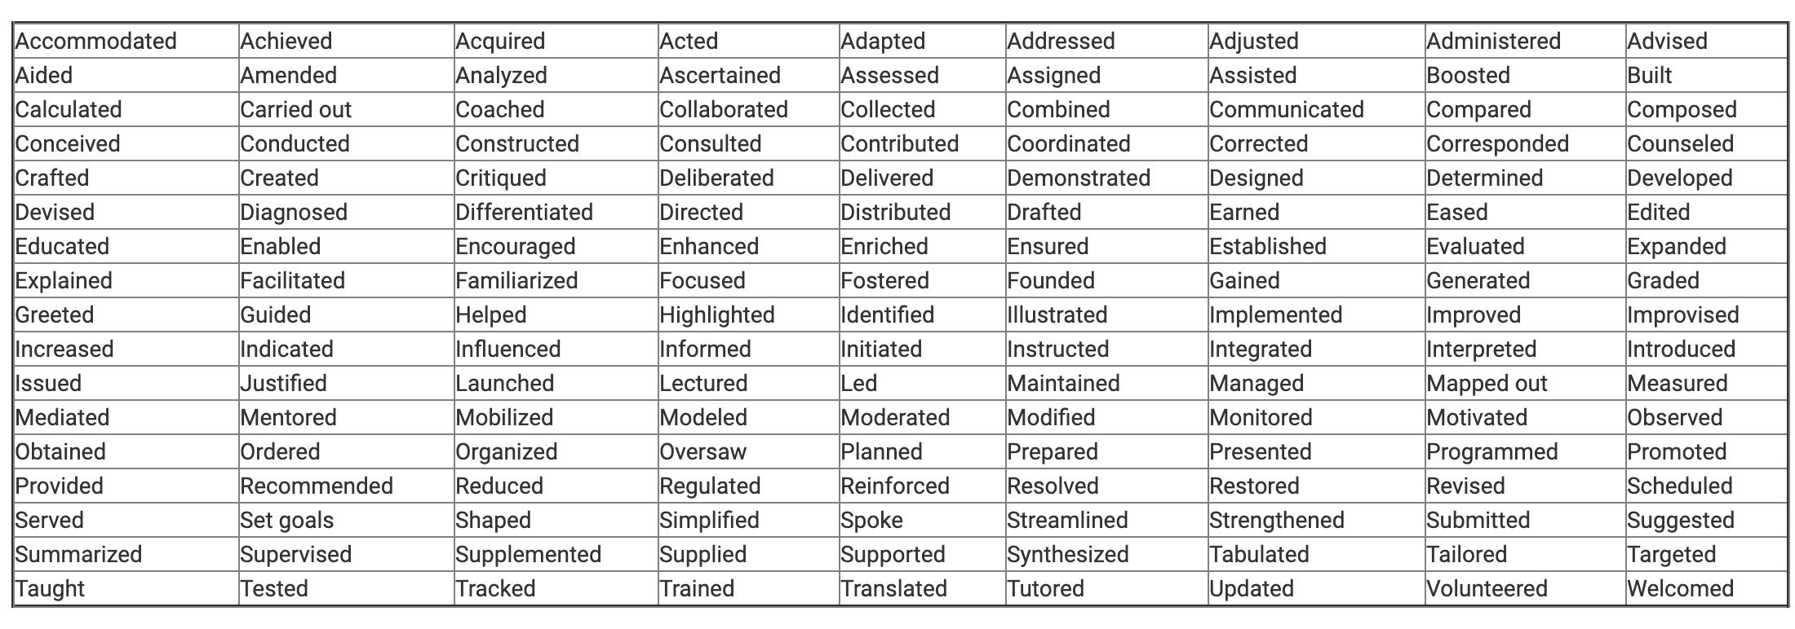
https://careers.uiowa.edu/power-verbs-education-resumes

Slide 9
resumes
A chronological (most recent comes first!) list of educational credentials and employment experiences that are applicable to the job you are seeking.
Education resumes can be two pages.
Objective is optional.
GPA is optional.

Slide 10
Heading 1: personal information
Name, address, contact information
  List campus and permanent address
  Make sure your email is appropriate (make sure it's one you check!)
  Voice message on your phone should be professional
  SIDE NOTE: Lock down your social media!

Slide 11
heading
1: Personal information
2: Education
3: Related Educational Experience
4: Work Experience
5: Campus Involvement (OPTIONAL)
6: Honors (OPTIONAL)
7: References

Slide 12
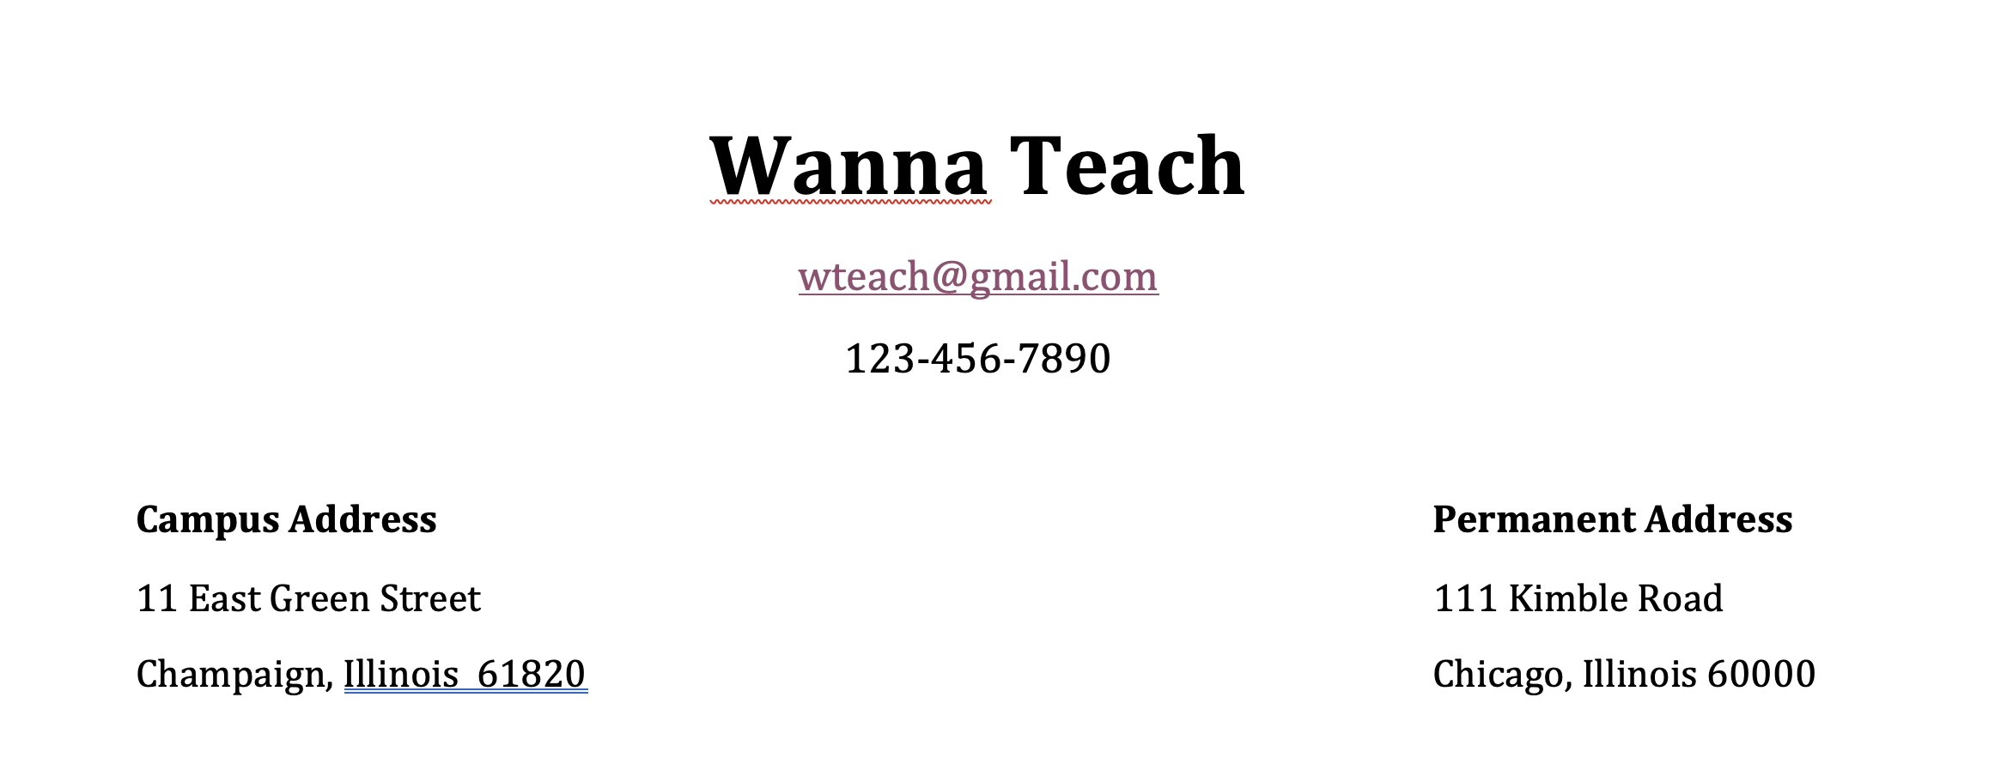
example

Slide 13
Heading 2: education
Include your high school
Graduation can be called “expected graduation date”
Expected licensure is “Professional Educator License”
List expected endorsements as well
Secondary – list major and minor

Slide 14
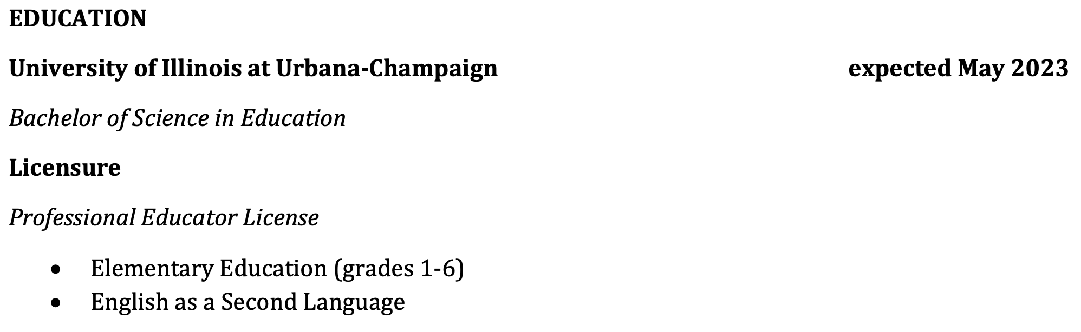
example

Slide 15
Heading 3: Related Educational experience
Starting with the most recent, you will highlight your teaching/school-related experiences
Have 2-3 bullet points under each experience to describe your responsibilities
Fall placement (if applicable) should be at the top. Call yourself a “practicum student” or “early field”

Slide 16
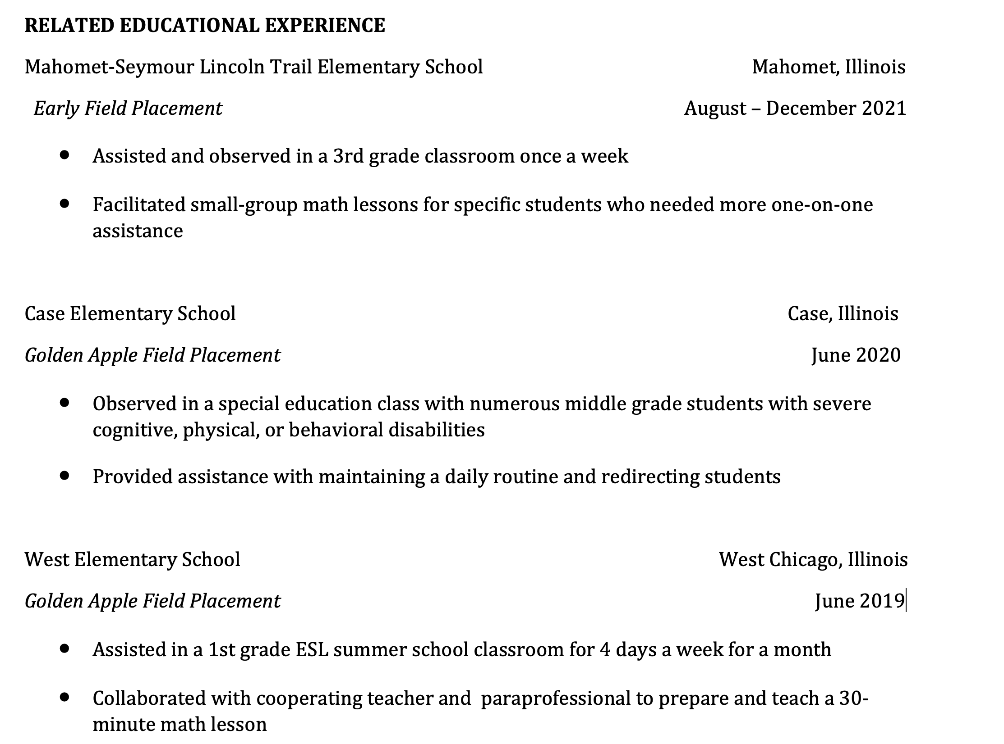
example

Slide 17
Heading 4: Work experience
Non-teaching related employment
Keep this section short, relevant, and professional
No need to go back to your very first job.
What jobs represent you the best?

Slide 18
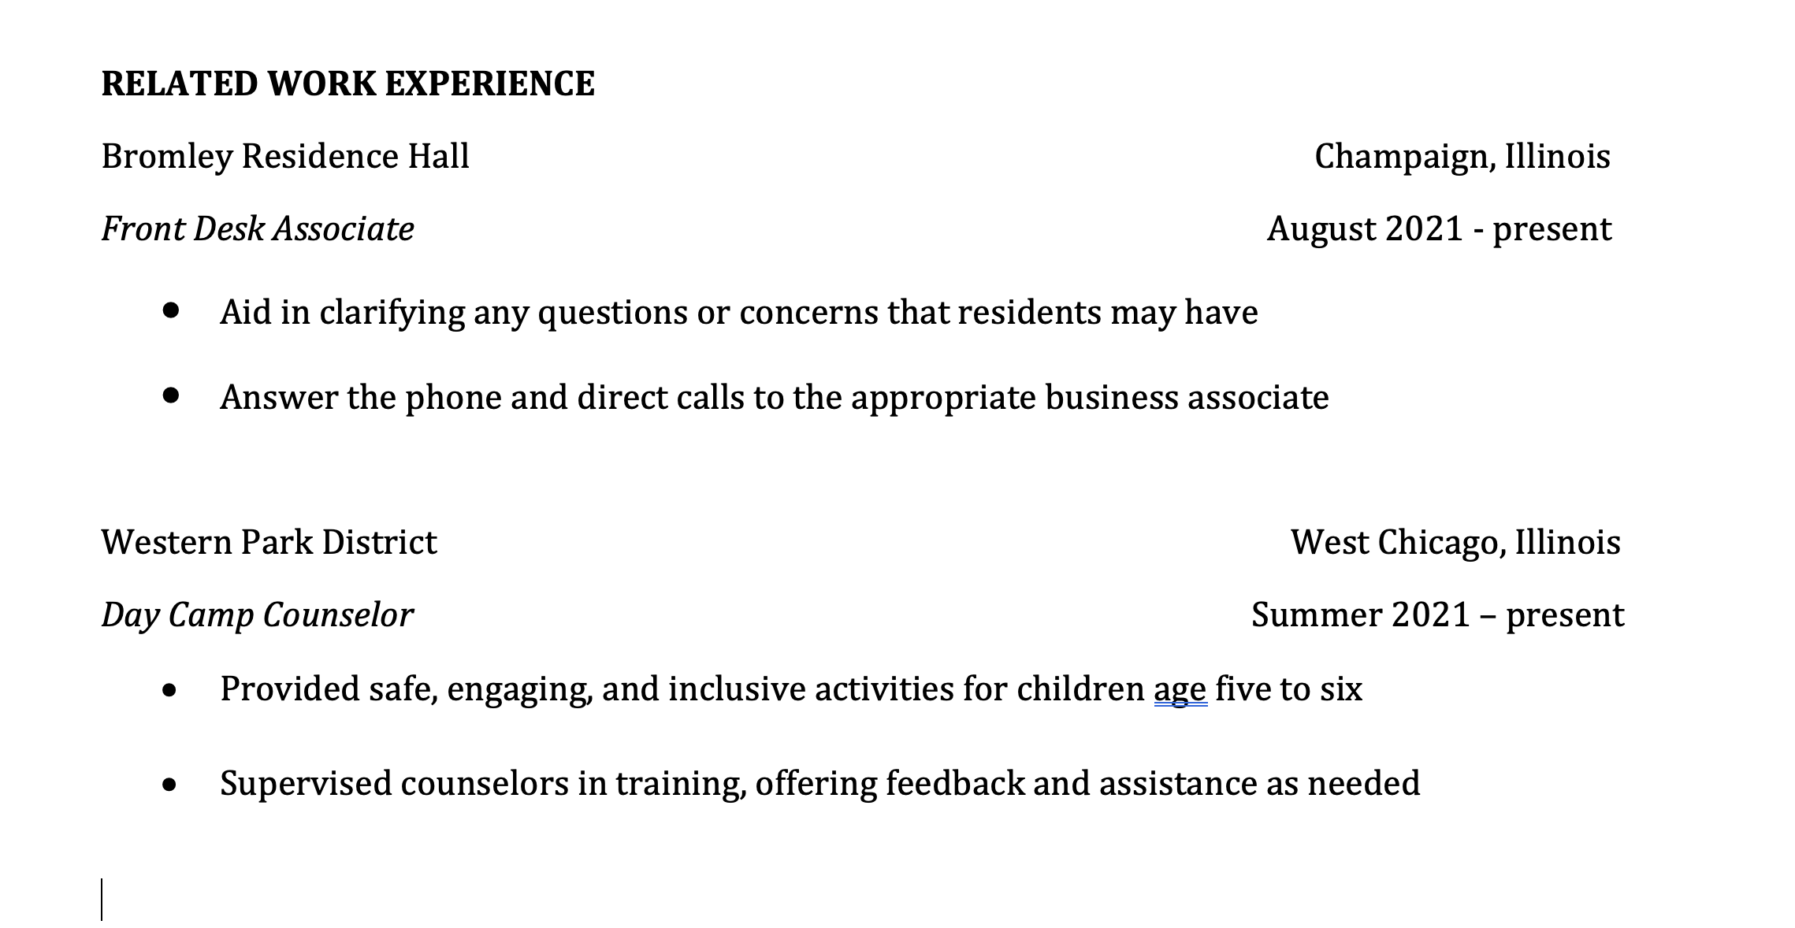
example

Slide 19
Heading 5: campus involvement
Optional
List clubs, organizations, teams, student government, etc.

Slide 20
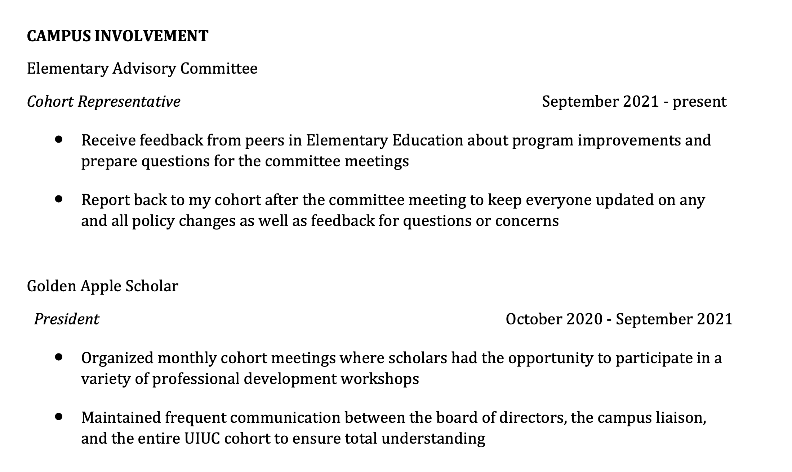
example

Slide 21
Heading 6: Honors
Optional
Dean’s list, awards, scholarships, etc.

Slide 22
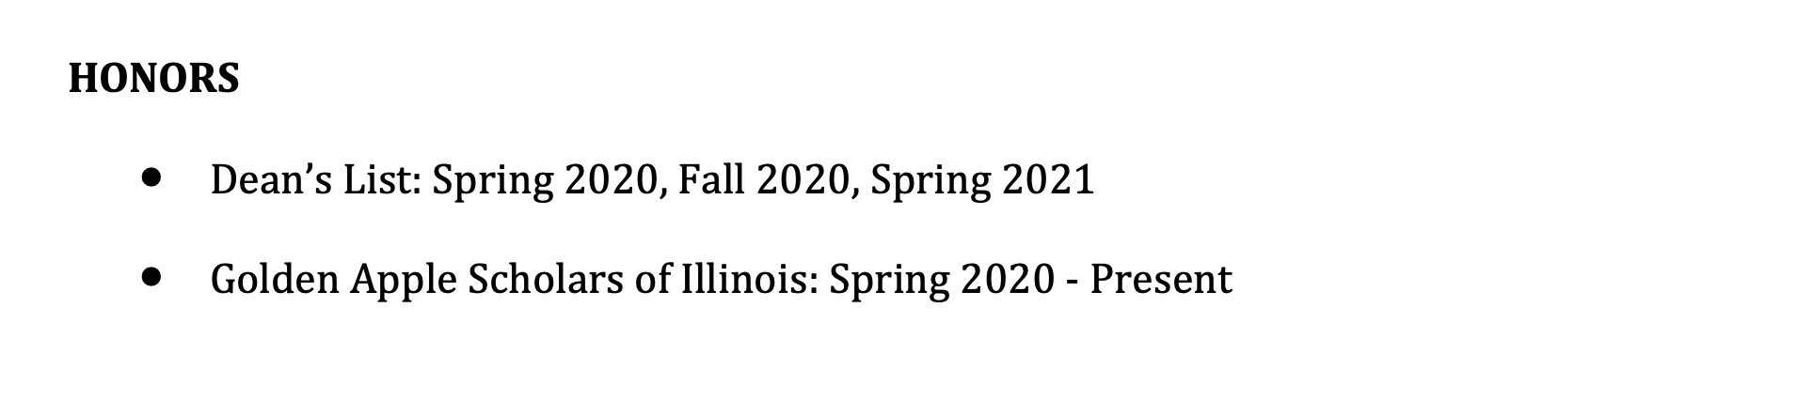
Example

Slide 23
Heading 7: references
List 2-3 professional references (get permission first!)
Include name, title, school/company/organization, email, and phone
If you have connections in a particular district, list them as references.

Slide 24
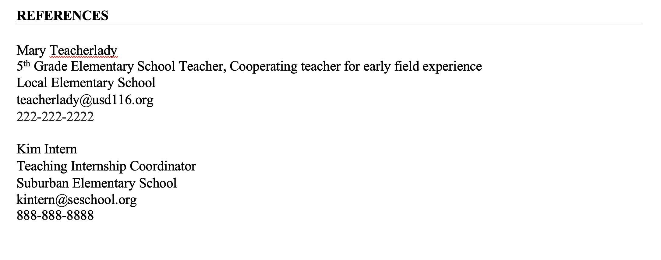
example

Slide 25

Questions about resumes?

Slide 26
Cover letters
Sets you apart from other candidates
Serves as a writing sample
Highlights your strengths and passions

Slide 27
Heading/Greeting
Letter should have same design elements as resume
Include your identifying information at the top (name, address, etc.)
“Dear School Administrator, “ is an appropriate start

Slide 28
Paragraph 1
Say why you are writing this letter (“I am writing to apply for a student teaching placement in your district…”)
Hook the reader with a statement of purpose/passion
Tell why you feel you would be a good match for the district

Slide 29
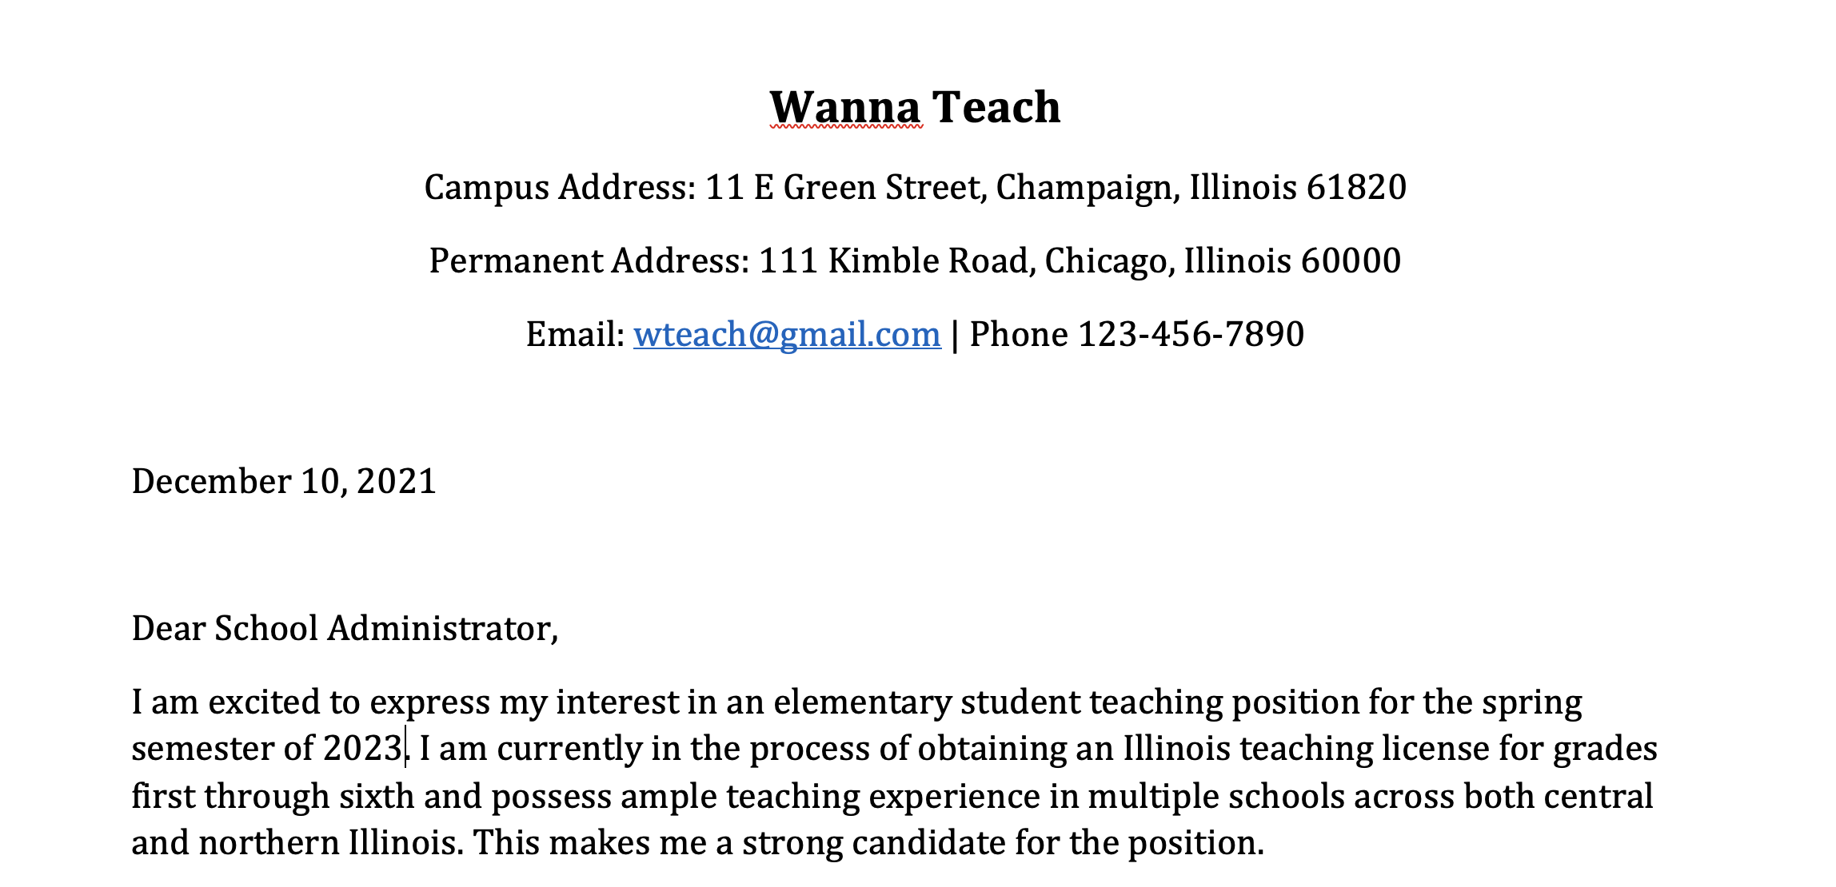
example

Slide 30
Paragraph 2
Highlight your strengths and tell what you would bring to the position
If you speak a language other than English, MENTION IT!
Share personal examples of success in teaching

Slide 31
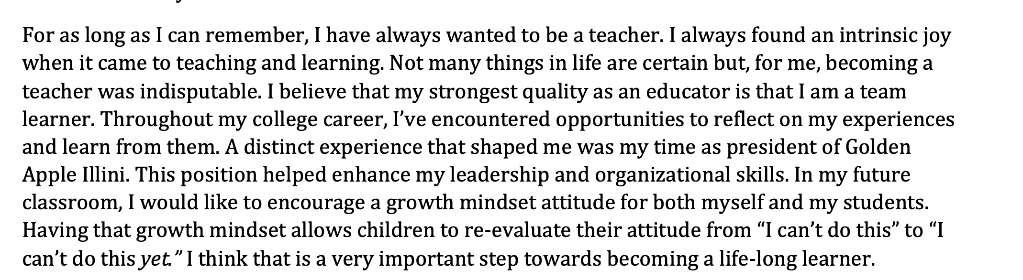
example

Slide 32
Paragraph 3
Close with a sincere thank you to the reader for their time and consideration
Include your contact information again (optional) and a statement of your availability
End with a professional closing and your name

Slide 33
example
I appreciate your time and consideration. I'm really looking forward to student teaching and to a life-long career in education. I hope this will be the beginning of a long and successful journey.
Please feel free to reach out if you have questions (wteach@gmail.com/123-456-7890).
Kindest regards,
Wanna Teach

Slide 34
Cover Letter Activity
https://docs.google.com/document/d/1mi1Jvr41x6u1DdQm-T_TL2pK13DdYT1if6q23LVPUD0/edit?usp=sharing
In a group of 3, discuss problems with this cover letter.

Slide 35
Questions about cover letters?

Slide 36
How to submit
PROOFREAD! Have several friends/family proofread! We will send it back to you, if needed.
Combine resume and cover letter into one document or pdf
Follow the naming format for your program
  Early Childhood: Last name, first name EC Stu teaching term CLR (example: Malony, Brian EC SP24 CLR)
  Elementary: Last name, first name EL Stu teaching term CLR (example: Malony, Brian EL SP24 CLR)
  Middle Grades: Last name, first name MG Stu teaching term CLR (example: Malony, Brian MG SP24 CLR)
  Secondary: Last name, first name Content abbreviation (see below) Stu teaching term CLR Content Abbreviations: ENG – English, MAT – Math, BIO – Biology, CHE – Chemistry, PHY – Physics, EAR – Earth Science, SOC – Social Studies (example: Malony, Brian ENG SP24 CLR)
  MAIL TO SCE@education.Illinois.edu by FRIDAY, DECEMBER 9, 2022

Slide 37
Wrap up!
Questions
Comments
Resources
  University of Illinois Career Center: https://www.careercenter.illinois.edu/
  Ashley Davis: adavis2@illnois.edu
  Resume templates and sample documents:
    https://resumegenius.com/resume-templates/google-docs-resume-templates
    https://docs.google.com/document/u/0/?ftv=1
    https://sce.education.illinois.edu/current-candidates/career-resources
    https://illinois.csod.com/ui/internal-career-site/app/job-details/1595
    THANK YOU, EVERYONE! ☺

