Slide 1
Supporting your students’ mental health
Fall 2021
Office of School and Community Experiences

Slide 2
agenda
Overview
Reactions to stress
Ways to support
What to do if you are concerned
General coping strategies
Resources

Slide 3
Reactions to stress
College students
Elementary/Middle school students
Having trouble thinking clearly/concentrating
Difficulty communicating/listening
Difficulty making decisions
Feeling overly anxious or worried
Feeling depressed or overwhelmed by sadness
Increased substance use or abuse
Trouble sleeping or relaxing
Physical aches and pains
Physical ailments – especially gastric issues and headaches
Regressive/Immature behavior
Trouble sleeping
Irritable, combative behavior
Crying
Distracted, lack of focus
Avoidance (not wanting to come to school, not following though on assignments)

Slide 4
Supporting Student Well-being
College students
Elementary/Middle school students
Assume good intentions
The majority of students are not taking advantage of this situation
Care and concern will go a long way in building a positive relationship
SAME!
What is your students’ behavior communicating to you?
How will your response or reaction to them help or harm your relationship?

Slide 5
Supporting student well-being
College students
Elementary/Middle school Students
Shift goals and expectations as needed
Consider “hurdle help” if students are not as independent as you think they should be
Be flexible with how student show their work. Can they do journals orally? Can pre-conferences be done via email?
What are some ways to maintain high expectations and rigor while accommodating needs in this strange time?
SAME!
Remember that many of your students may have missed more than a full year of school. Think about how to adjust the curriculum to accommodate all that they did not learn.

Slide 6
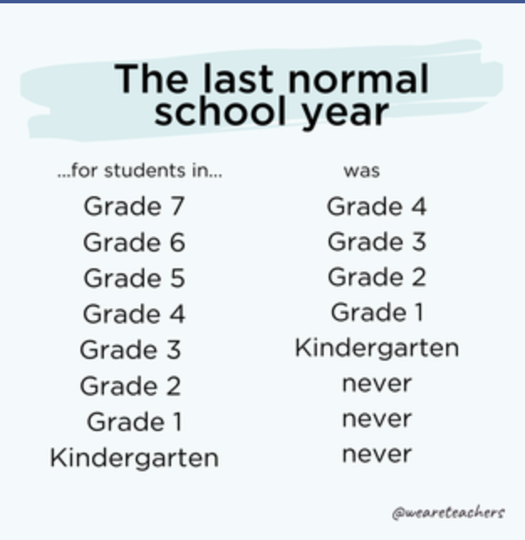

Slide 7
Supporting student well-being
College students
Elementary/Middle school students
There’s always something going right
Offer specific praise and celebrate at every opportunity. Share the good news with me/Cara/coop via email and copy the student
Ask students to to share a celebration at the start of each meeting. Share one yourself to get the ball rolling!
SAME!
Focus your energy on the positives
Be intentional about noticing and publicizing great things
Invite others to share what’s going well

Slide 8
What to do if you are concerned
College students
Elementary/middle school students
NOTICE
They stop communicating
Affect, hygiene, voice
Change in quality and/or timeliness of work
Disclosure of something concerning
(Note that midterm time is a typical time of great stress for students)
Communicate with your cooperating teacher about any concerns you have.
Reserve judgment on families
Recognize that this is a traumatic time for kids. They might not have the language to express their fears.

Slide 9
What to do if you are concerned
College students
Elementary/middle school students
ASK
Be direct, but gentle
“I notice that you’ve missed some meetings/deadlines and I want to make sure you’re ok. These are hard times and it makes sense that the way we prioritize and focus has shifted. It isn’t like you to miss things, though, so I just wanted check in on you.”
Honor their need to talk. Answer questions when you can. Find resources to help if you can’t.
Work with your cooperating teacher to create time and space to talk.
Talking to kids about COVID
How to Help

Slide 10
What to do if you are concerned
College students
Elementary/Middle school STUDENTS
Offer a listening ear
Hurdle help
Refer to campus resources
Be present, available, and supportive
Communicate with your coop about students.
Hurdle help
Ask what your school is doing to support their kids

Slide 11
Coping strategies
College students
Elementary/middle school students
Connect with others
Take breaks
Exercise and have healthy habits
Turn off the news
Give yourself permission to feel
Avoid comparing yourself to others
Accept imperfection
Seek help when needed
Source: https://www.brandeis.edu/health/promotion/covid/faculty-guide.html
Time to talk about COVID and related worries
Extra time to play
Provide opportunities to make friends, do group activities, and connect with classmates
Activities that encourage mindfulness (calming brain breaks)

Slide 12
resources
COVID-19 Resources at the University of Illinois
https://www.responsiveclassroom.org/educator-resources/covid-19-resources/covid-19-morning-meeting-and-responsive-advisory-meeting-downloads/

