Slide 2
Elementary Education
Professional Education Sequence (PES)
Induction Meeting
March 5, 2024
Notes:
Amira

Slide 3
Title
Welcome & Introductions
Elementary Education Program Representative (Lynn Burdick)
School & Community Experiences (SCE)
Office of Undergraduate Programs, Student Academic Affairs Office (SAAO)
Notes:
Amira-

Slide 4
Title
Welcome & Introductions
Lynn Burdick
Program Overview
Elementary Education
Notes:
Amira-

Slide 5
Title
Support Units
SAAO Undergraduate student advising
Degree Progress
Registration
Overall Program Questions
Clinical Embedded Counselor
SCE- Placement
Early Field Experiences
Student Teaching
Placement Applications
Department of Curriculum and Instruction (CI)
Program Coordinator
Instructors
Teaching Assistants
Faculty
COTE- Licensure
Licensure Requirements
Applying for Teaching License
Endorsements
Notes:
Amira Review role of each office—SAAO=degree, SCE=placement, CoTE=licensure (not likely to be in contact until senior year), go tot the people that your problem fits under

Slide 6
Title
Undergraduate Program Support
Scott Filkins, K-12 program coordinator
School & Community Experiences (SCE)
Student Academic Affairs Office (SAAO)
Office of Undergraduate Program
Embedded Clinical Counselor, Emese Poszet
Notes:
Amira-and more!

Slide 7
Title
Degree Requirements
DARS Audit
https://registrar.illinois.edu/academic-records/dars-audit/
Forms & Petitions Page- Advising Checklists and other important forms
https://education.illinois.edu/current-students/undergraduate/forms-petitions-resources
Notes:
Amira Review role of each office—

Slide 8
Title
Degree Requirements
Advising Checklist notes:
Must complete Gateways I and II before entering PES
MATH 103 is a program requirement.
Before your advising appointment (and on a regular basis):
Run a DARS audit
Complete advising checklist
Notes:
Amira DARS: tool, but not perfect
Check for exceptions
Transfer courses don’t always sort correctly, let us know at appt

Slide 9
Title
Course Registration Process
Must complete CoTE orientation, required trainings (safety training, mandated reporter training), and create ELIS account send IEIN to CoTE to register for professional education courses.
Priority registration begins April 1
Don’t drop a course without talking to advisor
Notes:
Amira
Important dates: March 11-time tickets available in Enterprise, March 8—drop deadline,

Slide 10
Title
Licensure Requirements
CoTE
Licensure: Grades 1-6
You must continue to monitor your email and review the CoTE website for up-to-date requirements
C- rule
Licensure exams*:
Content test-before student teaching
edTPA-completed during student teaching, submitted prior to recommendation for licensure, waived through August 31, 2025
Notes:
AMira

Slide 11
Title
Licensure Requirements
CoTE
Endorsements:
ESL & Bilingual
Specific course sequences
100 clock hours
Transitional bilingual/ESL
Exam required for Bilingual endorsement *
World Language
18 credit hours (AP okay)
Language content test OR State or Global Seal of Biliteracy affixed to ELIS account
Additional languages can be added with content test only
Notes:
Amira Difference between ESL, bi, and language
content tests for Bilingual Education and World Language endorsements may be waived for those holding an Illinois or Global Seal of Biliteracy in that language'
Transitional bilingual endorsement
Once you have one foreign language, you can add others by passing the content test
Normal to take some of the ESL/Bi coursework as an undergrad and finish the endorsement post-bacc

Slide 12
Title
Council on Teacher Education Website
(CoTE, "the portal")
https://cote.illinois.edu/cote-portal-access
The CoTE website deals with licensure, field-related requirements, and documentation. Please bookmark it and refer to it frequently when you have questions.
•Licensure information
•Time sheet
•Evaluations
•Required trainings

Slide 13
Title
Mandatory Licensure Information
You will receive details via email from the Council on Teacher Education (CoTE)

Slide 14
Title
School and Community Experiences
(SCE)
Dr. Cara Gutzmer, Director
Sue Talbott, Clinical Experiences Specialist
Danielle Galardy, Office Manager

Slide 15
Title
SCE Website
https://sce.education.illinois.edu/
The SCE website is for field placement information and clinical assignments. Please bookmark it and refer to it frequently when you have questions.
•Forms used in clinical experiences
•Handbooks, timelines, guidelines
•Remediation forms
•Information for cooperating teachers, supervisors, and students pertaining to clinical experiences
•Links to presentations
•Links to other resources
Notes:
SCE

Slide 16
Title
Placements
Year One – Fall Early Field | Year One – Spring Early Field | Year Two – Fall Early Field | Year Two – Spring STUDENT TEACHING
This placement is tied to your CI405 class. Three hours per week, arranged by you and your cooperating teacher. Teach lessons, receive written feedback. Other course assignments | EDPR 250 One full day – Tuesday OR Thursday. Teach two lessons, receive written feedback. Other course assignments | EDPR 250 Three mornings plus one full day. Supervisor observes a minimum of four lessons. Seminar at 8am on Fridays. | EDPR 432 All day, every day! Begins January 6 Supervisor observes a minimum of five lessons. Seminar arranged by supervisor. CI 407 Northern placements
Notes:
Amira-

Slide 17
Title
ABOUT STUDENT TEACHING
Option to teach locally or in northern suburbs/CPS
Option to participate in Teach Abroad program: https://international.education.illinois.edu/study-abroad/teach-abroad
You follow the calendar of your assigned district, which means:
Your spring break may be different from UIUC's
You will begin your placement before UIUC classes begin
You will have a few days off sprinkled in your experience (school holidays!)
Most candidates have only two course requirements during student teaching
Seminar for EDPR 432 (arranged by supervisor)
CI 407 (online)
Notes:
Amira-

Slide 18
Title
Placement Application
Due Friday, March 29 at 5pm
Look at grade level preferences carefully and think about what you want for student teaching.
Use the comment box!
Application FAQs are posted on SCE website for your reference
Let’s take a look at the application!
https://appserv7.admin.uillinois.edu/FormBuilderSurvey/Survey/6fcca4c2-7618-4bad-8da8-af1700999620/Survey
Notes:
Amira-

Slide 19
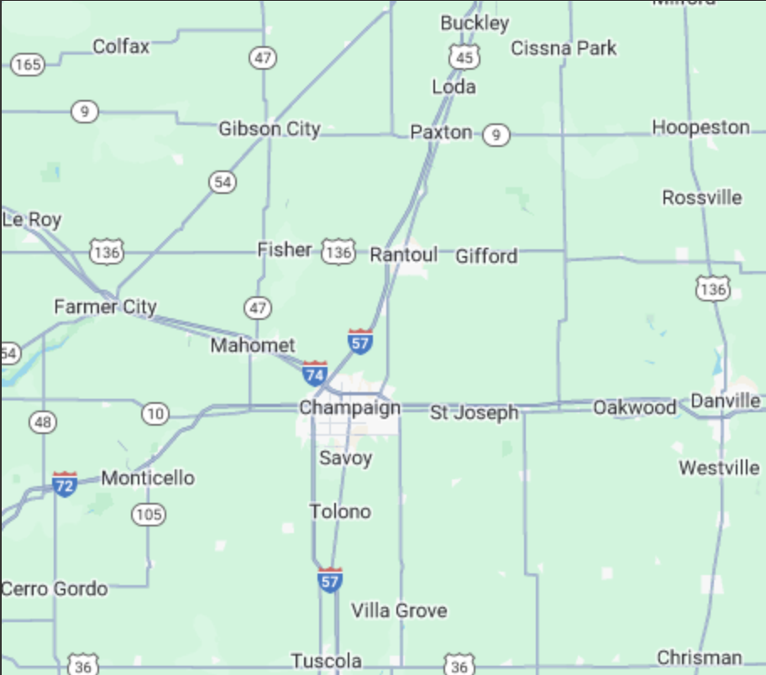
Title
Local Map
55 mile radius from campus
Notes:
Amira-

Slide 20
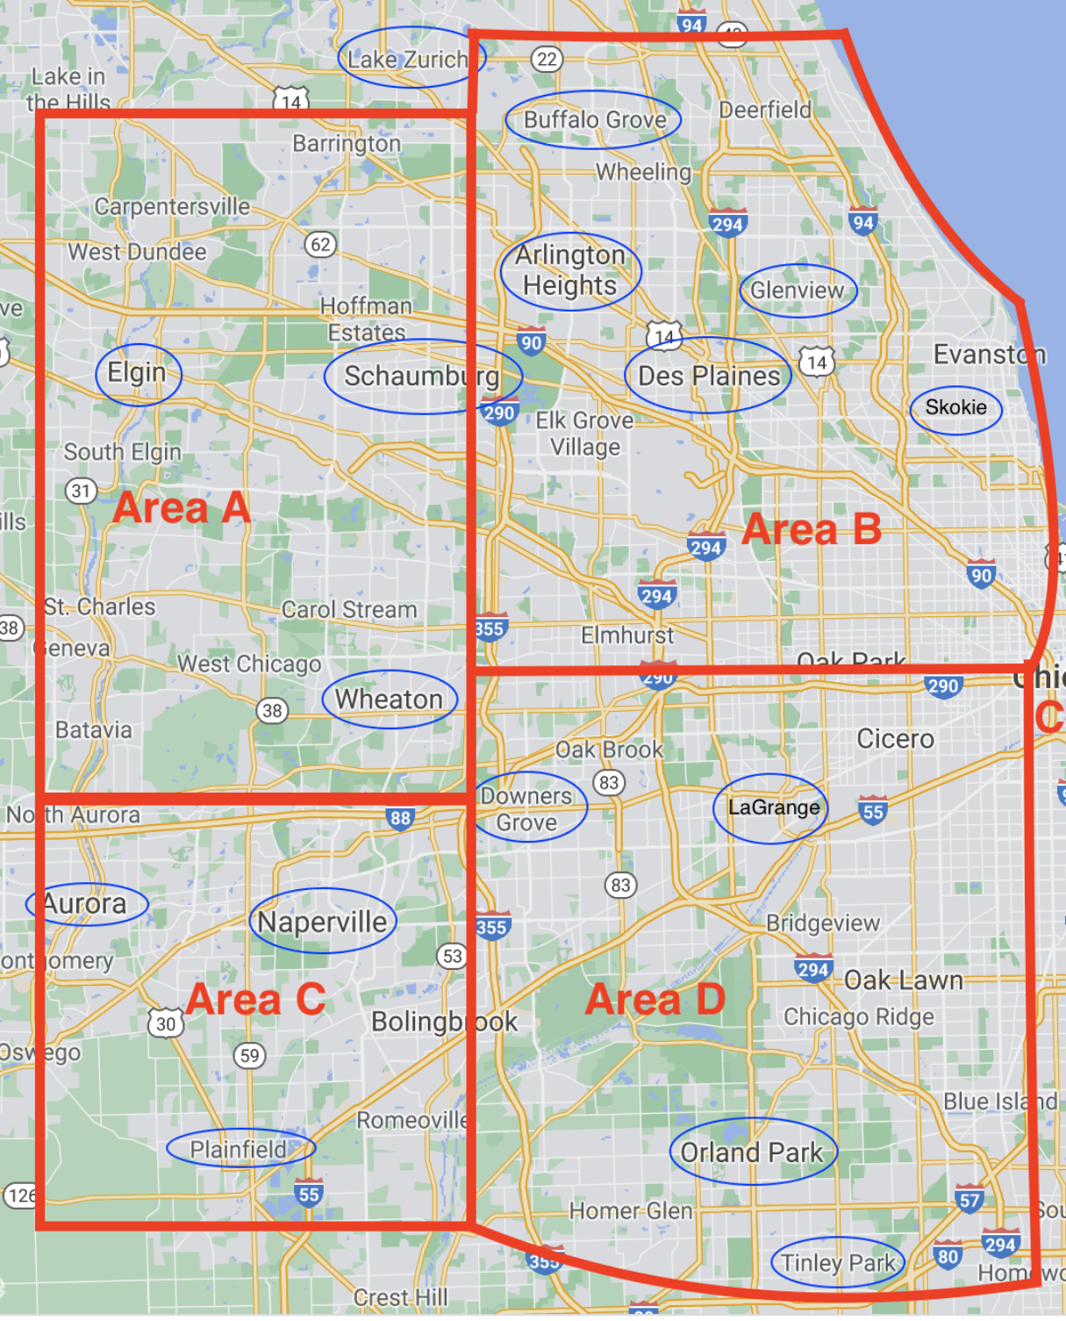
Title
Northern Placement Map
Notes:
Amira-

Slide 21
Title
If you have concerns...
COMMUNICATE! We are all here to support you in your journey!
•Start with instructors/cooperating teachers/supervisors
•If you need further support, talk to School and Community Experiences (Sue!) or the program coordinator (Scott!).
•The assistant dean is also here to help.
•NOTE: Dr. Mouza, the Dean of the College of Education, oversees the general functioning of the college and is not directly involved in individual student issues. Please refrain from contacting her with concerns.
Notes:
Amira-

Slide 22
Title
Helpful Hints
Plan to make an excellent first impression in your placements. Professional behaviors, such as maturity, good hygiene, clothing appropriate to the setting, and positive communication are critical.
LOCK DOWN YOUR SOCIAL MEDIA!
If you work during the semester, you need to plan your hours around your courses and your placement requirements. Holding a job during your last semester is very difficult. Plan ahead, if possible.
If you do not have your own transportation, plan to live close to a bus line so you can get to your school. We know the MTD isn't always convenient, but it's FREE!
Carpooling is often necessary. It's fun!
If you want to student teach in the northern suburbs, plan your fall campus housing early.
You will be a very visible and valued representative of the College of Education. Make us proud!
Notes:
Amira-

Slide 23
Title
Next Steps
•Complete the Placement Application by Friday, March 29 at 5pm
•Poke around the School and Community Experiences website
•Check your email often
•Contact me directly with questions or concerns about placement: stalbott@Illinois.edu
Notes:
Amira-

Slide 24
Title
Undergraduate Student Candidate Contract
Academic Advising/Standing
Licensure Requirements and Policies
Clinical Experiences
https://appserv7.admin.uillinois.edu/FormBuilderSurvey/Survey/uiuc_college_of_education/saao/student-contract/
Notes:
Amira:

Slide 25
Title
Next Steps
Review DARS Audit & Advising Checklist
Acknowledge licensure contract-Attend Express Advising or Schedule an Advising Appt.
Complete Mandatory Licensure Items
Must complete in order to access fall courses
Register according to time ticket
Be on the lookout for a next steps email
Notes:
SAAO

Slide 26
Questions?
Notes:
SAAO

