Slide 1

EDPR 250 MG Orientation
Fall 2026
April 16, 2026

Slide 2


Slide 3
Agenda
Welcome and updates
Teaching performance activity
Student teaching—Spring 2027 (updates)
Questions/comments/announcements

Slide 4
Welcome and updates
Cara Gutzmer, Ph.D., Director of School and Community Experiences
Helpful resources:
  Websites:
    http://sce.education.illinois.edu/ (School and Community Experiences
    http://www.cote.illinois.edu (Council on Teacher Education)
    sce@education.Illinois.edu (email to contact our office)
  Staff:
    Sue Talbott, Clinical Experiences Specialist, SCE
    Danielle Galardy, Office Manager, SCE Sce@education.Illinois.edu
    Robin Craig, Licensure officer, CoTE rcraig@Illinois.edu
    Academic advisors
    Program Coordinator, Scott Filkins

Slide 5
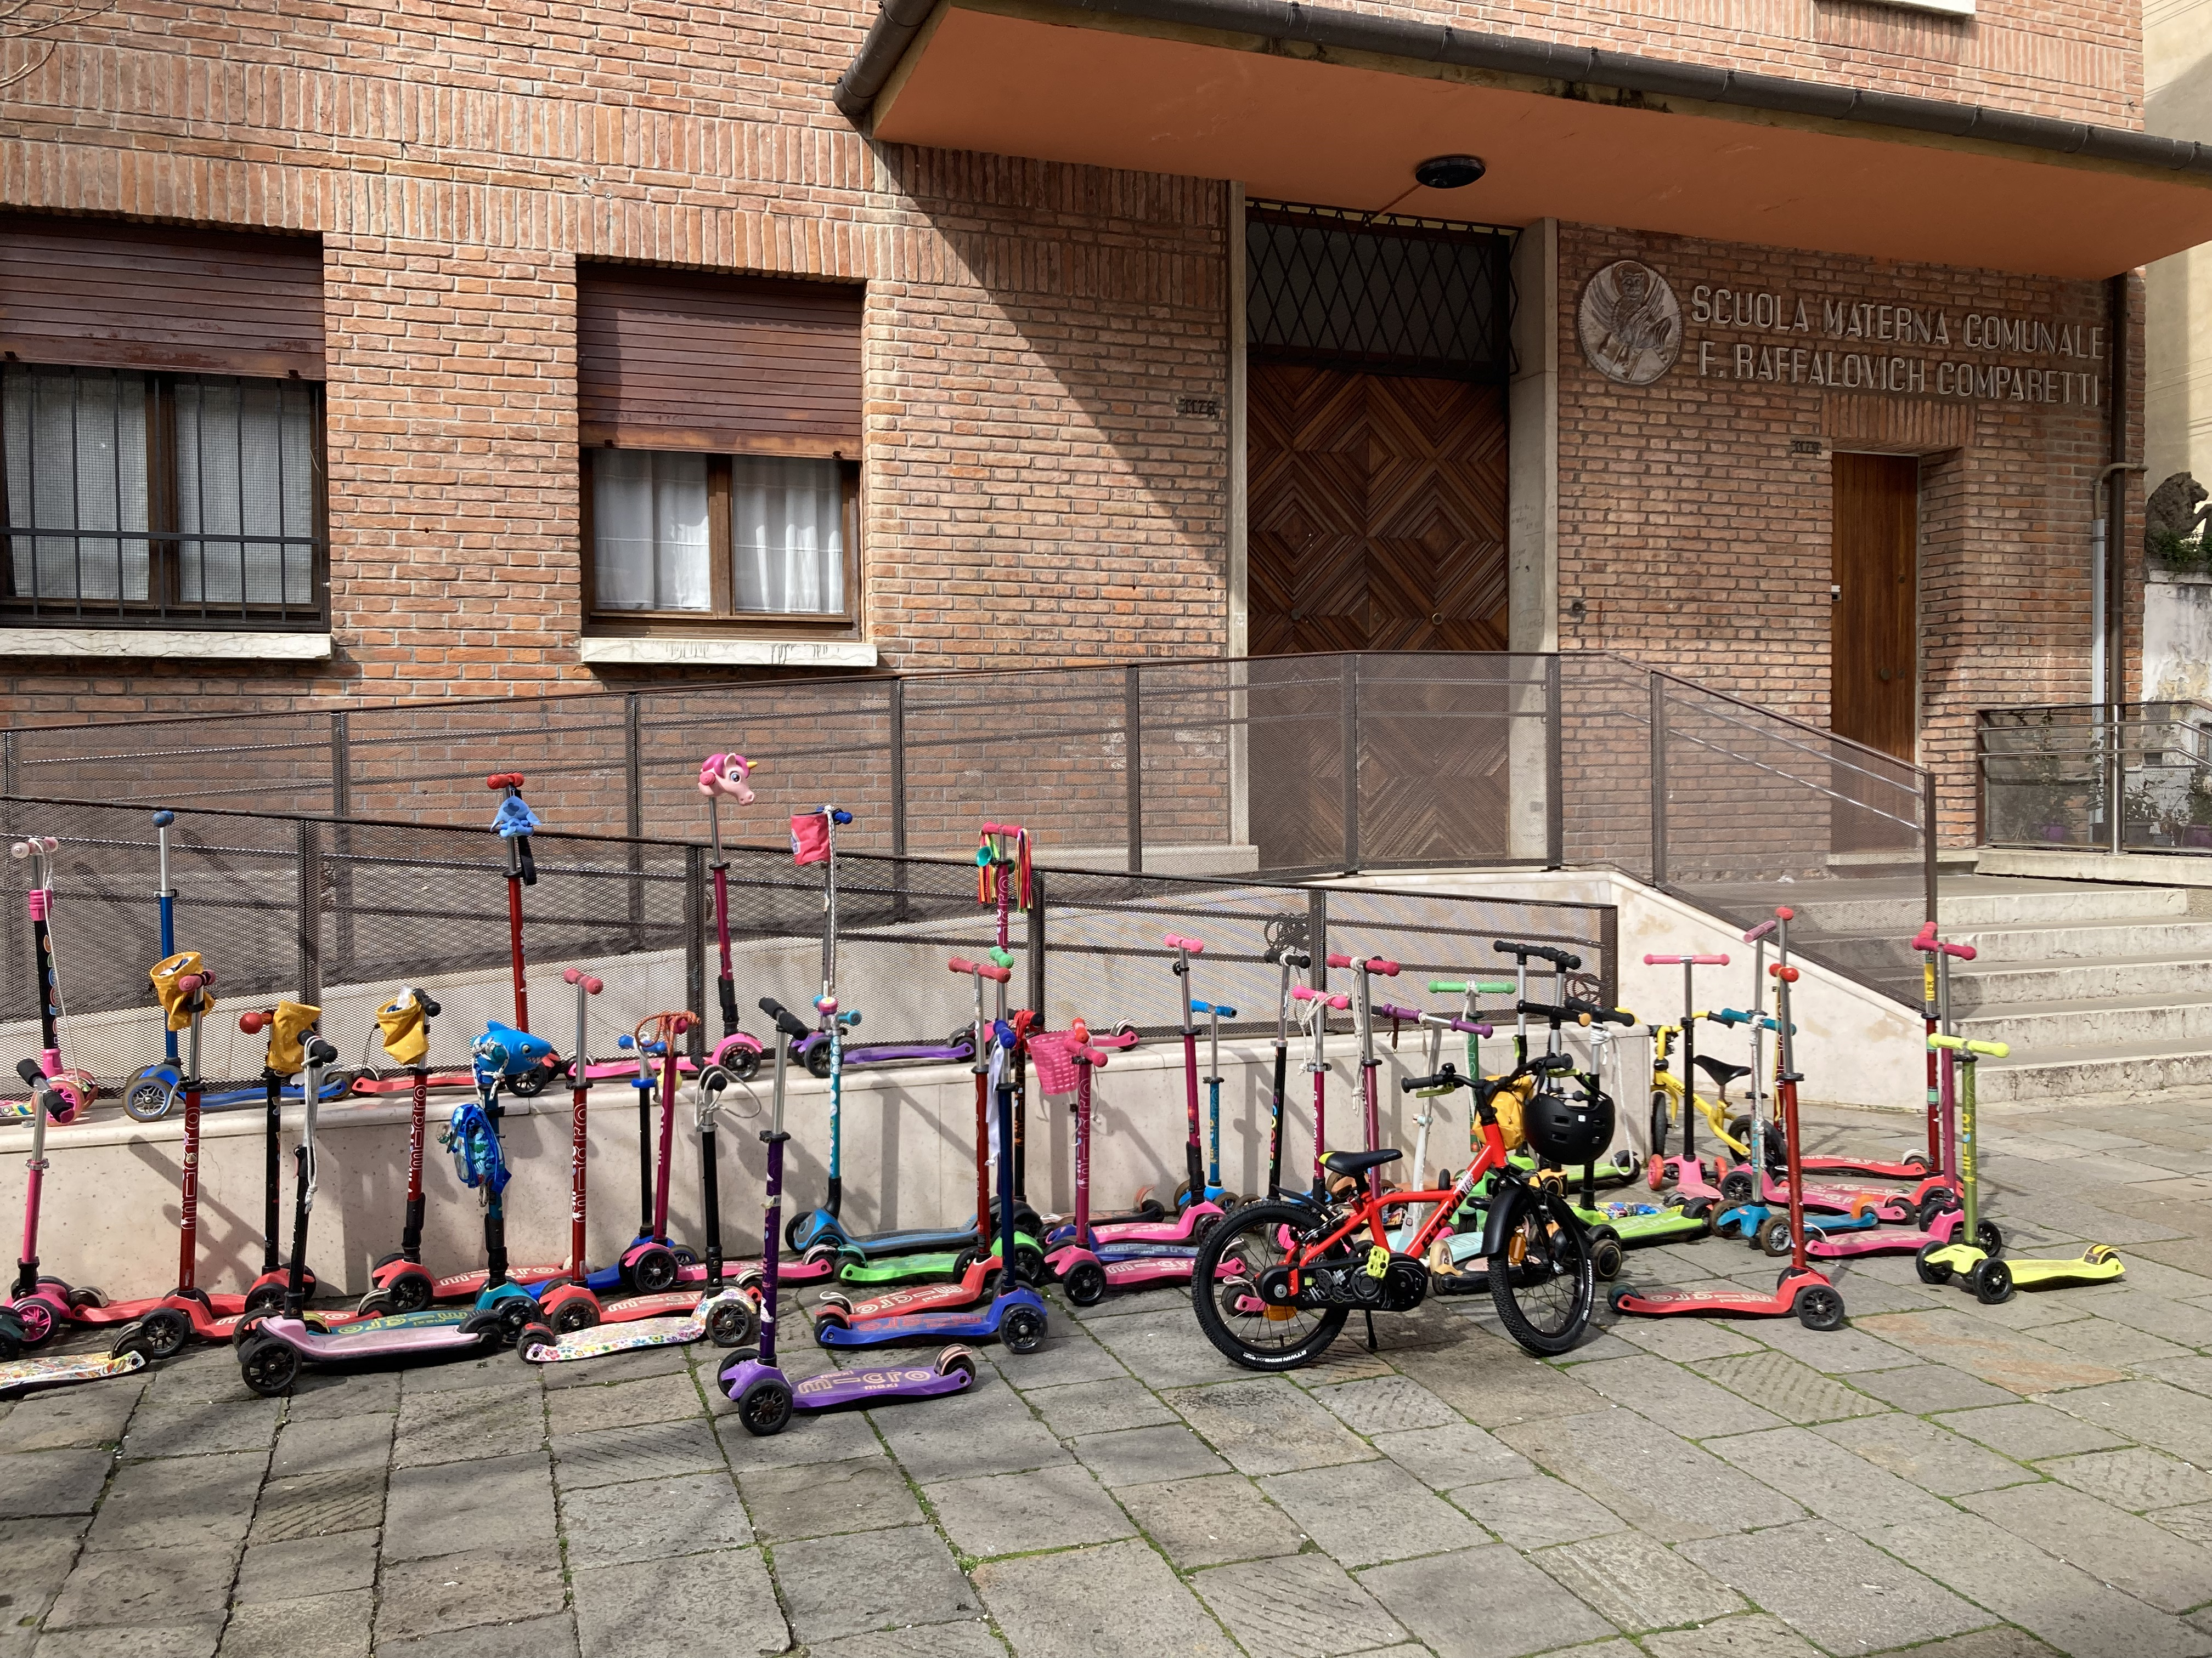


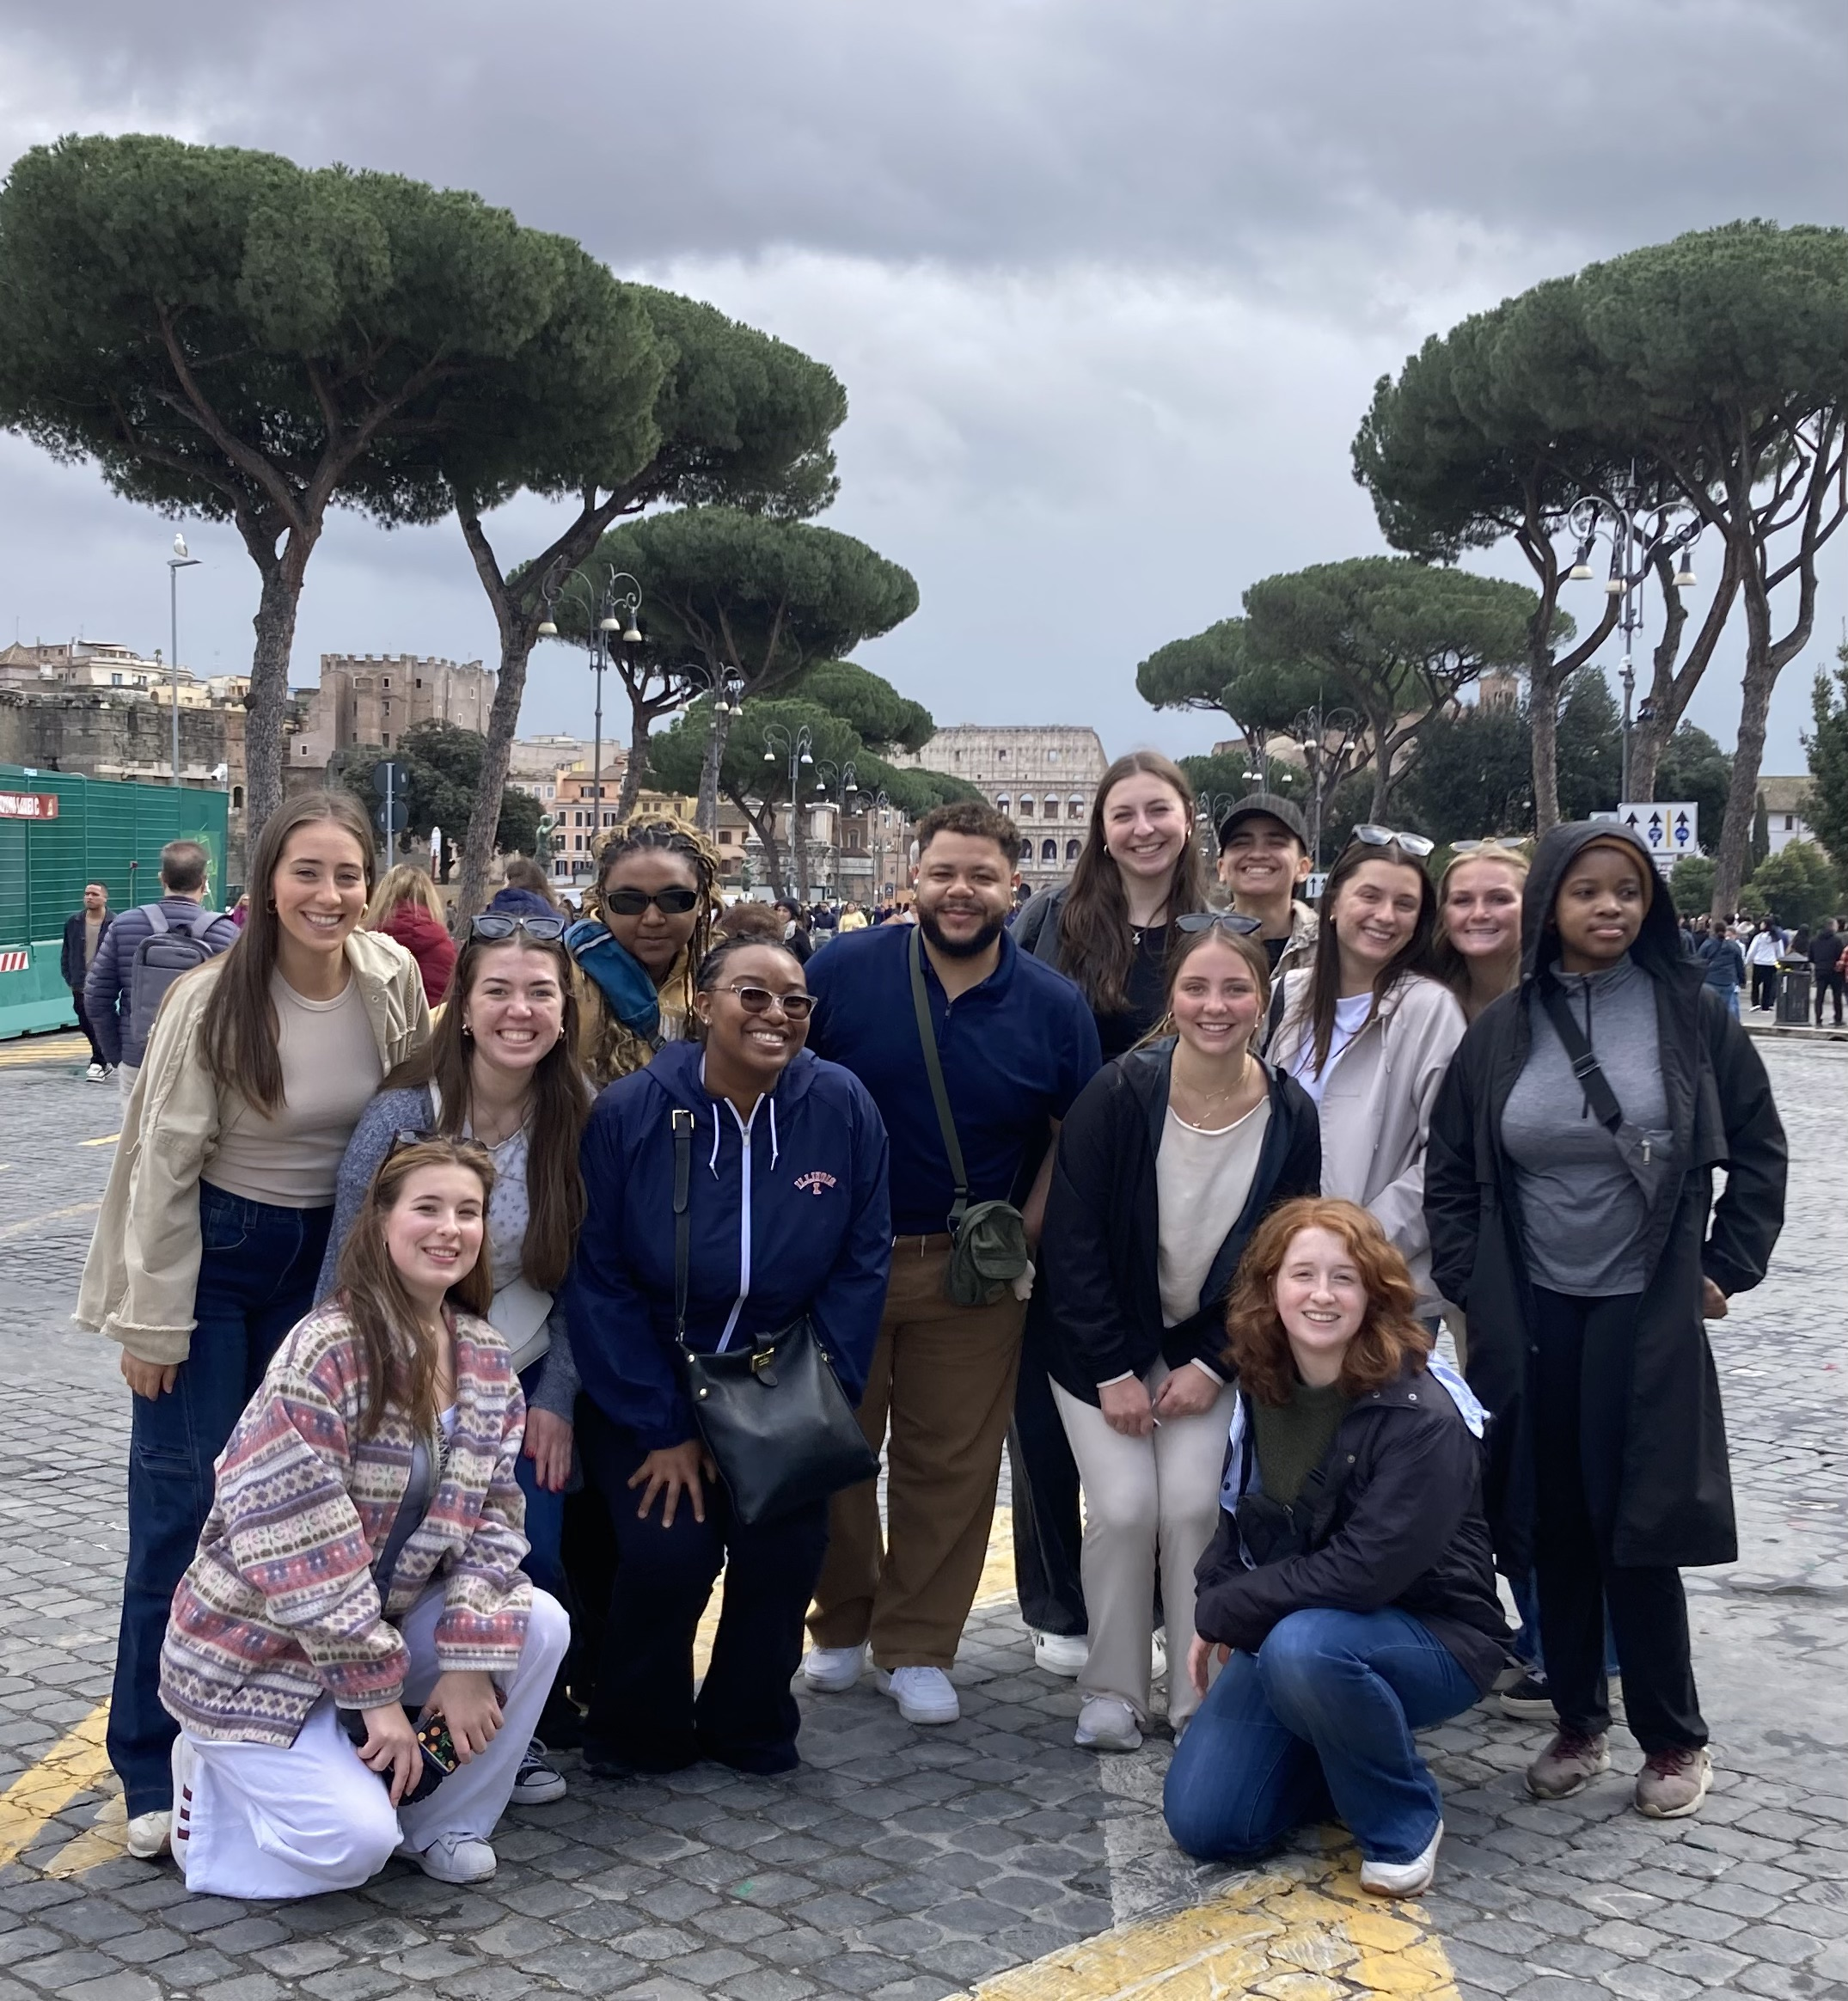
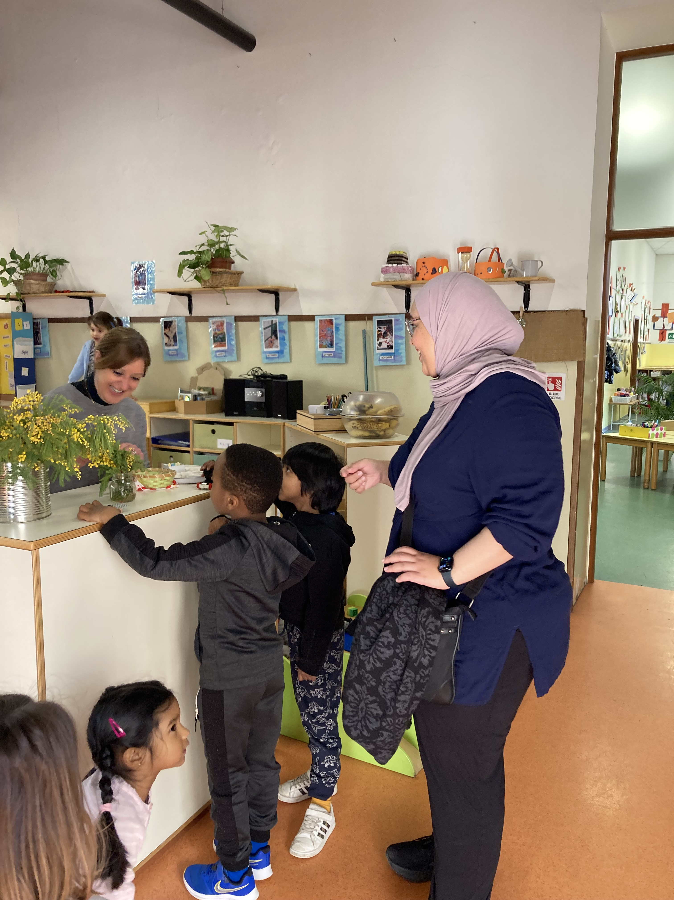
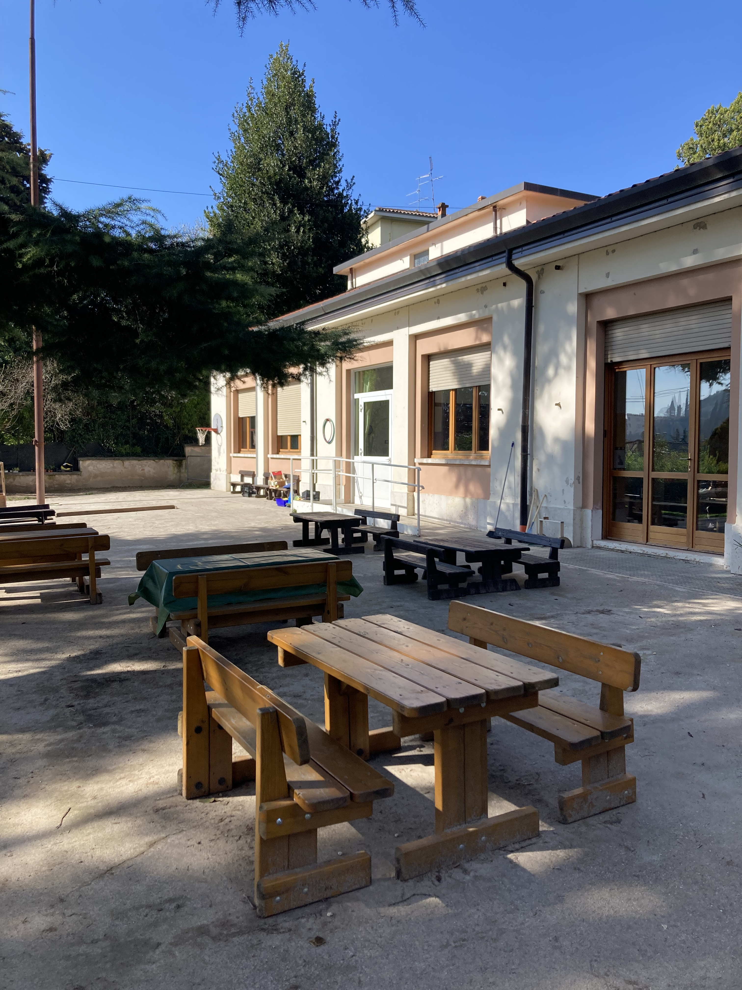
Teach abroad!!!
Dr. Jacob minniear

Slide 6
Important Information
Beginning of School-12 T, W, Th (Urbana 8:30-12:30)
You should be there 10 minutes before school starts
You will begin observing, but will take over more tasks (small groups, bell ringers, etc.) and build up to a 3-day take over. Don’t just sit there!
Some of you have more than one cooperating teacher. This is to give you experience in multiple grade levels and subject areas.
You are a guest in your teacher’s classroom. Please always be respectful.
You may not enter a building without a cleared background check if your district requires that. Do your background check before you leave for summer.
You are allowed 2 sick days

Slide 7
Placement expectations
Develop a routine schedule whereby you gain and sustain access to multiple classrooms and work collaboratively with multiple cooperating teachers and peers.
Follow the recommended guidelines for the gradual assumption of classroom responsibilities throughout the placement experience.
Attend weekly supervisor seminars (8 AM on Mondays, beginning 8/24/26) and complete all supervisor-directed activities (conferences, evaluations, Danielson-themed journal entries).
Develop a proactive communication plan with your supervisor, teammates and cooperating teachers.
Be professional in appearance and actions. Arrive on time and put devices away.
Please refrain from posting about placement on Social Media and set your profiles to private.

Slide 8
Supervised Placement
Beginning in the fall, each teacher candidate will be assigned a University supervisor.
Supervisors will visit school placements, observe candidates using the Danielson Framework, and provide feedback.
  Pre-conference prior to the observation
  Post-conference following the observation
  Weekly seminar on Monday mornings (8-8:50 a.m.) with your supervisor and supervision group

Slide 9
Teaching performance activity
Consider the following:
  “What knowledge, skills, and dispositions make for high-quality teaching performance? When you talk to a teacher or when you see a teacher, in action, what evidence could you gather that demonstrates ‘good teacher performance?’”

Slide 10
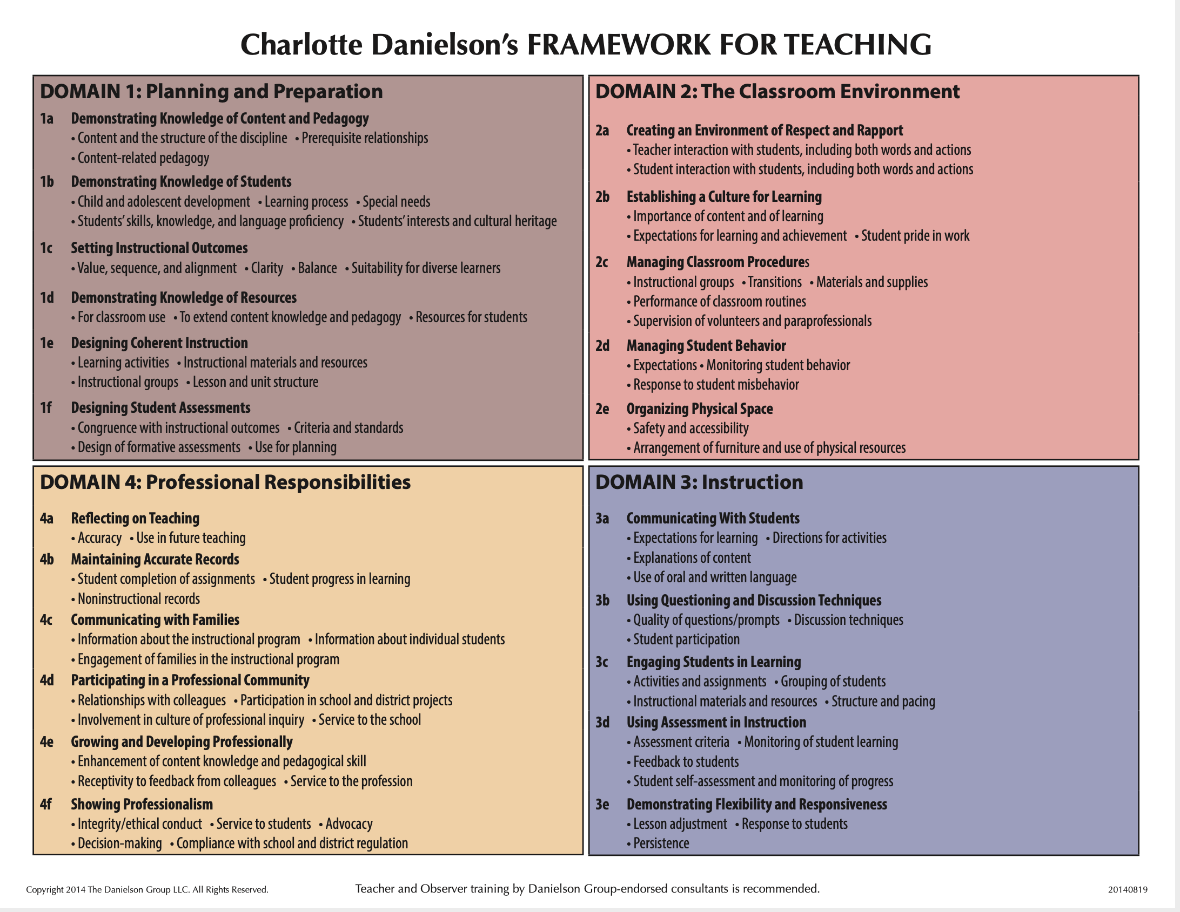
Danielson framework for teaching
Four domains
22 components
MANY indicators
On-stage vs. Off-stage
Big themes:
  Student-centered
  Engagement-driven
  Differentiated
  Reflective/responsive
Why does this matter?
  EFE/ST Evaluations
  Teacher evaluations

Slide 11
Professional behaviors
Checklist: Available on SCE website for your reference.
Professional dress – no sweats, no blue denim, no logo t-shirts
Communication
Relationship with cooperating teacher (interview, openness, compassion and care)

Slide 12
Student Teaching 2027
We have already started to place students for Spring 2027.
Be ready to interview in Spring-Fall 2026 (if necessary).
You may receive communication from a district. This does NOT guarantee your placement. PLEASE answer any requests by districts quickly and professionally.
You will receive your placement by the middle of November
EdTPA is waived for Spring 2027. You have to take your content tests by 8-24 and pass before December 15th 2026. SIGN UP NOW.
Student teaching will begin January 4th, and will follow your school calendar, NOT UIUC’s calendar. The last day will be April 30th.
RELAX!

Slide 13
Content test
https://www.il.nesinc.com/TestView.aspx?f=HTML_FRAG/IL305_TestPage.html​
Accommodations – Please get your documentation in order. Schedule early.​
​
Take it this summer when you have less going on​
Resources on SCE website​​ and CoTE portal
STUDY​
Materials are available on your CoTE portal. Under the Content Test requirement will be a “Click here for available content test study resources.” By clicking that link it will take you to all study resources available for ILTS content tests. These resources are available to students who also want to study for subsequent endorsements as well. Students must be logged into the VPN to access the materials. When logging into the VPN, after clicking connect, students will need to make sure the “Group:” is on TunnelAll in the drop-down box.

Slide 14
Endorsements
ESL and other content area endorsements make you more marketable as a candidate.
Look into seeing if you can get another endorsement.
In many cases, if might just mean taking one more 402 class!

Slide 15
Follow the chain of command
First, talk to instructors or cooperating teachers
Next, talk to me (placements)
If we can’t help, we will advise you who to contact next:
  Advisors
  Student Academic Affairs Office (SAAO)
  CI Department head
  Campus resources (Title IX, OSCR, Counseling Center, financial aid, etc.)
  If your issue is not resolved, please contact the Associate Dean of Undergraduate Affairs, Dr. Curtis Mason
The dean, Dr. Chrystalla Mouza, is responsible for overseeing the overall functioning of the College of Education and does not typically get involved in student issues unless they are extremely, EXTREMELY serious.

Slide 16
401 reminders (Math Only)
Please complete 2 observations with your cooperating teacher and have them fill out the form located here:
https://docs.google.com/spreadsheets/d/1Pd4TErdIoqjaSQOjXJyvE7dXFC-bR-vhd02Lt-d3Pps/edit#gid=0
sce@education.Illinois.edu
Please fill out your time card through the COTE portal and submit it at the end of the semester. You should have at least 45 hours.
Please fill out your cooperating teacher evaluation
Please write your cooperating teacher a thank you note. :)

Slide 17
QUESTIONS/COMMENTS/ ANNOUNCEMENTS
You will likely receive your fall placement letters by late April
  Make contact with your cooperating teacher
  Get a background check before you leave for summer
Check the webpage: https://sce.education.illinois.edu/current-candidates/middle-grades/edpr250mg-student
Email SCE sce@education.Illinois.edu
Email me caraknox@Illinois.edu
Come say hi! 120E Education Building

Slide 18


