Slide 1
EDPR 250 MG Orientation Fall 2022
April 14, 2022

Slide 2
Agenda
Welcome and updates
Teaching performance activity
Study Abroad
Teacher panel
An introduction to the edTPA
Student teaching—Spring 2023 (updates)
Questions/comments/announcements

Slide 3
Welcome and updates
Cara Gutzmer, Ph.D., Director of School and Community Experiences
Helpful resources:
Websites:
http://sce.education.illinois.edu/ (School and Community Experiences
http://www.cote.illinois.edu (Council on Teacher Education)
sce@education.Illinois.edu (email to contact our office)
Staff:
Sue Talbott, Clinical Experiences Specialist, SCE
Danielle Galardy, Office Manager, SCE
Brenda Clevenger Evans and Robin Craig, Licensure officers, CoTE
Academic advisors
Secondary Program Coordinator, Barbara Hug

Slide 4
EDPR 250 overview
Each of you are assigned to 2 Cooperating Teachers in the building you are placed in
Most, if not all, core content areas are represented by formal placements with cooperating teachers (Example: if you are seeking Math and Science endorsements, you are assigned to a Math teacher and to a Science teacher)
You will work with different teachers, potentially with different grade levels, and will have sustained experience in more than one content area (if applicable)
● If you are seeking the ESL and/or Bilingual endorsement, every effort has been made to assign you to a placement where you may earn clinical hours toward the endorsement
SCE website:

Slide 5
Placement Expectations
EXPECTATIONS:
1. Develop a routine schedule whereby you gain and sustain access to multiple classrooms and work collaboratively with multiple cooperating teachers and peers.
2. Follow the recommended guidelines for the gradual assumption of classroom responsibilities throughout the placement experience.
3. Attend weekly supervisor seminars (8 AM on Mondays, beginning 8/22/22) and complete all supervisor-directed activities (conferences, evaluations, Danielson-themed journal entries).
4. Develop a proactive communication plan with your supervisor, teammates and cooperating teachers.

Slide 6
Important Information
You will attend your placement:
T, W, Th (8:00 a.m. or the start of the school day until 12:00 p.m.)
You MUST remain at your placement school until 12:00 p.m. even if this is a lunchtime or your cooperating teacher tells you that you may leave!
Things to complete before the fall:
Bloodborne Pathogen training (BBP) must be renewed annually on the CoTE portal
Criminal Background Check (CBC) depends on district requirements--watch your email for district specific instructions

Slide 7
Teaching performance activity
Consider the following:
“What knowledge, skills, and dispositions make for high-quality teaching performance? When you talk to a teacher or when you see a teacher, in action, what evidence could you gather that demonstrates ‘good teacher performance?’”

Slide 8
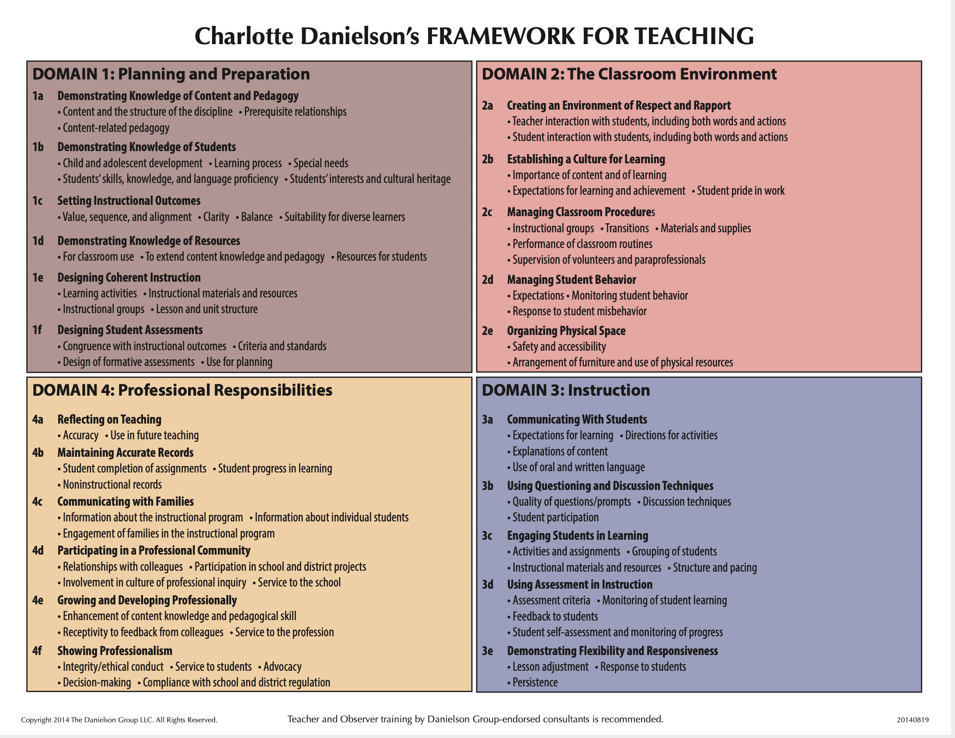
Danielson framework for teaching
Four domains
22 components
MANY indicators
On-stage vs. Off-stage
Big themes:
Student-centered
Engagement-driven
Differentiated
Reflective/responsive
Why does this matter?
EFE/ST Evaluations
Teacher evaluations

Slide 9
Professional behaviors
Checklist: Available on SCE website for your reference.
Professional dress – no sweats, no blue denim, no logo t-shirts
Communication
Relationship with cooperating teacher (interview, openness, compassion and care)

Slide 10
Supervised Placement
Beginning in the fall, each teacher candidate will be assigned a University supervisor.
Supervisors will visit school placements, observe candidates using the Danielson Framework, and provide feedback.
Pre-conference prior to the observation
Post-conference following the observation
Weekly seminar on Monday mornings (8-8:50 a.m.) with your supervisor and supervision group

Slide 11
What is the EDTPA?
Education Teacher Performance Assessment (edTPA)
State licensure performance examination for prospective teachers
Completed during student teaching (final semester)
Portfolio-based w/ video
LOTS of formative experiences and staff/faculty support along the way
What do you do now?
Review materials on EDPR 203 Canvas site
You will need to obtain permission for recording in the fall

Slide 12
Content test
https://www.il.nesinc.com/TestView.aspx?f=HTML_FRAG/IL305_TestPage.html
Accommodations – Please get your documentation in order. Schedule early.
You must take and pass it by December 15
Take it this summer when you have less going on
STUDY
Materials are available on your CoTE portal

Slide 13
Student teaching—spring 2023
We have already started to place students for Spring 2023
Be ready to interview in Spring 2022 through Fall 2022 (if necessary)
You may receive communication from a district. This does NOT guarantee your placement. PLEASE answer any requests by districts quickly and professionally.
You will receive your placement at the beginning of November
Student teaching will begin at the beginning of January, and will follow your school calendar, NOT UIUC’s calendar.
RELAX!

Slide 14
401 reminders (Math Only)
Please complete 2 observations with your cooperating teacher and have them fill out the form located here:
https://education.illinois.edu/docs/default-source/school-and-community-experiences/ci-401-clinical-observation-form.pdf?sfvrsn=b4738bd6_4
sce@education.Illinois.edu
Please fill out your time card through the COTE portal and submit it at the end of the semester. You should have at least 39 hours.
Please fill out your cooperating teacher evaluation
Please write your cooperating teacher a thank you note. :)

Slide 15
QUESTIONS/COMMENTS/ ANNOUNCEMENTS
You will likely receive your fall placement letters by late April
Make contact with your cooperating teacher
Get a background check before you leave for summer, if possible
REVIEW THE MATERIALS FOR EDPR 250 ON THE SCE WEBSITE
Questions?

