Slide 1
COOPERATING TEACHER ORIENTATION
EDPR 250 MG
Year 2 Candidates

Slide 2
AGENDA
Welcome
Course sequence
Expectations – Professionalism
Expectations – Academic
Giving feedback
Evaluations
Tuition waivers
Questions?

Slide 3
WELCOME!
Introductions/People to Know
Dr. Cara Gutzmer, Director of School and Community Experiences
Sue Talbott, Clinical Experiences Specialist
Danielle Galardy, Office Manager
Share some summer fun in the chat!
Share a story about a rock star candidate you hosted in the past.

Slide 4
COURSE SEQUENCE –YEAR 1
COURSES
PLACEMENTS
Intro to Teaching Diverse Students
Children's Literature
Disciplinary Literacy
Adolescent Educational Psychology
Fall
3 hours per week
Spring
3 hours per week (math only)

Slide 5
COURSE SEQUENCE – YEAR 2
COURSES
PLACEMENTS
Special Education
Content Methods
Disciplinary Writing
Seminar
Fall
Tuesday, Wednesday, Thursday mornings
Spring
STUDENT TEACHING

Slide 6
PROFESSIONAL EXPECTATIONS
Promptness: students should arrive on an agreed upon time before school starts
Mature and appropriate attire and hygiene
Communication
Engagement
Have a meeting with your candidate to discuss dress code, cell phone use, arrival/departure times, etc.
***Candidates are given two excused absences. Absences in excess must be made up.***
***Career Day is Thursday, November 7 – also an excused absence. ***
PROFESSIONAL BEHAVIOR CHECKLIST

Slide 7
ACADEMIC EXPECTATIONS
Four observations
Midterm/Final evaluation
Course assignments
Content test

Slide 8
CHARACTERISTICS OF FEEDBACK (POSITIVE AND CORRECTIVE)
Descriptive rather than evaluative
Similar to “evidence” on the Danielson, based on observations
Specific
Actionable

Slide 9
UNEXPECTED NEGATIVE FEEDBACK (IT'S AWKWARD FOR EVERYONE)
"I have some feedback for you, and it may be uncomfortable. I feel a bit uncomfortable myself, but I care about you and your development more than I care about how uncomfortable I feel. So, if you're feeling a little unsure about what to expect here, we are in this together. Can we talk a bit about _____________ ?"

Slide 10
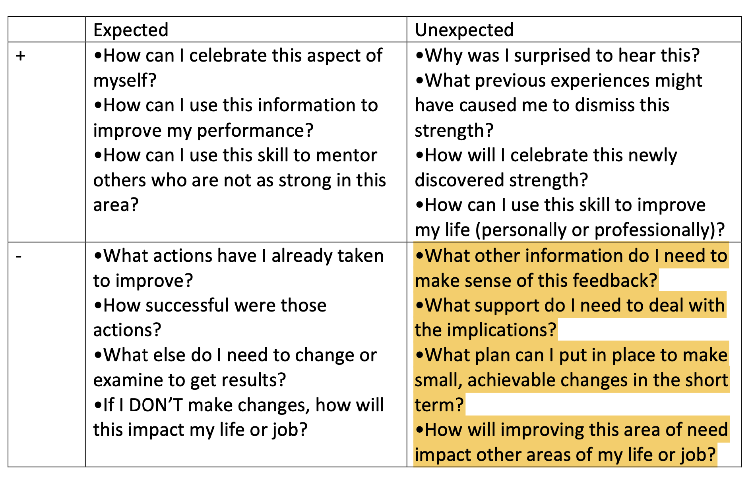

Slide 11
EVALUATIONS
Observation feedback
Weekly feedback
Midterm/Final
Portal: https://cote.illinois.edu/cote-portal-access
Support plans

Slide 12
SUPPORTS
Disposition Concern Form
Remediation Plan
Professional Growth Plan

Slide 13
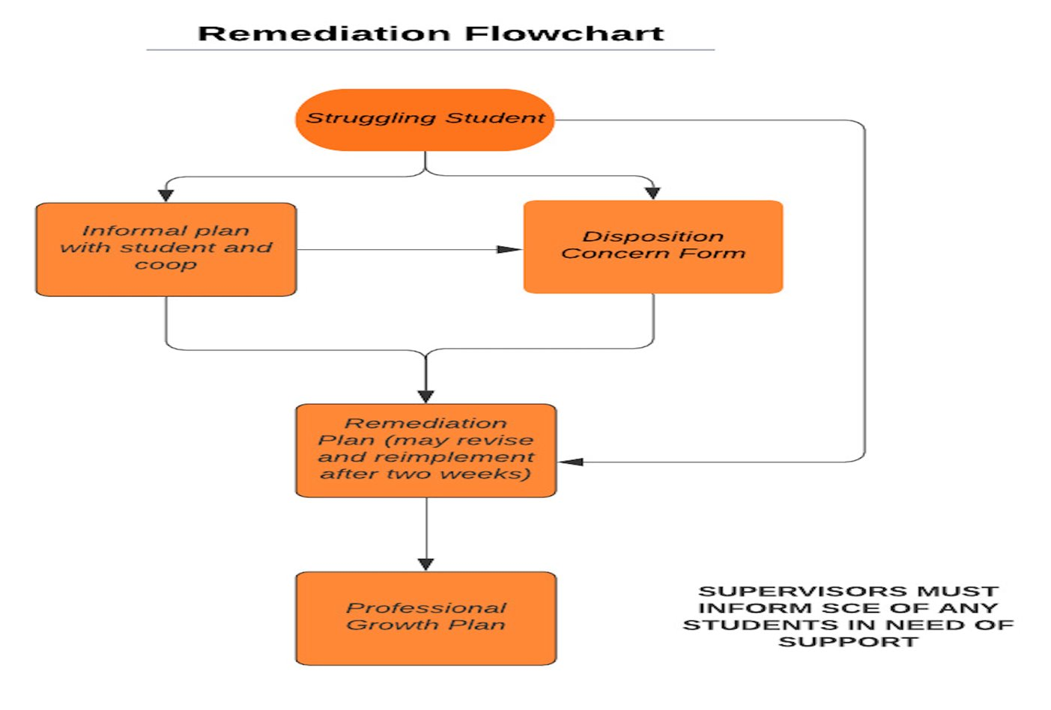

Slide 14
THE SUPERVISOR
Role, responsibility
Communication

Slide 15
IMMEDIATE ACTIONS TO WELCOME YOUR CANDIDATE
Exchange contact information (set boundaries!)
Explain the expectations for dress, cell phones, etc.
Show them where to put their belongings
Tour the school
Introduce them to staff
Teach them to access your online curriculum and classroom
Ask them to plan to introduce themselves to the students in a creative way
Post their name on the board
Explain the expectations for dress, cell phones, etc.
Be clear and specific about what you would like them to do the first few days and weeks

Slide 16
TUITION WAIVERS
Non-degree vs. Master’s/Endorsement/Doctoral
Contact Council on Teacher Education with questions!
cote-waivers@illinois.edu
https://cote.illinois.edu/cooperating-personnel-supervisors/cp-tuition-fee-waivers
Waiver Information (from SCE website)
If you are intending to use a Cooperating Teacher Waiver to complete an online degree through the College of Education, you must contact both Jena Pfoff (jrooseve@illinois.edu) and Linda Stimson (ls9@illinois.edu) after submitting your application to the Graduate College in order to utilize the Cooperating Teacher Waiver. Your subject line should read, “Cooperating Teacher Waiver – Online Program."

Slide 17
Still Recruiting for Spring!
We are in need of several cooperating teachers for spring, especially those who teach Math, Social Studies and ELA. Please talk to your colleagues and send them my way!
https://sce.education.illinois.edu/cooperating-teachers/prospective-cooperating-teachers

Slide 18
RESOURCES
SCE: https://sce.education.illinois.edu/
Portal: https://cote.illinois.edu/cote-portal-access
Email Cara or SCE directly:
caraknox@illinois.edu
sce@education.illinois.edu

Slide 20
QUESTIONS?

