Slide 1
EDPR250 orientation
School and Community Experiences
College of Education
Year 2 Fall Placements - ELED

Slide 2
Welcome!

Slide 3
agenda
Welcome!
People and places to know
Content test
Fall placements
Danielson
The supervisor’s role
edTPA
Student teaching update
Wrapping up this semester
Action items
Questions

Slide 4
Celebrations!
In the chat, describe briefly how your cooperating teacher effectively gets the class’s attention.
ATTENTION SIGNALS are one of the many basic competencies we will look for in the fall. Steal all the ideas you can! ☺

Slide 5
websites
Helpful resources:
Websites:
http://sce.education.illinois.edu (School and Community Experiences)
https://cote.illinois.edu (Council on Teacher Education)
sce@education.illinois.edu (email to contact our office)
There will also be a Canvas site for the class

Slide 6
People to know
Dr. Cara Gutzmer, Director, School and Community Experiences
Sue Talbott, Clinical Experiences Specialist, School and Community Experiences
Danielle Galardy, Office Manager, School and Community Experiences
Robin Craig, Licensure Officer, Council on Teacher Education
Dr. Scott Filkins, Program Coordinator
Amira, Keri, and Stacy – advisors
Dr. Wei Liu and Dr. Jacob Minniear - Study Abroad

Slide 7
Content test
https://www.il.nesinc.com/TestView.aspx?f=HTML_FRAG/IL305_TestPage.html
Elementary (305)
Accommodations – GET YOUR DOCUMENTATION IN ORDER!
Register to take the test by September 1st.
You must pass the test by December 15 in order to begin student teaching in January If you do not pass by this date, you will meet with your advisor to discuss your options.
STUDY!!!
Materials are available on your CoTE portal. Under the ”Content Test Requirement” you will see “Click here for available content test study resources.” Contact Room 25 if you need assistance with the VPN.
Free practice test vouchers (see email from SCE!)
Support sessions

Slide 8
About fall placements…. Sent Friday, April 19 at 3pm
Grade level considerations
Everyone will be in a classroom – no intervention or ESL support placements.
Think about how you will build a great relationship with your supervisor and cooperating teacher.
CARPOOL!!!!!

Slide 9
Fall placements
Three mornings plus one full day
Complete a VERY supported “mini-takeover” in November
Friday morning (8am!) seminar
PES class Friday 9am-noon
Start Monday, August 26, ends Wednesday, December 11
Two excused absences for illness and emergency – you must let your coop and supervisor know!
All students can expect to travel at some point their senior year
Great opportunity to see a variety of schools!
We want to give you a diverse range of experiences
CARPOOL to save money and make friends!
Must complete BBP training and background check prior to your August start date

Slide 10
Professional behaviors
Checklist: Available on SCE website for your reference.
Punctuality
Professional dress – no sweats, no logos
Communication
Relationship with cooperating teacher and supervisor
Here are some actual quotes from cooperating teachers and supervisors:
"My student teacher is a BLESSING. I don't know what I would do without her!"
"EM is an incredible asset to our school. She is making my job easier! I feel like she's more like my co-teacher than a student!"
"We are having so much FUN together!"
"JP has stepped up in every way possible. He shares data during referral meetings, is fearless in his interactions with some of our hard-to-reach students, and is active and 'present' every day."
“They are teaching me SO MUCH! I feel so rejuvenated and excited to teach! I will be at a loss when they leave. Can I keep them???”

Slide 11
What does it mean to be a guest?
What are the consequences of not following expectations – especially with regard to common courtesy and application of feedback?

Slide 12
Planning ahead
You will be TIRED! It takes time for your body and mind to adjust to the new hours and expectations. Your stamina will build over time.
You may not have very much time between placement and class. Pack a lunch and something to drink. Pack any meds or personal items you may need.
Good communication matters! Our support options are best if you tell us your needs!

Slide 13
Danielson framework for teaching
You will learn all about this evaluation tool during seminar!

Slide 14
Your supervisor
You are assigned a university supervisor who will teach your Friday seminar
Four observations (pre/post conference)
Midterm/Final evaluation
They will be your best support/coach/mentor!
Often initiate support plans

Slide 15
Chain of command
Chain of Cmmand
Please respect the protocols in place for addressing issues. Dean Mouza is responsible for the overall functioning of the College of Education and does not generally get involved in student issues unless they are very, very serious.
Course issues? -> Instructors
Registration issues? -> Advisors
Placement issues? -> School and Community Experiences
Licensure issues? -> Council on Teacher Education
We can also direct you to campus resources as needed. We are here to help!

Slide 16
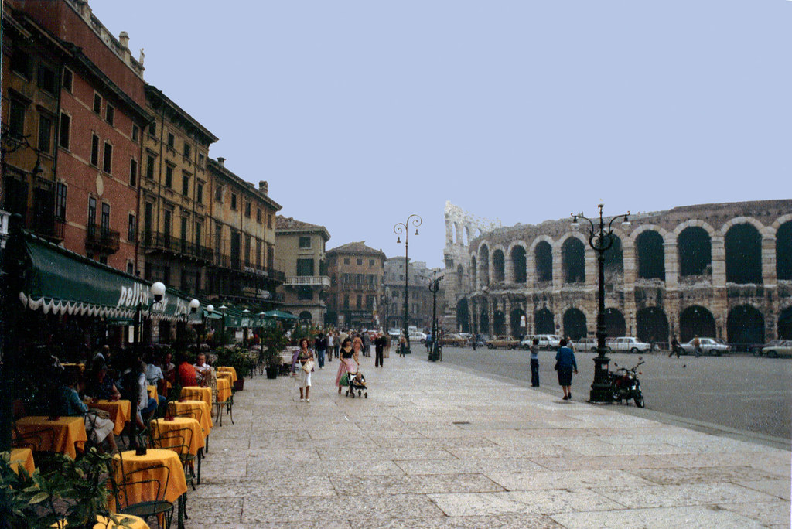
Teach abroad!!! Dr. Wei Liu Dr. Jacob minniear
Go to the Open House on Friday, 4/12 from 12pm-1pm! Room 260A Education!

Slide 17
Student teaching updates
Northern placements
Might have to interview
Take this process VERY SERIOUSLY
Placement confirmation comes from SCE, not from the district
All placements will be announced in late November
REMEMBER that you follow the calendar of the district to which you are assigned!
Placements begin January 6

Slide 18
Wrapping up the semester (checklist will be sent)
Upload your two observation feedback forms to Canvas by Friday May 10 at 5pm (Many of you have already done this. Good job!)
Enter your hours on the timesheet on COTE
Remind your cooperating teacher to complete your final evaluation (COTE)
Complete the cooperating teacher evaluation on COTE
If you are pursuing an endorsement, ask your cooperating teacher to write a letter to verify your hours.
You will submit that letter to Robin Craig (rcraig@Illinois.edu) at COTE.
THE LETTER MUST BE ON SCHOOL LETTERHEAD OR COME FROM THE TEACHER’S SCHOOL EMAIL
Please send an email or write a note to your cooperating teacher to say thank you for hosting you ☺
Send an introductory email to your fall cooperating teacher
Background checks, BBP
Have a safe and wonderful summer break!

Slide 19
MORE Action items
Check everything off the end of the semester list (posted on Canvas next week!)
Respond quickly and professionally to any outreach from northern districts
Wait patiently for fall placement information and take care of everything immediately for a smooth start in August.
Register for the content test
Do not freak out ☺

Slide 20
Questions

