Slide 2
Early Childhood Education
Professional Education Induction Meeting
March 5, 2024
Notes:
Amira

Slide 3
Title
Welcome & Introductions
Early Childhood Education Program Representative (Sue Talbott of SCE)
School & Community Experiences (SCE)
Student Academic Affairs Office (SAAO)

Slide 4
Title
Welcome & Introductions
Sue Talbott
Program Overview
Early Childhood Education

Slide 5
Title
Undergraduate Program Support
Scott Filkins, K-12 program coordinator
School & Community Experiences (SCE)
Cara Gutzmer, Director
Sue Talbott, Clinical Experiences Specialist
Danielle Galardy, Office Manager
Student Academic Affairs Office (SAAO)
Amira Al-Mutairi, Lead Academic Advisor (Last names A-F)
Stacy Clemmons, Academic Advisor (Last names G-N)
Keri Marion, Academic Advisor( Last names O-Z)
Hannah Duran, Admissions & Records Coordinator
Notes:
Amira-

Slide 6
Title
Support Units
SAAO- Undergraduate student advising
Degree Progress
Registration
Overall Program Questions
Clinical Embedded Counselor
SCE- Placement
Early Field Experiences
Student Teaching
Placement Applications
Department of Curriculum and Instruction (CI)
Program Coordinator
Instructors
Teaching Assistants
Faculty
COTE- Licensure
Licensure Requirements
Applying for Teaching License
Endorsements
Notes:
Stacy Review role of each office—SAAO=degree, SCE=placement, CoTE=licensure (not likely to be in contact until senior year), go tot the people that your problem fits under

Slide 7
Title
Student Academic Affairs Office (SAAO)
Amira Al-Mutairi, Lead Academic Advisor (Last Names A-F)
Stacy Clemmons, Academic Advisor (Last Names G-N)
Keri Marion, Academic Advisor (Last Names O-Z)
Hannah Duran, Admissions & Records Coordinator
Vacant, Assistant Dean
Notes:
Amira-

Slide 8
Title
Degree Requirements
DARS Audit
https://registrar.illinois.edu/academic-records/dars-audit/
Forms & Petitions Page- Advising Checklists and other important forms
https://education.illinois.edu/current-students/undergraduate/forms-petitions-resources
Notes:
Stacy: Review role of each office—SAAO=degree, SCE=placement, CoTE=licensure

Slide 9
Title
Degree Requirements
Advising Checklist notes:
Must complete Gateway before Fall 2024
MATH 103 strongly recommended QR gen ed taken prior to CI 443 Spring 2025
Can take EPSY 401 Fall 2024 or Spring 2025
Before your advising appointment:
Run a DARS audit
Complete advising checklist
Notes:
Amira DARS: tool, but not perfect
Check for exceptions
Transfer courses don’t always sort correctly, let us know at appt

Slide 10
Title
Course Registration Process
Must complete CoTE orientation, required trainings (safety training, mandated reporter training), and create ELIS account send IEIN to CoTE to register for professional education courses.
Priority registration begins April 1
Don’t drop a course without talking to advisor
Notes:
Amira
Important dates: March 11-time tickets available in Enterprise, March 8—drop deadline,

Slide 11
Title
Licensure Requirements
CoTE
Licensure: Birth-grade 2, pre-K SPED approval
You must continue to monitor your email and review the CoTE website for up-to-date requirements
C- rule
Licensure exams*:
Content test-before student teaching (Due December 15, 2024)
edTPA-completed during student teaching, submitted prior to recommendation for licensure
Notes:
AMira

Slide 12
Title
Licensure Requirements
CoTE
Endorsements:
ESL & Bilingual
Specific course sequences
100 clock hours
Transitional bilingual/ESL
Exam required for Bilingual endorsement
World Language
18 credit hours (AP okay)
Language content test OR State or Global Seal of Biliteracy affixed to ELIS account"
Additional languages can be added with content test only
Notes:
Amira Difference between ESL, bi, and language
content tests for Bilingual Education and World Language endorsements may be waived for those holding an Illinois or Global Seal of Biliteracy in that language'
Transitional bilingual endorsement
Once you have one foreign language, you can add others by passing the content test
Normal to take some of the ESL/Bi coursework as an undergrad and finish the endorsement post-bacc

Slide 13
Title
Council on Teacher Education Website
(CoTE, "the portal")
https://cote.illinois.edu/cote-portal-access
The CoTE website deals with licensure, field-related requirements, and documentation. Please bookmark it and refer to it frequently when you have questions.
•Licensure information
•Time sheet
•Evaluations
•Required trainings

Slide 14
Title
Mandatory Licensure Information
You will receive details via email from the Council on Teacher Education (CoTE)

Slide 15
Title
Candidate Contract
Teacher Candidate Contract
Notes:
Stacy:If we don’t have this on record, you won’t be able to register for fall professional ed

Slide 16
Title
School and Community Experiences
(SCE)
Dr. Cara Gutzmer, Director
Sue Talbott, Clinical Experiences Specialist
Danielle Galardy, Office Manager

Slide 17
Title
SCE Website
https://sce.education.illinois.edu/
The SCE website is for field placement information and clinical assignments. Please bookmark it and refer to it frequently when you have questions.
•Forms used in clinical experiences
•Handbooks, timelines, guidelines
•Remediation forms
•Information for cooperating teachers, supervisors, and students pertaining to clinical experiences
•Links to presentations
•Links to other resources
Notes:
Sue :If we don’t have this on record, you won’t be able to register for fall professional ed

Slide 18
Title
Placements
Year One – Fall Early Field | Year One – Spring Early Field | Year Two – Fall Early Field | Year Two – Spring STUDENT TEACHING
HDFS 301 Infant and Toddler placement at the Child Development Lab | CI 420 Primary Placement (K-2) Supervised by a university mentor – three observations One morning per week, then builds to four mornings per week | EDPR 420 Preschool Placement Supervised by a university mentor – four observations Four mornings per week, then builds to five mornings per week | EDPR 432 Most student teach in kindergarten All day, every day! Begins January 6 Supervisor observes a minimum of five lessons. Seminar arranged by supervisor. CI 445 Northern placements
Notes:
Sue :If we don’t have this on record, you won’t be able to register for fall professional ed

Slide 19
Title
About Student Teaching
Option to teach locally or in northern suburbs/CPS
Option to participate in Teach Abroad program: https://international.education.illinois.edu/study-abroad/teach-abroad
You follow the calendar of your assigned district, which means:
Your spring break may be different from UIUC's
You will begin your placement before UIUC classes begin
You will have a few days off sprinkled in your experience (school holidays!)
Most candidates have only two course requirements during student teaching
Seminar for EDPR 432 (arranged by supervisor)
CI 445 (online)
Notes:
Sue :If we don’t have this on record, you won’t be able to register for fall professional ed

Slide 20
Title
Placement Application
Due Friday, March 29 at 5pm
Look at grade level preferences carefully and think about what you want for student teaching.
Use the comment box!
Application FAQs are posted on SCE website for your reference
Let’s take a look at the application!
https://appserv7.admin.uillinois.edu/FormBuilderSurvey/Survey/6fcca4c2-7618-4bad-8da8-af1700999620/Survey
Notes:
Sue :If we don’t have this on record, you won’t be able to register for fall professional ed

Slide 21
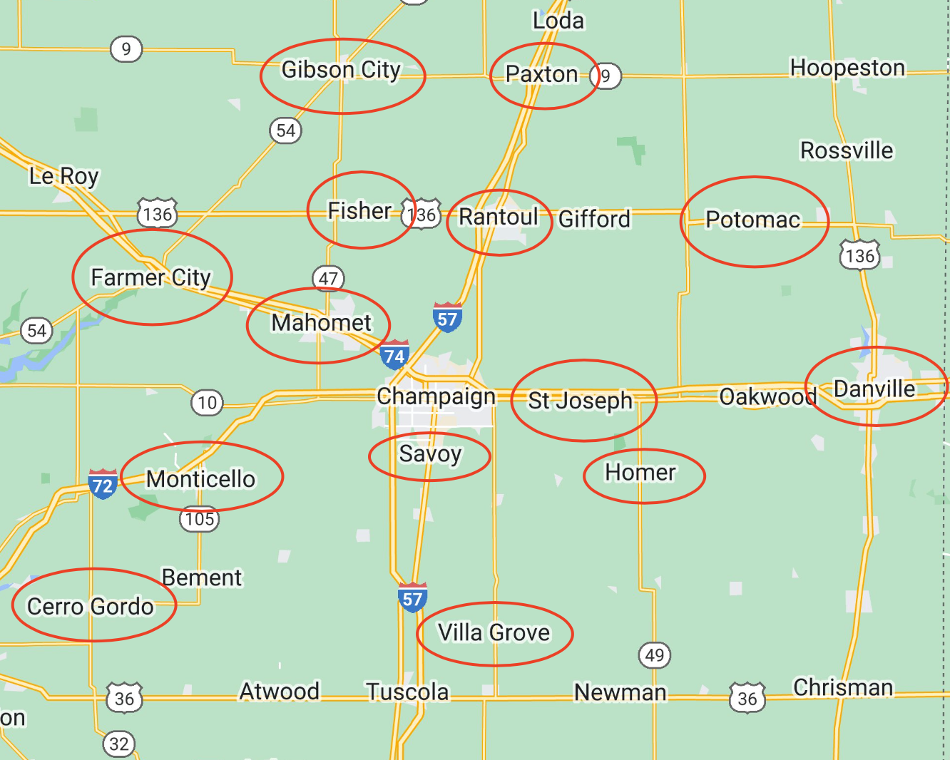
Title
Local Map
55 mile radius from campus
Notes:
SCE

Slide 22
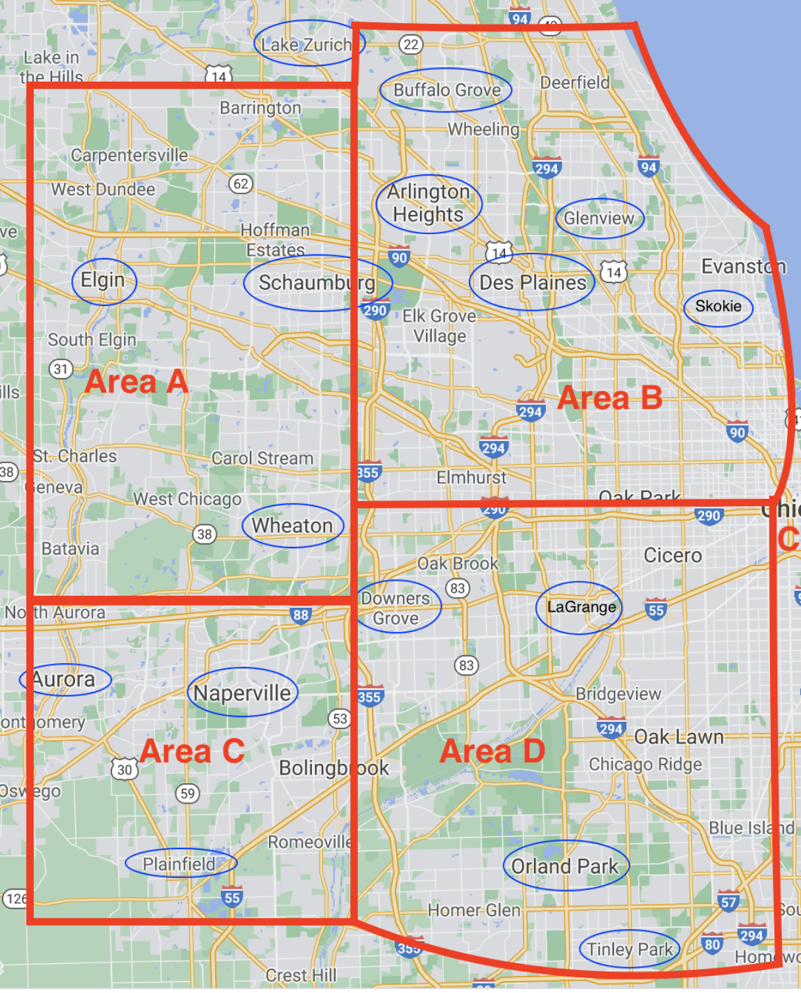
Title
Northern Placement Map
Notes:
SCE

Slide 23
Title
If you have concerns....
COMMUNICATE! We are all here to support you in your journey!
Start with instructors, cooperating teachers, and supervisors
•If you need more support, contact School and Community Experiences (Sue!) or the program coordinator (Scott!).
•The assistant dean can also help.
•NOTE: Dr. Mouza, the Dean of the College of Education, oversees the general functioning of the college and is not typically involved in individual student concerns. Please refrain from contacting her.
Notes:
Amira-

Slide 24
Title
Helpful Hints
Plan to make an excellent first impression in your placements. Professional behaviors, such as maturity, good hygiene, clothing appropriate to the setting, and positive communication are critical.
LOCK DOWN YOUR SOCIAL MEDIA!
If you work during the semester, you need to plan your hours around your courses and your placement requirements. Holding a job during your last semester is very difficult. Plan ahead, if possible.
If you do not have your own transportation, plan to live close to a bus line so you can get to your school. We know the MTD isn't always convenient, but it's FREE!
Carpooling is often necessary. It's fun!
If you want to student teach in the northern suburbs, plan your fall campus housing early.
You will be a very visible and valued representative of the College of Education. Make us proud!
Notes:
SCE

Slide 25
Title
Next Steps
Notes:
SCE

Slide 26
Title
Next Steps Continued…
Review DARS Audit & Advising Checklist
Sign teacher licensure contract- Attend Express Advising on Wednesday with any questions
Must complete CoTE orientation, required trainings (safety training, mandated reporter training), and create ELIS account send IEIN to CoTE to register for professional education courses
Register according to time ticket
Be on the lookout for a next steps email
Notes:
SAAO

Slide 27
Questions?
Notes:
SAAO

