Slide 1
COOPERATING TEACHER ORIENTATION
CI 403
Year 2 Candidates

Slide 2
AGENDA
Welcome
Course sequence
Expectations – Professionalism
Expectations – Academic
Giving feedback
Evaluations
Tuition waivers
Questions?

Slide 3
WELCOME!
Introductions/People to Know
  Dr. Cara Gutzmer, Director of School and Community Experiences
  Sue Talbott, Clinical Experiences Specialist
  Danielle Galardy, Office Manager
Share some summer fun in the chat
Share a story about an amazing candidate you hosted in the past

Slide 4
COURSE SEQUENCE –YEAR 1
COURSES
PLACEMENTS
Introduction to teaching in a Diverse Society
Disciplinary literacy
Spring
  3 hours per week

Slide 5

COURSE SEQUENCE – YEAR 2
COURSES
PLACEMENTS
Special Education
Teaching Diverse High School Students
Assessing Student performance
Seminar
Fall
  6 hours/week
  3 hours on Thursday and 3 hours arranged with the cooperating teacher
Spring
  STUDENT TEACHING

Slide 6
PROFESSIONAL EXPECTATIONS
Promptness
Mature and appropriate attire and hygiene
Communication
Engagement
Have a meeting with your candidate to discuss dress code, cell phone use, arrival/departure times, etc.
***Candidates are given 3 hours excused for illness. Absences in excess must be made up.***
***Career Day is also an excused absence. ***
PROFESSIONAL BEHAVIOR CHECKLIST

Slide 7
THE SUPERVISOR
Role, responsibility
Communication- please email them feedback weekly

Slide 8
ACADEMIC EXPECTATIONS
Two observations by University Supervisor
Midterm/Final evaluation and conference with supervisor, student and cooperating teacher
Course assignments
Classroom Engagement
Content test

Slide 9
GIVING FEEDBACK
How do you reinforce?
How do you correct and shape?

Slide 10
CHARACTERISTICS OF FEEDBACK
(POSITIVE AND CORRECTIVE)
Descriptive rather than evaluative
Similar to “evidence” on the Danielson, based on observations
Specific
Actionable

Slide 11
UNEXPECTED NEGATIVE FEEDBACK
(IT'S AWKWARD FOR EVERYONE)
"I have some feedback for you, and it may be uncomfortable. I feel a bit uncomfortable myself, but I care about you and your development more than I care about how uncomfortable I feel. So, if you're feeling a little unsure about what to expect here, we are in this together. Can we talk a bit about _____________ ?"

Slide 12
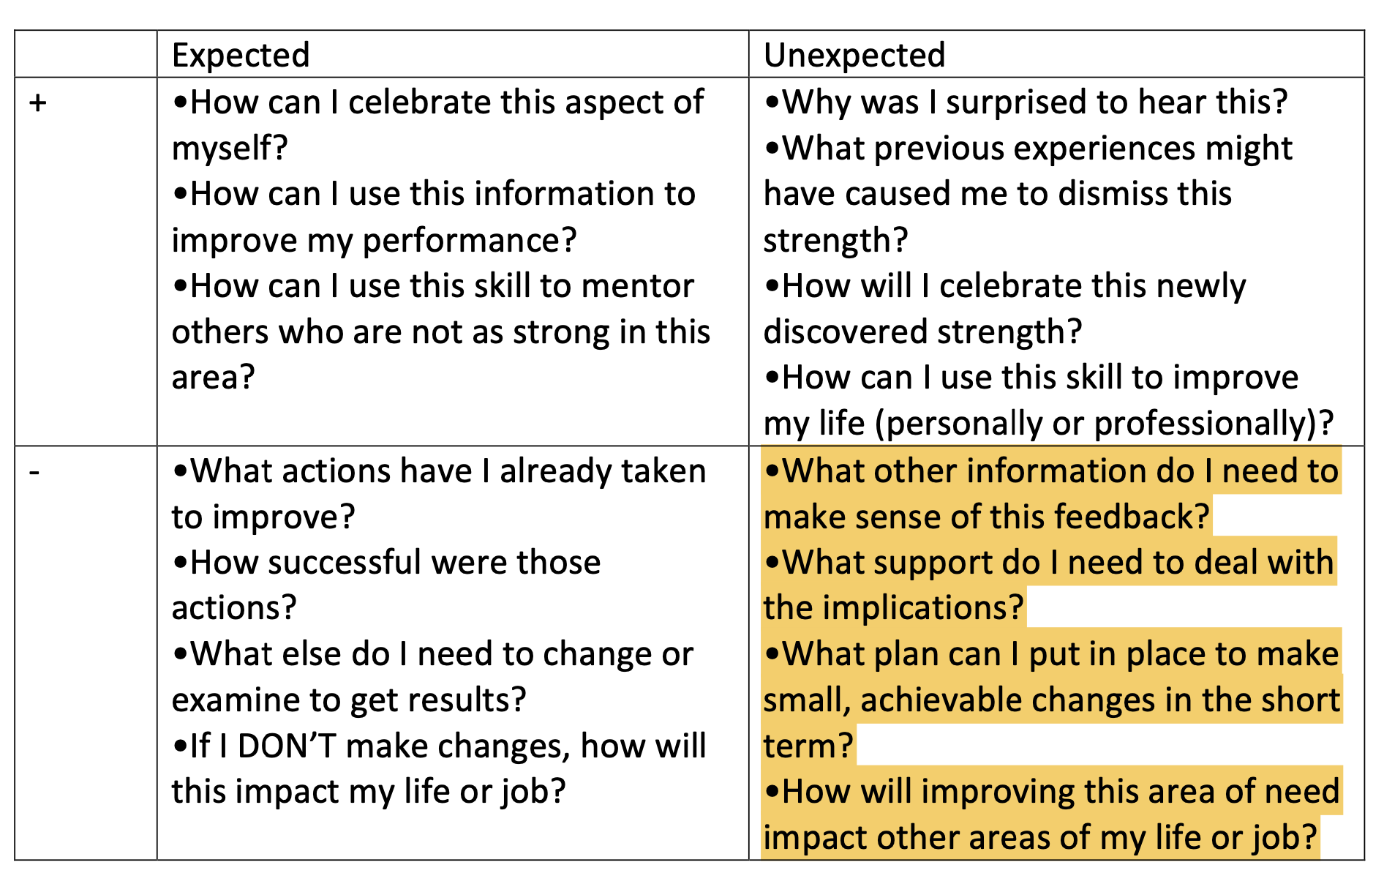

Slide 13
EVALUATIONS
Observation feedback
Weekly feedback to supervisor
Midterm/Final
  Portal: https://cote.illinois.edu/cote-portal-access
Support plans

Slide 14
SUPPORTS
Disposition Concern Form- please contact your student’s supervisor early if concerns arise
Remediation Plan
Professional Growth Plan

Slide 15
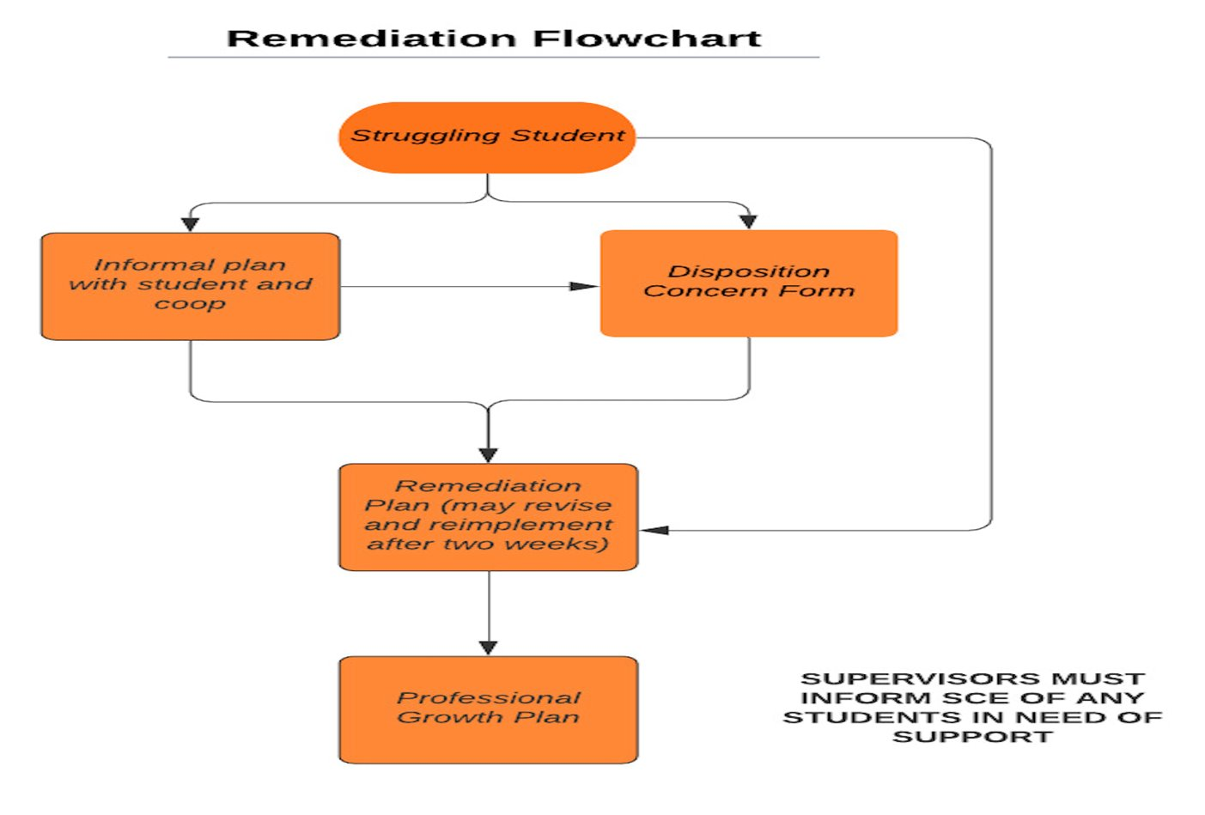

Slide 16
IMMEDIATE ACTIONS TO WELCOME YOUR CANDIDATE
Exchange contact information (set boundaries!)
Show them where to put their belongings
Tour the school
Introduce them to staff
Teach them to access your online curriculum and classroom
Ask them to plan to introduce themselves to the students in a creative way
Post their name on the board
Explain the expectations for dress, cell phones, etc.
Be clear and specific about what you would like them to do the first few days and weeks

Slide 17
TUITION WAIVERS
Non-degree vs. Master’s/Endorsement/Doctoral
Contact Council on Teacher Education with questions!
  cote-waivers@illinois.edu
  https://cote.illinois.edu/cooperating-personnel-supervisors/cp-tuition-fee-waivers
Waiver Information (from SCE website)
  If you are intending to use a Cooperating Teacher Waiver to complete an online degree through the College of Education, you must contact both Jena Pfoff (jrooseve@illinois.edu) and Linda Stimson (ls9@illinois.edu) after submitting your application to the Graduate College in order to utilize the Cooperating Teacher Waiver. Your subject line should read, “Cooperating Teacher Waiver – Online Program."

Slide 18
RESOURCES
SCE: https://sce.education.illinois.edu/
Portal: https://cote.illinois.edu/cote-portal-access
Email Cara or SCE directly:
  caraknox@illinois.edu
  sce@education.illinois.edu

Slide 19

Still Recruiting for Spring!
We are in need of a few cooperating teachers for spring, especially those who teach Social Studies, English and Science. Please talk to your colleagues and send them my way!
https://sce.education.illinois.edu/cooperating-teachers/prospective-cooperating-teachers

Slide 20
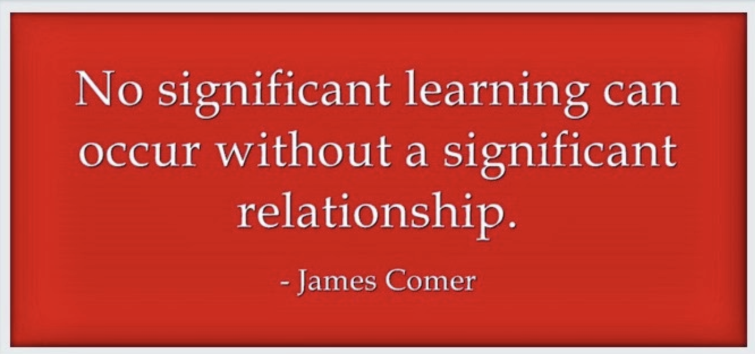

Slide 21

QUESTIONS?

