Slide 1
COOPERATING TEACHER ORIENTATION
CI 410
Year 1 Candidates

Slide 2
AGENDA
Welcome
Course sequence
Expectations – Professionalism
Expectations – Academic
Giving feedback
Evaluations
Tuition waivers
Questions?

Slide 3
WELCOME!
Introductions/People to Know
Dr. Cara Gutzmer, Director of School and Community Experiences
Sue Talbott, Clinical Experiences Specialist
Danielle Galardy, Office Manager
Share some summer fun in the chat!
Share a story about a rock star candidate you hosted in the past!

Slide 4
COURSE SEQUENCE –YEAR 1
COURSES
PLACEMENTS
Intro to Teaching Diverse Students
Children's Literature
Disciplinary Literacy
Adolescent Educational Psychology
Fall
3 hours per week
Spring
3 hours per week (math only)

Slide 5
COURSE SEQUENCE – YEAR 2
COURSES
PLACEMENTS
Special Education
Content Methods
Disciplinary Writing
Seminar
Fall
Tuesday, Wednesday, Thursday mornings
Spring
STUDENT TEACHING

Slide 6
PROFESSIONAL EXPECTATIONS
Promptness
Mature and appropriate attire and hygiene
Communication
Engagement
PROFESSIONAL BEHAVIOR CHECKLIST

Slide 7
BE PROACTIVE!
Have a meeting with your candidate to discuss dress code, cell phone use, arrival/departure times, etc.
If you have multiple candidates in your building, meet as a group so everyone hears the same message.

Slide 8
ACADEMIC EXPECTATIONS
Teach two lessons and ask cooperating teacher for written feedback
Final evaluation
Course assignments

Slide 9
GIVING FEEDBACK
How do you reinforce?
How do you correct and shape?
Do you have a way to track your positive to corrective ratio?

Slide 10
CHARACTERISTICS OF FEEDBACK (POSITIVE AND CORRECTIVE)
Descriptive rather than evaluative
Similar to “evidence” on the Danielson, based on observations
Specific
Actionable

Slide 11
UNEXPECTED NEGATIVE FEEDBACK (IT'S AWKWARD FOR EVERYONE)
"I have some feedback for you, and it may be uncomfortable. I feel a bit uncomfortable myself, but I care about you and your development more than I care about how uncomfortable I feel. So, if you're feeling a little unsure about what to expect here, we are in this together. Can we talk a bit about _____________ ?"

Slide 12
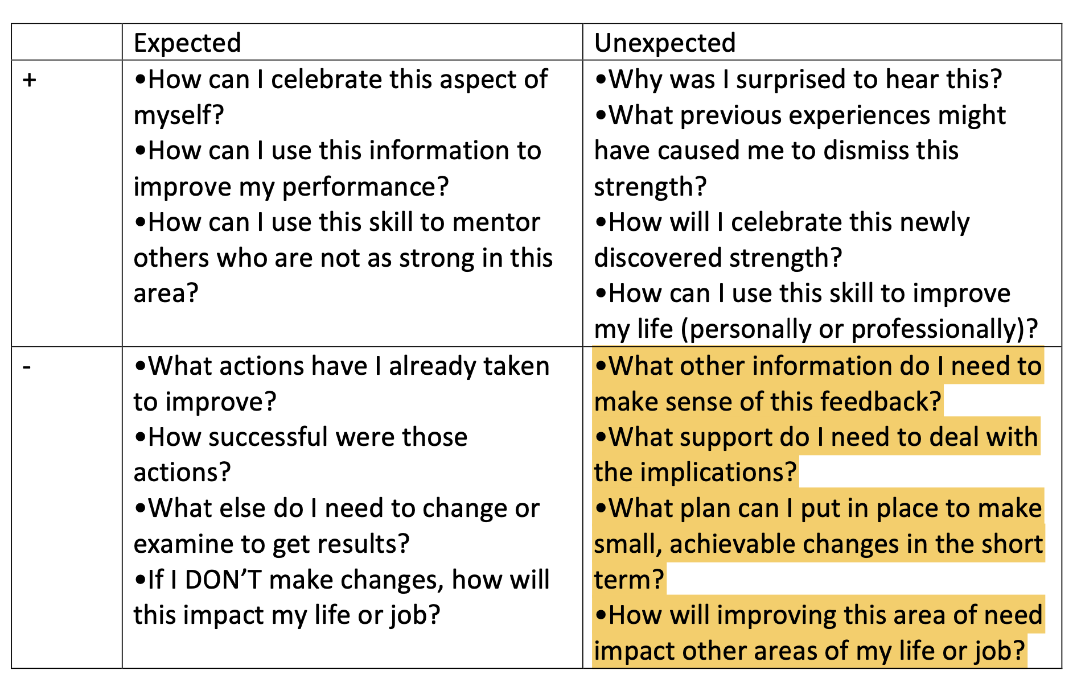

Slide 13
EVALUATIONS
Observation feedback
Final
Portal: https://cote.illinois.edu/cote-portal-access
Support plans

Slide 14
SUPPORTS
Disposition Concern Form
Remediation Plan
Professional Growth Plan

Slide 15
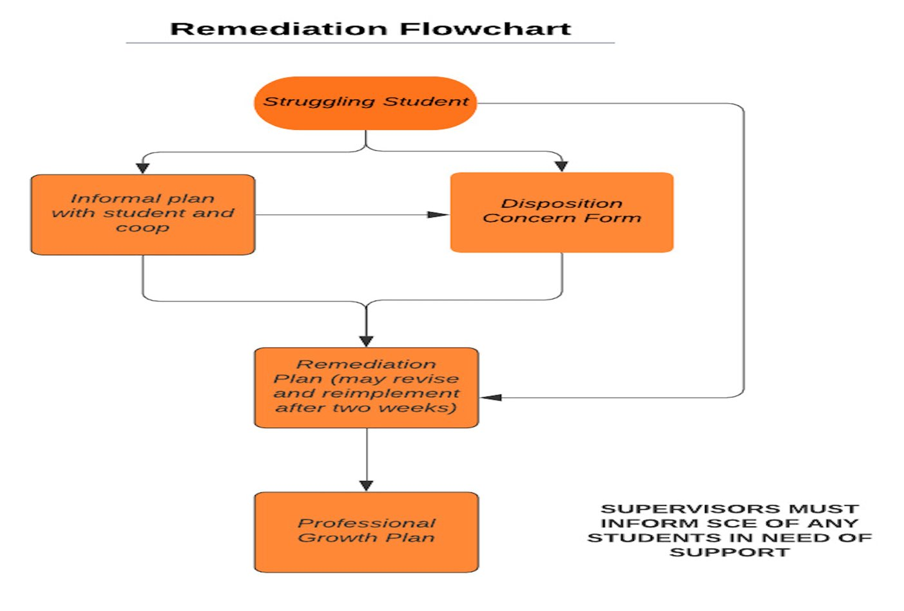

Slide 16
IMMEDIATE ACTIONS TO WELCOME YOUR CANDIDATE
Exchange contact information (set boundaries!)
Show them where to put their belongings
Tour the school (ask a student to show them around)
Introduce them to staff
Show them how to access your online curriculum and classroom
Ask them to plan to introduce themselves to the students in a creative way
Post their name on the board
Explain the expectations for dress, cell phones, etc.
Be clear and specific about what you would like them to do. They should be active, helpful, and engaged!

Slide 17
TUITION WAIVERS
Non-degree vs. Master’s/Endorsement/Doctoral
Contact Council on Teacher Education with questions!
cote-waivers@illinois.edu
https://cote.illinois.edu/cooperating-personnel-supervisors/cp-tuition-fee-waivers
Waiver Information (from SCE website)
If you are intending to use a Cooperating Teacher Waiver to complete an online degree through the College of Education, you must contact both Jena Pfoff (jrooseve@illinois.edu) and Linda Stimson (ls9@illinois.edu) after submitting your application to the Graduate College in order to utilize the Cooperating Teacher Waiver. Your subject line should read, “Cooperating Teacher Waiver – Online Program."

Slide 18
RESOURCES
SCE: https://sce.education.illinois.edu/
Portal: https://cote.illinois.edu/cote-portal-access
Email Cara or SCE directly:
caraknox@illinois.edu
sce@education.illinois.edu

Slide 19
WE NEED YOUR HELP! *APPLICATION ON SCE WEBSITE*

Slide 21
QUESTIONS?

