Slide 1
CI 403 orientation
Fall 2026
April 16, 2026

Slide 2
Agenda
Welcome and updates
Teaching performance activity
CI 401 reminders
Student teaching—Spring 2027 (updates)
Carpool/MG form
Questions/comments/announcements

Slide 3
Celebrations!
Take a moment to think about your placement. If you are willing, share something good that is going on in placement.
You can also share other things to celebrate in the chat, as well!

Slide 4
Welcome and updates
Cara Gutzmer, Ph.D., Director of School and Community Experiences caraknox@Illinois.edu
Helpful resources:
  Websites:
    http://sce.education.illinois.edu,(School and Community Experiences
    http://www.cote.illinois.edu (Council on Teacher Education)
    sce@education.Illinois.edu (email to contact our office)
  Staff:
    Sue Talbott, Clinical Experiences Specialist, SCE
    Danielle Galardy, Office Manager, SCE
    Robin Craig, Licensure officer, CoTE rcraig@Illinois.edu
    Secondary Program Coordinator, Scott Filkins filkins@illinois.edu

Slide 5
Undergraduate Advising Reminders
Website: https://education.illinois.edu/student-resources/undergraduate/undergraduate-advising-support
Education Minor Courses for Fall 2025:
CI 403: Teaching a Diverse High School Student Population (3 hrs)
SPED 405: General Educator's Role in Special Education (3 hrs)
EPSY 485: Assessing Student Performance (3 hrs)
Note: please register for additional courses outside of the minor sequence as necessary. Each subject within the minor has a departmental advisor who can assist with determining the best plan for your major completion.

Slide 6
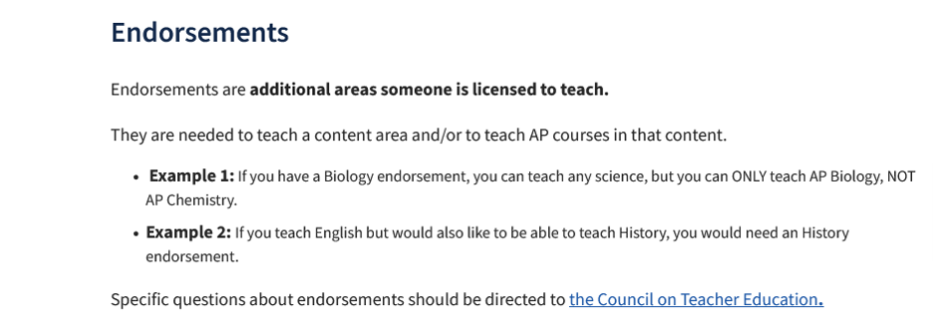
Advising Reminders
MG Endorsement requires taking CI 402 in the subject area you want endorsed in AND passing the content test.

Slide 7
CI 403 overview
Course
  Tuesdays, from 8 AM-10:50 AM, by content area
Field Placement
  Begins first week of semester (August)
  6-hours per week minimum for the duration of the semester
  Thursdays beginning of school-11 and 3 more hours/week arranged by you and your cooperating teacher
  90 minimum hours
  Placed in pairs (in most cases); you do not have to attend all your hours together
  Placed within a 50-mile radius. You may need to carpool.
  You will be supervised and will meet with your supervisor for 10 hours during the semester in seminars.
  SCE website: https://sce.education.illinois.edu/current-candidates/secondary

Slide 8
Carpool Form
https://forms.gle/1cHCrkUzT1jA8uVi7
This form can help me make decisions about placements.
I cannot guarantee I will be able to honor every request, due to program requirements and cooperating teacher availability.

Slide 9
Teaching performance activity
Consider the following:
  “What knowledge, skills, and dispositions make for high-quality teaching performance? When you talk to a teacher or when you see a teacher, in action, what evidence could you gather that demonstrates ‘good teacher performance?’”

Slide 10

Danielson
Framework for Teaching

Slide 11
What does professionalism look like?
Respectful
Being on Time
Building relationships
Professional dress
Safe boundaries
Maturity
Timely Communication

Slide 12
What is the EDTPA?
Education Teacher Performance Assessment (edTPA)
  State licensure performance examination for prospective teachers
  Completed during student teaching (final semester)
  Portfolio-based w/ video
  This portfolio has been waived for the time being, but watch your email for a replacement.

Slide 13
401 reminders
Please complete 2 observations with your cooperating teacher and have them fill out the form
Send completed forms to:
sce@education.Illinois.edu
Please fill out your time card through the COTE portal and submit it at the end of the semester. You should have at least 45 hours. If your school is not in session or you are sick, please reschedule your hours. You can add on hours to your next week or go on Reading Day or during Finals Week.

Slide 14
Content test
https://www.il.nesinc.com/TestView.aspx?f=HTML_FRAG/IL305_TestPage.html
Accommodations – Please get your documentation in order. Schedule early.
You must attempt the test by August 24th
You should pass it by December 15
Take it this summer when you have less going on
Resources on SCE website
STUDY
  Materials are available on your CoTE portal. Under the Content Test requirement will be a “Click here for available content test study resources.” By clicking that link it will take you to all study resources available for ILTS content tests. These resources are available to students who also want to study for subsequent endorsements as well. Students must be logged into the VPN to access the materials. When logging into the VPN, after clicking connect, students will need to make sure the “Group:” is on TunnelAll in the drop-down box.

Slide 15
Wrapping up the semester
(checklist will be sent)
☐ Email your two observation feedback forms to sce@education.Illinois.edu by Friday, May 8 at 5pm (Many of you have already done this. Good job!)
☐ Enter your hours on the timesheet on COTE (minimum 45)
☐ Remind your cooperating teacher to complete your final evaluation (COTE)
☐ Complete the cooperating teacher evaluation on COTE
☐ If you are pursuing an ESL endorsement, ask your cooperating teacher to write a letter to verify your hours. You will submit that letter to Robin Craig at COTE.
☐ Please send an email to your cooperating teacher to say thank you for hosting you ☺
☐ Send an introductory email to your fall cooperating teacher
Get your Background check for fall
☐ Have a safe and wonderful summer break!

Slide 16
Student teaching—Spring 2027
We have already started to place students for Spring 2027
Be ready to interview in Spring 2026 through Fall 2026 (if necessary)
You may receive communication from a district. This does NOT guarantee your placement. PLEASE answer any requests by districts quickly and professionally.
You will receive your placement at the beginning of November
You will need to pass the Content Test in order to student teach. Please schedule your content test this summer!
January 4th is the beginning of student teaching in 2027. You will follow the school calendar of your school, NOT the University's calendar.
RELAX!

Slide 17
Chain of Command
First, talk to instructors or cooperating teachers
Next, talk to me (placements)
If we can’t help, we will advise you who to contact next:
  Advisors
  Student Academic Affairs Office (SAAO)
  CI Department head
  Campus resources (Title IX, OSCR, Counseling Center, financial aid, etc.)
  If your issue is not resolved, please contact the Associate Dean of Undergraduate Affairs, Dr. Curtis Mason
The dean, Dr. Chrystalla Mouza, is responsible for overseeing the overall functioning of the College of Education and does not typically get involved in student issues unless they are extremely, EXTREMELY serious.

Slide 18
QUESTIONS/COMMENTS?
You will likely receive your fall placement letters by late April
  Make contact with your cooperating teacher
  Get a background check before you leave for summer
  REVIEW THE MATERIALS FOR CI 403 ON THE SCE WEBSITE
Questions?

