Slide 1
Secondary Education
Professional Education Induction
Tuesday, October 7th, 2025

Slide 2
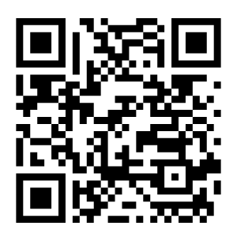
Sign In

Slide 3
Introductions
School & Community Experiences
Curriculum & Instruction Program Coordinator
Cara Gutzmer
Danielle Galardy
Scott Filkins
Student Academic Affairs Office
Council on Teacher Education
Kelli Halfman
Alex Kellerman
Kami Lafoon
Robin Craig
Candice Steidinger

Slide 4
Congratulations!

Slide 5
College of Education Support Structure
Council on Teacher Education
Connect with CoTE for questions related to:
CoTE Portal
Licensure requirements
Applying for teaching license
Subsequent endorsements
Content test vouchers and practice tests
03
Student Academic Affairs Office
Connect with SAAO staff for questions related to:
Registration, course schedules
Degree progress and requirements
Requests for credit overload, grade replacement, etc.
General campus resources such as getting connected to counseling and tutoring
School & Community Experiences
Connect with SCE for questions related to:
Early field experience and cooperating teachers
Student teaching
Placement applications
01
02

Slide 6
SAAO: Advising Structure
Students in the minor should refer to their college’s advisors for guidance on major coursework and can ask questions to Education’s advisors as needed for Education coursework
Students in Education’s Secondary Math program and CS+ Sec Ed will continue working with their assigned advisor

Slide 7
SAAO: Degree Requirements
Students must maintain a minimum 2.5 cumulative GPA and earn grades of C- or higher in all content and professional education coursework
PES classes are sequential for the next three semesters – they must be taken in order and passed with a qualifying grade to move onto the next semester of classes. Not passing a PES class can delay graduation

Slide 8
Professional Education Sequence (PES) Courses
Year One - Spring Semester 2026 | Year Two – Fall Semester 2026 | Year Two – Spring Semester 2027
CI 401: Introductory Teaching in a Diverse Society (3 hours) CI 473: Disciplinary Literacy (3 hours) | CI 403: Teaching a Diverse High School Student Population (3 hours) SPED 405: General Educator’s Role in Special Education (3 hours) EPSY 485: Assessing Student Performance (3 hours) | EDPR 422: Educational Practice in Secondary Education (12 hours) CI 404: Teaching and Assessing Secondary School Students (3 hours)* *online, evening course (meets 1x/week) No other classes should be taken this semester unless approved by SCE and your advisor!
Double check section restrictions to make sure you are registering correctly.
Some sections are specific to majors

Slide 9
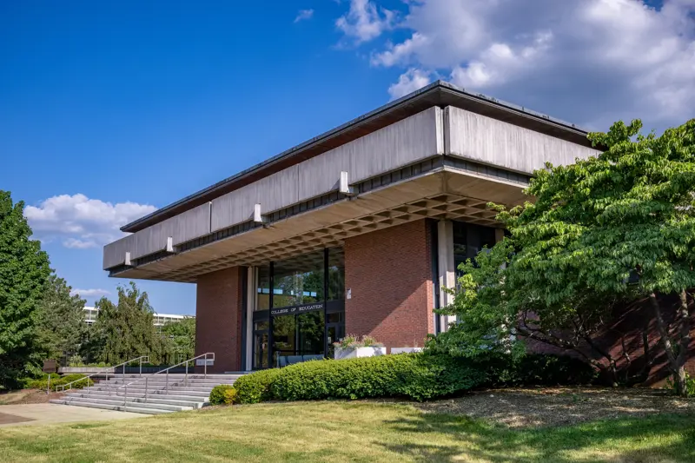
Council on Teacher Education (CoTE)
Resource for licensure and subsequent endorsement questions
Contact Information:
Website: https://cote.illinois.edu/
Email: info@cote.illinois.edu
Call: (217) 333-2804
Visit Us: College of Education Building,
Room 120 on the first floor

Slide 10
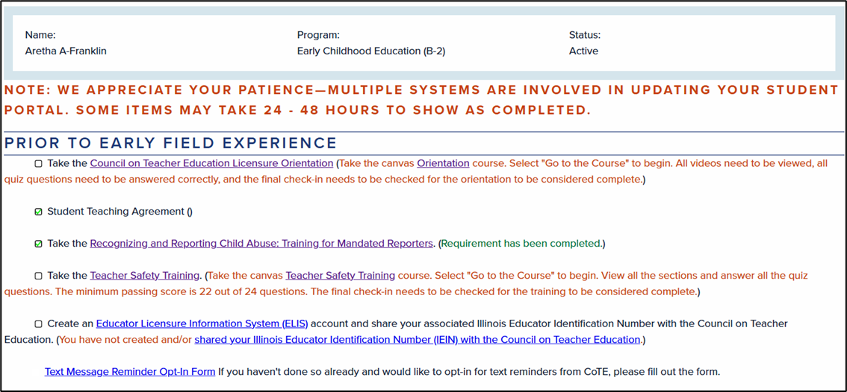
CoTE: Action items for new licensure program students
Refer to the "Action Required" email from CoTE
Log in to your Student Portal to complete the required items

Slide 11
CoTE: Trainings/tasks to complete after email from CoTE is received
CoTE Licensure Orientation
Safety Training
Recognizing & Reporting Child Abuse: Training for Mandated Reporters
Create Educator Licensure Information System (ELIS) account
  Send Illinois Educator Identification Number (IEIN) to info@cote.illinois.edu

Slide 12
CoTE: Registration attribute
Complete requirements to receive the registration attribute for future professional education/licensure coursework
Advice: Complete items early to avoid delays once registration opens
If you are unable to register, check your Student Portal to see if these requirements are marked as complete
Attribute codes are regularly added to student records

Slide 13
Subsequent Endorsements
Qualify teachers to teach in an additional subject area or grade band
Pre-service teachers can begin or even complete endorsement coursework while in undergrad, but subsequent endorsements can be added after a license is issued once requirements are complete
Endorsements are not trackable in DARS, and students are responsible for managing coursework and content tests independently

Slide 14
Subsequent Endorsements
ISBE website for list of subsequent endorsements: https://www.isbe.net/Pages/Subsequent-Teaching-Endorsements.aspx
Most subsequent endorsements require 18 hours of supporting coursework and passing the applicable content test
  ILTS website: https://www.il.nesinc.com/PageView.aspx?f=GEN_Tests.html%C2%A0

Slide 15
Subsequent Endorsements
English as a Second Language (ESL) | Middle Grades 5-8 | Senior High 9-12 in another subject area
18 hours of coursework across 5 categories Linguistics Theoretical foundations of Teaching ESL Assessment of the bilingual student Methods and materials for teaching ESL Cross-cultural studies for teaching limited-English proficient students Elective (additional class if needed) 100 clinical clock hours in ESL classroom | 18 hours of coursework including a methods* course Passing applicable content test *By adding CI 402 to your schedule Fall Senior year, you will qualify for the Middle Grades endorsement in your subject area pending the passing of the content test. CI 402 has sections specific to subject – make sure to add the correct one | Look at specific requirements outlined on ISBE website We do not have an exhaustive list of classes that “count” for each subject area Students are encouraged to look at the testing framework to determine UIUC classes that prepare them. Classes can be verified with CoTE as needed

Slide 16
ESL Endorsement Coursework
https://cote.illinois.edu/students/subsequent-endorsements/english-as-a-second-language
It might be difficult to complete all requirements by the time you graduate, but having the ESL endorsement in progress is still favorable on job applications and remaining coursework/clinical hours can be completed post-grad from approved institutions.
Refer to handout in your folder for class list & special notes.

Slide 17
School and Community Experiences (SCE)
Dr. Cara Gutzmer, Director
120E Education Building
caraknox@Illinois.edu
Danielle Galardy, Office Manager
217-333-2561 or sce@education.Illinois.edu
Visit Us: College of Education Building,
Room 120 on the first floor

Slide 18
School and Community Experiences Website
https://sce.education.illinois.edu/
The SCE website provides information on field placement and clinical assignments. Bookmark it and consult it frequently and refer to it when you have questions.
Secondary sequence of Professional Courses
Forms used in clinical experiences
Information for co-ops, supervisors, and students about clinical experiences
Links to other sites

Slide 19
Vocabulary
Endorsements: Additional coursework that qualifies one to teach in specific areas/disciplines
Cooperating Teacher (Co-op): Teacher in your assigned classroom
Supervisor: University personnel who observe student teachers
Field Experience + Practicum: Your time in schools
Observation: Supervisor visit to the classroom
Early Field Experience (EFE): practica prior to student teaching
Student Teaching: Final semester experience; extended, daily time in the classroom
Student Portal: Individual site on CoTE website for record keeping

Slide 20
Entering the Professional World
Congratulations on choosing one of the best professions!
Some things to do:
  Set your social media to private. Google yourself!
  Voicemail should be professional
  Make mature decisions for you and for your students
  Use discretion when discussing field experiences and maintain a tone of professional courtesy

Slide 21
Professional Responsibilities
Attendance
Attire
Arriving on time and staying for the duration of the scheduled field placement.
Communicating with the cooperating teacher and supervisor, where applicable, and making plans for makeup when absences or tardiness occur
Professional dress
No flip flops
No jeans
Clothing should be conservative and comfortable
Your appearance should not be a distraction to classroom learning

Slide 22
Placement Policies
All placements are made and confirmed by SCE
Placements are subject to change by SCE, but not at the student's request
Placements are made to ensure work experience with diversity
Placements are not made in a school where a close relative, friend, and/or significant other is employed
A UIUC student is responsible for completing the online evaluation with the co-op and themselves

Slide 23
Placement Policies
Students are responsible for their own transportation to and from field placements.
We use a variety of placements in and around C-U (a distance placement of up to 55 miles may be possible). Carpooling will be a necessity.
BBP, Mandated Reporter, and Safety Training clearance required prior to entry into the classroom. Criminal background checks are handled by each school district.
Absences must be made up.

Slide 24
Placement Structure
Spring 2026 (CI 401) | Fall 2026 (CI 403) | Spring 2027 (EDPR 442)
Field placement in high school or middle school 42 hours in placement 3 hours arranged per week Follow the UIUC calendar 55-mile radius of C-U campus Evaluated by cooperating teacher | Field placement in high school 90 hours in placement 6 hours per week, minimum 2 hours per visit Follow the UIUC calendar 55-mile radius of C-U campus Evaluated by the University supervisor | Local, CPS, Suburban placements 16-17 weeks in placement, 4-5 weeks full take over Follow assigned school calendar (starts on January 4 and follows placement’s spring break) Evaluated by University supervisor Evening seminars led by University supervisor (vary by location) CI 404 (Wednesdays @ 6pm)

Slide 25
Placement Application
DUE by October 17.
You will receive an email from sce@education.Illinois.edu
Fill out the appropriate sections based on your program and as accurately as you can at this time
If your personal information changes (car, contact number, interest in pursuing ESL/bilingual endorsements), please email SCE (sce@education.Illinois.edu) right away.
Please add any additional information in the notes section that would be helpful for placement considerations
Application FAQs are posted on the SCE website for your reference

Slide 26
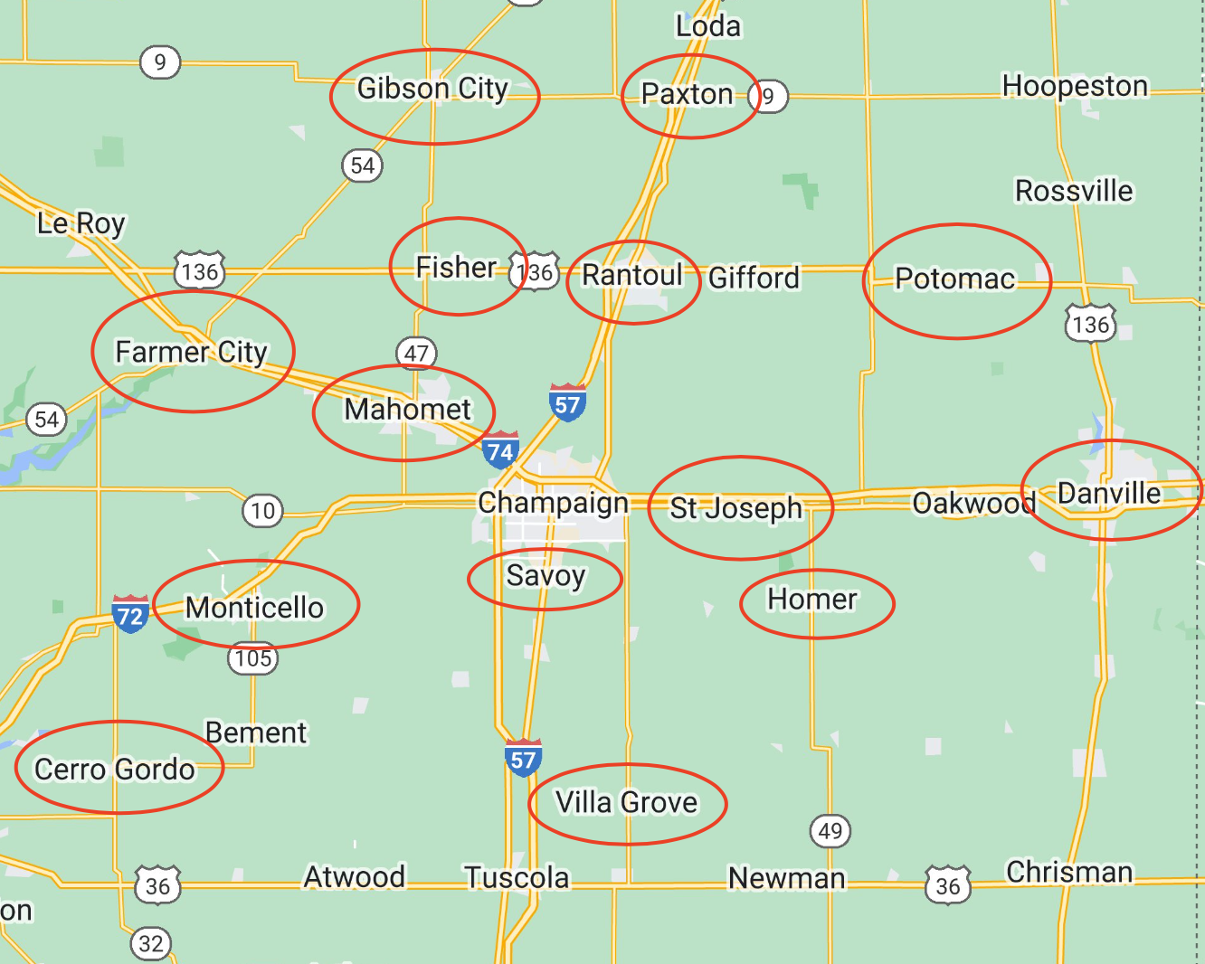
Local Map: 55-mile radius from campus

Slide 27
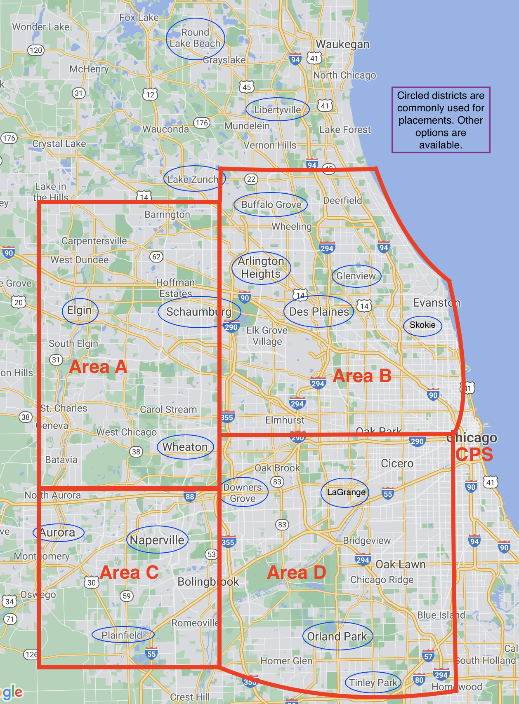
Northern Placement Map (Student Teaching Only)

Slide 28
Student Teaching Location
Areas are shown on the Northern Placement Map
Area A – Elgin area
Area B – Arlington Heights/Glenview area
Area C – Naperville/Aurora area
Area D – Hinsdale/La Grange area
CPS
You cannot student teach at the HS you attended or have family
If you prefer Local or CPS, enter that as the only request

Slide 29
If you have concerns
COMMUNICATE! We are all here to support you in your journey!
Start with instructors/cooperating teachers/supervisors
If you need further assistance, talk to your support team in Dr. Gutzmer, your Academic Advisor, the Program Coordinator, Scott Filkins, or Assistant Dean, Kelli Halfman. Your team can only help when they’re made aware of a situation!
Please note that Dr. Mouza, Dean of the College of Education oversees the general functioning of the college and is not directly involved in individual student issues. Please refrain from contacting her with concerns.

Slide 30
Helpful Hints
Watch for IMPORTANT e-mails from sce@education.illinois.edu
When emailing with a question, identify the teacher program and year you are in program
When responding to email, always hit the reply (not reply all) so our office has an historical understanding of the email.
Use Illinois account for all communications.

Slide 31
Next Steps
Bookmark & review SCE and CoTE websites for use during the next two years in teacher education
Fill out your placement application by October 17
When you receive your placement, clear the Criminal Background Check; districts will share requirements, as necessary.
Complete all necessary trainings in CoTE portal to allow for class registration
Complete Licensure contract by October 24
Start thinking about housing and transportation for 2026-2027

Slide 32
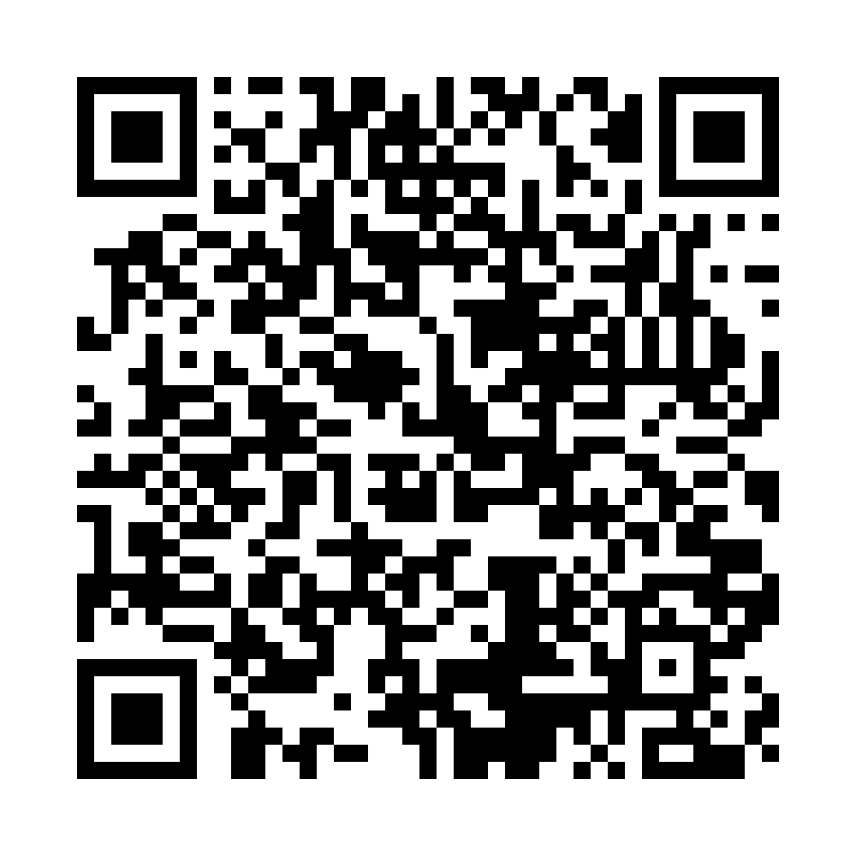
Licensure Contract
Due October 24
Review expectations for advising, program enrollment, academic performance, licensure requirements & policies, clinical experiences, and background checks
Failure to sign contract by due date may result in a delay to spring registration

Slide 33
Upcoming Meetings
Resume + Cover Letter Workshop:
  October 8th 4-5:30
  October 21st 4:30-6:00
CI 401 Placement Orientation:
  December 3rd 4-5:30

