Slide 1
The crisis cycle
Managing Challenging Behaviors
February 23, 2021
Office of School and Community Experiences

Slide 2
agenda
Pyramid model of supports
Students who engage in challenging behavior
The crisis cycle

Slide 3
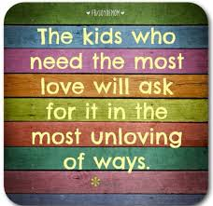

Slide 4
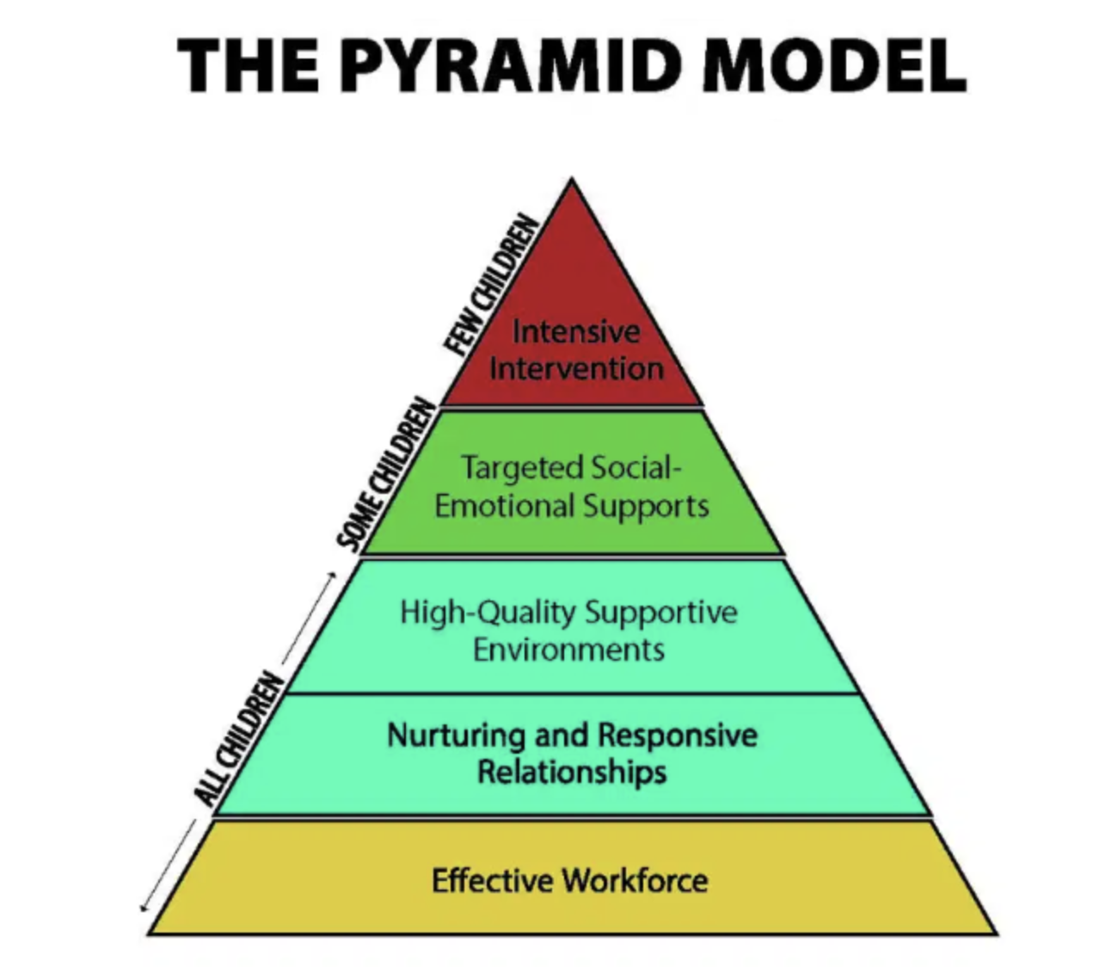
Pyramid model of behavior support

Slide 5
Students who engage in challenging behavior
Mental health
Simple changes in routines
Trauma
Special education (emotional disability, behavior intervention plans, sensory needs)
BEHAVIOR IS A FORM OF COMMUNICATION (attention, escape, access to tangibles, sensory)

Slide 6
Colvin: phases of the crisis cycle
Calm
Triggers
Agitation
Acceleration
Peak
De-escalation
Recovery

Slide 7
Crisis cycle
Peak
Acceleration
Intensity
De-escalation
Agitation
Trigger
Recovery
Calm
Time
Colvin, 2004

Slide 8
calm
On task
Following rules
Responsive
Goal-oriented
Able to handle all kinds of work (group, independent, interactive, etc.)

Slide 9
During calm
Optimal time to proactively intervene
Reiterate expectations and responsibilities
High amounts of feedback – both positive and corrective
Time to teach new skills or introduce new content
Student will be receptive to trying new things

Slide 10
Proactive strategies for maintaining calm
Take care when designing your physical environment.
Establish and post a schedule.
Establish classroom expectations.
Establish classroom routines (arrival/departure, lining up, asking permission, getting materials, etc.).

Slide 11
Phases of Acting Out Behavior
Peak
Acceleration
Intensity
De-escalation
Agitation
Trigger
Recovery
Calm
Time
Colvin, 2004

Slide 12
Triggering EVent
Student perceives they are not getting something they need
Repeated errors and corrections (frustration)
Provocation
Sleep deprivation
Change in routine
COVID-related struggles

Slide 13
Triggering Event
You may or may not know what it is, but there is always an event that sets off the cycle. Behaviors do not just “come out of nowhere.”
Your goal is to maintain a safe and productive classroom, so continue using universal management techniques.

Slide 14
Universal techniques
Proximity control
Descriptive praise
Humor
Hurdle help

Slide 15
Phases of Acting Out Behavior
Peak
Acceleration
Intensity
De-escalation
Agitation
Trigger
Recovery
Calm
Time
Colvin, 2004

Slide 16
agitation
Darting eyes
Non-conversational language (rambling, no give-and-take)
Withdrawl
Fidgeting
Refusing to participate/engage

Slide 17
During agitation
Focus on reducing anxiety
-provide empathy, acknowledge feelings
-give hurdle help
Be polite and non-threatening
-use care with body language, voice, tone, proximity
Allow student to cool down, walk away for a moment

Slide 18
Phases of Acting Out Behavior
Peak
Acceleration
Intensity
De-escalation
Agitation
Trigger
Recovery
Calm
Time
Colvin 2004

Slide 19
Acceleration
Questions
Argues
Non-compliant/disrespectful
Defiant
Whining/complaining
Threatening language
Verbal abuse

Slide 20
During acceleration
At this point, escalation is very likely to continue
Don’t take it personally
Don’t get drawn in
Avoid escalating words like, “You need to…”
Disengage if necessary (“Let’s take a break and go get a drink of water. Meet me back here in two minutes.”)

Slide 21
Tips for managing acceleration
Maintain calmness, respect, and detachment
Keep your behavior extremely controlled and non-threatening
Slow, quiet, eye level, stillness
Avoid power struggles at all costs
Terminate the interaction if behavior does not de-escalate

Slide 22
Phases of Acting Out Behavior
Peak
Acceleration
Intensity
De-escalation
Agitation
Trigger
Recovery
Calm
Time
Colvin, 2004

Slide 23
Peak
Property destruction
Assault
Severe tantrum
Self-abuse
Hyperventilation, uncontrolled crying
Elopement

Slide 24
During peak
Focus on safety (evacuate classroom, if necessary)
Be quiet
Wait
Remember, students cannot really “hear” you during this phase.

Slide 25
Phases of Acting Out Behavior
Peak
Acceleration
Intensity
De-escalation
Agitation
Trigger
Recovery
Calm
Time
Colvin, 2004

Slide 26
De-escalation
Confusion
Denial
Embarrassment
Withdrawl

Slide 27
During de-escalation
Avoid excess attention
Allow privacy
Don’t ask for an apology
Emphasize starting anew
Use words like: maybe, perhaps, sometimes, what if, I wonder if….

Slide 28
Phases of Acting Out Behavior
Peak
Acceleration
Intensity
De-escalation
Agitation
Trigger
Recovery
Calm
Time
Colvin, 2004

Slide 29
recovery
Defensiveness
Subdued behavior
May want to be alone/isolate
Desire to work independently

Slide 30
During recovery
Reinforce attempts at meeting expectations
Once calm, follow through with any consequences, if any are assigned (“You will have to clean up the things that you broke.” “You will need to see what you can do to make that better.” “You will have a detention on Tuesday.”)

Slide 31
Phases of Acting Out Behavior
Peak
Acceleration
Intensity
De-escalation
Agitation
Trigger
Recovery
Calm
Time
Colvin, 2004

Slide 32
debrief
What happened?
Why did it happen?
What could you have done instead?
Consider a Practice/Role-Play

Slide 33
Times to Intervene
Peak
Acceleration
Intensity
De-escalation
Agitation
Trigger
Recovery
Calm
Time
Colvin, 2004

Slide 34
triggers
A trigger is anything a student does or says that causes you to have an emotional response.
It is important to be aware of your own triggers. Consider what gets you angry or frustrated.
Even when confronted with students who exhibit the behaviors that bother you most, it is important to stay outwardly calm and maintain a professional perspective.
It’s not your anger/frustration that will get you into trouble, but how you act on that anger that might.

Slide 35
Keep your cool
Take a deep breath, take a step back.
Count to five (silently), take a sip of water.
Self-talk – “OK, now I have to…”
REMEMBER….It’s ok to tap out if you are not in control of your emotions.

Slide 36
The four questions (TCI)
What am I feeling now?
What does this student feel, need or want?
How is the environment affecting the young person?
How do I best respond?

Slide 37
Questions?

